Slide 1

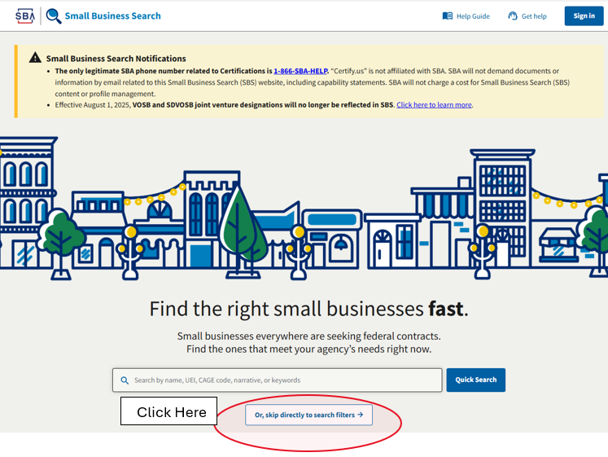
SBA Small Business Search - Tips
Link to SBA Small Business Search: https://search.certifications.sba.gov/

Slide 2
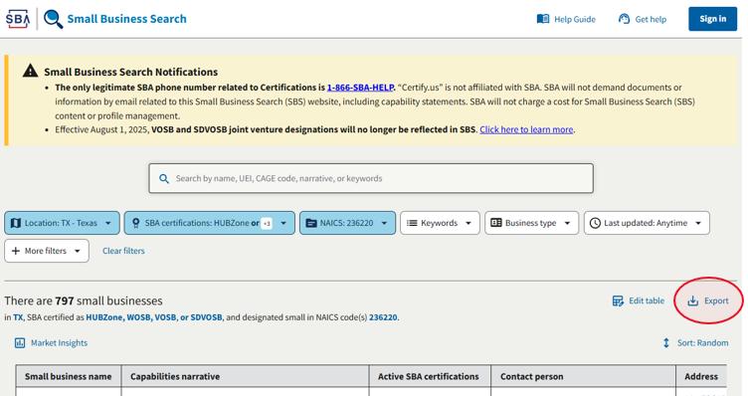

SBA Small Business Search - Tips

Slide 3
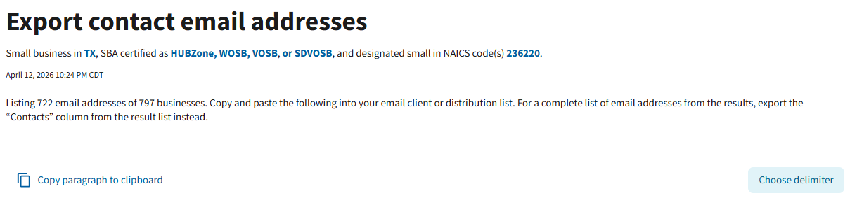
SBA Small Business Search - Tips

