Slide 1
Welcome to the TAC Outreach Call
Presenter(s) – Dan Greene
– Jason Prado
Date – September 9, 2025
Topic – Fiscal Year Crossover Series Pt. 1
The presentation will begin shortly
You can enable audio by selecting “Audio Settings” in the lower left portion of your screen. Options for Computer Audio and Call Me information will be displayed there.
Call Me will only be available for those using the client version of ZoomGov
(not the browser version).

Slide 2
TAC Outreach Call –
Fiscal Year Crossover Series Pt. 1
Dan Greene
Jason Prado
September 9, 2025

Slide 3
Agenda
Top Issues for August/September
Excellence in Practice Awards Nominations
Inactive Duty Training (IDT) outside the Normal Commuting Distance
Fiscal Year Crossover
  Rolling over LOAs
  Establishing Budgets
  Updating the Default LOA
Reorganization
  Preparation
  Execution
  Hiding Old Organization
Resources

Slide 4
Top Issues for August/September
Issue # | Summary | Workaround | Release
Stuck at CTO SUBMIT | There are multiple factors that can cause an authorization to get stuck at CTO SUBMIT. Authorizations are not considered stuck until they remain at CTO SUBMIT longer than the close of business on the next business day. | The TAC can access the Global Distribution System (GDS) and will attempt to push the document to CTO BOOKED. If unsuccessful, these documents must be manually abandoned. | Issues are regularly researched and resolved.
DTS-21056 | Reservation for Car rental does not show rates in the PNR or in DTS. This affects Sabre PNRs only. | Please contact the TAC for further assistance. | Ready for Assignment
DTS-26668 | Multiple EFT emails are sent to the traveler when a DTA with Permission Level 5 updates the traveler’s profile through the DTA Maintenance Tool. | This issue was resolved with the deployment of the latest release. | FY25 MR4

Slide 5
Top Issues for August/September (cont.)
Issue # | Summary | Workaround | Release
PPT | Slowness experienced during the Pilot phase of FY25 MR4. | This was resolved.
PPT | Expenses renamed in FY25 MR4 are missing in Production | This was resolved.

Slide 6
Excellence in Practice Awards Nominations
The Defense Travel Management Office (DTMO) is accepting nominations for the FY25 DoD Excellence in Practice (EIP) Awards.
These awards recognize the tremendous efforts of DoD travel professionals toward building effective and efficient travel programs within their organizations.
Nomination forms and more information, including highlights from last year’s winners, can be found at:
  https://www.travel.dod.mil/About/DoD-Excellence-in-Practice-Awards/

Slide 7
Excellence in Practice Awards Nominations (cont.)
Supervisors and colleagues are encouraged to submit an outstanding individual or team for recognition across the Department in one of five categories:
  The Champion Award
    Recognizes a Lead Defense Travel Administrator (LDTA) who goes above and beyond in providing mentoring and training to their organization.
  The Elite Award
    Recognizes a local help desk team whose superior efforts result in continuous improvement and outstanding customer care.
  The Icon Award
    Recognizes a major command or agency whose strategies and tactics enhance their travel program capabilities for their subordinate sites.

Slide 8
Excellence in Practice Awards Nominations (cont.)
Supervisors and colleagues are encouraged to submit an outstanding individual or team for recognition across the Department in one of five categories (cont.):
  The Premier Award
    Recognizes the Agency Program Coordinator (APC) who demonstrates an extraordinary and exemplary commitment to cardholders and stakeholders through proactive education, effective communication, responsive customer service, and outstanding Program Coordination.
  The Paramount Award
    Recognizes a Compliance Tool Administrator (CTA) whose perception and advisability through customer service, training, and staff development initiatives lead to an improvement in their organization's travel program.

Slide 9
Inactive Duty Training (IDT) outside the Normal Commuting Distance
To comply with the JTR, expenses have been added to authorizations for Reserve Component (RC) members in the Selected Reserve of the Ready Reserve who perform IDT that requires them to commute outside the local commuting distance.
Local vouchers are not to be used for IDT purposes.
Expenses incurred while on IDT should instead be claimed in an authorization and follow-on voucher per the JTR.

Slide 10
Inactive Duty Training (IDT) outside the Normal Commuting Distance (cont.)
032304. IDT outside the Normal Commuting Distance
B. Allowances. If an RC member is outside the local commuting distance and traveling to perform IDT and is authorized travel and transportation allowances, then the member is in an official travel status.
See Table 3-8 under 032303 in the JTR for specific allowance scenarios.

Slide 11
Fiscal Year Crossover
The new fiscal year a little over one month away!
  FY 26 begins on October 1, 2025.
The following 3 Outreach Presentations will focus on preparing for crossing into the next fiscal year.
Many actions take place around this time of year.
  Reorganizations
  Setting up the LOAs and Budgets
  Clearing Unliquidated Funds
  And More…

Slide 12
Fiscal Year Crossover Resources
Fiscal Year Crossover
  https://www.travel.dod.mil/Programs/DoD-Travel-Systems/Fiscal-Year-Crossover/
Affected Partner Systems and Downtimes
  https://media.defense.gov/2022/Jun/21/2003021205/-1/-1/0/Accounting_System_Downtime.PDF
DTS Guide to Establishing Lines of Accounting (LOAs) and Budgets for the New Fiscal Year
  https://media.defense.gov/2022/May/12/2002995654/-1/-1/1/ESTABLISH_LOAS_FOR_THE_NEW_YEAR.PDF
DTS Guide to Processing Authorizations for the New Fiscal Year
  https://media.defense.gov/2022/May/12/2002995650/-1/-1/1/PROCESSING_AUTHORIZATIONS_FOR_THE_NEW_YEAR.PDF

Slide 13
Fiscal Year Crossover
This presentation will be concentrating on what to do for the next fiscal year, focusing on Lines of Accounting (LOAs) and Budgets.
  Establishing LOAs
  Updating Default LOAs
  Establishing Budgets
The future presentations will be:
  September 23, 2025 – Fiscal Year Crossover Series Pt. 2
    Document Processing
  October 14, 2025 – Fiscal Year Crossover Series Pt. 3
    Approval Failures

Slide 14
Fiscal Year Crossover
Every fiscal year, elements in the LOAs and corresponding budgets may require modification to reflect the new fiscal year.
This part of the presentation is geared towards Finance Defense Travel Administrators (FDTAs) and Budget DTAs (BDTAs) when setting up the LOAs and budgets in the Defense Travel System (DTS) for the new fiscal year.
Please check with your Organization’s Local Business Rules and ensure you are following with their intention.

Slide 15
Lines of Accounting
The process begins with the FDTA obtaining a list of LOAs and then determining the appropriate method to create the new LOAs for the new fiscal year.
There are three main options to establish LOAs for the new fiscal year:
  Rolling Over method using either Default or Custom rules
  Copying an existing LOA
  Creating a new LOA

Slide 16
Roll Over LOA To New Fiscal Year
DTS provides two means of rolling over LOAs to the new fiscal year:
  Default Rules
  Custom Rules
Default rules automatically update fiscal year and program year account elements in each LOA to the designated fiscal year defined for each LOA format map.
  Any empty elements in the LOA will remain empty.
  All other data elements within the LOA will be copied into the new LOA.
  Default rules can be customized.

Slide 17
Roll Over LOA To New Fiscal Year
Custom rules allow users to turn off individual fiscal/program year account element rules from the default rule set.
  Custom rules can apply to one or more LOAs when selected in the Roll over feature.
  Once the user has turned off the LOA element rules, DTS will not automatically update fiscal/year account elements in each LOA with a specified fiscal year value.

Slide 18
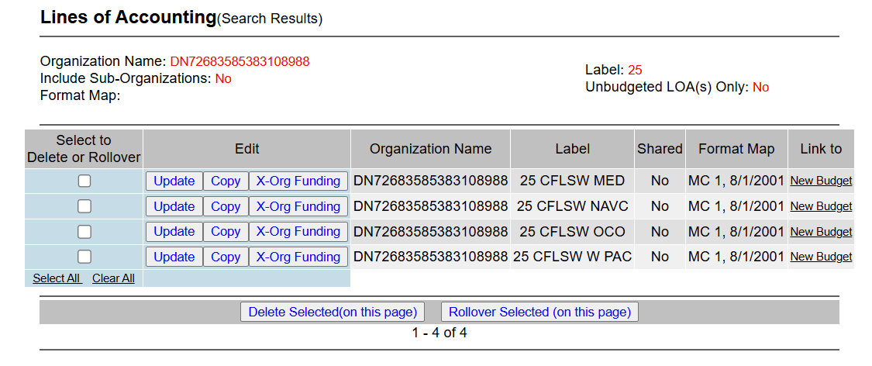
Roll Over LOA To New Fiscal Year
To Rollover an LOA, or multiple LOAs, select the check box next to each LOA and select “Rollover Selected (on this page)” at the bottom.

Slide 19
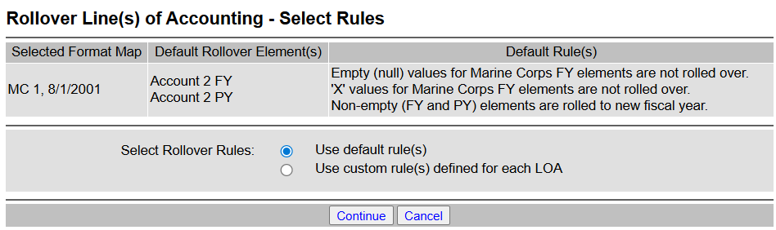
Roll Over LOA To New Fiscal Year
You will now be able to select if you want to use the roll over feature using default or custom rules.

Slide 20
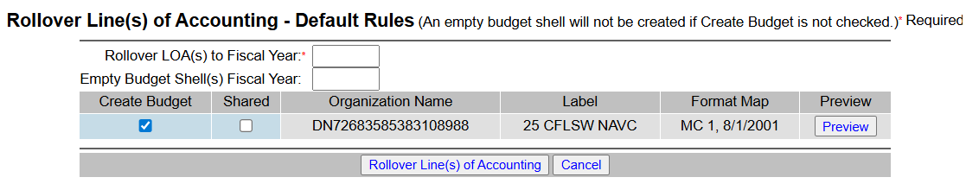
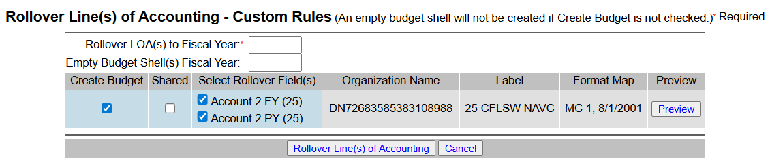
Roll Over LOA To New Fiscal Year
Depending on the method selected and format map, the fields will be displayed with the ability to Preview before completing the process.

Slide 21
Copy LOA
The FDTA should use the Copy LOA feature when other data elements change from one fiscal year to the next (i.e., changes in addition to fiscal year and program year related elements).
The Copy LOA feature does the following:
  Allows all the elements of an existing LOA to be copied so that a new LOA can be created for another fiscal year.
  This must be done individually, as only one LOA may be copied at a time.
  The LOA can only be copied into an organization that the FDTA has access to.
  Note: This does not change the fiscal year related elements in the LOA.

Slide 22
Copy LOA
To copy an LOA, select the Copy button next to the LOA.

Slide 23
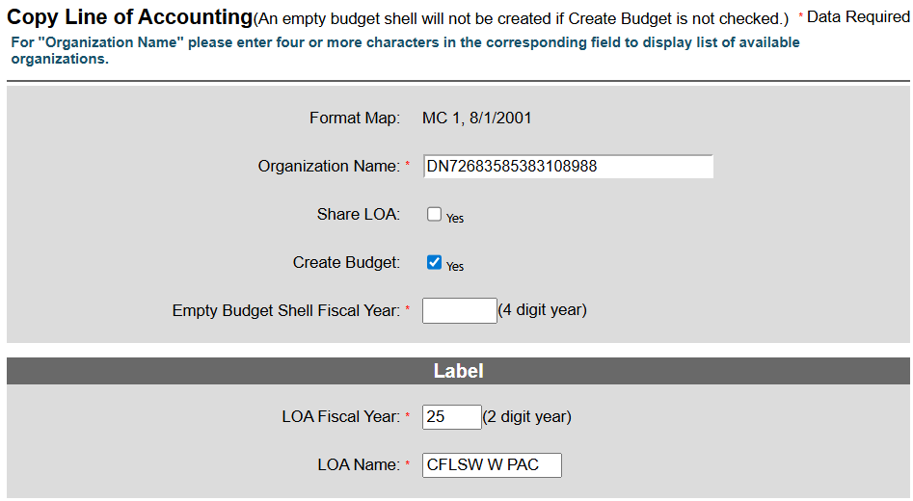
Copy LOA
It’s important to remember that you are copying an existing LOA, so all fields will be identical.
If this copy is to replace your next fiscal year, ensure you have these fields filled out correctly to reflect the correct fiscal year.

Slide 24
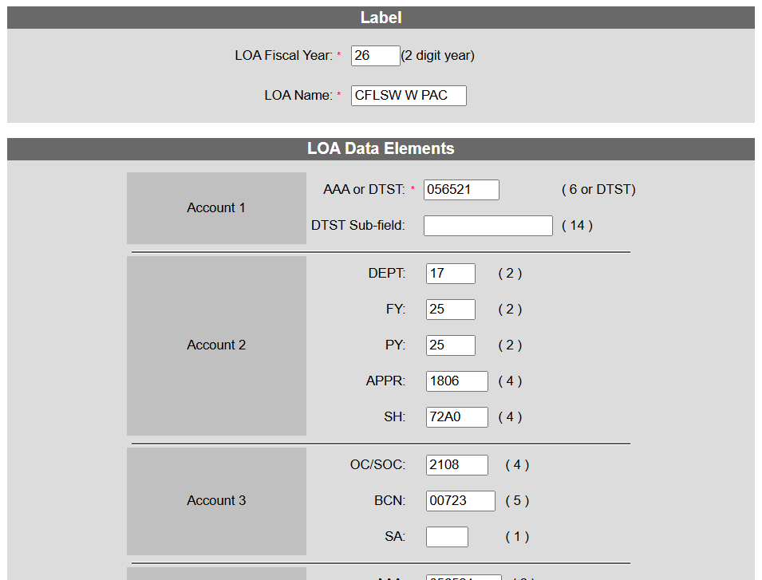
Copy LOA
You also can choose the Organization, rename the LOA, and edit any appropriate account elements if necessary.

Slide 25
Establishing Budgets
The DTS Budget Tool tracks and manages travel funds in DTS; however, the DTS Budget Tool is not an official accounting system.
  It does not link to your official accounting system.
Since the DTS Budget Tool does not link to your official accounting system, its accuracy depends on you entering accurate spending limits and periodically reconciling available funds against your official accounting system.
You should think of the Budget Tool as a bookkeeping tool that monitors the use of your travel funds.
  Its purpose is to ensure that unfunded travel does not take place.

Slide 26
Establishing Budgets (cont.)
Like the LOAs, Budgets must be established for the next fiscal year.
There are three main options to establish Budgets for the new fiscal year:
  Creating a Budget simultaneously when the LOA is created
  Creating a Budget manually
  Using an existing LOA to create a new Budget
    This can be done in the Budget Module or in the DTA Maintenance Tool
Permission Level 1 is required to view Budgets and Permission Level 3 is required to edit Budgets.

Slide 27
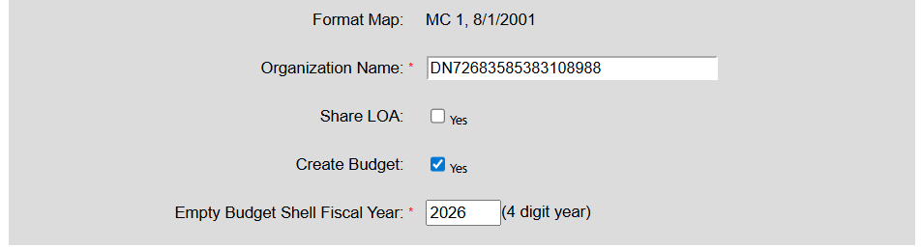
Creating a Budget simultaneously when creating LOA
Creating a Budget can be performed by checking these boxes and filling in the appropriate data when either rolling over or copying the LOA.
Keep in mind that if you decide to create a budget this way, it can only be created as a quarterly budget.

Slide 28
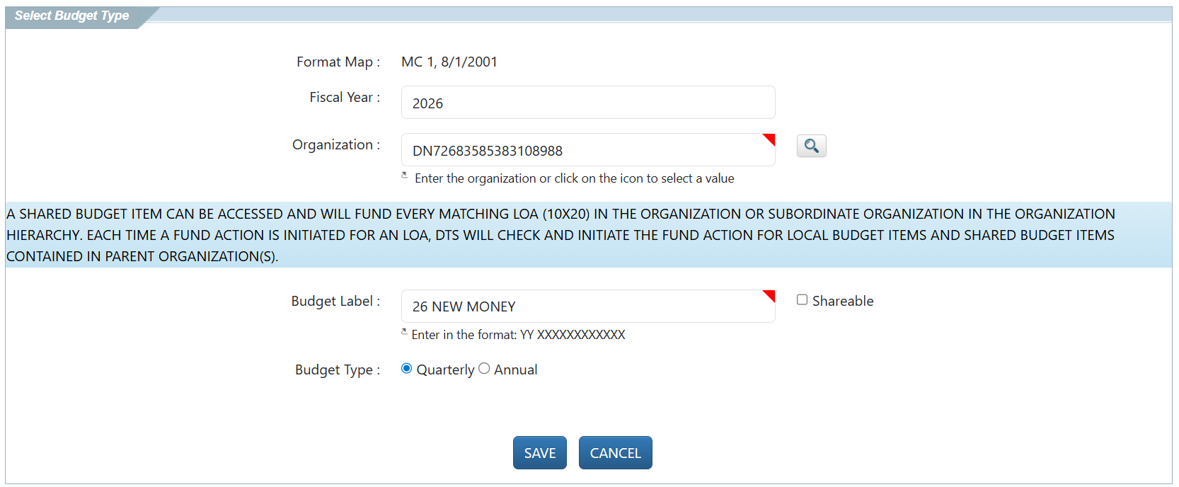
Creating a Budget manually
When creating a budget manually, you will need to fill out all the appropriate data before saving.

Slide 29
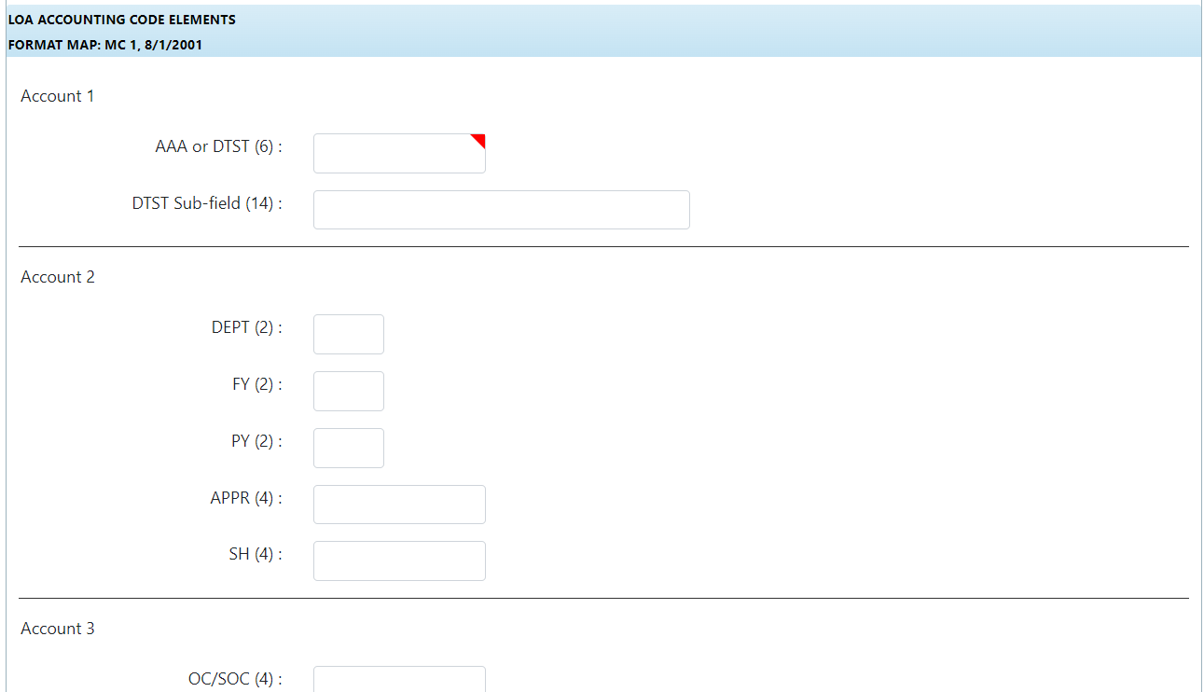
Creating a Budget manually
When creating a budget manually, you will need to fill out all the appropriate data before saving.

Slide 30
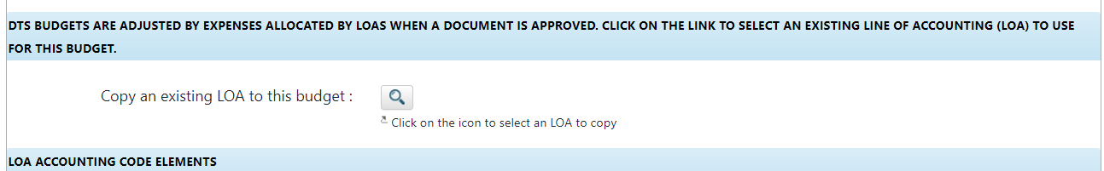
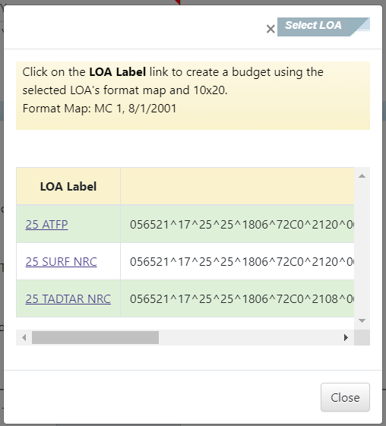
Using an existing LOA to create a new Budget
– Budget Tool
If an LOA is already established, an easier way to fill out the budget can be using the “Copy an existing LOA to this Budget”.
This will appear after you have begun the Budget creation.
Selecting the magnifying glass will cause a pop-up that you can easily use to choose an existing LOA.

Slide 31
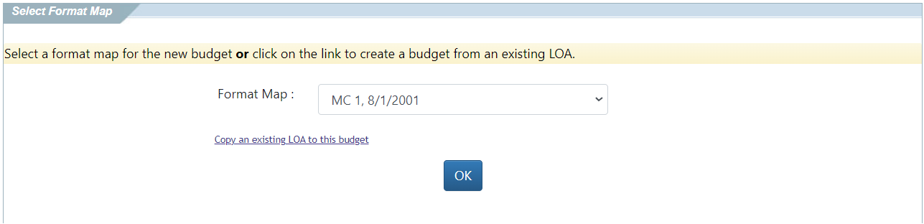
Using an existing LOA to create a new Budget
– Budget Tool
The Copy feature is also available at the beginning of the budget creation by selecting this link.

Slide 32
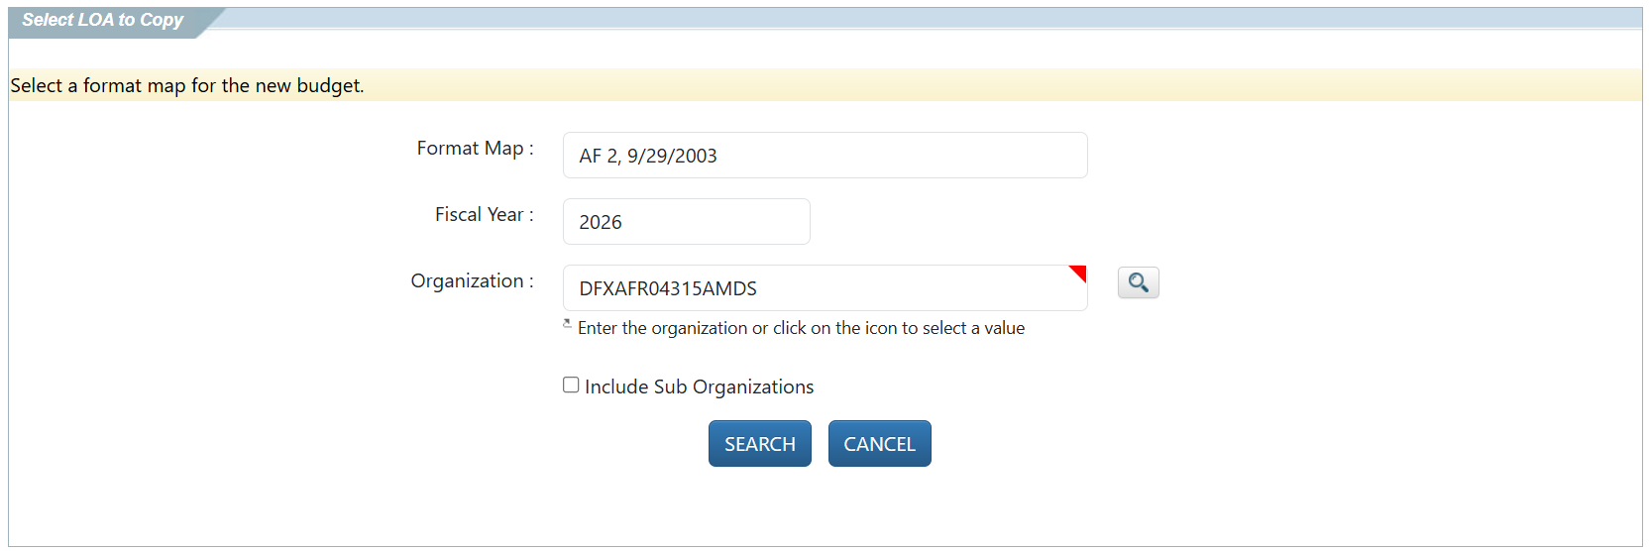
Using an existing LOA to create a new Budget
– Budget Tool
When using this method, you will need to put in the proper search criteria to return the proper LOAs.

Slide 33
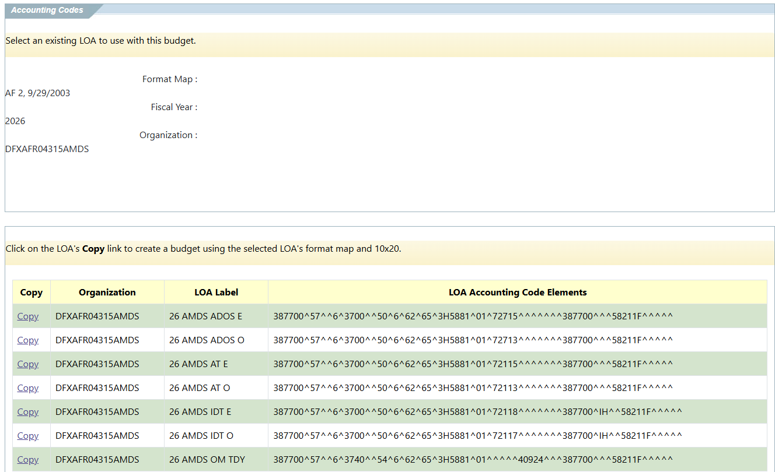
Using an existing LOA to create a new Budget
– Budget Tool
When the search returns results, simply choose the “Copy” next to the appropriate LOA.

Slide 34
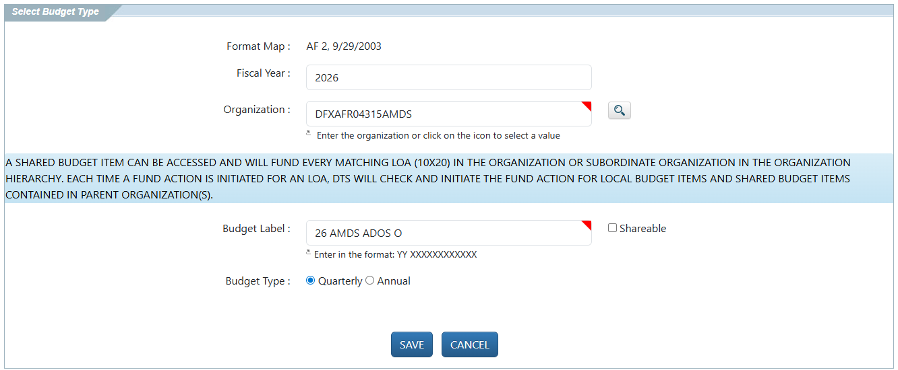
Using an existing LOA to create a new Budget
– Budget Tool
At this point, the information will be filled in.
Choose the type and hit “Save” to continue.

Slide 35
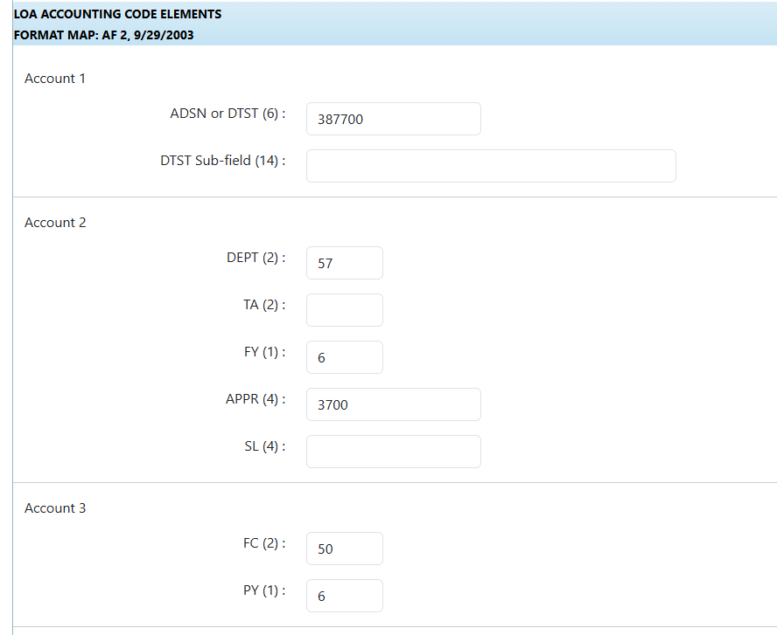
Using an existing LOA to create a new Budget
– Budget Tool
All the information from the LOA will be copied into the new Budget automatically.

Slide 36
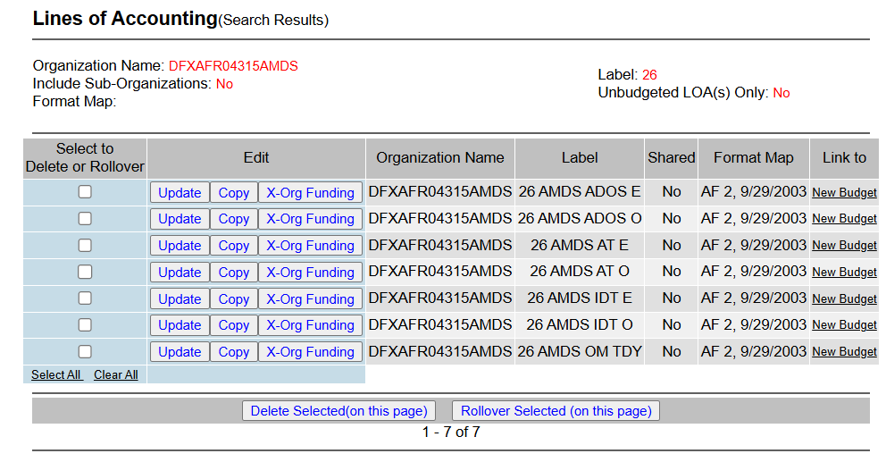
Using an existing LOA to create a new Budget
– DTA Maintenance Tool
If an LOA is already established, the budget can be created from the DTA Maintenance Tool by selecting the “Link to New Budget”.
This option should only be utilized if the FDTA is also the BDTA.

Slide 37
Adding Funds to your newly established budget
After creating a budget, you must manually add budget targets (that is, funds) to it.
  DTS automatically adjusts the travel funds available in the DTS budget as the Authorizing Official (AO) approves obligations and reimbursements against that budget.
There are two types of Budgets available, Annual and Quarterly.
  Once the Budget type is established, it cannot be changed.

Slide 38
Adding Funds to your newly established budget (cont.)
If you created your Budget simultaneously your LOA, the Budget will automatically be created as a Quarterly Budget.
Instructions to add funds to your budget can be found in Chapter 9 of the DTA Manual
  https://media.defense.gov/2022/May/11/2002994835/-1/-1/0/DTA_9.PDF

Slide 39
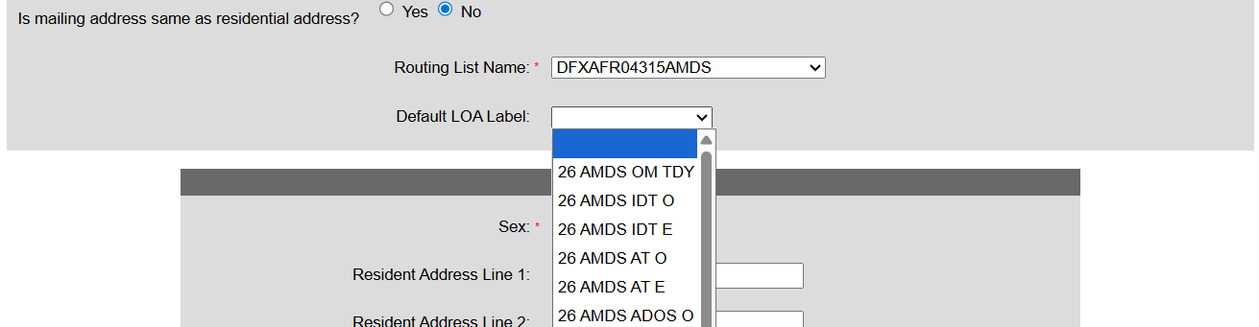
Update Default LOA
Every traveler’s profile contains a default LOA.
  Some profiles contain the organization’s default LOA while other travelers use different default LOAs.
  Whichever one they use, DTS automatically assigns it to all that person’s travel documents.

Slide 40
Update Default LOA
An organization generally changes its default LOA when the fiscal year changes, but it may happen more (or even less) often than that.
  It can also occur for different reasons altogether, such as when the organization is performing a reorganization.
Regardless of when it happens, DTS provides a way to change the default LOA for some or all an organization’s travelers at the same time.
Before updating travelers’ default LOA, be sure the new default LOA is associated with a funded budget or financial transactions that use the LOA will fail.

Slide 41
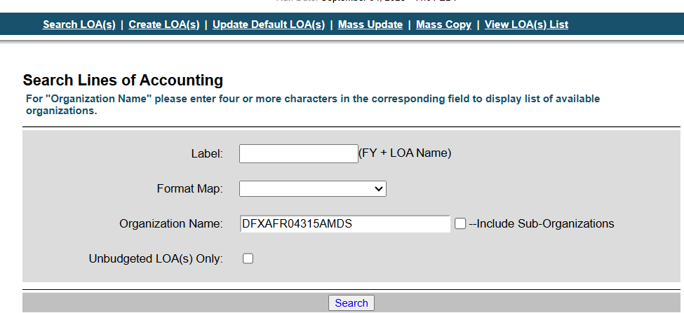
Update Default LOA
Update Default LOA(s) has its own section in the DTA Maintenance Tool under Lines of Accounting.

Slide 42
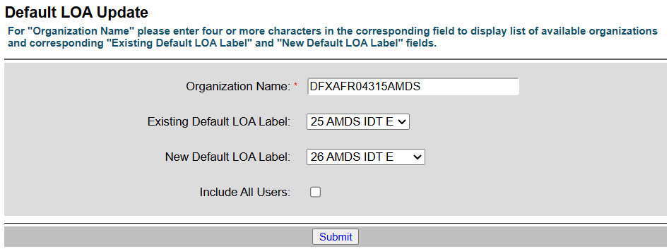
Update Default LOA
Select an Existing Default LOA Label to only find travelers with a specific LOA in their profiles or leave it blank to only find travelers that have no default LOA listed in their profiles.

Slide 43
Update Default LOA
Select a New Default LOA Label that all the selected travelers will use.

Slide 44
Update Default LOA
If you want to update everyone to the new LOA label (regardless of their “Existing”), then check the box to “Include All Users”.

Slide 45
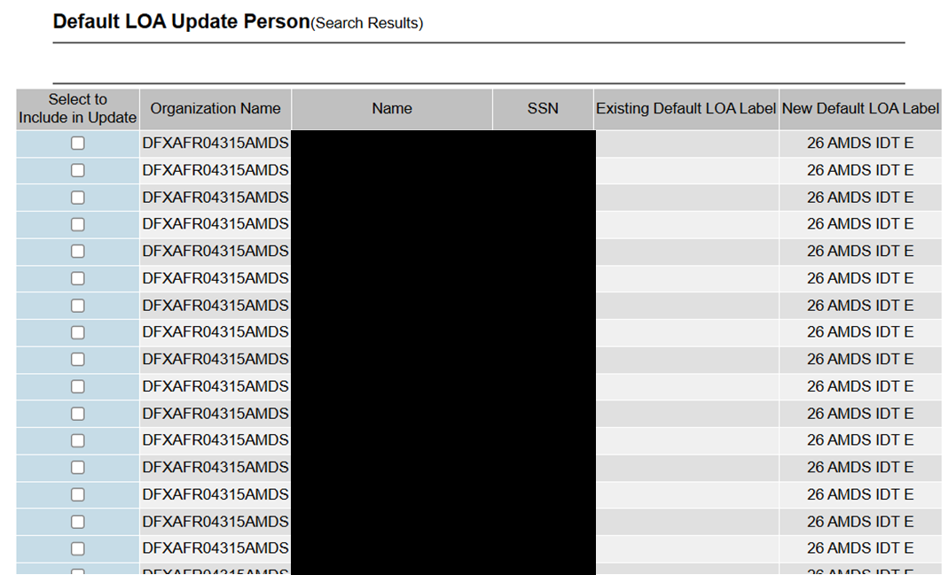
Update Default LOA
The search results display the travelers who met your search criteria, along with their truncated SSN, current default LOA, and new default LOA, if you include them in the update.

Slide 46
Reorganizations
When your senior management changes your organization structure, you may find it necessary to change your DTS organization set-up as well.
This process is referred to as a reorganization.
Even without such a change, other circumstances – for example, an organization name change or a mass reassignment of personnel – may lead you to consider a DTS reorganization.
Reorganizations are normally performed during the Fiscal Year Crossover time period.

Slide 47
Reorganization Preparation
Preparation is a key element in reorganization
  You can never start preparing too soon.
It’s important your organization is aware of when this is planned to happen.
  Travelers should be discouraged from traveling until the reorganization is completed.

Slide 48
Reorganization Preparation
Administrative Process
  Consult with upper echelon
  Conduct meetings and discuss naming the new org
  Sketch out new and old organization on paper
  Centrally Billed Accounts (CBA) need to be linked to new organization
  Designate roles and responsibilities
  Inactivate and hide organization to prevent future use

Slide 49
Reorganization Execution
The DTA should coordinate to ensure there is enough time to complete all the necessary actions for the reorganization.
Depending on the extent of the reorganization, this can include:
  Creating/Copying/Modifying the Organization
  Establishing Routing Lists
  Setting up the Lines of Accounting and Budgets
  Adding funding to the newly created Budgets
  Creating the Groups
  Establishing the Global Group Membership Rules
  Re-Assigning Personnel
  Assign and verify the roles and responsibilities for each member

Slide 50
Reorganization Execution
The DTA performing the actions of the reorganization should have Organization Access to see both organizations.
  For example, if DA250ARC09334 is transitioning to DA250NEW, the DTA will need Organization Access to DA250.
It’s recommended that the DTA run the Complete Traveler Information Report prior to performing any actions to ensure that all personnel are accounted for upon completion.
  After completing the reorganization process, the Complete Traveler Info Report should be re-ran.
Using the old report and new report, the DTA should compare permission levels, organizational, and group access.

Slide 51
Hiding your Old Organization
Keep in mind that existing organizations cannot be deleted if they have ever had a budget that has been used.
  This is pretty much every organization.
Instead of deletion, the previous organization should be restricted from use.
  Inactivate the Commercial Travel Office information.
  Change organization description.
    Recommend adding ‘DO NOT USE’ in the Organization Description.
  Change the Site Name to “Z – DISABLED ORGANIZATION” to hide it in Self-Registration.

Slide 52
Hiding your Old Organization
If the former organization will remain in use by some personnel, it’s recommended that the DTA create a duplicate non-traveler profile.
  Non-Traveler profiles can be created by adding a character to the end of the social security number.

Slide 53
Reorganization Assistance
Appendix L of the DTA Manual should be reviewed prior to performing a reorganization.
  https://media.defense.gov/2021/Nov/15/2002893229/-1/-1/0/DTA_APP_L.PDF
After reviewing Appendix L, you may have questions specific to the reorganization process.
  You can submit tickets to the TAC if the question is not, “Can you do my reorganization for me?”
  The TAC is happy to help and give advice on how to perform the different steps of the process, but we are not allowed to do this for you.
  You may want to contact your Service/Agency Representative if you need assistance the TAC cannot provide.

Slide 54
Resources
Fiscal Year Crossover
  https://www.travel.dod.mil/Programs/DoD-Travel-Systems/Fiscal-Year-Crossover/
Affected Partner Systems and Downtimes
  https://media.defense.gov/2022/Jun/21/2003021205/-1/-1/0/Accounting_System_Downtime.PDF
DTS Guide to Establishing Lines of Accounting (LOAs) and Budgets for the New Fiscal Year
  https://media.defense.gov/2022/May/12/2002995654/-1/-1/1/ESTABLISH_LOAS_FOR_THE_NEW_YEAR.PDF

Slide 55
Resources (cont.)
DTS Guide to Processing Authorizations for the New Fiscal Year
  https://media.defense.gov/2022/May/12/2002995650/-1/-1/1/PROCESSING_AUTHORIZATIONS_FOR_THE_NEW_YEAR.PDF
DTA Manual, Chapter 08: LOAs
  https://media.defense.gov/2022/May/11/2002994836/-1/-1/0/DTA_8.PDF
DTA Manual, Chapter 09: Budgets
  https://media.defense.gov/2022/May/11/2002994835/-1/-1/0/DTA_9.PDF

Slide 56
Resources (cont.)
DTA Manual, Appendix L: Reorganizations
  https://media.defense.gov/2022/May/12/2002995654/-1/-1/1/ESTABLISH_LOAS_FOR_THE_NEW_YEAR.PDF
You can contact the Travel Assistance Center (TAC) via:
  Phone 888-Help1Go (888-435-7146)
  Web (https://www.defensetravel.dod.mil/passport/)
  Chat (Available Monday – Friday between 8am and 6pm ET)
The slides for this presentation, as well as previous Outreach presentations, can be found on the DTMO Website at:
  https://www.travel.dod.mil/Support/Travel-Assistance-Center/TAC-Outreach

