Slide 2
Agenda
Financial Planning
PCS Considerations
Before Your Move
During Your Move
After You Arrive
Allowances and Entitlements
Summary and Resources

Slide 3
Financial Planning
3

Slide 4
Create / Manage a Spending Plan
STEP 1:
Understand your current
situation
STEP 4:
Make
adjustments
STEP 2:
Know where
your money
should go
4-STEP SPENDING PLAN
PROCESS
STEP 3:
Create a plan

Slide 5
Estimate Changes to Income
Basic Allowance for Housing (BAH)
Overseas Housing Allowance (OHA)
Cost of Living Allowance (COLA)
Family Separation Allowance (FSA)
Special and Incentive Pays
Spousal Income

Slide 6
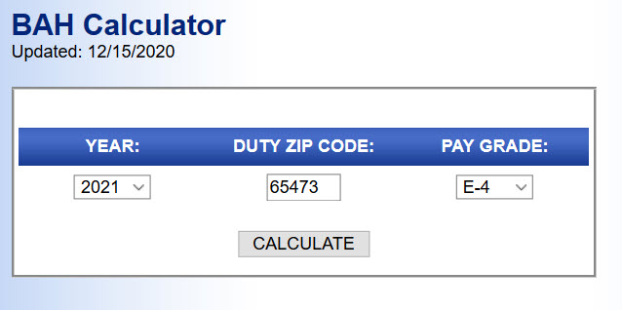
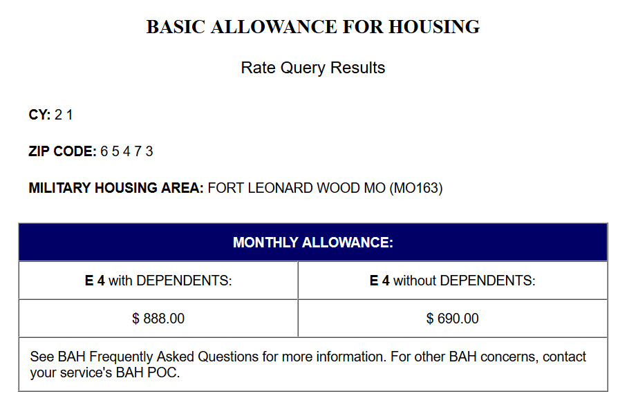
Basic Allowance for Housing (BAH) Calculator
Source: https://www.defensetravel.dod.mil/site/bahCalc.cfm

Slide 7
Estimate Changes to Expenses
Housing
Food
Transportation
Health
Personal and Family
Other

Slide 8
Protect Your Credit
Notify financial institutions
Set up automatic payments
Check your credit
Enroll in free credit monitoring
Update your address

Slide 9
Manage Debt
Debt destroyer strategies
Snowball
Avalanche
Major purchases
Housing
Vehicles

Slide 10
PCS Considerations

Slide 11
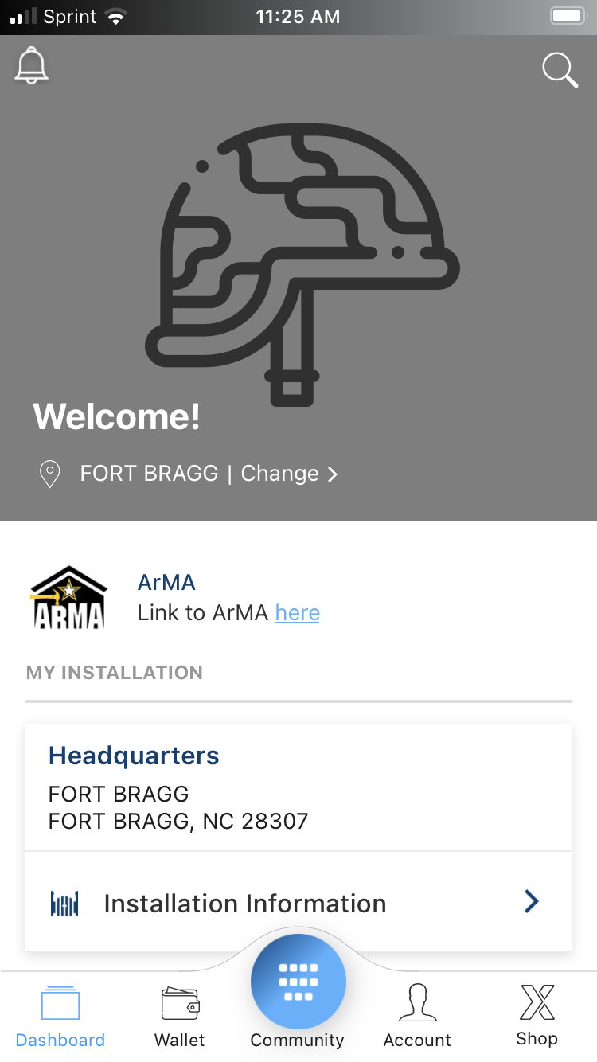
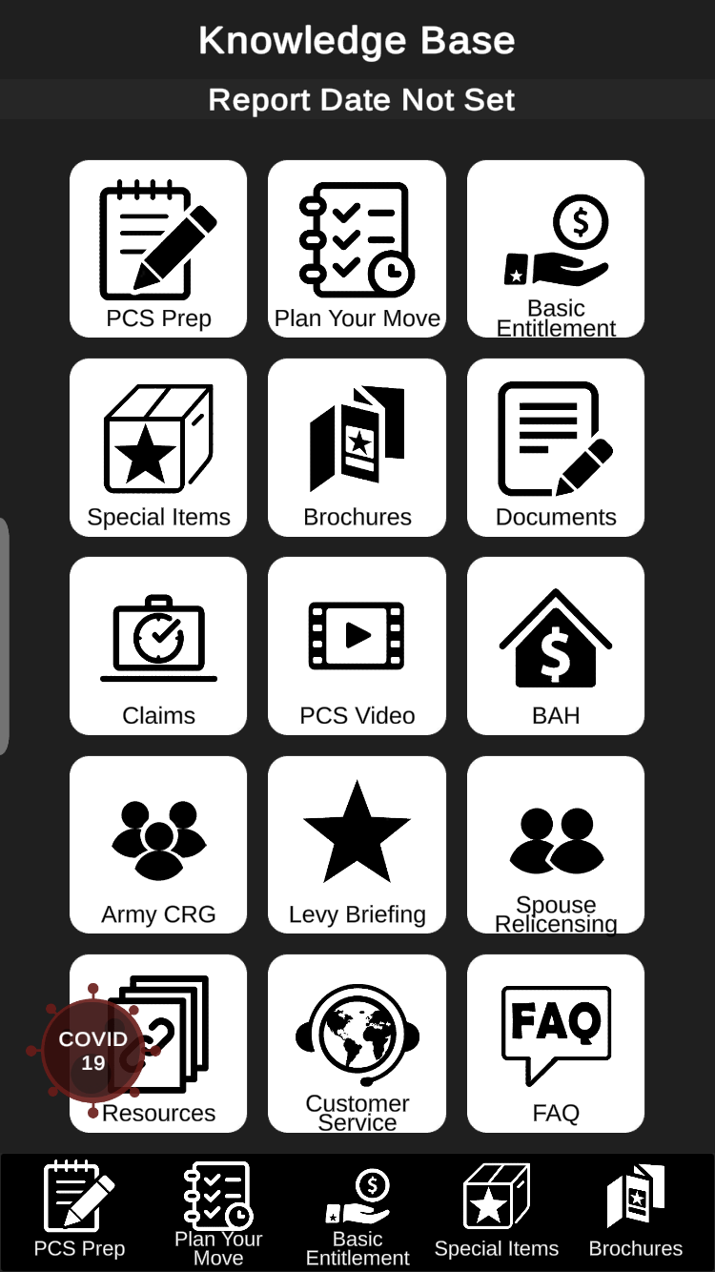
Before Your Move – Part 1
Digital Garrison
Army PCS Move
* Financial Readiness info coming soon!

Slide 12
Before Your Move – Part 2
Household Goods (HHG) and Personally Procured Move (PPM)
Housing
House hunting
Moving out
On-post housing
OCONUS housing
Weight limitations

Slide 13
Before Your Move – Part 3
TRICARE
SCRA
Childcare
Vehicles
Pets
Passports

Slide 14
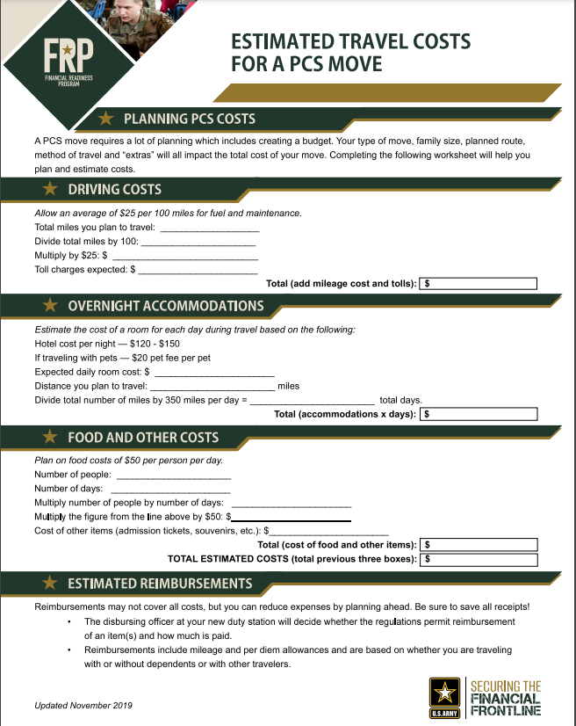
During Your Move
Estimated Travel Costs for a PCS Move Worksheet
Tax Considerations

Slide 15
After You Arrive
Initial expenses
State residency
Spouse employment

Slide 16
Allowances and Entitlements

Slide 17
Travel Pay and Allowances
Pay | Advance Eligible | Purpose
Monetary Allowance in Lieu of Transportation | Yes, If no GTCC | Mileage reimbursement
Per diem | Yes, If no GTCC | Reimburse travel expenses (i.e., hotel and meals)
Dislocation Allowance | Yes | Partially offsets cost of moving a household (i.e., deposits, first and last month rent, unexpected moving costs, etc.)
Temporary Lodging Expense | No | Partially covers lodging and meal expenses while in temporary lodging
Overseas Housing Allowance | No | Offset housing and living expenses (Location-Specific)
Move-in Housing Allowance
Temporary Lodging Allowance
Cost of Living Allowance

Slide 18
PCS Pay Resources
Government Travel Charge Card (GTCC)
Advance on:
Regular pay
Basic Allowance for Housing (BAH)
Dislocation Allowance (DLA)

Slide 19
Summary and Resources

Slide 20
Summary
Congratulations on your upcoming move to your next duty station!
Along with new adventure opportunities, a Permanent Change of Station can add many additional expenses. Preparation and planning can help alleviate the stress of spending more than you can afford.
Let’s wrap up all of the topics we talked about today:
Financial Planning
PCS Considerations
Before Your Move
During Your Move
After You Arrive
Allowances and Entitlements

Slide 21
Resources

Slide 22
Thank You!
The appearance of U.S. Department of Defense (DoD) visual information does not imply or constitute DoD endorsement.

