Slide 1
Welcome to the TAC Outreach Call
Presenter(s) – Dan Greene
– Jason Prado
Date – April 9, 2024
Topic – Sustainable Defense Travel – Encore and Updates
The presentation will begin shortly
Audio is available through ZoomGov (ensure you enable Audio) or using the telephone number(s) below.
Location | Phone Number
United States | 551 285 1373
United States (San Jose) | 669 254 5252
United States (New York) | 646 828 7666
United States (Toll Free) | 833 568 8864
If you are dialing internationally, find your phone number at https://zoomgov.com/u/absGdkJ9AD
Meeting ID - 161 892 0052

Slide 2
TAC Outreach Call
Sustainable Defense Travel – Encore and Updates
Dan Greene – TAC Outreach Call Coordinator
Jason Prado – TAC Manager
April 9, 2024

Slide 3
Top Issues for March/April
Sustainable Defense Travel
UTD-CTD for MAP-CAP 104-23(I), “Sustainable Transportation for Official Temporary Duty (TDY) Travel”
JTR Changes and Revisions
Constructed Travel Worksheet
Sustainable Defense Travel Best Practices
Questions about Sustainable Defense Travel
Resources
Questions

Slide 4
Top Issues for March/April
Issue # | Summary | Workaround | Release
Stuck at CTO SUBMIT | There are multiple factors that can cause an authorization to get stuck at CTO SUBMIT. Authorizations are not considered stuck until they remain at CTO SUBMIT longer than the close of business on the next business day. | The TAC can access the Global Distribution System (GDS) and will attempt to push the document to CTO BOOKED. If unsuccessful, these documents must be manually abandoned. | Issues are regularly researched and resolved.
PPT | Authorizations with past dated reservations outside the trip dates receive an audit fail for LODGING OUTSIDE OF TRIP DATES: The document has lodging reservations outside of the trip dates. | The dates could be changed to allow it to process then updated on the voucher. Alternatively, it will need to be trip cancelled. Please consult local business rules prior to making any changes.
DTS-21056 | Reservation for Car rental does not show rates in the PNR or in DTS. This affects Sabre PNRs only. | Please contact the TAC for further assistance. | Ready for Assignment
PPT | Issues with Cancelling authorizations that were part of the Feb 2024 conversion. | Please contact us for further assistance.
DTS-24862 | Traveler profiles with a lowercase letter in their SSN are receiving a login error stating "User certificate is already registered to two profiles". This is occurring even when users properly have only two traveler profiles; two traveler profiles and one non-traveler profile; or profiles that are not in the same organization. | There is currently no workaround for this issue. | FY24 MR4

Slide 5
Introduction to Sustainable Defense Travel
To support the goals in Executive Order 14057 of December 8, 2021, Catalyzing Clean Energy Industries and Jobs through Federal Sustainability, the White House has issued instructions that direct Federal agencies to prioritize the use of sustainable transportation for official travel.
  https://www.whitehouse.gov/briefing-room/presidential-actions/2021/12/08/executive-order-on-catalyzing-clean-energy-industries-and-jobs-through-federal-sustainability/
The Memorandum from December 14, 2023, provides guidance to agencies to make the use of sustainable transportation easier to access and book, consistent with agency missions and fiscal responsibility.
  https://www.whitehouse.gov/wp-content/uploads/2023/12/M-24-05-Catalyzing-Sustainable-Transportation-Through-Federal-Travel.pdf

Slide 6
UTD-CTD for MAP-CAP 104-23(I), “Sustainable Transportation for Official Temporary Duty (TDY) Travel”
The UTD-CTD for MAP-CAP 104-23(I), Sustainable Transportation for Official Temporary Duty (TDY) Travel was posted February 20, 2024 with an effective date of March 1, 2024.
  https://media.defense.gov/2024/Feb/22/2003398474/-1/-1/0/UTD-CTD_for_MAP-CAP_104-23(S)_Sustainable_Transportation_for_Official_Temporary_Duty_(TDY)_Travel.PDF
This bulletin clarifies existing regulations for determining the method of transportation that is most advantageous to the Government and encourages Federal travelers to make sustainable, cost-effective transportation choices when conducting official TDY travel.

Slide 7
JTR Changes and Revisions
JTR 0202
0202 TRANSPORTATION
  This section addresses transportation to, from, and around official travel locations. The AO should authorize transportation before a traveler departs. If the AO does not, then air transportation is the authorized transportation mode for transoceanic travel. For non-transoceanic TDY travel, the transportation types specified in par. 020203 should be used. If the traveler selects an alternate mode than as specified in par. 020203, then they must demonstrate to the AO’s satisfaction that the selected mode of travel was the most efficient or economical option reasonably available. Each traveler is allowed a seat on the authorized transportation mode. While an AO does not normally direct transportation, he or she may do so for a traveler under certain circumstances. If travel changes unexpectedly, the transportation type can be approved after travel has begun if the reasons are acceptable to the AO. Travel other than by a usually traveled route must be justified for any excess cost to be Government funded.

Slide 8
JTR Changes and Revisions (cont.)
JTR Appendix A
ZERO-EMISSION VEHICLE is a vehicle that when operating produces zero tailpipe exhaust emissions of any criteria pollutant (or precursor pollutant) or greenhouse gas.

Slide 9
JTR Changes and Revisions (cont.)
JTR 020203 A2
JTR 020203 B10
020203. Transportation Types Most Advantageous to the Government
  2. When Government transportation is not directed, commercial travel by airplane, rail, bus, or ship is generally the most advantageous method of transportation and should be selected when reasonably available. Of these types, travel by airplane, or rail if the distance is less than 250 miles, is usually preferable when available.
  B. Determination Factors. The AO will use the following factors to determine which type of transportation is most advantageous to the Government for TDY travel:
    10. Zero-emission vehicles (ZEVs) when the rental rate is equal to or less than the least expensive compact car, and charging infrastructure availability en route or at the destination.

Slide 10
JTR Changes and Revisions (cont.)
JTR 020206 O
O. Sustainable Travel Modes. To promote sustainable transportation, the traveler should consider using ZEVs over other automobiles; rail over air travel if the distance is less than 250 miles or long-distance automobile travel; and public transit over automobiles.
    1. Government automobile. Traveler should use a Government ZEV to the maximum extent practicable where available and where adequate charging infrastructure is likely to be available en route or at the destination.
    2. Rental Vehicle. If a traveler is authorized or approved the use of a rental vehicle for official travel, then the traveler should select a ZEV when the daily rental rate is equal to or less than the daily rental rate of the least expensive compact car available.
    3. Taxis and transportation network companies (TNC). If a ZEV TNC or taxi is available and the charge is equal to or less than gasoline-fueled vehicles, then travelers should select a ZEV.
    4. Ridesharing. Travelers sharing a ride may use larger TNC vehicles, taxis, or shuttle services between airports, hotels, and conferences or meetings.
    5. Rail. Travelers should use trains when the destination is less than 250 miles away and when cost effective and consistent with mission needs.
    6. Public transportation. When available, travelers should use public bus and rail options

Slide 11
JTR Changes and Revisions (cont.)
JTR 020209 A
020209. Rental Vehicle
  A. Selecting a Rental Vehicle. If a traveler is authorized or approved the use of a rental vehicle for official travel, then the traveler should select a ZEV when the daily rental rate is equal to or less than the daily rental rate of the least expensive compact car available. If another class of rental vehicle is approved, then travelers should select a ZEV when the rental rate is equal to or less than the least expensive car of the approved class of vehicle. If no ZEVs are available, then the traveler should consider renting a hybrid vehicle when the rental rate is equal to or less than the least expensive car of the approved class of vehicle.

Slide 12
JTR Changes and Revisions (cont.)
JTR 020210
Table 2-11
Table 2-11. Cost Comparison Rules for Using a POV
If… | If… | Then…
Vehicle v. Train
8 | the official distance between authorized locations (as determined by the DTOD or from appropriate distances (non-DoD Services)) is less than 250 miles one way or less than 500 miles round trip, and use of rail is available and time and cost effective, | rail is considered advantageous to the Government. When rail transportation is considered advantageous to the Government, and a POV is used instead, the traveler is limited to the rail transportation cost.

Slide 13
JTR Changes and Revisions (cont.)
JTR 020212 B1
020212. Travel in and around the TDY Location
  B. Transportation Modes. The AO may authorize or approve the most economical transportation mode at the TDY location that meets the mission requirements. The transportation mode must be specified in the travel order if it is authorized before travel begins.
    1. Public transportation should be the first option in and around the TDY location. Travelers should familiarize themselves with subway, trains, and bus routes that are available between meetings, lodging, and other locations at which business is to be conducted.

Slide 14
JTR Changes and Revisions (cont.)
JTR 020213 B
B. Transportation Network Companies. Although travelers may use this transportation mode, as defined in Appendix A, cancellation fees and penalties charged by these companies are not reimbursable expenses. Travelers must select the ride option most economical and advantageous to the Government, when cost and other factors are considered. There is no authority to authorize or approve a premium or luxurious option. A class upgrade for a larger vehicle may be authorized or approved to accommodate multiple travelers; additional equipment; or when a premium TNC is equal to or less than the most economical TNC. A traveler should select a ZEV TNC if the rate is equal to or less than the rate of the non-ZEV TNC. If a ZEV TNC is not available, then travelers should select a hybrid TNC if the rate is equal to or less than the rate of the non-ZEV TNC. If none are available, the traveler should select the least expensive vehicle with the highest fuel efficiency

Slide 15
JTR Changes and Revisions (cont.)
JTR 020213
Table 2-13
Table 2-13. Reimbursement for Ground Transportation to and from Terminals and Rental Car Facilities
If… | If… | Then…
7 | a traveler uses public transportation, | he or she may be reimbursed the fare cost.

Slide 16
Break-Down of Changes
If a POV is used, then a Constructed Travel Worksheet must be completed and submitted with the voucher
  There is no longer an exemption for trips 400 miles one way or 800 miles roundtrip
  Keep in mind that a CTW is not required for local travel or when using your POV to travel to/from the terminal.
For trips 250 miles or less, select rail if it is available and advantageous
  Currently, selecting an Amtrak fare in DTS requires a TMC “touch fee”
  Amtrak and DoD are working together to integrate the reservation process
Select an electric vehicle if it is the cheapest vehicle in the authorized vehicle class
  Currently, DTS does not display if a vehicle is electric and travelers should simply continue to select the lowest cost vehicle in the authorized class
  The rental vehicle companies and DoD are working together to display electric vehicle options in DTS
Travelers are encouraged to use public transit whenever possible

Slide 17
Constructed Travel Changes
JTR 020210 F
In addition to the changes for March 1, 2024, there have been additional changes to the regulations on April 1, 2024.
F. Cost Comparisons Between Use of a POV and Other Modes of Transportation (Computation and Calculation Rules). When a traveler uses a POV instead of an authorized type of transportation deemed most advantageous to the Government, a cost comparison is done to determine reimbursement. The POV mileage is compared to the constructed cost of the authorized transportation type and the lesser of the two amounts is reimbursed. The constructed cost is the sum of the transportation ticket cost, the TMC fee, and other related costs that include, but not limited to, taxi and TNC fares, terminal mileage, baggage fees, ferry fees, parking, or rental car when authorized and necessary. The per diem that the Government would have incurred if travel had been performed by the authorized transportation mode is paid.

Slide 18
Constructed Travel Changes (cont.)
This is a major change to the Constructed Travel.
The DTMO has updated the Constructed Travel Worksheet (CTW) and the instructions to comply with this new change and are available on their website.
  https://www.travel.dod.mil/Programs/Defense-Travel-System/Constructed-Travel/
Travelers are not required to use this CTW.
  Travelers may use any locally-approved worksheet but should check with their organization’s local business rules.

Slide 19
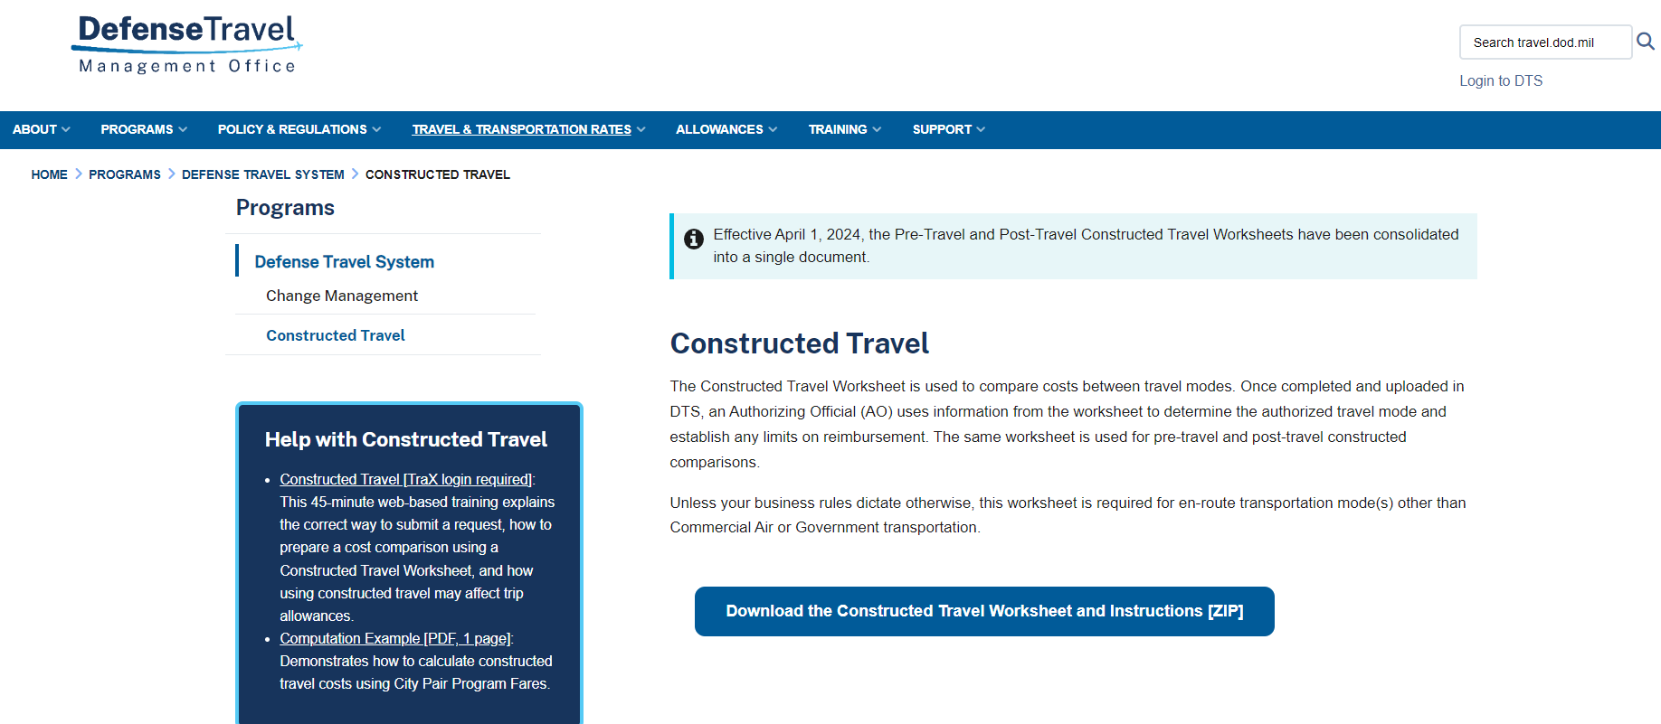
Constructed Travel Changes (cont.)
https://www.travel.dod.mil/Programs/Defense-Travel-System/Constructed-Travel/

Slide 20
Constructed Travel Changes (cont.)
Due to a setting in Chrome and Edge, some users will experience issues trying to open/download/view the CTW.
  The user is presented with a message that says, “Please Wait” and it will remain there indefinitely.
Instead of viewing the .pdf file in Chrome or Edge, the settings should be updated to always download and open in Adobe Reader.
It’s also recommended that Adobe Reader be the default program of .pdf files.

Slide 21
Possible “Error” Message with the CTW - Chrome
To view the documents using Chrome, please follow the steps below.
  Open a Google Chrome browser
  Select the option for Tools (3 dots in upper right corner)
  Select Settings
  Select Privacy and security
  Select Site Settings
  Select Additional content settings (bottom of list)
  Select PDF documents
  Turn on the option to Download PDF files instead of automatically opening them in Chrome.

Slide 22
Possible “Error” Message with the CTW - Edge
To view the documents using Chrome, please follow the steps below.
  Open the Microsoft Edge browser
  Select the option for Tools (3 dots in upper right corner)
  Select Settings
  Select Cookies and Site permissions on right hand side
  Select PDF documents under All Permissions
  Select Always download PDF files

Slide 23
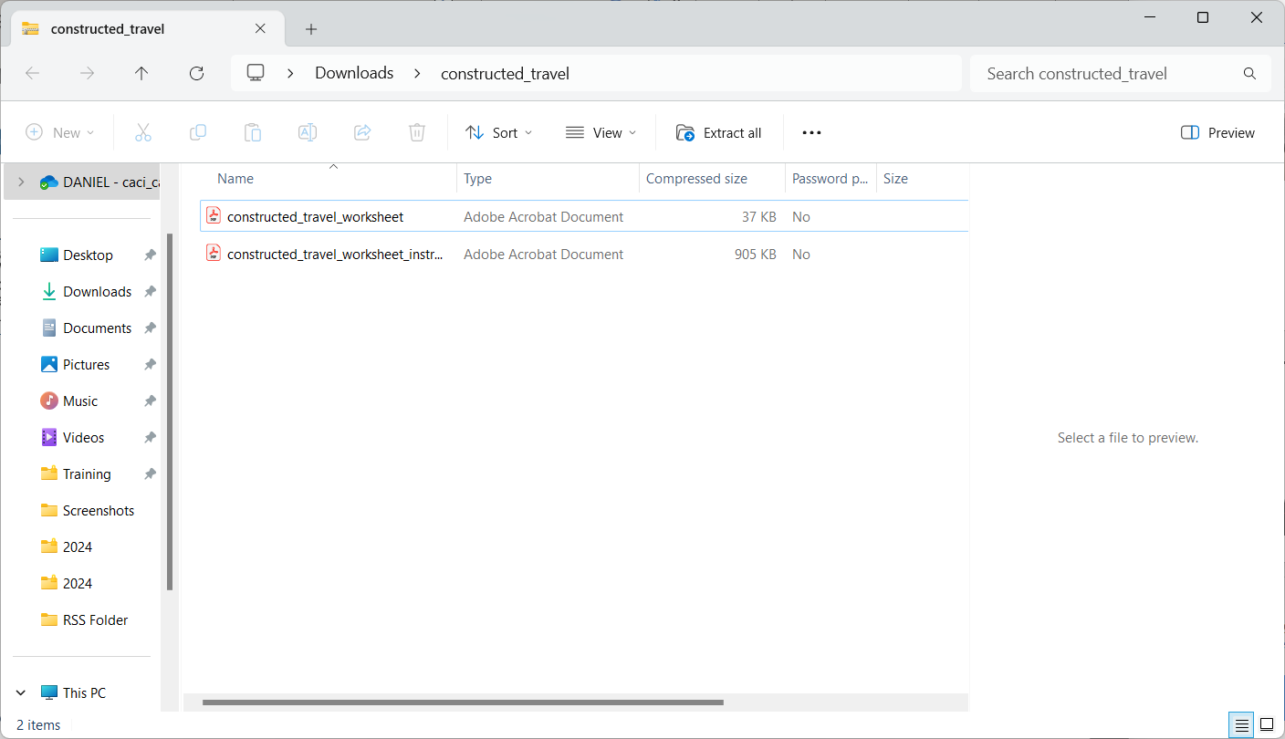
Constructed Travel Changes (cont.)
Because the Pre-Travel and Post-Travel CTW’s have been combined, it’s recommended that travelers and AOs review the Worksheet Instructions included in the .zip file.

Slide 24
Constructed Travel Changes (cont.)
Additional assistance with the Constructed Travel, including examples, training, and an introduction, can be found on the left side of the page.

Slide 25
Constructed Travel Changes (cont.)
The next TAC Outreach Call (April 23, 2024) will focus on the changes to the policy for Constructed Travel, how to fill out the CTW, and assistance for AOs who will be approving constructed travel.
In the meantime, we recommend reading the instructions provided in the .zip file and if you have further questions, submit them to the TAC.

Slide 26
Sustainable Defense Travel Best Practices
While previous policy has directed travelers to select modes of transportation that are advantageous to the Government, the Joint Travel Regulations (JTR) has been updated to clarify the implementation of this new guidance.
More information about this can be found on the DTMO website at:
  https://www.travel.dod.mil/About/News/Article/Article/3681564/sustainable-defense-travel-travel-green-on-your-next-official-trip/

Slide 27
Sustainable Defense Travel Best Practices
DoD components and staff can take certain steps to make an immediate impact when on official travel (TDY) and support current policy:
Assess your need to travel
  A virtual meeting may be able to provide a more cost-effective and environmentally-friendly alternative to traveling for an on-site meeting.
Combine trips when possible and geographically reasonable
  When the mission takes you to multiple/consecutive TDY points, consider taking a single trip with multiple legs. This may create a smaller carbon footprint than returning to your official duty station between trips to each destination.

Slide 28
Sustainable Defense Travel Best Practices (cont.)
DoD components and staff can take certain steps to make an immediate impact when on official travel (TDY) and support current policy:
Choose public transportation over automobiles
  When possible, use public transportation for official local travel and limit the use of rental vehicles when on TDY. Consider walking, carpooling, or using local public transportation, like buses or metro trains, instead. Use the map app on your smartphone to find the quickest public transportation route to your destination.
Take the train
  Interstate and commuter rail options should be prioritized over air travel or use of personal vehicle (POV) for travel under 250 miles when cost-effective and available.

Slide 29
Sustainable Defense Travel Best Practices (cont.)
DoD components and staff can take certain steps to make an immediate impact when on official travel (TDY) and support current policy:
Personally owned vehicles (POVs)
  Updated Join Travel Regulations policy (section 020210, Table 2-10 and 2-11) states that a POV will no longer be automatically considered advantageous if the trip is 400 miles or less one way and that all commercial travel options must be considered before a POV is authorized.
Choose zero-emission vehicles (ZEVs) over other automobiles when cost effective
  Use of zero emission vehicles is encouraged when the daily rate is equal to or less than the daily rental rate of the least expensive compact car available.

Slide 30
Questions about Sustainable Defense Travel
At this time, are travelers required to request TMC assistance for Zero Emission Vehicles (ZEV)?
  No. Travelers should continue to select the lowest cost option for their authorized vehicle class
What if there are no rail options or use of rail is not practical for my enroute travel to the TDY destination?
  The AO should continue to direct use of a Government or rental vehicle
When is a Constructed Travel Worksheet required to be submitted?
  Anytime a traveler uses their POV

Slide 31
Questions about Sustainable Defense Travel (cont.)
Will travel approved prior to March 1, 2024, be allowed to use the 400/800 (one-way/roundtrip) rule for POV?
  Yes. If travel was approved prior to March 1, 2024, then a CTW is not required for trips 400 miles one-way and 800 miles roundtrip
Do documents need to be re-evaluated if their travel was approved prior to March 1, 2024, but does not take place until after March 1, 2024?
  No. If travel was approved prior to March 1, 2024, then documents do not need to be re-evaluated

Slide 32
Questions about Sustainable Defense Travel (cont.)
Do travelers need a CTW for Local Travel?
  No. A CTW is not necessary for Local Travel.
Do travelers need a CTW when they drive their POV to the airport?
  No. A CTW is only necessary when the POV is their mode of transportation to/from a TDY Location.

Slide 33
Questions about Sustainable Defense Travel (cont.)
Will there be a new rate class listed to show electric vehicle cost to rent compared to the compact that the traveler initially looked for?
  Electric vehicles are not their own class (e.g., the class of car is compact, and it is an electric vehicle)
  DoD is working to display electric vehicle options in DTS
How should the travelers obtain an estimate to compare the costs for rail and rental car?
  As stated previously in the presentation, use the DTS Reservation Module for Rental Cars and Amtrak’s website for Rail.
    https://www.amtrak.com/plan-your-trip.html

Slide 34
Questions from Outreach on Sustainable Travel
We received around 100 questions from the TAC Outreach Call on March 12, 2024.
The DTMO took these questions and got the official answer for each.
We have placed them into a PowerPoint for you to view on the DTMO’s website in the same location as the TAC Outreach Slides.
  https://www.travel.dod.mil/Support/Travel-Assistance-Center/TAC-Outreach/
These FAQs are titled “Sustainable Travel FAQs” with a date of 4/9/2024.

Slide 35
Resources
Executive Order on Catalyzing Clean Energy Industries and Jobs Through Federal Sustainability
  https://www.whitehouse.gov/briefing-room/presidential-actions/2021/12/08/executive-order-on-catalyzing-clean-energy-industries-and-jobs-through-federal-sustainability/
Catalyzing Sustainable Transportation Through Federal Travel
  https://www.whitehouse.gov/wp-content/uploads/2023/12/M-24-05-Catalyzing-Sustainable-Transportation-Through-Federal-Travel.pdf
UTD-CTD for MAP-CAP 104-23(I), “Sustainable Transportation for Official Temporary Duty (TDY) Travel”
  https://media.defense.gov/2024/Feb/22/2003398474/-1/-1/0/UTD-CTD_FOR_MAP-CAP_104-23(S)_SUSTAINABLE_TRANSPORTATION_FOR_OFFICIAL_TEMPORARY_DUTY_(TDY)_TRAVEL.PDF

Slide 36
Resources (cont.)
Joint Travel Regulations
  https://www.travel.dod.mil/Policy-Regulations/Joint-Travel-Regulations/
Constructed Travel
  https://www.travel.dod.mil/Programs/Defense-Travel-System/Constructed-Travel/
GSA City Pairs Program Lookup
  https://www.gsa.gov/travel/plan-book/transportation-airfare-rates-pov-rates-etc/airfare-rates-city-pair-program

Slide 37
Resources (cont.)
Sustainable Defense Travel – Travel Green on your next Official Trip
  https://www.travel.dod.mil/About/News/Article/Article/3681564/sustainable-defense-travel-travel-green-on-your-next-official-trip/
Amtrak Trip Planner
  https://www.amtrak.com/plan-your-trip.html
You can contact the Travel Assistance Center (TAC) via:
  Phone 888-Help1Go (888-435-7146)
  Web (https://www.defensetravel.dod.mil/passport/)
  Chat (Available Monday – Friday between 8am and 6pm ET)
The slides for this presentation, as well as previous Outreach presentations, can be found on the DTMO Website at:
  https://www.travel.dod.mil/Support/Travel-Assistance-Center/TAC-Outreach

Slide 38
Questions
Questions are taken by Site Name in alphabetical order
  A – E (Example – Dyess Air Force Base)
  F – L (Example – Fort Huachuca)
  M – S (Example – Redstone Arsenal)
  T – Z (Example – Yuma Proving Ground)
If using your telephone to dial in, you can press *6 to unmute yourself to ask a question.
  Please be considerate and mute your phone if you are not talking by pressing *6 again.

