Slide 1
Welcome to the TAC Outreach Call
Presenter(s) – Dan Greene – Jason Prado
Date – September 26, 2024
Topic – Fiscal Year Crossover Preparation (cont.)
The presentation will begin shortly
Audio is available through ZoomGov or using the telephone number(s) below.
Location | Phone Number
United States | 551 285 1373
United States (San Jose) | 669 254 5252
United States (New York) | 646 828 7666
United States (Toll Free) | 833 568 8864
If you are dialing internationally, find your phone number at https://zoomgov.com/u/absGdkJ9AD
Meeting ID - 161 892 0052

Slide 2
TAC Outreach Call Fiscal Year Crossover Preparation (cont.)
Dan Greene – TAC Outreach Call Coordinator
Jason Prado – TAC Manager
September 26, 2024

Slide 3
Top Issues for September
DTMO Excellence in Practice Award Nominations
DoD Installation Name Changes
Overview
Document Handling
Fiscal Year Crossover
Transaction Release Dates
Expected System Downtimes
DTS Obligation and Payment Process
Document Processing
FY Crossover Travel
New Fiscal Year
Cross Fiscal Year
Resources
Questions

Slide 4
Top Issues for September
Issue # | Summary | Workaround | Release
Stuck at CTO SUBMIT | There are multiple factors that can cause an authorization to get stuck at CTO SUBMIT. Authorizations are not considered stuck until they remain at CTO SUBMIT longer than the close of business on the next business day. | The TAC can access the Global Distribution System (GDS) and will attempt to push the document to CTO BOOKED. If unsuccessful, these documents must be manually abandoned. | Issues are regularly researched and resolved.
PPT | Spawned authorizations with completed vouchers are appearing on the Unsubmitted Voucher Report. | Once you’ve verified the spawned authorization has a completed voucher, these documents can be disregarded from the report.
PPT | Unable to edit a CTO Amendment with two PNRs and document has NOT been signed but has adjusted stamps-only option is to view. | Both PNRs must be placed on the Outbound queue for the document to update properly. Please contact the TAC for further assistance.
PPT | Documents stall at processing your request when trying to view or edit them. | If you can manually trip cancel this authorization, we recommend performing this action. If not, please contact us to have the document manually abandoned.
DTS-19818 | Trip Cancelled documents are stamped Pay Process Ignore prior to Pos Ack Received. This prevents funds from de-obligating at the appropriations level. | The local organization must take the appropriate action to handle the necessary adjustments to the DTS Budget Module and associated obligations will have to be manually de-obligated in the accounting systems. | FY23 MR4

Slide 5
Excellence in Practice Awards – Nominations
The Defense Travel Management Office (DTMO) is pleased to announce the 2024 Excellence in Practice Awards, which will recognize the top performers in DoD travel for the value and services they provided to their travel program during Fiscal Year 2023 (from October 1, 2022, up to September 30, 2023).
The Excellence in Practice Award winners are nominated by their colleagues each Fiscal Year.
We encourage you to submit nominations for individuals or teams that make a difference in your travel program.

Slide 6
Excellence in Practice Awards – Nominations
Recipients receive award certificates and are recognized on the DTMO website, in the Defense Travel Dispatch, and honored at the annual National Defense Transportation Association's GovTravels Symposium in 2024.
https://www.travel.dod.mil/About/News/Dispatch-Newsletter/
The nomination period is open now and the deadline is November 14, 2023, so submit your nomination today!
More information can be found on the DTMO’s website:
https://www.travel.dod.mil/about/news/article/article/3000711/nominations-open-for-excellence-in-practice-awards/

Slide 7
DoD Installation Name Changes
In January 2023, Under Secretary of Defense for Acquisition and Sustainment William A. LaPlante directed all DoD organizations to begin full implementation of the Department of Defense Naming Commission recommendations.
This directive includes the renaming of nine Army installations by January 1, 2024.
The affected Army installations will undergo official Naming Ceremonies and will retain their former names until those Ceremonies are held and the Secretary of the Army officially approves each change.
To date eight installations have been officially renamed.
The single remaining installation will be renamed by the January 1, 2024 deadline.

Slide 8
DoD Installation Name Changes (cont.)
Regardless of the actual effective date of the new Army installation name, in the Defense Travel System (DTS) the new per diem location name changes will be effective as of October 1, 2023.
The old base per diem location names will expire on September 30, 2023.
Per Diem location information on the DTMO website and in the Defense Travel System (DTS) will be updated as of October 1, 2023.
Use the former names until September 30, 2023 and start using the new names on October 1, 2023.
Per Diem location changes may also affect ILP rates, adjust other lodging rates, and add pre-audits.

Slide 9
Affected Army installations
Current Name | Location | Former Name
Fort Walker | VA | Fort A.P. Hill
Fort Barfoot | VA | Fort Pickett
Fort Cavazos | TX | Fort Hood
Fort Gregg-Adams | VA | Fort Lee
Fort Johnson | LA | Fort Polk
Fort Liberty | NC | Fort Bragg
Fort Moore | GA | Fort Benning
Fort Novosel | AL | Fort Rucker
Current Name | Location | Future Name
Fort Gordon | GA | Fort Eisenhower

Slide 10
Affected Army installations
Current Name | Location | Former Name
Fort Walker | VA | Fort A.P. Hill
Fort Barfoot | VA | Fort Pickett
Fort Cavazos | TX | Fort Hood
Fort Gregg-Adams | VA | Fort Lee
Fort Johnson | LA | Fort Polk
Fort Liberty | NC | Fort Bragg
Fort Moore | GA | Fort Benning
Fort Novosel | AL | Fort Rucker
Starting October 1, 2023, even though Fort Gordon won’t have gone through an official name change, travelers will need to use Fort Eisenhower, GA as their TDY location.
Current Name | Location | Future Name
Fort Gordon | GA | Fort Eisenhower

Slide 11
How to Handle Travel Documents
Travel documents with trip dates of October 1, 2023 or later that use an old Army installation name as per diem locations must be updated to reflect the new Army installation name beginning October 1, 2023.
The new per diem location names can only be added on or after October 1, 2023.
There are 3 situations that can occur:
Trips created now for travel that occurs in this current fiscal year.
Trips created now for travel that occurs in this current fiscal year and crosses into the next fiscal year.
Trips created now for travel that occurs in the new fiscal year.

Slide 12
Fiscal Year Crossover Preparation
The new fiscal year is this Sunday!
FY 24 begins on October 1, 2023.
This presentation is part two of a three-part series and will be focused on understanding the DTS Obligation and Payment Process, as well as, how to process documents for the next fiscal year.
The previous Outreach Presentation focused on the Lines of Accounting, Budgets, and Reorganizations.
https://www.travel.dod.mil/Support/Travel-Assistance-Center/TAC-Outreach/
The final presentation will focus on Approval Failure Messages that typically occur after the beginning of the next fiscal year.

Slide 13
Fiscal Year Crossover Preparation
Now is the time to start preparing for the next fiscal year.
Reorganizations
Rolling over Lines of Accounting (LOAs)
Creating Budgets
Adding funds to the newly created Budgets
Travel documents created this time can be especially tricky.
Current Fiscal Year Travel
Cross Fiscal Year Travel
Next Fiscal Year Travel

Slide 14
Fiscal Year Crossover
During the Fiscal Year Crossover, there are several things that can impact travel documents.
Transaction Release Dates
Expected System Downtimes
DTS will be available to process travel documents, but you may experience accounting-related delays including settlement vouchers between the 26th of September and 15th of October.

Slide 15
Fiscal Year Crossover Resources
Fiscal Year Crossover
https://www.travel.dod.mil/Programs/DoD-Travel-Systems/Fiscal-Year-Crossover/
Affected Partner Systems and Downtimes
https://media.defense.gov/2022/Jun/21/2003021205/-1/-1/0/Accounting_System_Downtime.PDF
DTS Guide to Establishing Lines of Accounting (LOAs) and Budgets for the New Fiscal Year
https://media.defense.gov/2022/May/12/2002995654/-1/-1/1/ESTABLISH_LOAS_FOR_THE_NEW_YEAR.PDF
DTS Guide to Processing Authorizations for the New Fiscal Year
https://media.defense.gov/2022/May/12/2002995650/-1/-1/1/PROCESSING_AUTHORIZATIONS_FOR_THE_NEW_YEAR.PDF

Slide 16
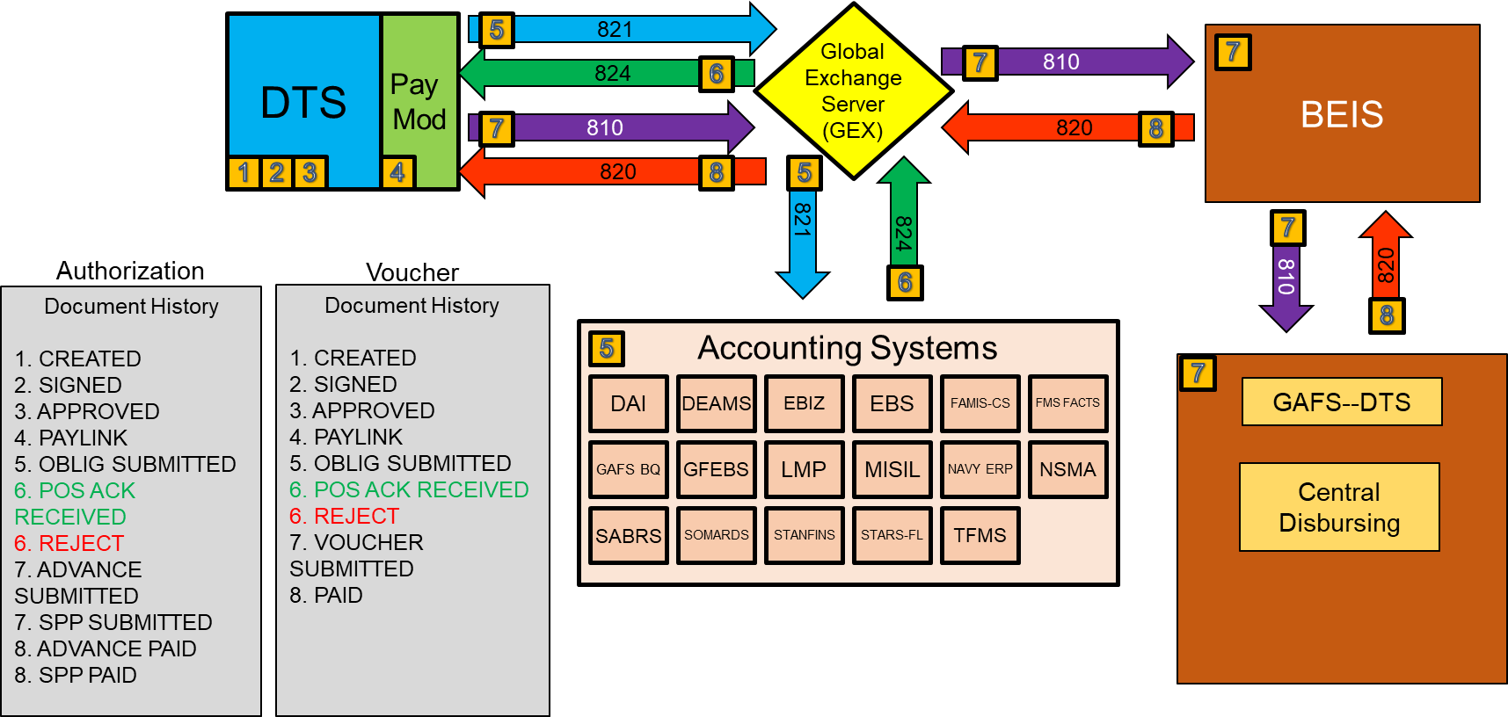
DTS Obligation and Payment Process

Slide 17
DTS Obligation and Payment Process
DTS interfaces with several different systems after documents are Approved.
Global Exchange Server (GEX)
Converts and sends obligations and payments to/from DTS.
Accounting System
Where obligations are made.
DTS interfaces with around 15 different Accounting Systems via the GEX.
BEIS, GAFS-BQ, Central Disbursing
This is where the Payments are made .

Slide 18
FY Crossover and Affected Partner Systems

Slide 19
What does this mean?
The Partner System is the Accounting System that DTS interfaces with.

Slide 20
What does this mean?
If a document contains an FY 24 Obligation, DTS will hold that obligation until the FY 24 Transaction Release Date.

Slide 21
What does this mean?
If an Accounting System is going to go down during the FY Crossover period, it will be listed here along with any notes.

Slide 22
What does this mean?
We’re going to focus on a single Accounting System (DEAMS) and show how 3 different documents will behave during the Fiscal Year Crossover period.

Slide 23
Document # 1
Travel Dates
September 9 – September 30th
Line(s) of Accounting
23 Travel
This document is strictly FY23 Travel.
It should not be delayed on the Authorization but may be delayed on the Voucher.
This will depend on the Accounting System and when the voucher is filed.
Not every Accounting System goes down during the FY Crossover Period.

Slide 24
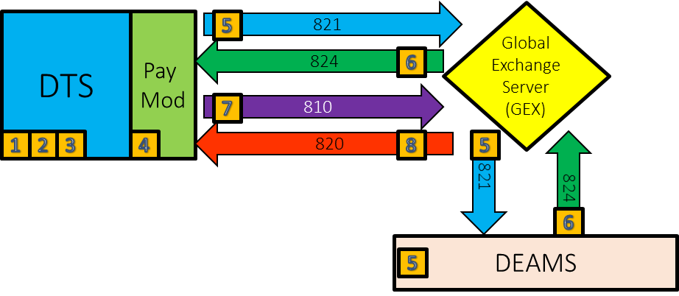
Document # 1 Processing
Date: September 6, 2023
Approximately 3 days before travel.
The authorization processes normally.
Authorization
Document History
1. CREATED
2. SIGNED
3. APPROVED
4. PAYLINK
5. OBLIG SUBMITTED
6. POS ACK RECEIVED

Slide 25
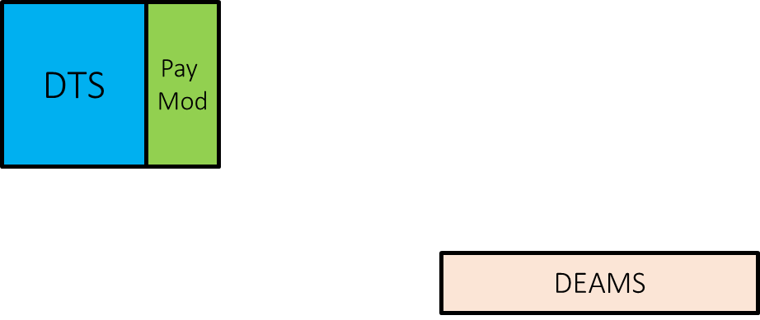
Document # 1 Processing
Date: September 30, 2023
The traveler comes back from their trip.
The Accounting System is still available to process any requests.

Slide 26
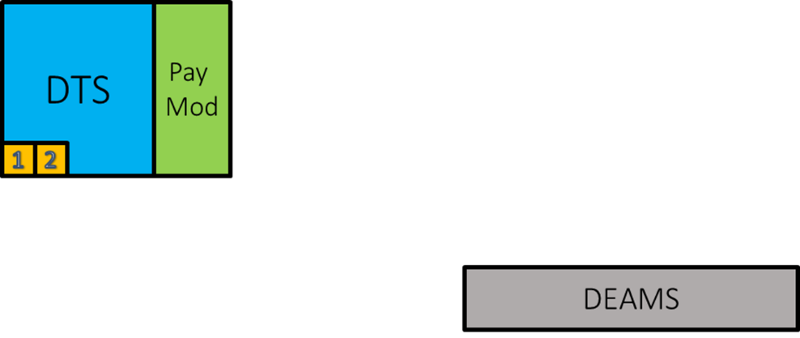
Document # 1 Processing
Date: October 2, 2023
The traveler has started their voucher, but it’s in the approval process and has yet to be approved.
The Accounting System goes down for maintenance.
Voucher
Document History
1. CREATED
2. SIGNED
3. APPROVED
4. PAYLINK
5. OBLIG SUBMITTED

Slide 27
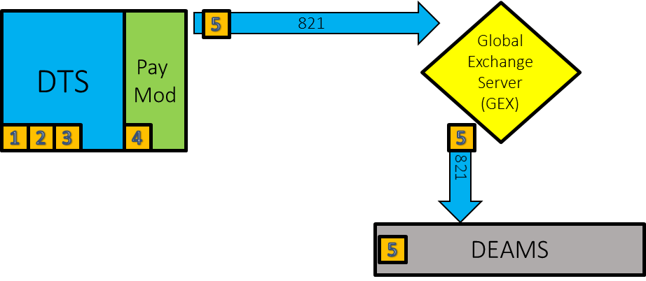
Document # 1 Processing
Date: October 3, 2023
Approximately 3 days after travel, the voucher is Approved.
The voucher still requires the obligation to be checked with the Accounting System.
The Accounting System is currently down, so it will display as OBLIG SUBMITTED until the Accounting System can process the Obligation.
It is not expected to be up until the 10th of October, so payment will be delayed.
Voucher
Document History
1. CREATED
2. SIGNED
3. APPROVED
4. PAYLINK
5. OBLIG SUBMITTED

Slide 28
Document # 2
Travel Dates
September 9 – October 19th
Line(s) of Accounting
23 Travel
24 Travel
This document crosses the fiscal year and contains both FY 23 and FY 24 Travel, thus requiring 2 LOAs.
It will be delayed on the Authorization but may not be delayed on the Voucher.
DTS will hold the FY 24 Obligation until the Transaction Release Date.
Depending on the status of the Accounting System, the voucher may or may not be delayed.

Slide 29
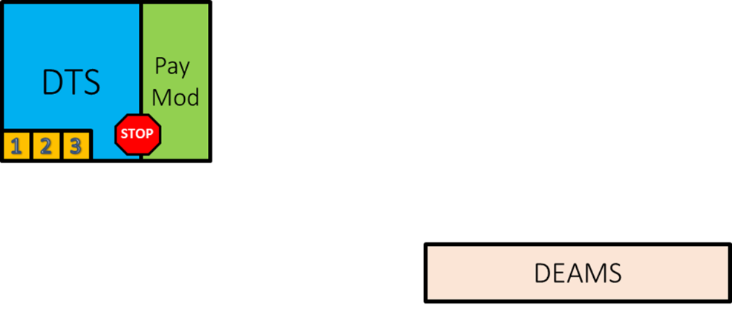
Document # 2 Processing
Date: September 6, 2023
Approximately 3 days before travel.
Because the document contains FY 24 Obligations, DTS will “hold” both the FY 23 and FY 24 obligations until it knows that the Accounting System is ready.
This can create a delay if the document contains any pre-voucher payments.
Authorization
Document History
1. CREATED
2. SIGNED
3. APPROVED

Slide 30
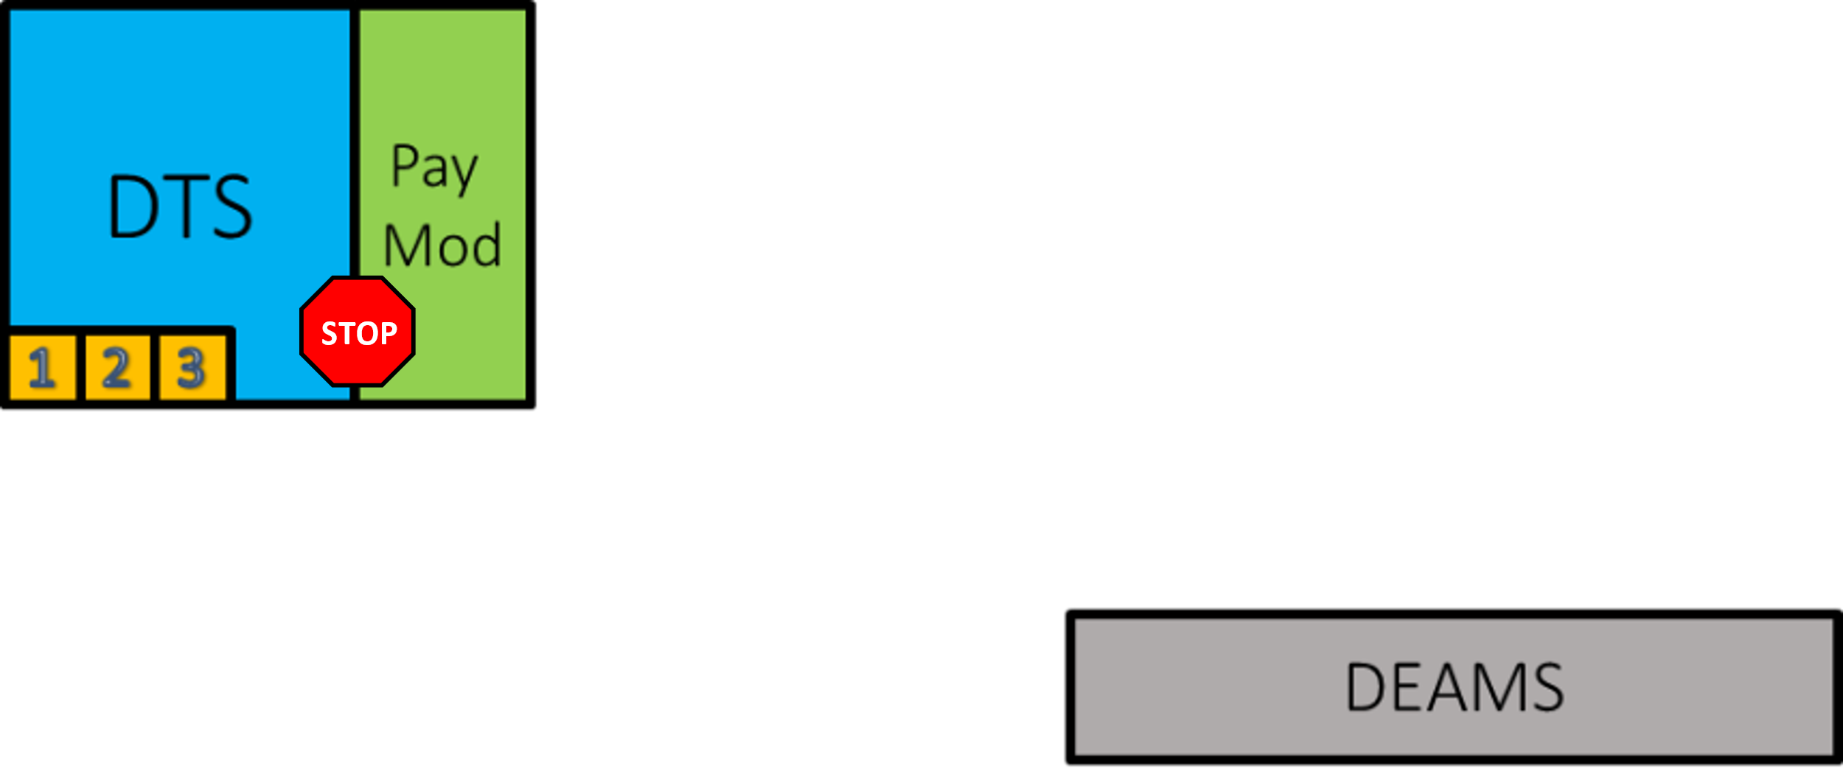
Document # 2 Processing
Date: October 2, 2023
Traveler is currently on travel.
The Accounting System goes down for Maintenance.
Authorization
Document History
1. CREATED
2. SIGNED
3. APPROVED

Slide 31
Document # 2 Processing
Date: October 10, 2023
Traveler is currently on travel.
The Accounting System comes back up and begins processing the transactions.
Because of the downtime, there is likely a backlog of obligations that need to be processed.
Authorization
Document History
1. CREATED
2. SIGNED
3. APPROVED

Slide 32
Document # 2 Processing
Date: October 11, 2023
Traveler is currently on travel.
The FY 24 Transaction Release Date hits and DTS sends the Obligation to the Accounting System.
There may be a delay in processing the requests, however, due to the number of obligations that have now been transmitted.
Authorization
Document History
1. CREATED
2. SIGNED
3. APPROVED
4. PAYLINK
5. OBLIG SUBMITTED

Slide 33
Document # 2 Processing
Date: October 16, 2023
Traveler is currently on travel.
The Accounting System has “caught up” and sent the Positive Acknowledgement back to DTS.
If the traveler had a pre-voucher payment (Advance on FY 23 LOA), it will now begin processing.
Authorization
Document History
1. CREATED
2. SIGNED
3. APPROVED
4. PAYLINK
5. OBLIG SUBMITTED
6. POS ACK RECEIVED

Slide 34
Document # 3
Travel Dates
October 11th – October 22nd
Line(s) of Accounting
24 Travel
This document is strictly FY 24 Travel.
It may be delayed on the Authorization but should not be delayed on the Voucher.
This will depend on the Accounting System and when the Authorization is filed.
Not every Accounting System goes down during the FY Crossover Period.

Slide 35
Document # 3 Processing
Date: September 25, 2023
Approximately 16 days before travel.
Because the document contains FY 24 Obligations, DTS will “hold” the FY 24 obligations until it knows that the Accounting System is ready.
Authorization
Document History
1. CREATED
2. SIGNED
3. APPROVED

Slide 36
Document # 3 Processing
Date: October 2, 2023
Approximately 9 days before travel.
The Accounting System goes down for Maintenance.
Authorization
Document History
1. CREATED
2. SIGNED
3. APPROVED

Slide 37
Document # 3 Processing
Date: October 10, 2023
Approximately 1 day before travel.
The Accounting System comes back up and begins processing transactions.
Because of the downtime, there is likely a backlog of obligations that need to be processed.
Authorization
Document History
1. CREATED
2. SIGNED
3. APPROVED

Slide 38
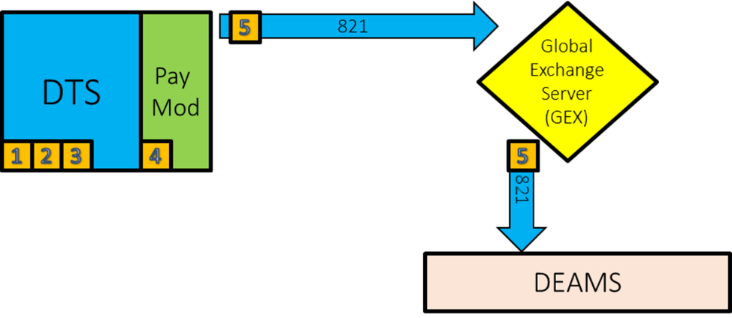
Document # 3 Processing
Date: October 11, 2023
Traveler begins their travel.
The FY 24 Transaction Release Date hits and DTS sends the Obligation to the Accounting System.
There may be a delay in processing the requests, however, due to the number of obligations that have now been transmitted.
Authorization
Document History
1. CREATED
2. SIGNED
3. APPROVED
4. PAYLINK
5. OBLIG SUBMITTED

Slide 39
Document # 3 Processing
Date: October 16, 2023
Traveler is currently on travel.
The Accounting System has “caught up” and sent the Positive Acknowledgement back to DTS.
If the traveler had a pre-voucher payment (Advance on FY 24 LOA), it will now begin processing.
Authorization
Document History
1. CREATED
2. SIGNED
3. APPROVED
4. PAYLINK
5. OBLIG SUBMITTED
6. POS ACK RECEIVED

Slide 40
Processing Documents for Next Fiscal Year
When it comes to processing documents for the next Fiscal Year, every organization has its own policy.
Please check with your Organization’s Local Business Rules and ensure you are following with their intention.

Slide 41
New Fiscal Year Travel
Create the travel authorization in DTS.
Complete the Itinerary
Make Travel Reservations
Enter the Expenses for the Trip
If the LOA for the next fiscal year is available, select it in the Accounting section.
If a new fiscal year LOA is not available, then leave the LOA selection blank

Slide 42
New Fiscal Year Travel
If the LOA for the next fiscal year is available, select it in the Accounting section.

Slide 43
New Fiscal Year Travel
Leaving the LOA selection blank is also acceptable in this situation.
When the authorization is signed, DTS will trigger the following advisory: NO ACCT CODE ASSIGNED

Slide 44
New Fiscal Year Travel
Go to the Preview Trip Screen.
Complete the Comments to the AO field with text like – Travel is for next fiscal year.

Slide 45
New Fiscal Year Travel
Proceed to the Digital Signature screen to sign the document.
After the document is signed, the Travel Management Company (TMC) will confirm the travel reservation(s) and the normal routing process continues.

Slide 46
Approving an Authorization When New Fiscal Year Funding Is Available
The Approving Official (AO) will hold the document for approval until notified new fiscal year funding is loaded in DTS.
When new fiscal year funding becomes available, the FDTA/BDTA will load new LOA(s) and budget items(s) in DTS.
The AO approves the authorization in DTS after new fiscal year LOAs and budget are loaded, even if the accounting system is not ready to process transactions.

Slide 47
Trips Departing Before New Fiscal Year Funding is Available
If the new funding is not available before a trip’s start date, a traveler may need to depart before the authorization is approved.
This may occur because the LOA rollover and budget modules updates cannot be made in time.
The DTA should establish procedures in advance with the TO and the TMC facilitate this situation.
Depending on the organization’s local business rules and the TMC contract, verbal approval can be given to travel, and the TMC tickets the trip based on instructions from the TO or other designated official.

Slide 48
Cross-Fiscal Year Travel
Due to the changes in document processing, organizations have their own local business rules for how to process documents that cross the fiscal year.
The following slides depict how the process is laid out in the guide on the DTMO website.
https://media.defense.gov/2022/May/12/2002995650/-1/-1/1/PROCESSING_AUTHORIZATIONS_FOR_THE_NEW_YEAR.PDF
Please consult your local business rules for processing documents that cross the fiscal year.

Slide 49
Cross-Fiscal Year Travel
Create the travel authorization in DTS.
Complete the Itinerary.
This trip begins in 2023 and ends in 2024.

Slide 50
Cross-Fiscal Year Travel
Make Travel Reservations for the entire trip.

Slide 51
Cross-Fiscal Year Travel
Enter the Expenses with the appropriate dates or date ranges for the trip.
Some expenses will require a start and end date so that they can be allocated properly.

Slide 52
If New Fiscal Year LOA is Available
If the LOA for the next fiscal year is available, then add the new fiscal year LOA.

Slide 53
If New Fiscal Year LOA is Available
DTS will ask if the user would like to automatically allocate the expenses using FY Auto.

Slide 54
If New Fiscal Year LOA is Available
Depending on the dates input for certain expenses, DTS will divide them up between each fiscal year.
DTS will allocate each ticketed transportation expense to the LOA(s) for the fiscal year in which the expense is ticketed.
If the return flight is in the new fiscal year, but is ticketed using the current fiscal year LOA, it will be charged against the current fiscal year LOA.

Slide 55
If New Fiscal Year LOA is Available
The document can then be SIGNED and stamped APPROVED by the AO.

Slide 56
If New Fiscal Year LOA is Not Available
After booking the reservations, the itinerary will need to be modified to allow the document to process.

Slide 57
If New Fiscal Year LOA is Not Available
Change the Departure Date to 09/30/2023.
Change the Returning On Date to 09/30/2023.

Slide 58
If New Fiscal Year LOA is Not Available
The document can then be SIGNED and stamped APPROVED by the AO.
The document will now be processed using the FY 23 funds only.

Slide 59
Creating an Amendment for the Trip Portion that Occurs in a New Fiscal Year
When the funding becomes available, the trip can be amended.
The new fiscal year LOA can be added to the Authorization.
The Overall End Point and Return Date can be modified as well.
Keep in mind that this will reset the Per Diem Entitlements.

Slide 60
Creating an Amendment for the Trip Portion that Occurs in a New Fiscal Year
If a trip includes scheduled partial payments (SPPs), when the amendment is created, the SPPs will have to be rescheduled.
The SPPs will process normally once the amendment is approved.
If a payment is scheduled during the accounting system shutdown period, it will be processed as soon as the amendment receives the POS ACK RECEIVED stamp.

Slide 61
Advances and Scheduled Partial Payments
Because of accounting system shutdown, it is necessary to give careful consideration when requesting advances and scheduled partial payments (SPPs) during the new fiscal year transition period.
It is important to know that authorizations can be approved during the shutdown, but disbursements will be held until the accounting system restarts.

Slide 62
Advances and Scheduled Partial Payments
As the departure date approaches 30 September, the amount of the advance is reduced because it is calculated on the reimbursable costs through 30 September.
Because Advances are calculated based upon Lines of Accounting.
The fewer days left in 2023, the lower the amounts will be.
Travelers departing later in September should obtain a GTCC, and the AO, and DTA should closely monitor the shutdown process and, as soon as possible, have the current fiscal year amendment approved and processed.

Slide 63
Delays with Pre-Voucher Payments New Fiscal Year Trips
Advances may be delayed due to the FY Transaction Release Date and Accounting System shutdown period.
Scheduled Partial Payments will not be delayed.

Slide 64
Delays with Pre-Voucher Payments Cross-Fiscal Year Trips
Advances should be requested at least five days prior to the Accounting System shutdown period.
Advances on current FY LOA should not be delayed.
Advances split between current and next FY LOA may be delayed.
Scheduled Partial Payments may be delayed due to the Accounting System shutdown period.

Slide 65
Resources
Excellence in Practice Award Nominations
https://www.travel.dod.mil/about/news/article/article/3000711/nominations-open-for-excellence-in-practice-awards/
Managing Installation Name Changes in DTS
https://www.travel.dod.mil/About/News/Article/Article/3503553/managing-installation-name-changes-in-dts/
DoD to Change the Name of Nine Army Installations by 2024
https://www.travel.dod.mil/About/News/Article/Article/3362393/dod-to-change-the-name-of-nine-army-installations-by-2024/

Slide 66
Resources (cont.)
Fiscal Year Crossover
https://www.travel.dod.mil/Programs/DoD-Travel-Systems/Fiscal-Year-Crossover/
Affected Partner Systems and Downtimes
https://media.defense.gov/2022/Jun/21/2003021205/-1/-1/0/Accounting_System_Downtime.PDF
DTS Guide to Establishing Lines of Accounting (LOAs) and Budgets for the New Fiscal Year
https://media.defense.gov/2022/May/12/2002995654/-1/-1/1/ESTABLISH_LOAS_FOR_THE_NEW_YEAR.PDF

Slide 67
Resources (cont.)
DTS Guide to Processing Authorizations for the New Fiscal Year
https://media.defense.gov/2022/May/12/2002995650/-1/-1/1/PROCESSING_AUTHORIZATIONS_FOR_THE_NEW_YEAR.PDF
You can contact the Travel Assistance Center (TAC) via:
Phone 888-Help1Go (888-435-7146)
Web (https://www.defensetravel.dod.mil/passport/)
Chat (Available Monday – Friday between 8am and 6pm ET)
The slides for this presentation, as well as previous Outreach presentations, can be found on the DTMO Website at:
https://www.travel.dod.mil/Support/Travel-Assistance-Center/TAC-Outreach

Slide 68
Questions
Questions are taken by Site Name in alphabetical order
A – E (Example – Dyess Air Force Base)
F – L (Example – Fort Huachuca)
M – S (Example – Redstone Arsenal)
T – Z (Example – Yuma Proving Ground)
If using your telephone to dial in, you can press *6 to unmute yourself to ask a question.
Please be considerate and mute your phone if you are not talking by pressing *6 again.

