Slide 1
Welcome to the TAC Outreach Call
Presenter(s) – Dan Greene Larry Cox – Jason Prado Tisha Braun
Date – May 24, 2022
Topic – Post Pay Review & Analysis
The presentation will begin shortly
Audio is available through ZoomGov or using the telephone number(s) below.
Location | Phone Number
United States | 551 285 1373
United States (San Jose) | 669 254 5252
United States (New York) | 646 828 7666
United States (Toll Free) | 833 568 8864
If you are dialing internationally, find your phone number at https://zoomgov.com/u/absGdkJ9AD
Meeting ID - 161 892 0052

Slide 2
TAC Outreach Call Post Pay Review & Analysis
Dan Greene – TAC Outreach Call Coordinator
Jason Prado – TAC Manager
Larry Cox – DFAS
Tisha Braun - DFAS
May 24, 2022

Slide 3
Top Issues for May
Internet Explorer No Longer Supported by DTS
Post Pay Review & Analysis
PPR&A’s Role
Travel Pay – Dec Error Rates
Examples of Invalid Receipts
Resources
Questions

Slide 4
Top Issues for May
Issue # | Summary | Workaround | Release
PPT | Unable to edit a CTO Amendment with two PNRs and document has NOT been signed but has adjusted stamps. | Both PNRs must be placed on the Outbound queue for the document to update properly. Please contact the TAC for further assistance.
DTS-20052 | Authorization stuck at CTO SUBMIT due to unconfirmed segments in the Passenger Name Record (PNR). | Please contact the TAC anytime an authorization has been stuck at CTO SUBMIT for more than one business day. The TAC can see both DTS and the Global Distribution System (GDS). If the unconfirmed segments are in the active portion of the PNR the TMC needs to fix those for them to sweep. | Ready For Assignment
DTS-21384 | Initiating Payroll Collection causes an error “Unable to process your request for the following reason”. | This issue was resolved May 13, 2022. | FY22-May DMM CBA Update
DTS-1842 | Authorization stuck at CTO SUBMIT for unknown reasons. We have attempted to push these documents multiple times, but unfortunately, they will not update. | Please contact the TAC anytime an authorization has been stuck at CTO SUBMIT for more than one business day. The TAC can see both DTS and the Global Distribution System (GDS). These documents must be manually abandoned. | Ready For Assignment
DTS-15645 | Travelers are receiving “Error Message: An Error has Occurred. We are encountering an issue with our partner system. Please try again in a few minutes.” When trying to book reservations. | There are a few reasons as to why this issue can occur. Please contact the TAC for guidance on how to resolve this issue. | Ready For Assignment

Slide 5
Internet Explorer No Longer Supported by DTS
As of May 28, 2022, Microsoft is ending all support for Internet Explorer.
For both sustainment and security purposes, Internet Explorer will no longer be a supported browser for DTS.
DTS can still be accessed using Microsoft Edge, Google Chrome, Mozilla Firefox, and Safari browsers.

Slide 6
PIIA Travel Pay Program
Defense Finance and Accounting Service
Post Pay Review & Analysis
Larry Cox
Tisha Braun

Slide 7
PPR&A’s Role
Conduct improper payment (IP) reviews under the Payment Integrity Information Act (PIIA) to identify, estimate, and report IPs for: Military Pay, Civilian Pay, Military Retirement Pay, Travel Pay, and Commercial Pay
Conduct trend analysis to assist Services and Defense Agencies with identifying avenues to target for improvement.
Assist OSD with reporting results in annual Agency Financial Report (AFR)

Slide 8
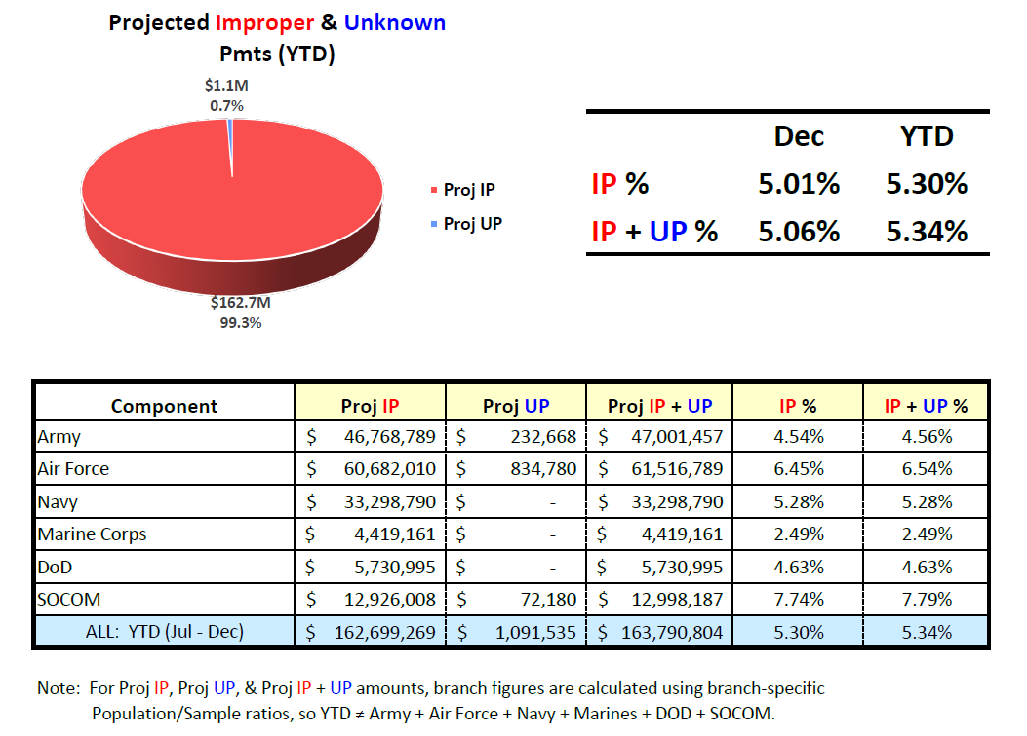
Travel Pay – Dec Error Rates
Target for FY 22: 3.48%

Slide 9
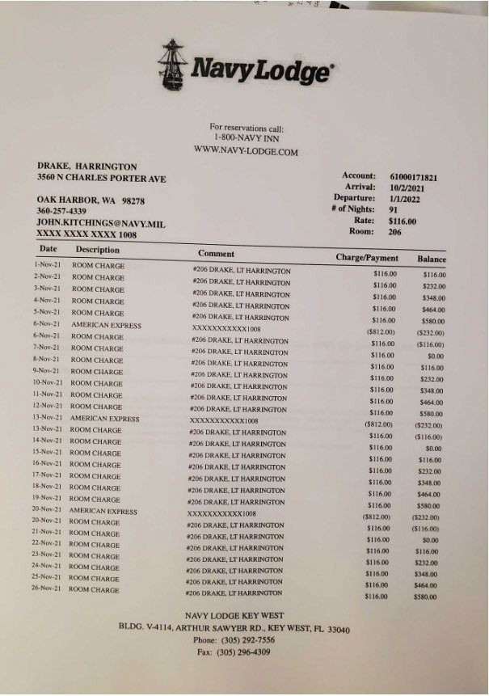
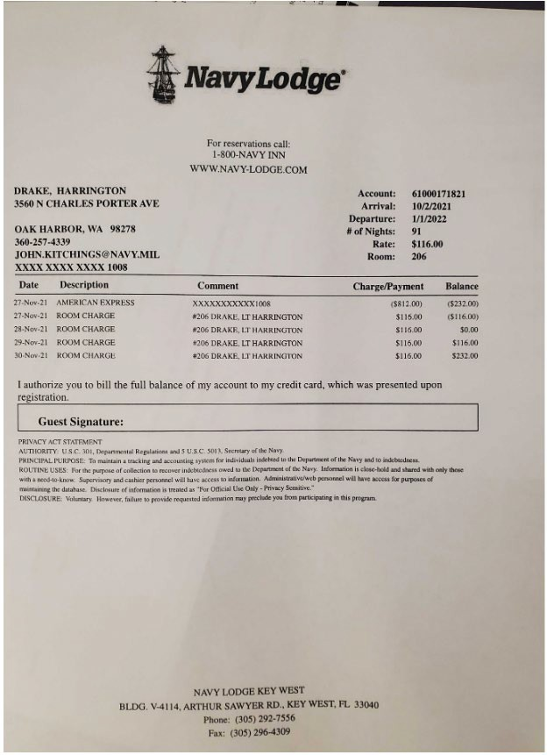
Invalid Lodging Receipt – Example 1
Receipt provided shows a balance due.

Slide 10
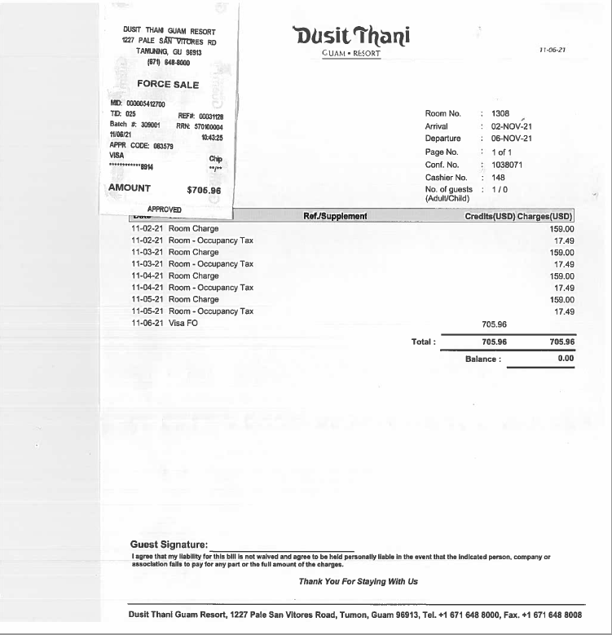
Invalid Lodging Receipt – Example 2
Charge slip is covering name of traveler.

Slide 11
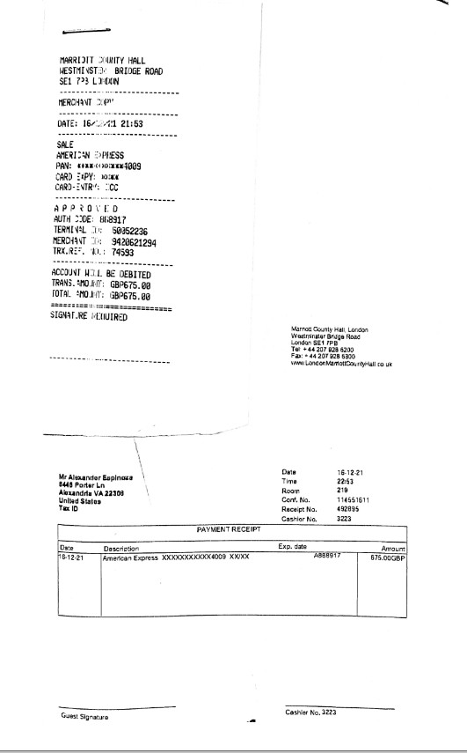
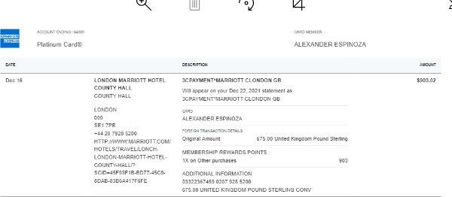
Invalid Lodging Receipt – Example 3
Lodging receipt does not show the daily itemized charges.

Slide 12
Invalid Rental Car Receipt – Example 1
Receipt provided was blank with no information.

Slide 13
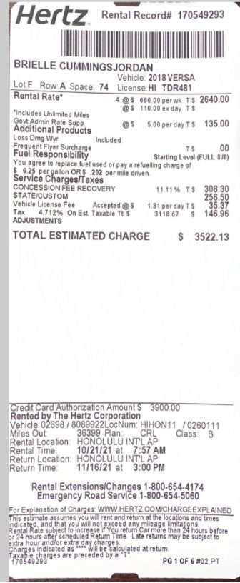
Invalid Rental Car Receipt – Example 2
Receipt only shows estimated not the actual charges.

Slide 14
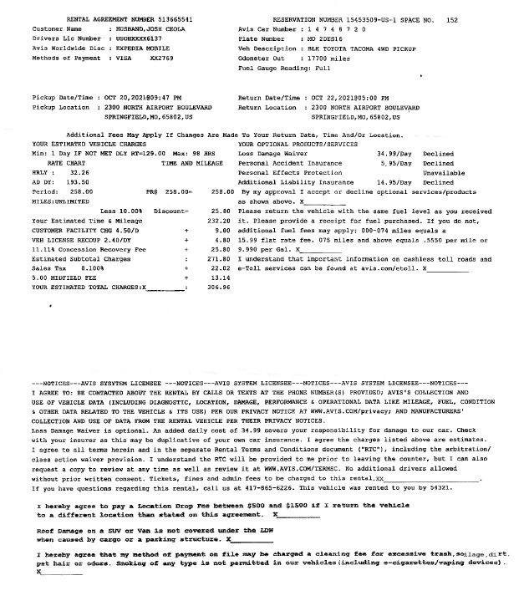
Invalid Rental Car Receipt – Example 3
Only rental agreement with estimated charges provided.

Slide 15
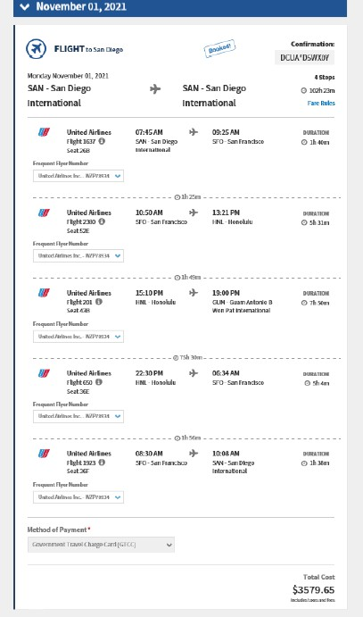
Invalid Airfare Receipt – Example 1
No Airfare receipt provided just the DTS screenshot.

Slide 16
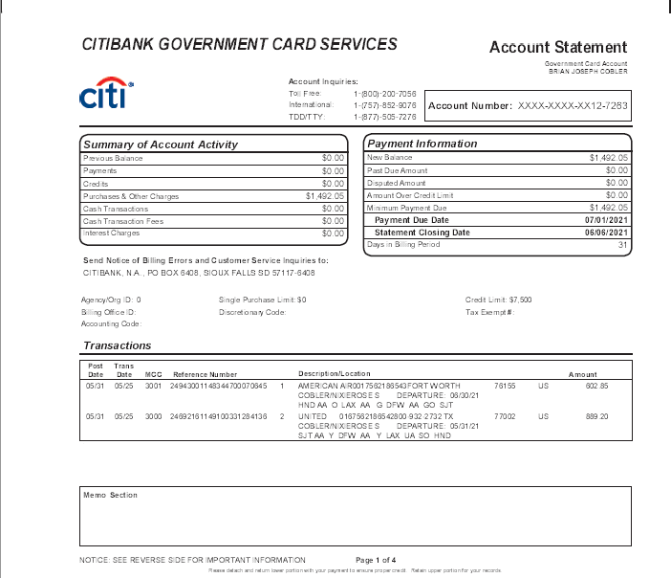
Invalid Airfare Receipt – Example 2
Only the credit card statement provided for the airfare expense.

Slide 17
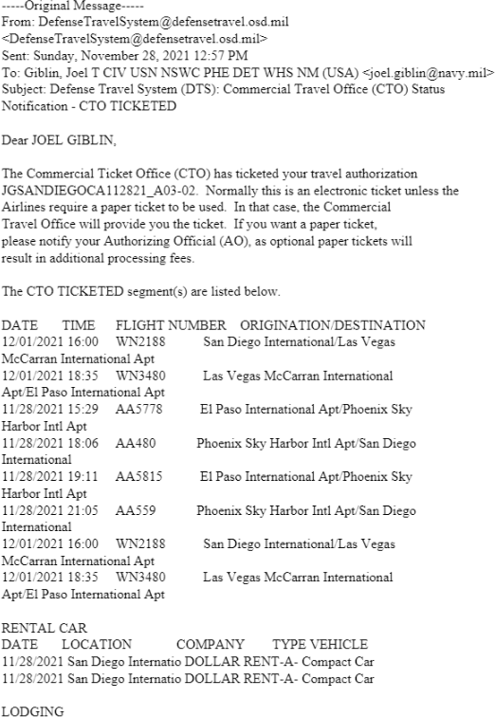
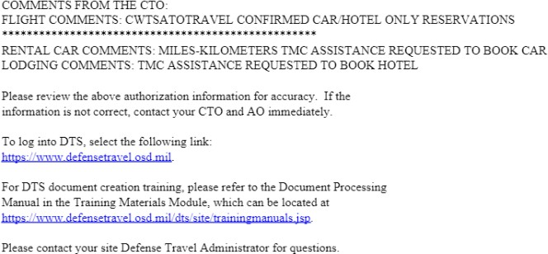
Invalid Airfare Receipt – Example 3
Document provided is not an airfare receipt but rather the reservation confirmations in DTS.

Slide 18
Questions
For any questions on the
Post Pay Review & Analysis
presentation, please reach out to:
Larry Cox – larry.e.cox.civ@mail.mil
Tisha Braun - tisha.m.braun.civ@mail.mil

Slide 19
Resources
Joint Travel Regulations
http://www.defensetravel.dod.mil/Docs/perdiem/JTR.pdf
DoD Financial Management Regulations Volume 9
https://comptroller.defense.gov/Portals/45/documents/fmr/Volume_09.pdf
DoD Instruction 5154.31
https://www.defensetravel.dod.mil/site/dodi5154.cfm
DFAS Lost Receipts Forms
STATEMENT IN LIEU OF ACTUAL RECEIPTS - https://www.dfas.mil/Portals/98/Statement%20in%20Lieu%20of%20Actual%20Receipts.pdf
STATEMENT IN LIEU OF ACCEPTABLE LODGING RECEIPT - https://www.dfas.mil/Portals/98/Statment_in_Lieu_of_Lodging_1.pdf
You can contact the Travel Assistance Center (TAC) via:
Phone 888-Help1Go (888-435-7146)
Web (https://www.defensetravel.dod.mil/passport/)
Chat (Available Monday – Friday between 8am and 6pm ET)

Slide 20
Questions
Questions are taken via Telephone by Site Name in alphabetical order
A – E (Example – Dyess Air Force Base)
F – L (Example – Fort Huachuca)
M – S (Example – Redstone Arsenal)
T – Z (Example – Yuma Proving Ground)
You can press *6 to unmute your phone’s line to ask a question.
Please be considerate and mute your phone if you are not talking by pressing *6.

