Slide 1
Welcome to the TAC Outreach Call
Presenter(s) – Dan Greene
– Jason Prado
Date – January 11, 2022
Topic – Trip Cancel
The presentation will begin shortly
Audio is available through ZoomGov and Telephone.
Phone Number – 703-679-6200
Conference Call ID – 8210518109
Participant Pin – HELP1GO (4357146)

Slide 2
TAC Outreach Call
Trip Cancel
Dan Greene – TAC Outreach Call Coordinator
Jason Prado – TAC Manager
January 11, 2022

Slide 3
Top Issues for December/January
GSA State Tax Exempt List Link Not Working
New TAC Callback Functionality
Trip Cancel
  Removing An Authorization
  Cancelling An Authorization
    With No Expenses
    With Expenses
  Hotel Reservations and Cancellations
  Common Issues and Misconceptions
Resources
Questions

Slide 4
Top Issues for December/January
Issue # | Summary | Workaround | Release
PPT | Unable to edit a CTO Amendment with two PNRs and document has NOT been signed but has adjusted stamps. | Both PNRs must be placed on the Outbound queue for the document to update properly. Please contact the TAC for further assistance.
DTS-15645 | Travelers are receiving “Error Message: An Error has Occurred. We are encountering an issue with our partner system. Please try again in a few minutes.” When trying to book reservations. | There are a few reasons as to why this issue can occur. Please contact the TAC for guidance on how to resolve this issue. | Ready For Assignment
DTS-20052 | Authorization stuck at CTO SUBMIT due to unconfirmed segments in the Passenger Name Record (PNR). | Please contact the TAC anytime an authorization has been stuck at CTO SUBMIT for more than one business day. The TAC can see both DTS and the Global Distribution System (GDS). | Ready For Assignment
PPT | Unable to approve- Error Message: System Errorcom.ngc.dts.exceptions.DTSException: com.ngc.dts.exceptions.DTSException: Error processing GDS command. Please retry in a few minutes. | This is being seen with documents when travel is within 72 business hours and the traveler is attached to a TMC that is OCONUS. The only known work around at this time is work with the TMC to get ticketing done outside of DTS and to try and approved after trip is complete. Please note requesting TMC assistance may result in a higher fee being charged.
DAI Migration for USMC Organizations | Vouchers rejecting in SABRS for USMC organizations that migrated to DAI will not be able to fix the reject. This is not a DTS Issue. | The TAC will escalate to have the documents manually abandoned.

Slide 5
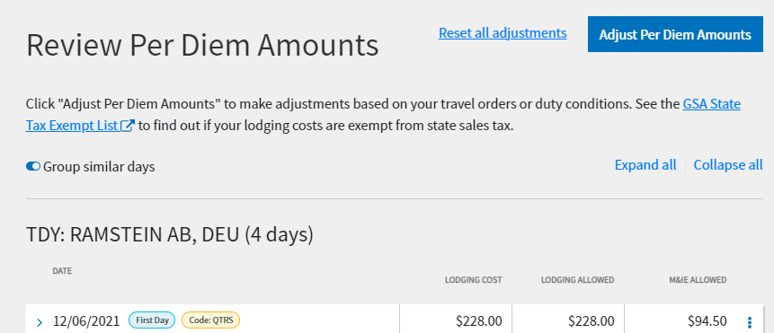
GSA State Tax Exempt List Link Not Working
The GSA State Tax Exempt List link on the Per Diem page is currently not working.
  An error is received when accessing the site.

Slide 6
GSA State Tax Exempt List Link Not Working (cont.)
This is not a DTS issue.
  Due to recent security updates, the GSA SmartPay website and its training site are currently unavailable.
We have been notified that the downtime could be several months.
  As soon as we know that GSA has fixed this issue, we will send out notifications.
In the meantime, travelers should consult with their Defense Travel Administrator (DTA) for further guidance on being reimbursed for lodging taxes in tax-exempt states that require the form.

Slide 7
New TAC Callback Functionality
The TAC plans to provide the option for callbacks on January 17, 2022!
Rather than remain on the line while on hold, this new feature will allow callers to leave a callback number. Once their place in line is reached, the system will call them back and place them directly with an analyst.
During its initial launch, the callback feature may be unavailable at certain times (such as lower levels of call volume) while we continue to fine-tune it.

Slide 8
New TAC Callback Functionality (cont.)
Some notes about the callback feature:
  The system will only attempt to call the customer back one time.
    If the caller can not be reached (such as no answer, phone number is incorrect, caller’s phone is busy, etc), the system will not make another attempt.
  Calling back to cancel your callback and choosing to instead wait on hold will move you to the end of the line.

Slide 9
Cancelling Trips in DTS
If an authorization was created in DTS, but the trip was not taken, then the document still needs to be closed out.
Documents that have not been closed out can cause multiple issues for the traveler and/or their organization.
There are many factors that will affect “how” the document is closed out.
  The Authorization may need to be removed.
  The Authorization may need to be cancelled.
  The Authorization may need to have a Voucher created and submitted.

Slide 10
Cancelling Trips in DTS
The required actions taken will depend on:
  What is the current or past statuses of the document?
    Was it Signed?
    Was it Approved?
  Were tickets ever issued?
  Did the document contain reservations at any point?
  Is the traveler owed any money?
  Is the Government owed any money?

Slide 11
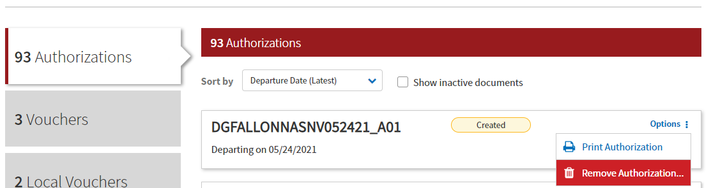
Removing an Authorization
If the document has been CREATED, but never SIGNED, then the document should be removed.
From the DTS Traveler Dashboard, select “Options > Remove Authorization”.

Slide 12
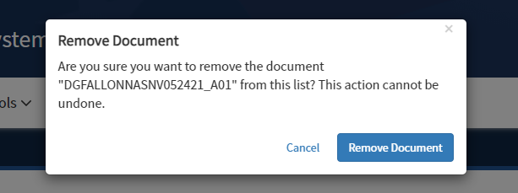
Removing an Authorization (cont.)
You will get prompted to confirm the removal of the document.
If you made no reservations, DTS deletes the authorization.

Slide 13
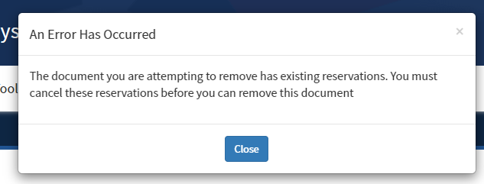
Unable to Remove Authorization
If you have made reservations, you will NOT be able to remove the document until the reservations have been deleted from the document.

Slide 14
Removing Authorization with Active Reservations
Active Reservations are reservations that are still being held by the vendor.
  These are normally reservations that will take place in the future.
If the reservations are still active in the document:
  Select Edit next to the affected authorization.
  Navigate to the DTS Reservations module and cancel all reservations.
  Return to the DTS Dashboard and select Remove Authorization again.
Always contact the vendor (e.g. airline, hotel, rental car company) to ensure all your reservations are fully cancelled to avoid incurring additional charges or fees.

Slide 15
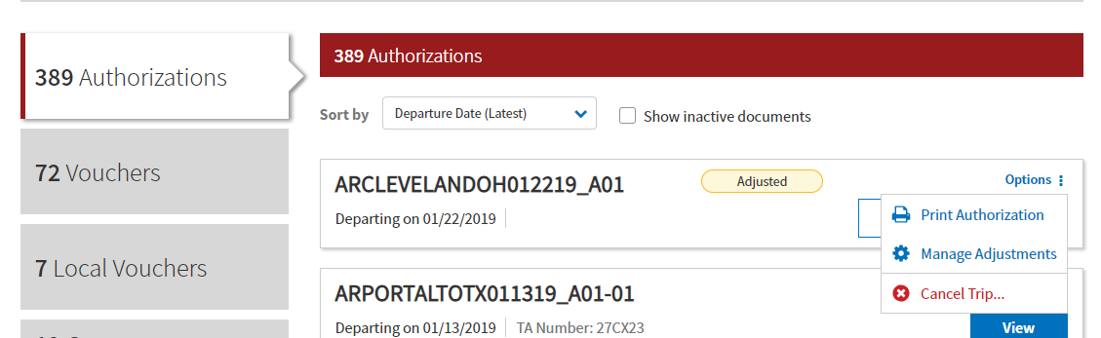
Cancelling a Trip
DTS has an automated Trip Cancel process that allows for:
  Reservations to be cancelled automatically by DTS.
  Existing expenses in the document to be handled properly.
  Documents to route differently.
  De-Obligations to be performed.

Slide 16
Cancelling a Trip - Options
There are two ways to Cancel a Trip in DTS:
  No Expenses were incurred
  Expenses were incurred or the traveler received a non-ATM advance or scheduled partial payment
DTS will not always present the user with this pop-up.
  If the DTS can determine how your
  document should be cancelled; it will choose one of these two options automatically.

Slide 17
Cancelling a Trip – No Expenses were Incurred
No expenses were incurred by the traveler.
  DTS realizes that there is no voucher is required for reimbursement.
Voucher can no longer be created from the Authorization.
Routing for the document is altered to only allow the SIGNED, RETURNED, or CANCELLED stamp.
  The document can no longer be stamped APPROVED.
Expenses do not need to be removed from the document.
The CANCELLED stamp is the final stamp on this document.

Slide 18
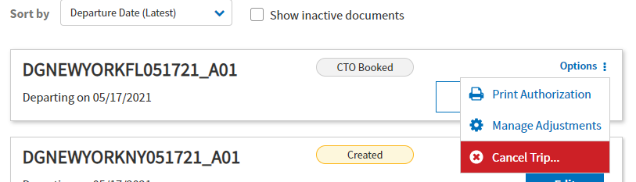
Cancelling a Trip – No Expenses were Incurred
The Trip Cancel process can begin by pressing “Options”, then “Cancel Trip…”.

Slide 19
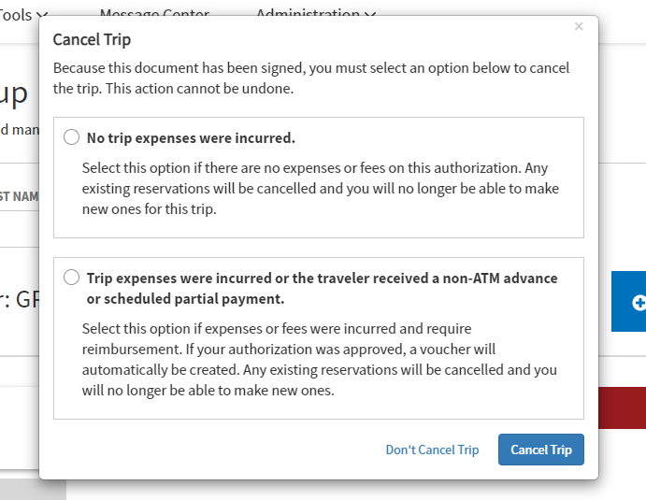
Cancelling a Trip – No Expenses were Incurred
If the traveler did not incur any expenses, “No trip expenses were incurred” should be selected, then “Cancel Trip”.

Slide 20
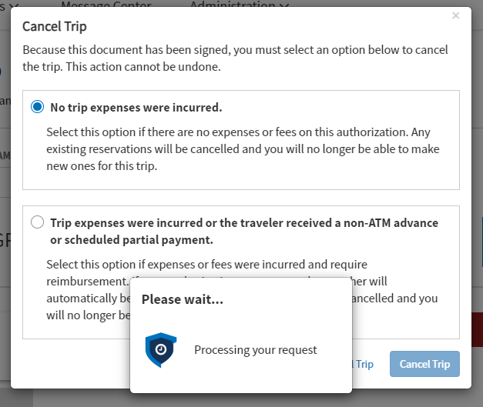
Cancelling a Trip – No Expenses were Incurred
Upon hitting “Cancel Trip”, DTS has begun the trip cancel process.
There is no way to stop this process once it has begun and it cannot be undone.

Slide 21
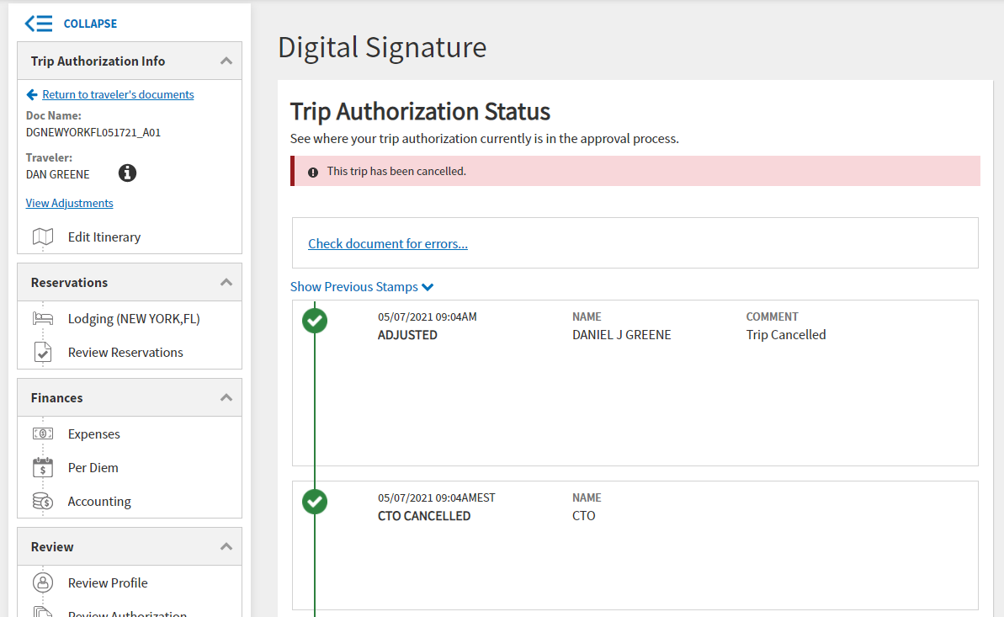
Cancelling a Trip – No Expenses were Incurred
The user will be brought to the Digital Signature of the Authorization.
DTS has placed a banner at the top and cancelled the reservations.

Slide 22
Cancelling a Trip – No Expenses were Incurred
Be careful on the Digital Signature screen because the traveler will be “bumped back” to Pre-Audits.
  If this happens, the traveler must access the Sign and Submit page again and attempt the signature afterwards.
At this point, the traveler needs to apply the SIGNED stamp so the document can route to the AO for cancellation.
The Approving Official is the only person who can stamp the authorization CANCELLED.
Any previously approved obligations will de-obligate once the CANCELLED stamp is applied.

Slide 23
Cancelling a Trip – Expenses were Incurred
If you incurred any expenses (e.g., TMC fee) or earned any allowances, you must file a voucher to claim them.
  DTS realizes that reimbursement will need to be made, so the goal is to create a voucher as soon as possible.
For documents that were currently in the routing process, DTS will prevent the CANCELLED stamp from appearing.
  Authorization needs to be APPROVED, so a voucher can be created and processed.
  After the AO approves the authorization, the user can create and submit a voucher following the usual voucher process to receive reimbursement for expenses incurred for the cancelled trip.

Slide 24
Cancelling a Trip – Expenses were Incurred (cont.)
For documents that have been APPROVED and are not currently routing, DTS will:
  Amend the document.
  Cancel any existing reservations through the reservation module.
  Auto-approve the authorization.
  Create a voucher.
  Zero out all expenses (including per diem entitlements) except for TMC Fees.
For this trip cancellation method, the final step is to stamp the voucher APPROVED.
  The APPROVED stamp begins the de-obligation process for any previous obligations.

Slide 25
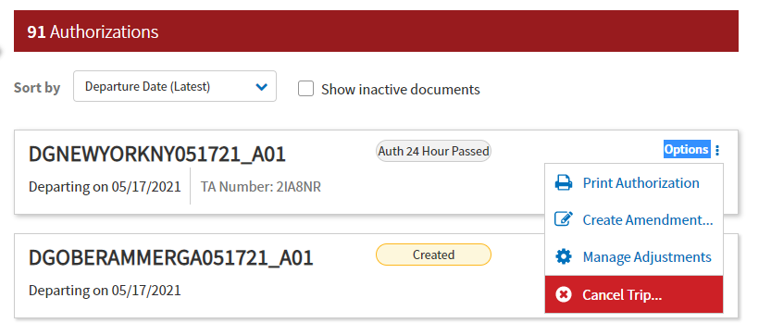
Cancelling a Trip – Expenses were Incurred
The Trip Cancel process can begin by pressing “Options”, then “Cancel Trip…”.

Slide 26
Cancelling a Trip – Expenses were Incurred
If the traveler incurred any expenses, “Trip expenses were incurred or the traveler received a non-ATM advance or scheduled partial payment” should be selected, then “Cancel Trip”.

Slide 27
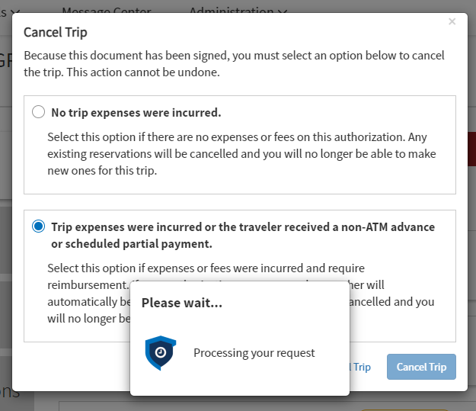
Cancelling a Trip – Expenses were Incurred
Upon hitting “Cancel Trip”, DTS has begun the trip cancel process.
There is no way to stop this process once it has begun and it cannot be undone.

Slide 28
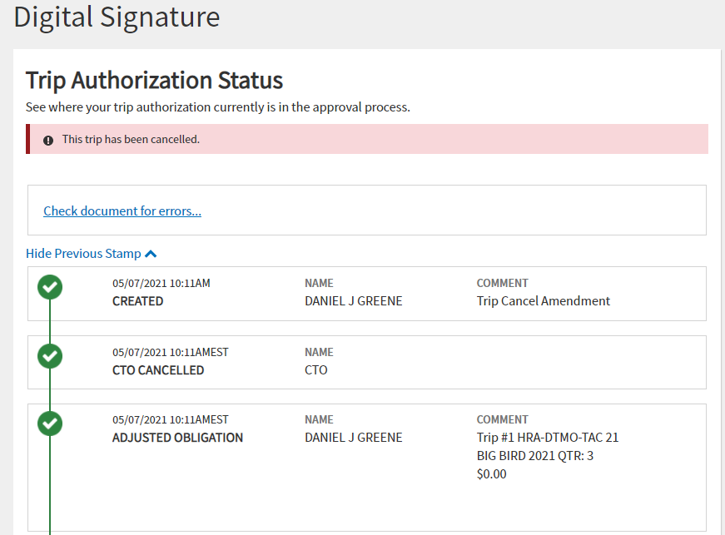
Cancelling a Trip – Expenses were Incurred
On the authorization, some steps occur automatically to get the traveler to the voucher.
An amendment is created, the reservations are cancelled, and the authorization is stamped APPROVED.

Slide 29
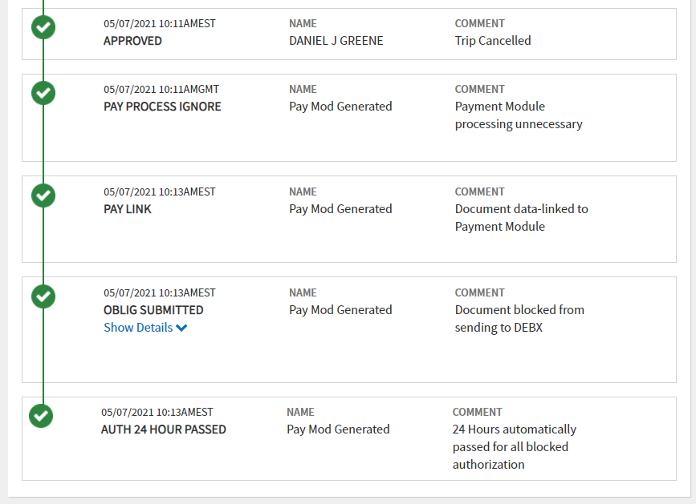
Cancelling a Trip – Expenses were Incurred
After approval, the document goes PAY PROCESS IGNORE to skip any changes to the obligation of funds for this trip on the authorization.
All of this happens immediately after hitting “Cancel Trip”.

Slide 30
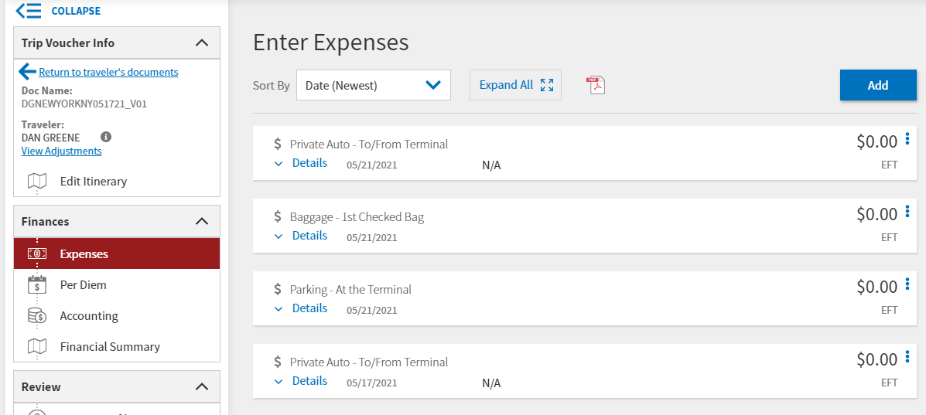
Cancelling a Trip – Expenses were Incurred
The first thing the user will see after hitting “Cancel Trip” is the Expenses section of the Voucher.

Slide 31
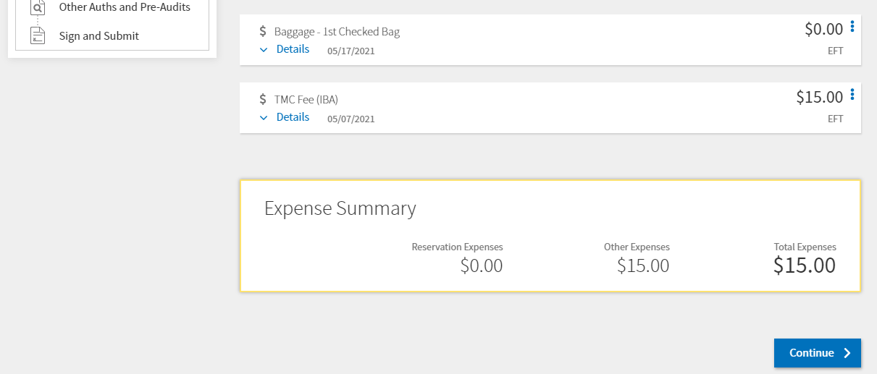
Cancelling a Trip – Expenses were Incurred
All expenses except TMC related fees will be zeroed out automatically.

Slide 32
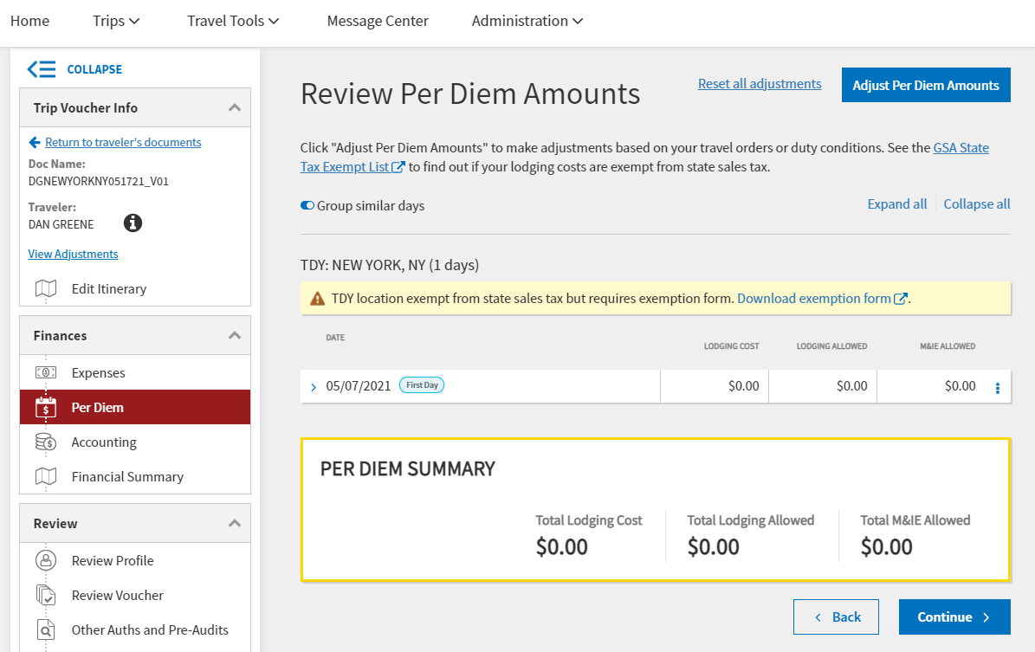
Cancelling a Trip – Expenses were Incurred
DTS also zeroes out any per diem entitlements.

Slide 33
How to determine if the Trip Cancel process was started
Whenever a document has been trip cancelled via DTS Trip Cancel functionality, a banner will appear on every version of the document under the Digital Signature (Sign and Submit) page.

Slide 34
Hotel Reservations
You should always cancel hotel reservations as soon as you know that travel is no longer required, especially when within 24 to 48 hours of departure to avoid hotel cancellation or no-show fees.
Even if the authorization is unsigned with “reserved” reservations, you can still incur fees.
  A common misconception is that since you did not sign the document, the reservations were not officially booked.
Be sure to follow the cancellation process in DTS and obtain cancellation confirmation numbers.
  Always, follow up with the vendor to ensure reservations fully cancel.

Slide 35
Hotel Cancellations
When a hotel is selected in DTS, the reservation is confirmed and guaranteed for late arrival if the traveler has a GTCC or provides a personal credit card number.
Each hotel or hotel chain has its own cancellation and no-show policy.
Travelers must ensure that their hotel reservations are actually cancelled before the cancellation deadline to avoid paying a no-show charge.

Slide 36
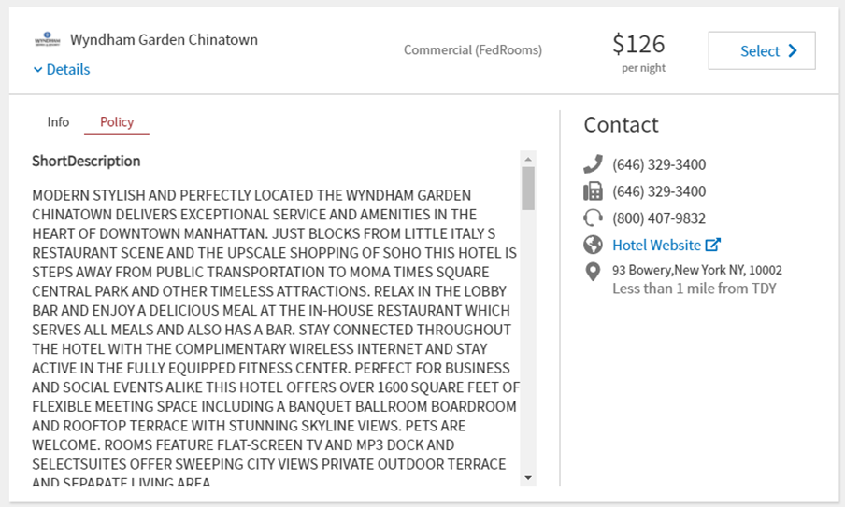
Hotel Cancellations
Travelers should utilize the Details drop-down to see the cancellation policy for a particular hotel prior to booking.

Slide 37
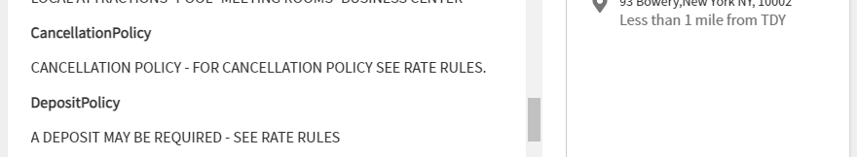
Hotel Cancellations
Some cancellation policies will refer to the “Rate Rules.

Slide 38
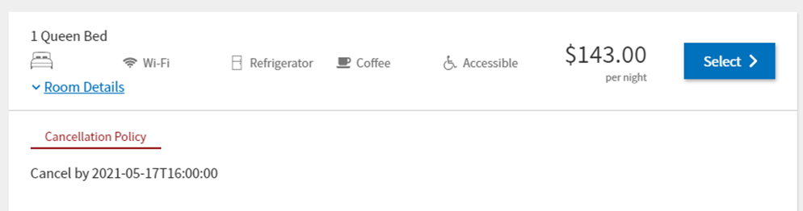
Hotel Cancellations
If this happens, the traveler can learn more by navigating to the rate page (by hitting the “Select” button) and then selecting “Room Details”.
If the Cancellation Policy is still vague or unclear to the traveler, they should reach out to the property prior to booking the hotel to ensure they are aware of any cancellation penalties or requirements if their trip is cancelled.

Slide 39
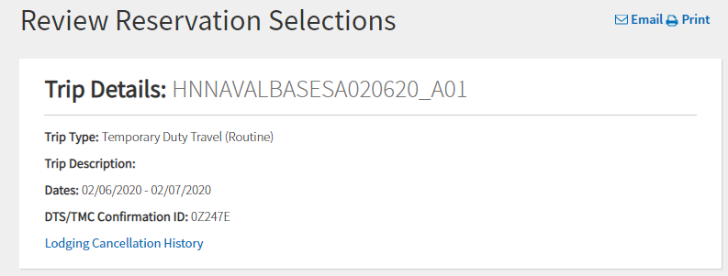
Hotel Cancellations
DTS will display a Lodging Cancellation History link after a hotel is cancelled via DTS.
  This will display the hotel Cancellation Number.

Slide 40
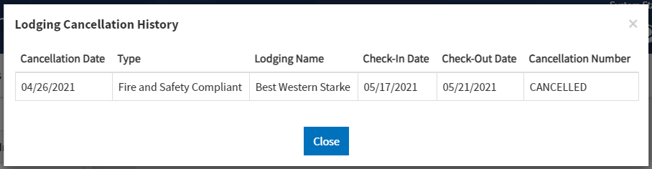
Hotel Cancellations
Selecting the Lodging Cancellation History link will display a history of every hotel selected and then cancelled.
It’s very important that the Cancellation Number is an actual number and not the word CANCELLED.

Slide 41
Hotel Cancellations
DTS communicates with different systems when lodging reservations are made or cancelled.
It is possible that when the cancellation request leaves DTS, it may have to go to 2-3 different systems before reaching the hotel.
DTS
Global Distribution System
Main Hotel System
Hotel Vendor System

Slide 42

Hotel Cancellations
By the time it is received by the hotel, there may be a time-out, resulting in the reservation not being cancelled, but appearing as “CANCELLED” in DTS.
If the traveler sees “CANCELLED”, they should contact the hotel directly to obtain a hotel cancellation confirmation number or go to the hotel’s own reservation system web site.
DTS
Global Distribution System
Main Hotel System
Hotel Vendor System

Slide 43
Cancelling a Trip – Common Issues/Misconceptions
“Travelers must remove all expenses from the document.”
  False.
    If an authorization is trip cancelled with no expenses incurred, DTS leaves all the expenses as a record. Additionally, since the authorization will be stamped CANCELLED and can never be stamped APPROVED, there is no reason to remove any expenses.
    If an authorization is trip cancelled with expenses incurred, DTS will automatically zero any non-TMC related fees. The traveler can then make modifications to the zeroed-out expenses to claim what is needed.

Slide 44
Cancelling a Trip – Common Issues/Misconceptions (cont.)
“Travelers must remove all reservations from the document prior to using the trip cancel.”
  False.
    DTS will automatically cancel the reservations. Nothing should be done to the reservations prior to using the trip cancel feature.
    Once Trip Cancel has been used, the only additional steps that should be taken involve the hotel. Check the Review Reservations page after using Trip Cancel to ensure you have a hotel cancellation confirmation number for all lodging. If it says “CANCELLED”, then contact the hotel directly to see if the reservation can be cancelled.

Slide 45
Cancelling a Trip – Common Issues/Misconceptions (cont.)
“Per Diem must be zeroed out prior to cancellation.”
  False.
    If an authorization is trip cancelled with no expenses incurred, per diem and expenses do not need to be zeroed out or removed. Once the document is stamped CANCELLED a de-obligation will occur for any previous obligation.
    If an authorization is trip cancelled with expenses incurred, it will automatically zero out the per diem for the voucher.

Slide 46
Cancelling a Trip – Common Issues/Misconceptions (cont.)
“I didn’t incur any expenses, but I can’t cancel with no expenses incurred.”
  If the document contains one of the following, DTS will prevent the ability to cancel a document with no expenses incurred:
    A scheduled partial payment or advance has been submitted for payment or has been paid.
    Centrally Billed Account (CBA) tickets are on or within the tickets are waiting (TAW) date.
    The document has been stamped CTO TICKETED.
    A TMC fee (either Individually Billed Account [IBA] or CBA) exists on the authorization.
    One or more CBA tickets has a status of “Matched” in the CBA Module.

Slide 47
Cancelling a Trip – Common Issues/Misconceptions (cont.)
“The traveler (or whoever cancelled the document) was able to apply the APPROVED stamp! This should not happen!”
  Not quite true.
    This only occurs when using trip cancel with expenses incurred on an authorization that had completed routing.
    The APPROVED stamp that goes on the auto-generated amendment during the trip cancel process is PAY PROCESS IGNORE.
    This stamp “ignores” the obligation portion of the approval process and does not obligate or de-obligate any funds.
    It simply allows the system to create a voucher.

Slide 48
Cancelling a Trip – Common Issues/Misconceptions (cont.)
“I don’t get the option to trip cancel this authorization.”
  There are several reasons that can prevent trip cancellation:
    Authorization has not yet been SIGNED.
    Authorization is locked because it is at CTO SUBMIT.
    Authorization has already been trip cancelled.
    Voucher has already been created.
  Always check the status of the document to ensure that it is available to be trip cancelled.
    If at CTO SUBMIT for more than one business day, contact the TAC to push
    back into DTS.
    Once updated to CTO BOOKED, the “Cancel Trip” button will appear.

Slide 49
Cancelling a Trip – Common Issues/Misconceptions (cont.)
“I can’t apply the CANCELLED stamp anymore.”
“Only the Approving Official can apply the CANCELLED stamp.”
  Only Approving Officials can stamp documents as CANCELLED.
  This is NOT a system issue.
  This change was implemented, by design, with the release of FY22 Maintenance Release 1 on December 10, 2021.
  This change was implemented to ensure that Separation of Duties are upheld.

Slide 50
Cancelling a Trip – Common Issues/Misconceptions (cont.)
“I’m trying to edit the Itinerary, but my changes won’t save.”
  Another change that was implemented, by design, with the most recent release (FY22 MR1), was the itinerary page of documents that were trip cancelled.
  After a document has been trip cancelled with no expenses incurred, while the Itinerary page looks like edits can be made, any changes will not be saved.
  This change was made to fix several system issues with Trip Cancel.
  Keep in mind that on an authorization that was trip cancelled with no expenses incurred, the itinerary does not need to be a “one day, less than 24 hours”. Per diem and expenses do not need to be zeroed out or removed. Once the document is stamped CANCELLED a de-obligation will occur for any previous obligation.
  For documents trip cancelled with expenses incurred, the itinerary should be able to be modified on the voucher.
    There is currently a system issue that is preventing this from happening.

Slide 51
Resources
DTS (Special Topic) - Cancellation Procedures Web Based Training
  https://www.defensetravel.dod.mil/passport
Trip Cancellation Procedures in DTS Information Paper
  https://www.defensetravel.dod.mil/Docs/Cancellation_Procedures_Information_Paper.pdf
Cancel a Trip Tri-Fold
  https://www.defensetravel.dod.mil/Docs/Training/Cancel_A_Trip_Tri-fold.pdf
You can contact the Travel Assistance Center (TAC) via:
  Phone 888-Help1Go (888-435-7146)
  Web (https://www.defensetravel.dod.mil/passport/)
  Chat (Available Monday – Friday between 8am and 6pm ET)

Slide 52
Questions
Questions are taken via Telephone by Site Name in alphabetical order
  A – E (Example – Dyess Air Force Base)
  F – L (Example – Fort Huachuca)
  M – S (Example – Redstone Arsenal)
  T – Z (Example – Yuma Proving Ground)
You can press #6 to unmute your phone’s line to ask a question.
Please be considerate and mute your phone if you are not talking by pressing *6.

