Slide 1
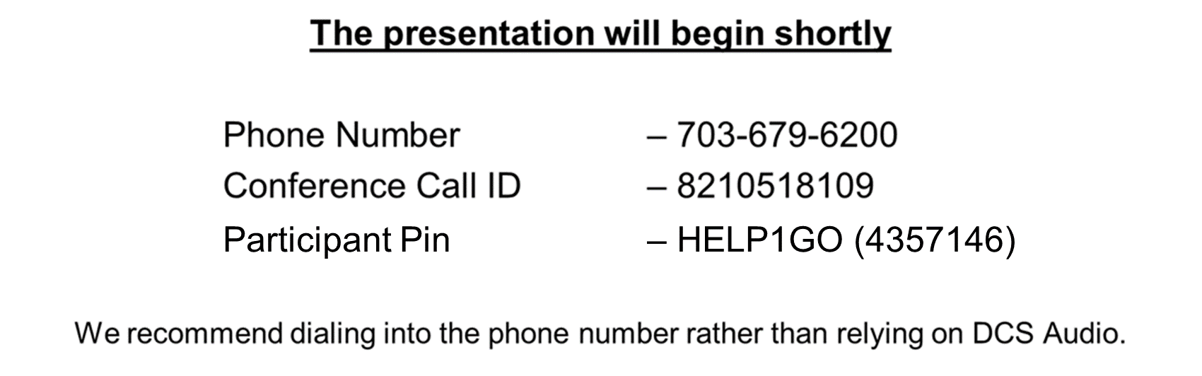
Welcome to the TAC Outreach Call
Presenter(s) – Dan Greene
– Jason Prado
Date – December 8, 2020
Topic – DMM and CCV Process

Slide 2
TAC Outreach Call
December 8, 2020
DMM and CCV Process
Presenters:
Jason Prado, Travel Assistance Center (TAC) Manager
Dan Greene, TAC Outreach Call Coordinator

Slide 3
Agenda
Top Issues for November/December
Top Issues for CY 2020
Upcoming Outreach Presentations
2021 NDTA-DTMO Annual GovTravels Symposium
DTS Message Center Update
Debt and CCV Process
  DMM Overview
  CCV Overview
  Requesting a CCV
Resources
Questions

Slide 4
Top Issues for November/December
Issue # | Summary | Workaround | Release
Disbursing Partner System | Documents are currently stuck at VOUCHER SUBMITTED, ADVANCE SUBMITTED, or SPP SUBMITTED. | The Disbursing Partner Systems are aware of the issue. Once the obligations or payments have been made, the documents will update and the travelers will be notified. | Not a DTS Issue
DTS-18693 | Documents with repeating locations on the Itinerary will not load, creating a blank Expenses page. | Itinerary contains a same day (arriving and departing on same day) location and has a location that repeats this same day location. Recommend consulting your local business rules or Defense Travel Administrator on updating the Itinerary to remove the same day location. | FY21-MR-2
DTS-14360 | Document routes to CTO SUBMIT after the Trip Cancelled has been applied. Authorizations with the trip cancel applied will not update to CTO BOOKED. This is due to travelers canceling reservations prior to using the trip cancel. Canceling reservations manually is not necessary and will cause this issue. | Unfortunately, there is no workaround for this issue. Please submit a ticket to the TAC so we can have the document properly handled. | Ready for Assignment
DTS-18742 | An audit fail is received when all required expenses have receipts associated when there is one location that is repeated on the itinerary. | Unfortunately, there is currently no workaround for this issue. Recommend contacting your DTA or consulting local business rules on selecting an alternate location. | FY21-MR-2
Request for Manual Abandon | Request to Lock a Local Voucher that has been stamped SIGNED, but never been stamped APPROVED. | Local Vouchers, by design, require at least one expense to process. Additionally, they cannot be cancelled.

Slide 5
Top 10 Issues for CY 2020
Issue # | Summary | Release
DTS-14360 | Document routes to CTO SUBMIT after the Trip Cancelled has been applied. | Ready for Assignment
DTS-17920 | Stuck at Processing when saving changes to rental car reservations expenses. | FY20 July Expenses
DTS-18017 | Reservation expenses can not be deleted from vouchers. | FY20 July Expenses
PPT | Trip Cancelled Authorization cannot be stamped SIGNED.
Disbursing Partner System | Documents are currently stuck due to the Finance Disbursing Partner Systems September 22 through September 25. | Not a DTS Issue
Request for Manual Abandon | Request to Lock a Local Voucher that has been stamped SIGNED, but never been stamped APPROVED. | System Design
DTS-1842 | Authorizations stuck at CTO SUBMIT for unknown reasons that must be manually abandoned. | Ready For Assignment
PPT | Authorizations stuck at CTO SUBMIT due to Unconfirmed Segments in the PNR.
Disbursing Partner System | Documents are currently stuck due to the Finance Disbursing Partner Systems October 29, 2020. | Not a DTS Issue
DTS-17959 | Voided tickets update to CTO Cancelled with no routing actions instead of CTO Booked with routing actions. | FY21-MR-1

Slide 6
Upcoming Outreach Presentations
As a reminder, there will be no more Outreach Presentation Dates in 2020.
  This is due to the upcoming December holidays.
The Travel Assistance Center will resume its regular schedule of TAC Outreach Presentations every 2nd and 4th Tuesday on January 12, 2021.
We appreciate all the participation and feedback we’ve received over the course of 2020 and look forward to seeing you in the new year!

Slide 7
2021 NDTA-DTMO Annual GovTravels Symposium
The National Defense Transportation Association (NDTA) and the Defense Travel Management Office (DTMO) will co-sponsor the 2021 NDTA-DTMO Annual GovTravels Symposium virtually next year.
The symposium brings together U.S. government and industry passenger travel experts to examine and discuss a wide range of topics focused on commercial travel issues associated with the U.S. Government and Department of Defense’s multi-billion-dollar travel enterprise.
GovTravels focuses on government-wide travel programs and travel policy, providing professional development and networking opportunities for all participants.

Slide 8
2021 GovTravels Symposium (cont.)
If you work in passenger travel and related services for the federal government, a state government, or the private sector, GovTravels is for you.
The NDTA is creating an exciting program for this year’s event with input from DTMO, the General Services Administration, and private sector stakeholders and hopes you will join them.
The NDTA-DTMO Annual GovTravels Symposium is currently scheduled for February 23-25, 2021.
To register, view the agenda, and see additional information, please visit the NDTA website at https://www.ndtahq.com/events/gov-travels/.

Slide 9
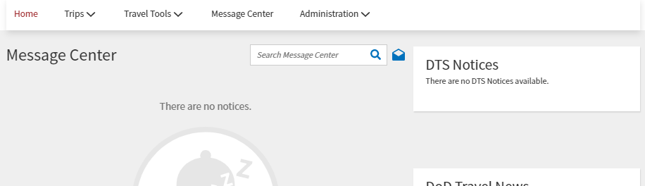
DTS Message Center Update
The DTS Message Center update has been fully released and is now available in DTS across all organization for use at the DTS Program level.
The DTMO will provide an update to the respective Service/Agency representatives once the DTS Message Center process guide and official request form have
been published.

Slide 10
Debt and CCV Process
We are going to briefly cover the Debt Management Monitor (DMM) Process and Cash Collection Voucher (CCV) Process in this presentation.
  For more in depth look at the DMM Process, please refer to the July 28, 2020 Outreach Presentation.
The TAC has been working closely with the Defense Finance Accounting Service (DFAS) on the CCV process.
You will now be able to request CCV’s by submitting a ticket through TraX.
  More on that later in the presentation.

Slide 11
Debt Process
A travel-related debt results when one of the following occurs:
  The trip was cancelled after the traveler received a travel advance.
  The total previous payments (i.e., travel advances, scheduled partial payments [SPPs], and previous vouchers or local vouchers) exceed the actual reimbursable expenses.
  A post-payment review (PRR) determines that the paid voucher contains an unauthorized expense that the Government must recover.
When a voucher is filed, if the actual expense amounts are less than the previous payments (advances, SPPs, or Voucher) the traveler received, DTS identifies the trip as DUE US.

Slide 12
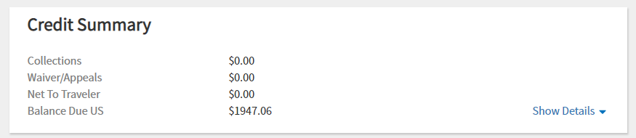
Recognizing a Debt Situation
Debts can be identified in a DTS voucher by selecting Financial Summary on the Progress Bar.
When the Review Financial Summary screen opens, look at the following two lines located in the Credit Summary section:
Net to Traveler: If this line reads $0.00, the Government does not owe the traveler any money.
This line will always read $0.00 in a debt situation.
Balance Due US: If there is any amount on this line other than $0.00, the traveler owes money to the Government.

Slide 13
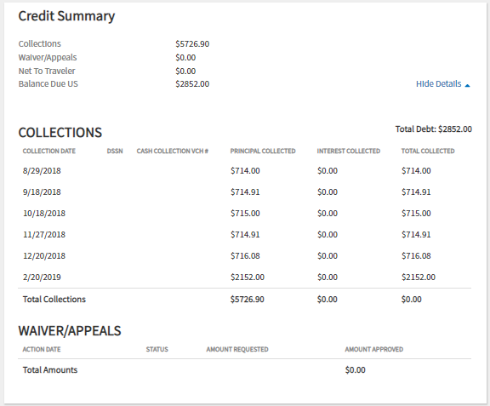
Recognizing a Debt Situation (cont.)
To assist in the debt management
process, DTS keeps the fields in the
Credit Summary current including any
Collections and Waivers/Appeals.

Slide 14
Recognizing a Debt Situation (Traveler/NDEA)
When a potential DUE US voucher is signed, DTS displays a screen that states the traveler will owe money to the Government if the AO approves the voucher in its current state.
  This notification serves as the traveler’s initial notification of the debt (it does not apply DUE PROCESS SERVED).
  If a Non-DTS Entry Agent (NDEA) creates and signs a DUE US voucher, DTS sends an email to the traveler to serve as the traveler’s initial notification of a potential debt situation

Slide 15
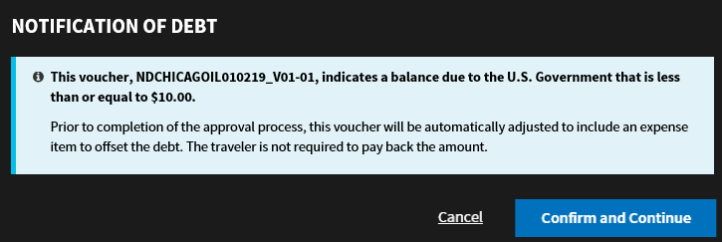
Recognizing a Debt Situation (AO)
The AO first learns of the potential debt situation when approving a voucher that has a negative balance.
  If the amount of the debt is less than or equal to $10.00, the Digital Signature screen displays a Notification of Debt that indicates the debt will not be collected.

Slide 16
Recognizing a Debt Situation (AO)
The AO first learns of the potential debt situation when approving a voucher that has a negative balance.
  If the amount of the debt exceeds $10.00, the AO sees a Notification of Debt indicating the need to inform the traveler and the DMM about the debt.

Slide 17
Recognizing a Debt Situation (DMM)
To ensure that the due process requirements in the DoD Financial Management Regulation (DoDFMR), Volume 16 are met, the AO and DMM must verify that the traveler has received notification of the debt.
  Selecting Confirm and Continue completes the signing process.
  The AO should notify the traveler of the debt immediately.
Applying the APPROVED stamp to the document will begin the DUE US process within DTS.

Slide 18
The DUE US (Debt) Process within DTS
When the APPROVED stamp is applied to a voucher that contains a debt, the following actions occur:
  DTS generates and sends an adjusting obligation to the accounting systems to decrease the obligation to the amount previously disbursed, if necessary.
  DTS sends a “no pay due voucher” with a zero dollar net to traveler to the disbursing system.
  A 96-hour delay allows transactions to post to accounting and disbursing.
  DTS transmits an initial A/R to the accounting system to set up the debt.
  Upon receipt of the positive acknowledgement from accounting that the A/R has posted successfully, DTS emails the due process notification of debt to the traveler, AO, DMM, and the Central Disbursing System (CDS).
  DTS tracks the DUE US situation and reports it in the Debt Management Monitor.

Slide 19
Traveler’s Responsibility for Payment of Debt
The traveler has 30 days from the email notification to repay the debt or request a waiver of the debt before actions can be initiated to collect the unpaid debt through payroll deduction.
  Civilian employees with a debt on a cancelled trip are allowed up to 15 days to settle the debt.
If the traveler is repaying the debt directly, they should include a copy of the notification email when submitting the payment to the disbursing system.

Slide 20
What is a DMM?
The Debt Management Monitor is responsible for tracking, processing, and recording of all actions related to traveler debt.
In accordance with the DTS Regulations (DoDI 5154.31, Volume 3), paragraph 030403:
  DMMs may be appointed as Departmental Accountable Officials (DAOs) to track the debt collection process in DTS due to overpayment of travel funds to travelers.
It is not necessary for a DMM to be located at each site, but each organization within DTS must have at least one DMM assigned.

Slide 21
Eligibility Requirements for DMMs
Components must identify DMMs and decide whether to appoint them as Departmental Accountable Officials (DAOs).
  If appointed as DAOs, DMMs should be appointed on a DD Form 577, which must be maintained as outlined in DoDFMR, Volume 5, Chapter 5, paragraph 050401.
DMMs must have permission level 6 and the Debt Management Monitor indicator set to Yes in their DTS user profile.
  This grants access to DTS Debt Management functionality.
The DTA must also grant the DMM organization access to allow them to run the DM Report, and group access so they can access the documents of the travelers who are in debt.

Slide 22
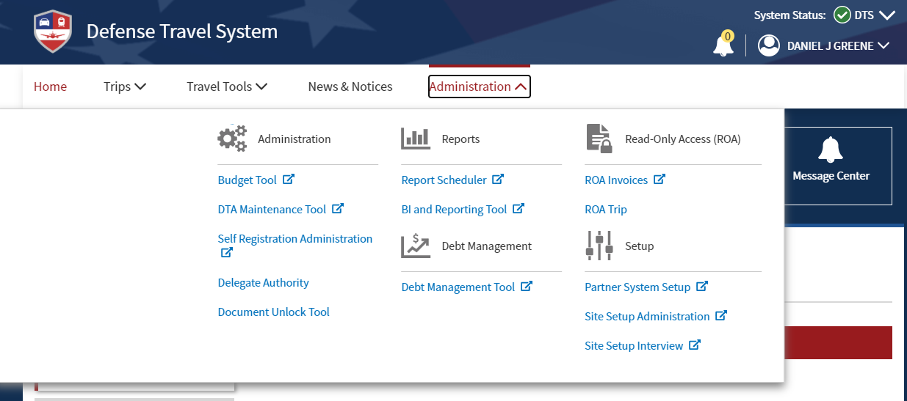
Debt Management Tool (Gateway)
The Debt Management Tool can be accessed from the Administration Drop-Down only for users who have that setting set to “Yes” in their DTS Profile.

Slide 23
Debt Settlement Actions
There are many different ways Debt can be Settled:
  Traveler Mails a Payment
  Traveler Makes a Payment Online
  Traveler Requests a Waiver or Appeal
  Debt is Referred to Payroll for Collection
  DMM Refers Debt to the Out of Service (OOS) Office
In order to properly settle the debt, the DMM must apply the DUE PROCESS stamp in the DMM Gateway first.
  VERY IMPORTANT

Slide 24
Cash Collection Voucher (CCV) Ticket Process

Slide 25
What is a CCV?
DTS and the Defense Finance and Accounting Service (DFAS) Partner System communicate back and forth via the Global Exchange Server (GEX).
In certain situations, DTS may not have a stamp that can be applied to a DTS document or there may be an issue where it cannot post.
  Paper checks mailed out to travelers that are sent back to DFAS as RETURN TO SENDER.
  Payments to the Government Travel Charge Card (GTCC) that cannot deposit properly.
  Receipts of Debt Collection that need to be manually posted into the DMM Gateway.
DFAS personnel log into TraX and submit tickets for Paper Check Return notifications, Citi EFT Returns, and Cash Collection Vouchers (CCV).
  Of the 3 types, the CCV’s are the most common.

Slide 26
CCV Ticket Process
Once the ticket has been received from DFAS, the TAC performs verification checks to ensure that the information in the attachment is accurate and there is no Personally Identifiable Information (PII).
The TAC will then notify the traveler and the Debt Management Monitor (DMM).
  If the DMM cannot be found, the TAC will notify the email addresses in the DTA ID and Organizational Email fields from the Organization’s profile.
DMMs are determined using a quarterly report pulled from DTS.
  DMM set to “Yes” and Group Access
The instructions in the email inform the notified parties of what to do with the returned check, Citi EFT Return, or Cash Collection Voucher depending on the form.

Slide 27
CCV Ticket Process
Once the notification has been sent, it will be archived in the TAC’s ticket system as reference material.
  Additionally, in the event that an original notification was not received by the traveler/DTA, the archived notification can be sent again, as required.
If a ticket/call is received requesting one of these forms, the ticket created by DFAS will be assigned to the person requesting the form.
Additionally, if a request comes in for a CCV and a ticket does not exist, the TAC will escalate the ticket to DFAS to obtain the CCV.

Slide 28
More Information on Citi EFT Reject
Citi EFT Rejects are caused by one of two things:
  The CITI Bank Social Security Number (SSN) listed in the profile for the traveler is not established correctly preventing payment from being made by DFAS.
  The Traveler's SSN has been loaded in the DTS profile incorrectly preventing payment.
The SSN needs to be verified before taking action with Citi Bank or the traveler’s profile.
Instructions are provided by the TAC in the email on how to perform either of these actions.

Slide 29
More Information on Cash Collection Vouchers
DFAS has sent the DTMO Travel Assistance Center a Notification for Manual Debt Collection.
The traveler will need to contact the Lead Defense Travel Administrator (LDTA)/ Debt Management Monitor (DMM) for assistance.
  The Travel Assistance Center cannot amend nor update traveler's documents and post any manual collection to DTS.
Please confirm with your LDTA/DMM if the collection has been posted correctly in DTS.
  If the collection has been posted correctly, no further action is required.

Slide 30
More Information on Cash Collection Vouchers
If the collection has not been posted correctly, please contact your DMM to have the Manual Collection posted by adding it into the DMM Gateway.
Once the Manual Collection has been added in the DMM Gateway, please have the LDTA/DMM load the manual collection using the Response Imaging feature within the DMM Gateway.
Once the Manual collection has been loaded, the document will need to be approved to clear a partial debt or to fully satisfy the debt.

Slide 31
More Information on Paper Check Returns
DFAS has sent the DTMO Travel Assistance Center an authorization for re-disbursement of a Treasury Check Cancellation.
  It is recommended the traveler be reimbursed via EFT.
The Travel Assistance Center cannot amend nor update traveler's account information in DTS.
Instructions are provided by the TAC in the email on how either the Traveler or DTA can perform this action.

Slide 32
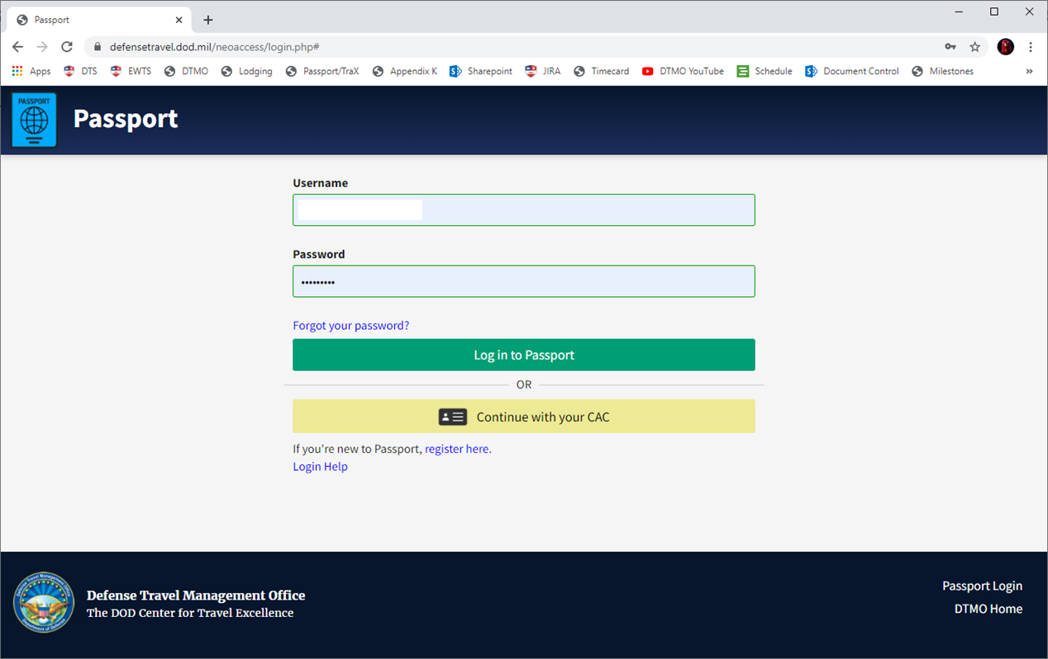
Submitting a Ticket to Request a CCV
Log into Passport at www.defensetravel.dod.mil/passport.

Slide 33
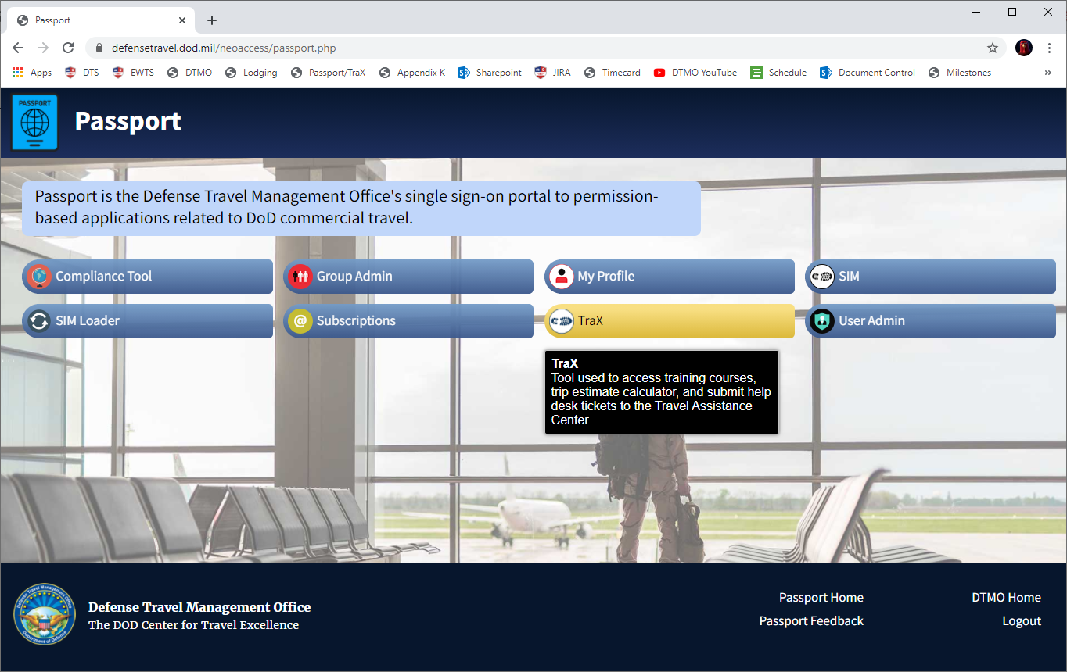
Submitting a Ticket to Request a CCV
If prompted, select “TraX” from the list of available modules.

Slide 34
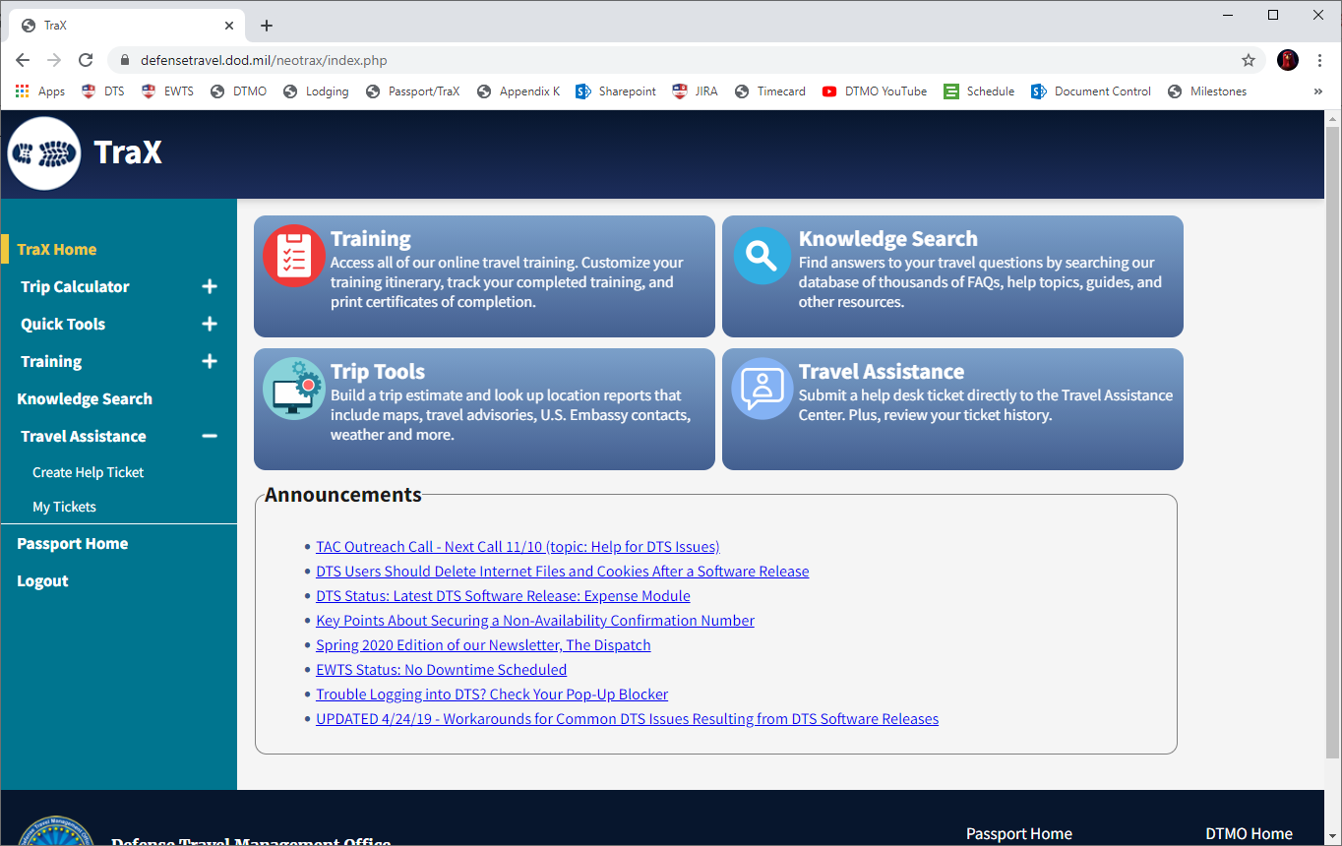
Submitting a Ticket to Request a CCV
Go to Travel Assistance > Create Help Ticket from the navigation bar on the left or by selecting Travel Assistance on the Home Page.

Slide 35
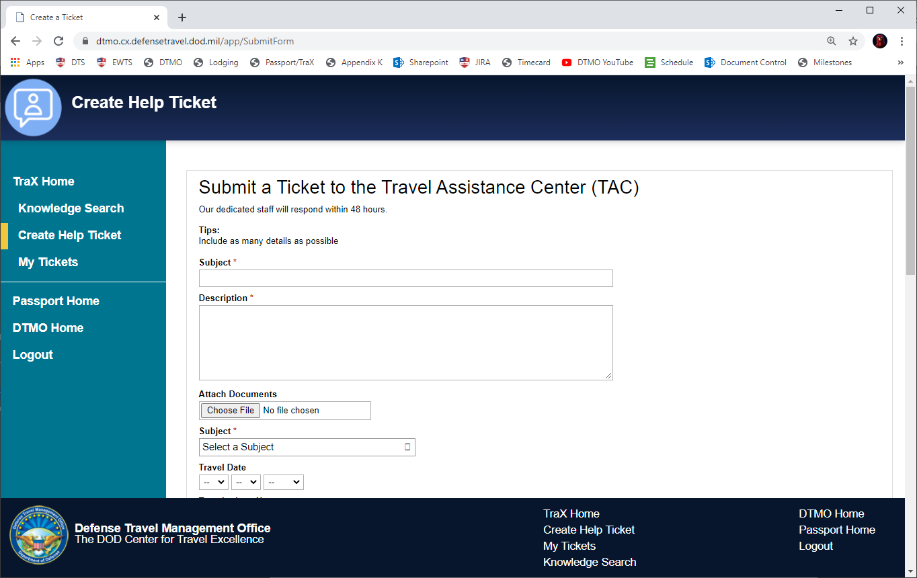
Submitting a Ticket to Request a CCV
This will bring you to the Create a Ticket Screen.
It’s important to fill out the information as completely and accurately as possible to avoid any problems or delays.

Slide 36
Submitting a Ticket to Request a CCV
The first box is labeled “Subject” but in reality, is the “Title” of the ticket.
In this box, enter that this is a “Request for “ followed by the type of CCV you’re requesting.
Cash Collection Voucher
Citi EFT Return
Paper Check Return

Slide 37
Submitting a Ticket to Request a CCV
The second box is labeled “Description”.
You can repeat whatever you put in the first field.
It’s important that no Personally Identifiable Information (PII) is entered into this field as it will result in ticket deletion, delay of ticket creation, and requirement to recreate the ticket.

Slide 38
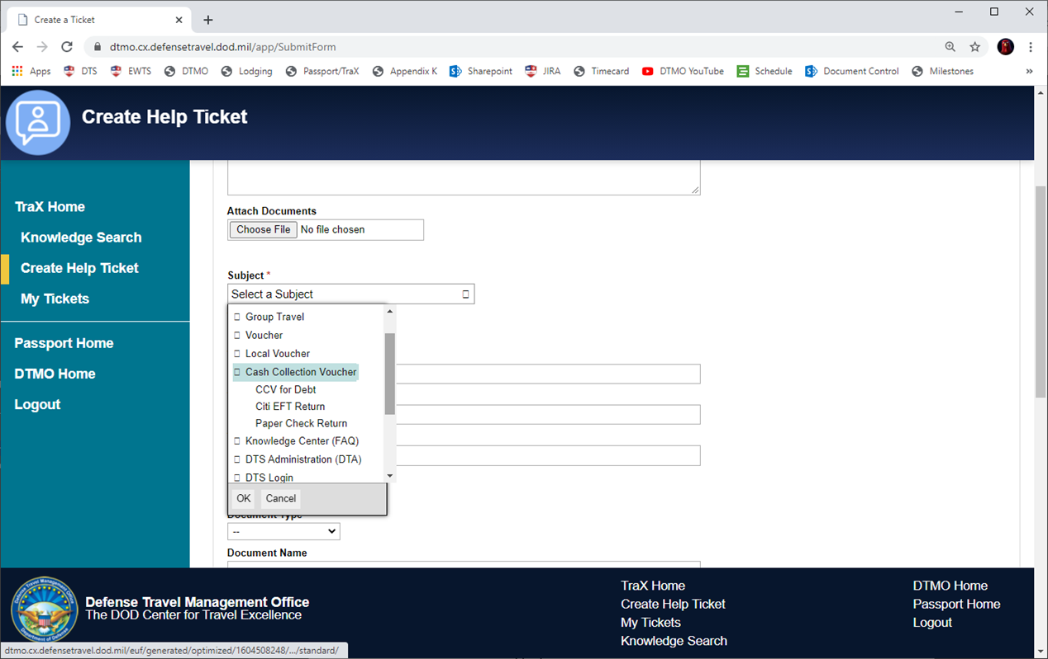
Submitting a Ticket to Request a CCV
The next field is the Subject Drop-Down.
This field is very important because it will determine how your ticket is routed.
If you know the type of CCV you are requesting, drill down, otherwise, simply select “Cash Collection Voucher”.

Slide 39
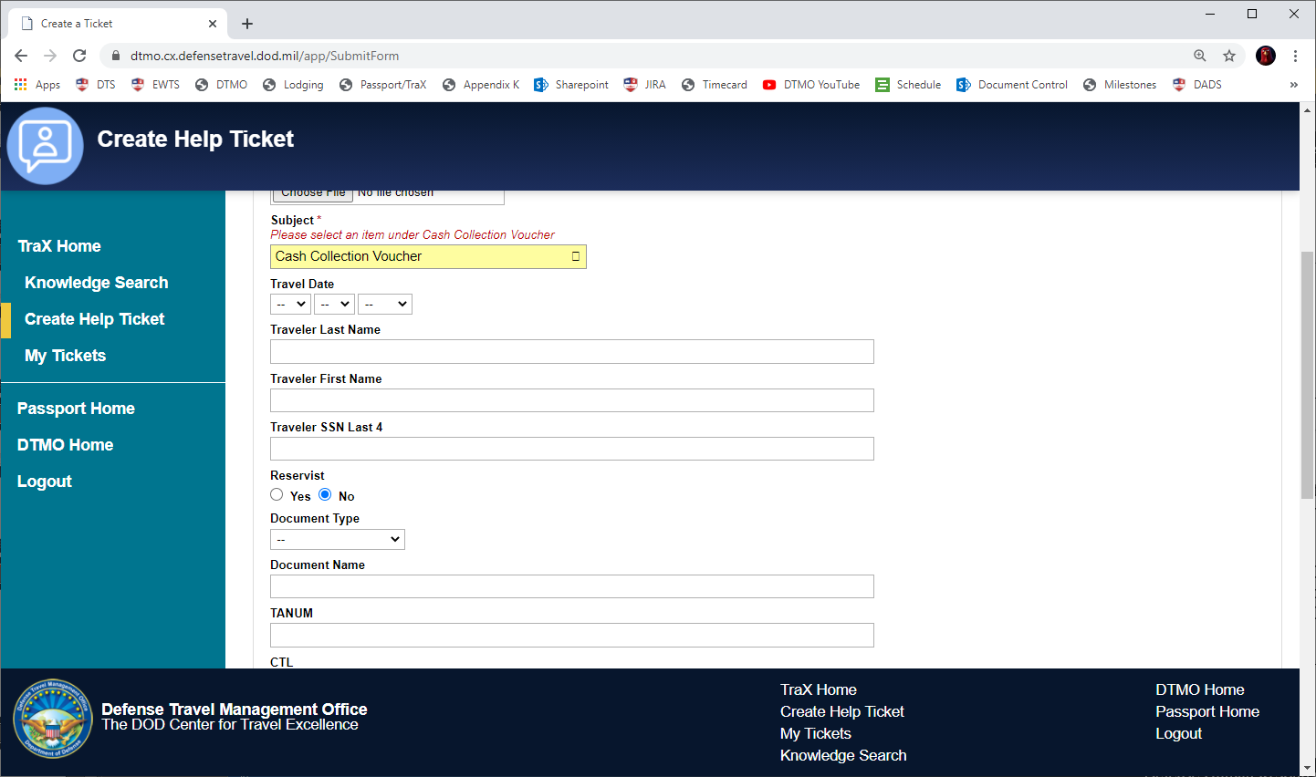
Submitting a Ticket to Request a CCV
The following fields should be filled out as accurately as possible to ensure a quick response turnaround.
Traveler Last Name
Traveler First Name
Traveler SSN Last 4
Document Name
TANUM

Slide 40
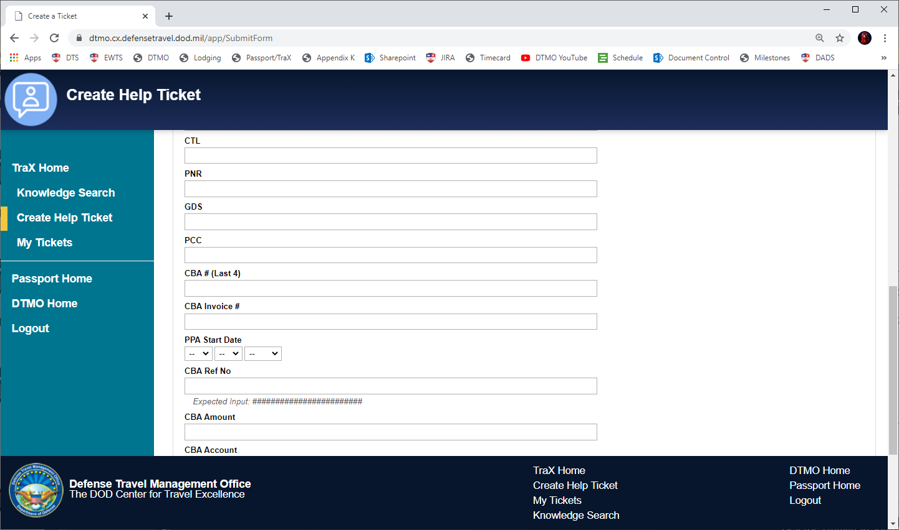
Submitting a Ticket to Request a CCV
The last field to be filled out should be the CTL Field.
The TAC uses this to track the number of requests we receive for CCV Tickets.
Since you will be requesting a CCV, enter six zeroes into this box (000000) and the TAC will fill it in later.

Slide 41
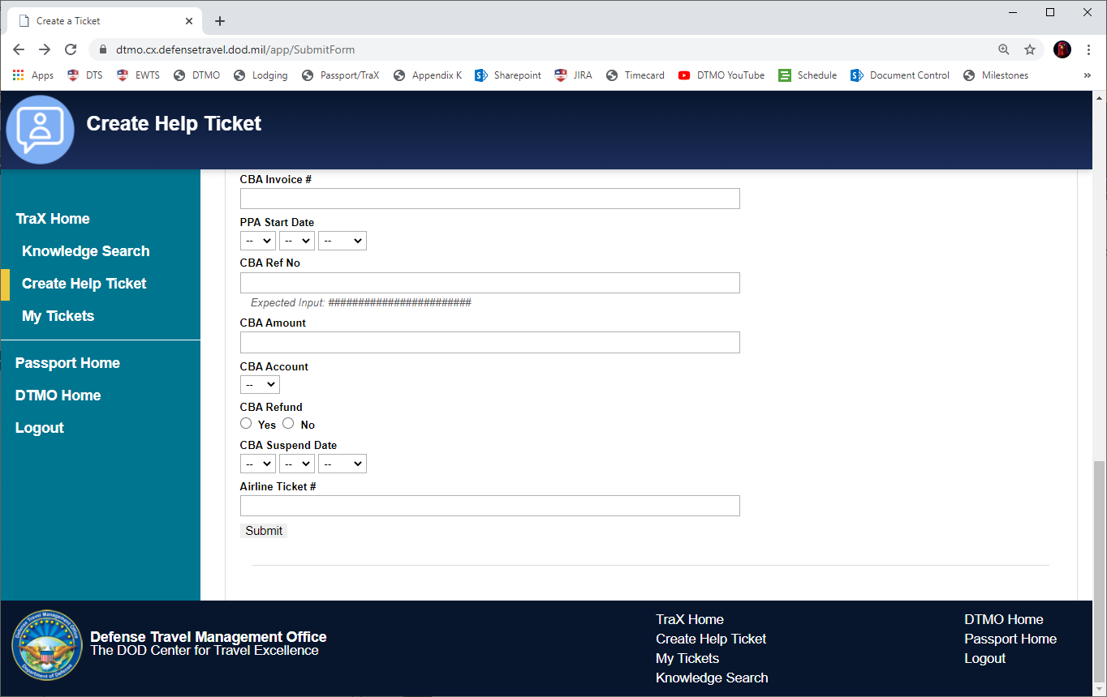
Submitting a Ticket to Request a CCV
Once everything has been filled out, select “Submit”.
You will receive a pop-up, select “Finish Submitting Ticket” to complete the process.

Slide 42
What happens next?
The TAC will receive your ticket and perform research on the requested CCV.
We will look at our backlog of tickets to determine if DFAS has sent one prior to the creation of your ticket.
  If so, your ticket will be closed and the original ticket will be updated with your information.
If no prior tickets can be found, the TAC will escalate to DFAS.
  During this time, you will continue to receive emails, but you will not be able to make modifications to your ticket through TraX.
Once the TAC receives notification from DFAS, the ticket will be updated.
  The appropriate steps will be sent to the original contact, along with the requested attachment.

Slide 43
Resources
2021 NDTA-DTMO Annual GovTravels Symposium
  https://www.ndtahq.com/events/gov-travels/
Guide for Managing Travel-Incurred Debt
  https://www.defensetravel.dod.mil/Docs/Guide_to_Managing_Travel_Incurred_Debt.pdf
You can contact the Travel Assistance Center (TAC) via:
  Phone 888-Help1Go (888-435-7146)
  Web (https://www.defensetravel.dod.mil/passport/)

Slide 44
Questions
Questions are taken via Telephone by Site Name in alphabetical order
  A – E (Example – Dyess Air Force Base)
  F – L (Example – Fort Huachuca)
  M – S (Example – Redstone Arsenal)
  T – Z (Example – Yuma Proving Ground)
You can press *6 to unmute your phone’s line to ask a question.
  Please be considerate and re-mute your phone when you are finished by pressing *6 again.

