Slide 1
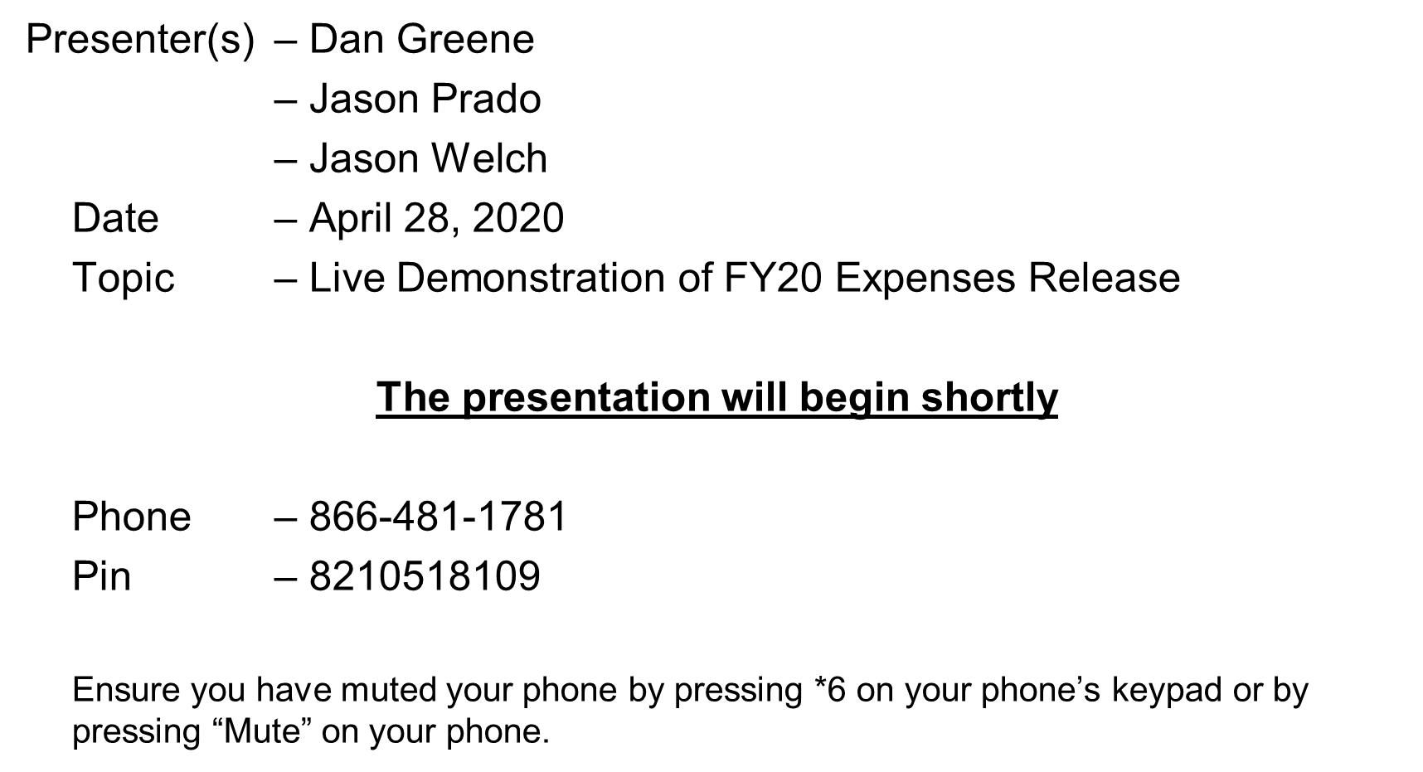
Welcome to the TAC Outreach Call

Slide 2
TAC Outreach Call
Date
Live Demonstration of FY20 Expenses Release
Presenters:
Jason Prado, Travel Assistance Center (TAC) Manager
Dan Greene, TAC Outreach Call Coordinator
Jason Welch, DTS Developer

Slide 3
Agenda
TAC Phones – April 30, 2020
Upcoming Change to TAC Outreach Phone – May 26, 2020
Live Demonstration
Resources
Questions

Slide 4
TAC Phones – April 30, 2020
There will be a scheduled outage in the Travel Assistance Center’s phone system on April 30th, 2020 from 8PM to 12AM ET.
While the phones will be unavailable during this time, you can still reach the TAC using self-support.

Slide 5
Upcoming Change to TAC Outreach Phone – May 26, 2020
On May 26, 2020, the phone number used to dial into the TAC Outreach presentations will be changing.
This new solution that will allow more connections for the expanding participation seen in Outreach over the past few months and ensure that the phone option is always available when DCS audio goes out.
More information on the next Outreach Presentation.

Slide 6
Resources
FY20 Expenses Release
  https://www.defensetravel.dod.mil/Docs/Look_Ahead_IP_14.pdf
You can contact the Travel Assistance Center (TAC) via:
  Phone 888-Help1Go (888-435-7146)
  Web (https://www.defensetravel.dod.mil/passport/)

Slide 7
Questions
Questions are taken via Telephone by Site Name in alphabetical order
  A – E (Example – Dyess Air Force Base)
  F – L (Example – Fort Huachuca)
  M – S (Example – Redstone Arsenal)
  T – Z (Example – Yuma Proving Ground)
You can press #6 to unmute your phone’s line to ask a question.
Please be considerate and mute your phone if you are not talking by pressing *6.

