Slide 1
Welcome to the TAC Outreach Call
Presenter(s) – Dan Greene
– Jason Prado
Date – June 25, 2019
Topic – FY19 Release 4 - Group Authorizations JFU
The presentation will begin shortly
Phone – 866-481-1781
Pin – 8210518109
Ensure you have muted your phone by pressing *6 on your phone’s keypad or by pressing “Mute” on your phone.

Slide 2
TAC Outreach Call June 25, 2019
FY19 Release 4 - Group Authorizations JFU
Presenters: Jason Prado, Moderator Dan Greene, TAC Outreach Call Coordinator

Slide 3
Agenda
Top Issues for June
DTS Reservation Errors and Latency Issues
FY19 Release 4
Dates
Group Authorizations
Resources
Questions

Slide 4
Top Issues for June
# | Issue | Summary | Release
DTS-14717 | Authorizations that are amended by the CTO after they have been ticketed can be edited but cannot be routed. | 1. Select Edit from the dashboard 2. Select View Adjustments from the Review Trip Authorization screen 3. Select Edit from this page on current level 4. Select Signed on Sign and Submit page | FY19-SABRE-API
DTS-7179 | Document routes to CTO SUBMIT after the Trip Cancelled has been applied. Authorizations with the trip cancel applied will not update to CTO BOOKED. This is due to travelers canceling reservations prior to using the trip cancel. Canceling reservations manually is not necessary and will cause this issue. | Unfortunately, there is no workaround for this issue. Please submit a ticket to the TAC so we can have the document properly handled. | Ready for Assignment
PPT | Doc stalls at processing your request when changing the dates on the doc to not include the rental car date. | Unfortunately, there is no workaround for this issue. Please submit a ticket to the TAC so we can have the document properly handled.
PPT | ISE received on pre-audit page of Import/Export documents with certain new expense types, including: Lodging Resort Fees, Government Vehicle - Fuel/Oil, TMC Fee - Not in Air Amount, Lodging Early Check-In Fee, Lodging Retained on Leave. | As a workaround until this issue is resolved, please use an alternative expense type that applies to the trip.
DTS-14679 | Rental Car Expense Imported from GTCC Link Has Blank Expense Name, Sign and Submit page only has the Back option, unable to add expenses | Remove the expense with a blank expense name and add it to the document manually as a Transportation Expense > Rental Car instead of using the Import from GTCC link. | Ready for Assignment

Slide 5
DTS Reservation Errors and Latency Issues
On 31 May 2019, DTS users began experiencing errors with reservations (availability, booking, and signing/approving), as well as, overall system slowness, resulting from a Global Internet Access Point (IAP) issue on the DISA network.
While the DISA IAP issue was resolved on 5 June 2019, DTS users continued to experience system latency and errors with reservations.
On June 13, DTS operations identified what appears to be a residual issue from the DISA IAP event that is continuing to cause extreme latency across the DISA NIPRnet connections for DTS.
DTS operations has opened a ticket with DISA and DISA is troubleshooting the issue.
We will provide an update as we learn more about when system performance will improve.

Slide 6
Java Framework Updates (JFU) FY19 Release 4
This release will continue the incremental implementation of updates to the system’s Java Framework (JFU).
These updates enhance technology to include 508 compliance, system stability and security, and allow the system to leverage new browser capabilities.
This release will update Group Authorizations.

Slide 7
FY19 Release 4
Dates:
EWTS – June 25, 2019 (Tonight)
DTS – TBD Mid-July
The following screenshots were taken in a test environment and are subject to change prior to the official release.
As with any guidance provided by the TAC, please consult your local business rules on how to process Group Authorizations.

Slide 8
Group Authorizations
To save time when two or more people travel together to the same TDY location, you can create a single document, a group authorization, to capture travel details common to all group travelers.
Later, DTS splits the group authorization into individual authorizations, which each traveler can edit to enter details unique to their own trip.
After travel, each traveler creates and submits a voucher to claim reimbursement for the expenses they incurred and payment for the allowances they earned.

Slide 9
Group Authorizations
To create a group authorization, you must have group access to all travelers in the group.
The person who creates a group authorization in DTS is known as the Primary Traveler if they will travel with the group, although a travel clerk or Non-DTS Entry Agent (NDEA) can also create a group authorization.

Slide 10
Group Authorization Process
The local business rules for an organization determine the process of how an authorization for group movement is created.
Typically, the NDEA, Travel Clerk, or Primary Traveler will:
Create the Itinerary
Identify and assign travelers to the Group Authorization
Selects Reservation Preferences**** and transmits them via DTS Email to the local TMC
Selects the appropriate LOA
Enters and Distributes expenses
Justifies any pre-audit flags
Stamps the document SIGNED
**** Reservations cannot be booked in DTS for Group Authorizations, only preferences can be identified.

Slide 11
Group Authorization Process (cont.)
After the document is stamped SIGNED, it will route through the approval process.
Once the Approving Official applies the APPROVED stamp, DTS will spawn an individual authorization for each traveler that was identified on the document.
Until the Group Authorization is locked, these spawned authorizations will not be editable.
This is to allow the Primary Traveler to make amendments to the original Group Authorization.
Any approved amendments will update each individually spawned authorization.

Slide 12
Group Authorization Process (cont.)
Once the travel has been completed, the Group Authorization can be locked.
Once locked, the Group Authorization cannot be unlocked.
Locking a Group Authorization unlocks each individually spawned authorization.
Once unlocked, amendments can be made to the spawned authorizations as needed or vouchers can be created.

Slide 13
Group Authorization – Create

Slide 14
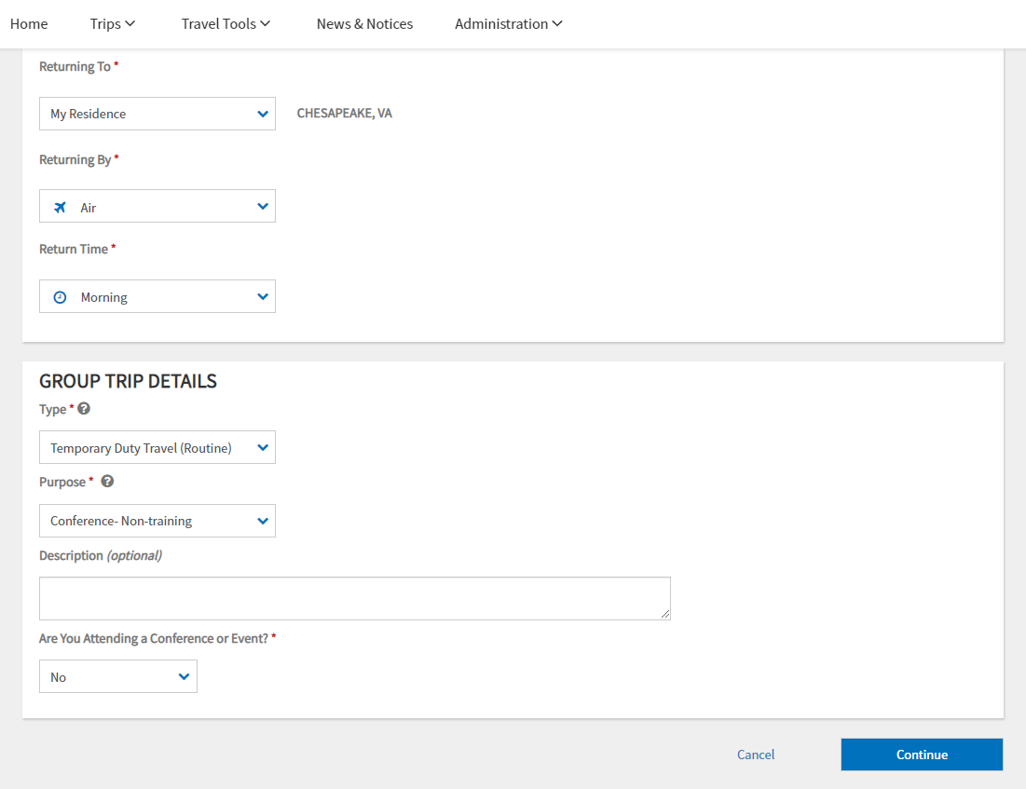
Group Authorization – Create Itinerary
The Group Itinerary page will look similar to the Authorization’s Itinerary page.

Slide 15
Group Authorization – Create Itinerary
Selecting the method of transportation will help DTS guide the user to the proper place in the Reservation Module so that the preferences can be identified.

Slide 16
Group Authorization – Create Itinerary
Users will notice slight variations to Authorizations, such as field placement, under the Group Trip Overview.
The page will function similarly and can be modified using the drop-down fields.

Slide 17
Group Authorization – Create Itinerary
Group Authorizations have limited trip types.
Only Temporary Duty Travel (Routine) and Invitational Travel can be selected.

Slide 18
Group Authorization – Create Itinerary
A new “Processing your request” icon is planned to be deployed with this release.

Slide 19
Group Authorization – Add Group Travelers
When you save the itinerary, the Add Group Travelers (formerly referred to as Group Travel Selection) screen will open up.

Slide 20
Group Authorization – Add Group Travelers
This screen lets you select group travelers, provided they are members of a group to which a Defense Travel Administrator (DTA) has granted you group access.

Slide 21
Group Authorization – Add Group Travelers
To add travelers, select “Manage Travelers”.

Slide 22
Group Authorization – Add Group Travelers
The screen will pop-up with the Traveler Search.

Slide 23
Group Authorization – Add Group Travelers
You will have the option to search by Name, SSN, and Travel Team.
Group Access is required to perform this action.

Slide 24
Group Authorization – Add Group Travelers – Travel Team
A Travel Team is a group of travelers who frequently travel together.

Slide 25
Group Authorization – Add Group Travelers – Travel Team
Selecting a Travel Team will bring up everyone associated with that team.
Select the “+” to add that person to your selection.

Slide 26
Group Authorization – Add Group Travelers – Travel Team
Once a traveler has been selected, the icon will change to “x”.
You can select the “x” to remove the traveler from the selection, or “Save” to add the selected travelers to the Group Authorization.

Slide 27
Group Authorization – Add Group Travelers
After saving, the travelers will be displayed in a list on the document.
The Primary Traveler will be displayed with a star icon next to their name.

Slide 28
Group Authorization – Add Group Travelers – Valid GTCC
Cardholders will be displayed with a green check mark next to their name and non-cardholders will be displayed with a red “x”.
As a general rule with Group Authorizations, you should never mix cardholders and non-cardholders on the same document.
This can cause issues in the future.

Slide 29
Group Authorization – Removing Group Travelers
To remove travelers from the group, check the box next to their name.
A banner will display at the bottom to remove.

Slide 30
Group Authorization – Removing Group Travelers
After selecting Remove, a confirmation pop-up will appear.

Slide 31
Group Authorization – Traveler Summary
Under the Traveler Summary, a different Primary Traveler can be selected, the Routing List can be identified, and the list of travelers can be added to a new Travel Team.

Slide 32
Group Authorization – Create Travel Team
To create a travel team, select the travelers currently on the document and give the team a name.

Slide 33
Group Authorization – Create Travel Team
The Travel Team success notification will appear under Traveler Summary.
Select “Continue” to move on to the next portion of the document.
For users without Group Access, this section will not be visible.

Slide 34
Group Authorization – Reservations
When requesting reservations, keep the following rules in mind:
Your local business rules may require a Transportation Officer (TO) to make transportation arrangements if your group contains 10 or more travelers.
If so, skip the entire transportation reservations process and contact your TO to make transportation arrangements and give you the costs.
Your organization may have a routing list that includes a TO review.
If so, select that routing list before you sign the group authorization.
For more about routing lists, see DTA Manual, Chapter 5 Routing Lists - https://www.defensetravel.dod.mil/Docs/Training/DTA_5.pdf

Slide 35
Group Authorization – Reservations
When requesting reservations, keep the following rules in mind:
When you select reservations, you’re actually only identifying reservation preferences for the TMC
The TMC may have to select a different flight to get seats for all travelers, so be aware that your flight requests may change.
The cost you will ultimately enter into DTS is the total estimated cost for all travelers, not the cost per traveler.
Example: The group contains five travelers. The TMC returns a flight cost of $2,500. The tickets therefore cost $500 per traveler.

Slide 36
Group Authorization – Reservations – Air
When you select reservations, you’re actually only identifying reservation preferences for the TMC
The TMC may have to select a different flight to get seats for all travelers, so be aware that your flight requests may change.

Slide 37
Group Authorization – Reservations – Rental Car
When you select reservations, you’re actually only identifying reservation preferences for the TMC.

Slide 38
Group Authorization – Reservations – Lodging
When you select reservations, you’re actually only identifying reservation preferences for the TMC.

Slide 39
Group Authorization – Reservations – Group Reservation Preferences
Once the reservation preferences have been selected, you will be brought to the Review Reservations screen.

Slide 40
Group Authorization – Reservations – Group Reservation Preferences
The Total Group Cost is the estimated amount multiplied by the number of travelers on the document.

Slide 41
Group Authorization – Reservations – Group Reservation Preferences
Remember that the amounts are only estimates.
After the TMC gets back to you with the total costs, you’ll remove them from here and enter them into DTS under the Expenses section.

Slide 42
Group Authorization – Reservations – Request Reservations
One big change is that the TMC Email will be transmitted from this section rather than the Digital Signature page (in legacy).

Slide 43
Group Authorization – Reservations – Request Reservations
Reservation preferences selected in the previous screens will be displayed on this page for review prior to submitting the email.

Slide 44
Group Authorization – Reservations – Request Reservations
Under the Point of Contact Information, you should ensure the information is correct and up to date prior to sending the request to the TMC.
To transmit the information to the TMC, select “Request and Continue”.

Slide 45
Group Authorization – Reservations – Request Reservations TMC Email
From: DefenseTravelSystem@defensetravel.osd.mil
Sent: Wednesday, June 12, 2019 1:48 PM
To: Travel Management Company
Cc: daniel.d.greene@dtshelp.mail.mil
Subject: DTS Request for Group Travel Reservations
This is a request for CTO assistance in booking group travel reservations.
The preferred travel arrangements are listed below, as well as the list of travelers. The CTO Group ID is 106083. If there are any questions or additional information is needed, please contact the POC below.
POC: Daniel D. Greene Phone: 757-555-1233
Email: daniel.d.greene@dtshelp.mail.mil
Primary Daniel D. Greene Phone: 757-555-1233
Traveler: daniel.d.greene@dtshelp.mail.mil
Document: DGBOSTONMA081219_G01 Travelers: 6 DTS Group ID: 106083 Start Location: RES: CHESAPEAKE,VA 08/12/2019
Location 1: BOSTON,MA 08/12/2019
……

Slide 46
Group Authorization – Reservations – Request Reservations TMC Email (cont.)
……
Remarks: We have a group of travelers who need to be seated together as they are afraid to travel alone.
Travel Group:
NAME SEATING SMOKING
Daniel D. Greene NO
Kim D. Saunders NO
Gregory O. Turner NO
Brandon English NO
Jason D. Prado NO
Erin D. Tackett NO
Preferred transportation and lodging arrangements:
======================================================================
Location - BOSTON,MA Time Zone: EST
Itinerary: Leave From: BOSTON,MA
TDY/TAD Location: BOSTON,MA
Arrive: 08/12/2019
Depart: 08/16/2019
……

Slide 47
Group Authorization – Reservations – Request Reservations TMC Email (cont.)
……
Air Travel Carrier: Delta Air Lines
Flight: 3457
Fare: $1188.00
Airport Passenger facility charge included in
ticket price.
Departure: ORF-Norfolk International Apt 12-Aug-19
10:15 AM
Arrival: LGA-New York LaGuardia Apt 12-Aug-19
11:56 AM
Method Of Reimbursement: GOVCC
Ticket: See Attached Ticket 1
Comments to the Travel Agent:
SEAT PREFERENCE:
Air Travel Carrier: Delta Air Lines
Flight: 5993
Fare: $1188.00
Airport Passenger facility charge included in
……

Slide 48
Group Authorization – Reservations – Request Reservations TMC Email (cont.)
……
ticket price.
Departure: LGA-New York LaGuardia Apt 12-Aug-19
12:59 PM
Arrival: BOS-Boston Edward L Logan Intl Apt 12-Aug-19
02:25 PM
Method Of Reimbursement: GOVCC
Ticket: See Attached Ticket 1
Comments to the Travel Agent:
SEAT PREFERENCE:
Lodging Name: Yotel Boston
Cost: $205.00
Tax: 0
Check-in: 08/12/2019 11:59 PM
Check-out: 08/16/2019 11:59 PM
Method Of Reimbursement: GOVCC Comments to the Travel Agent:
ROOM DATA: FEDROOMS R
……

Slide 49
Group Authorization – Reservations – Request Reservations TMC Email (cont.)
……
Rental Car Company: Budget Rent-a-Car
Enroute: No
Cost: $414.65
Location: BOSTON,MA
Pickup: 08/12/2019 08:30 AM
Dropoff: 08/16/2019 05:30 PM
Method Of Reimbursement: GOVCC
Ticket: 061219131041
======================================================================
Not Associated to a TDY Stop
Air Travel Carrier: Delta Air Lines
Flight: 3291
Fare: $1135.80
Airport Passenger facility charge included in
ticket price.
Departure: BOS-Boston Edward L Logan Intl Apt 16-Aug-19
06:20 AM
Arrival: ORF-Norfolk International Apt 16-Aug-19
08:05 AM
……

Slide 50
Group Authorization – Reservations – Request Reservations TMC Email (cont.)
……
Method Of Reimbursement: GOVCC
Ticket: See Attached Ticket 2
Comments to the Travel Agent:
SEAT PREFERENCE:
Please do not reply to this email.

Slide 51
Group Authorization – TMC Email Submission
Once the TMC Email has been transmitted, the document will be stamped CTO Email Sent.

Slide 52
Group Authorization – TMC Email Submission
Once the TMC Email has been transmitted, the document will be stamped CTO Email Sent.

Slide 53
Group Authorization – TMC Email Submission
On the Preview Authorization screen, the information sent will be displayed here.

Slide 54
Group Authorization – Expenses
The Group Authorization Expenses page functions just like it does in the Authorization.
You should enter all reimbursable expenses and travel allowances that you are aware of just like you do for any other authorization.

Slide 55
Group Authorization – Reservation Expenses
In addition, once you get the total reservation costs back from the TMC, you must enter the total reservation costs (minus lodging) under Other Expenses area (not Reservation Expenses).
Just like Authorizations, the Reservation Expenses is driven off of the Reservation section of the Authorization, so ensure you travel back to that section to remove the Reservation Preferences.

Slide 56
Group Authorization – Adding Group Expenses
For all expense items, be sure to enter the total cost for all travelers.
Example:
The group contains six travelers.
Each traveler will incur a total lodging tax of $123.
This is an estimate of 15% of lodging cost for 4 days:
205 x .15 = 30.75
30.75 x 4 = 123
You can enter a single Lodging Taxes (CONUS and Non-foreign) expense of $738 ($123 x 6) to be distributed equally among each traveler.

Slide 57
Group Authorization – Adding Group Expenses
Some expenses and allowances (e.g., driving distance to the trip starting point) may be different for each traveler.
For those types of expenses, you can estimate the totals to get a good “should cost” for the overall trip or let each traveler update the mileage when they have access to their individual authorization.

Slide 58
Group Authorization – Per Diem
The Per Diem page functions similarly as it does in a typical authorization, but it displays the total lodging cost for all travelers.
Example:
The group contains six travelers.
The Lodging Cost displayed is $1230 ($205 x 6) per night.

Slide 59
Group Authorization – Cost Distribution
The Distributions screen lets you divide the costs amongst all group travelers as appropriate.
Undistributed costs are at the top, while distributed expenses are at the bottom.
Per Diem (Lodging/M&IE) is automatically distributed evenly among each traveler and cannot be distributed differently.

Slide 60
Group Authorization – Distribute Costs
You must distribute all cost items before the AO may approve the group authorization.

Slide 61
Group Authorization – Distribute Costs
Selecting “Distribute” next to a specific expense will display the Distribution Method, all the travelers associated with the Group Authorization, and the total amount that has not yet been distributed.

Slide 62
Group Authorization – Distribute Costs
You can distribute evenly, by amount, or by percent.
Single Traveler will be removed with this release as it’s the same as distributing evenly.

Slide 63
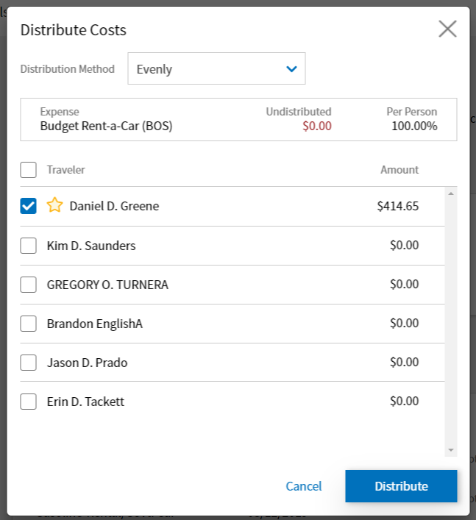
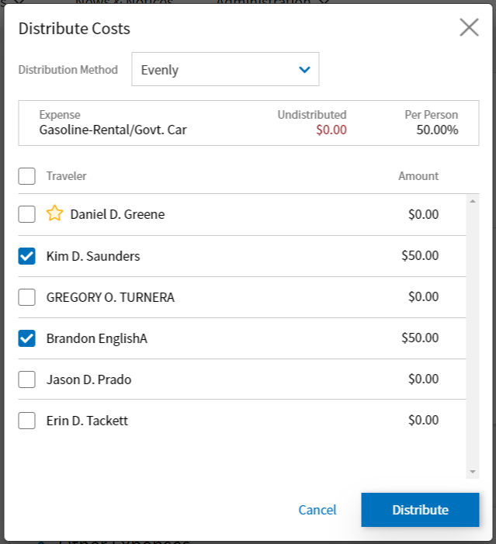
Group Authorization – Distribute Costs – Evenly
When distributing evenly, selecting the top box will distribute to all travelers.
You can also check individual or multiple boxes and DTS will make the change automatically.

Slide 64
Group Authorization – Distribute Costs – By Amount
Distributing By Amount will allow you to type in the individual amount for each traveler.
The total amount must equal the expense to fully distribute.

Slide 65
Group Authorization – Distribute Costs – By Percent
Distributing By Percent will allow you to type in the individual percentage for each traveler.
The total percentage must equal 100% to fully distribute.

Slide 66
Group Authorization – Cost Distribution
As expenses are fully distributed, they will move into the Distributed Expenses section of this page.

Slide 67
Group Authorization – Individually Spawned Authorizations
Group Authorization
0O31PX
Travelers
Routing List
Expenses
Line(s) of Accounting
Pre-Audit Justifications
Dan
0O31Q2
Erin
0O31Q3
Jason
0O31Q1
Brandon
0O31Q0
Kim
0O31PY
Greg
0O31PZ
After the Group Authorization is APPROVED, DTS creates a copy of the group authorization (known as an Individually Spawned Authorization) for each traveler.
Individually Spawned Authorizations are view-only for the travelers at this point.
Should you need to amend the group authorization, when the AO approves the amendment, DTS reflects all changes in the Individually Spawned Authorizations (which are still view only at this point).

Slide 68
Group Authorization – Individually Spawned Authorizations
Individually Spawned Group Authorizations all have the exact same naming sequence for the Document Name.
They will have the Primary Traveler’s First and Last initials and end in “G”

Slide 69
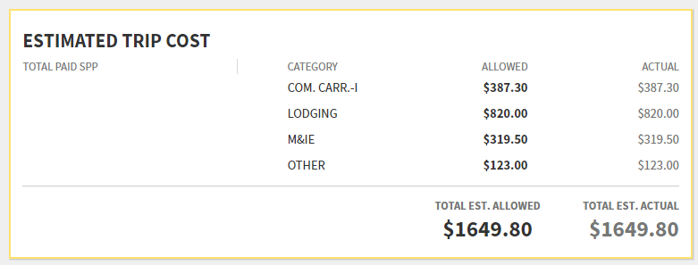
Group Authorization – Individually Spawned Authorizations
The Individually Spawned Authorization will contain all the expenses placed in the original Group Authorization, however, the amounts will reflect what was determined on the distribution page for each traveler.

Slide 70
Group Authorization – View Group Manifest
After the Group Authorization is APPROVED, you can view the Group Manifest to view all the documents at once.

Slide 71
Group Authorizations – Group Manifest
The Group Manifest is a useful page unique only to Approved Group Authorizations.
On this screen, you have the ability to view, print, and release each individually spawned authorization.
You also have the ability to amend the group authorization to make changes, lock the group authorization to allow for individual changes, view the status of voucher creation, and print the manifest.

Slide 72
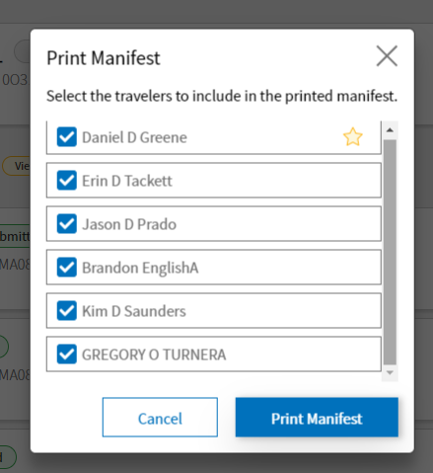
Group Authorizations – Group Manifest – Print Manifest
Printing the manifest will allow you to easily print all or specific travelers in your group.

Slide 73
Group Authorizations – Group Manifest – Release Traveler
You can Print the traveler’s individual document or release them from the group while the Group Authorization is unlocked.
Releasing the traveler will unlock the traveler’s Individual Spawned Authorization and allow them to trip cancel, amend, or file a voucher.

Slide 74
Group Authorizations – Group Manifest – Voucher Status
If any of the travelers have created vouchers from their Individually Spawned Authorizations, it will be indicated here.

Slide 75
Group Authorizations – Group Manifest – Voucher Status
Amendments to Individually Spawned Authorizations can be created and accessed here once the group has been Locked.

Slide 76
Group Authorization – Lock a Group Authorization
Group Authorization
0O31PX
Travelers
Routing List
Expenses
Line(s) of Accounting
Pre-Audit Justifications
Dan
0O31Q2
Erin
0O31Q3
Jason
0O31Q1
Brandon
0O31Q0
Kim
0O31PY
Greg
0O31PZ
“Locking” is an important concept for group authorizations, though it’s one that doesn’t affect any other DTS document type.
Locking happens in two ways:
Manually: You can manually lock the group authorization any time after the AO approves it by selecting Lock Group Auth
Automatically: DTS automatically locks the group authorization three days after the trip end date if you have not locked it already
When the group authorization is locked DTS makes the individual authorizations editable, so travelers can update their own authorizations and create vouchers.
After locking, the group authorization is permanently non-editable.

Slide 77
Group Authorization – Lock a Group Authorization

Slide 78
Group Authorization – Lock a Group Authorization
Once a Group Authorization is locked, it will be indicated by a special icon.

Slide 79
Group Authorization – Lock a Group Authorization
Each Individually Spawned Authorization will be unlocked.

Slide 80
Resources
DTS Guide Chapter 5 – Group Authorizations
https://www.defensetravel.dod.mil/Docs/DTS_Guide_5_Group_Authorization.pdf
You can contact the Travel Assistance Center (TAC) via:
Phone 888-Help1Go (888-435-7146)
Web (https://www.defensetravel.dod.mil/passport/)

Slide 81
Questions
Questions are taken via Telephone by Site Name in alphabetical order
A – E (Example – Dyess Air Force Base)
F – L (Example – Fort Huachuca)
M – S (Example – Redstone Arsenal)
T – Z (Example – Yuma Proving Ground)
You can press #6 to unmute your phone’s line to ask a question.
Please be considerate and mute your phone if you are not talking by pressing *6.

