Slide 1
Welcome to the TAC Outreach Call
Presenter(s) – Dan Greene
– Jason Prado
Date – April 11, 2023
Topic – Types of Fares in DTS
The presentation will begin shortly
Audio is available through ZoomGov or using the telephone number(s) below.
Location | Phone Number
United States | 551 285 1373
United States (San Jose) | 669 254 5252
United States (New York) | 646 828 7666
United States (Toll Free) | 833 568 8864
If you are dialing internationally, find your phone number at https://zoomgov.com/u/absGdkJ9AD
Meeting ID - 161 892 0052

Slide 2
TAC Outreach Call
Types of Fares in DTS
Dan Greene – TAC Outreach Call Coordinator
Jason Prado – TAC Manager
April 11, 2023

Slide 3
Top Issues for March/April
CCV Timeframe and Delays
GSA City Pair Program
    YCA
    _CA
Other Government Airfare
Other Airfare
Restricted Fares
  Checklist
  Lowest Logical Airfare
  Issues with Restricted Airfare
  Tips for Travelers when booking
Resources
Questions

Slide 4
Top Issues for March/April
Issue # | Summary | Workaround | Release
Stuck at CTO SUBMIT | There are multiple factors that can cause an authorization to get stuck at CTO SUBMIT. Authorizations are not considered stuck until they remain at CTO SUBMIT longer than the close of business on the next business day. | The TAC can access the Global Distribution System (GDS) and will attempt to push the document to CTO BOOKED. If unsuccessful, these documents must be manually abandoned. | Issues are regularly researched and resolved.
DTS-22273 | DTA Maintenance error occurs when attempting to receive or create deleted profiles. | Please have the traveler self-register their profile. If they are unable to perform this action, please submit a ticket. | FY23-MR-3
DTS-22083 | Authorization stuck at ADJUSTED after CTO TICKETED with two PNRs. | Both PNRs must be placed on the Outbound queue for the document to update properly. Please contact the TAC for further assistance. | FY23-MR-3
PPT | Expenses screen is blank on a document, preventing different actions from being taken including stamping the document approved, updating a Line of Accounting (LOA), cancelling an authorization, or trying to update the itinerary. | Unfortunately, there is currently no workaround for this issue. Please contact the TAC for further assistance.
DTS-15645 | Generic error message received when attempting to book reservations. Error Message: An error has occurred. We are encountering an issue with our partner system. Please try again in a few minutes. | We are currently working with Operations to improve the error message to fit the situation. Please contact the TAC for further assistance. | FY23-MR-3

Slide 5
CCV Timeframe and Delays
We wanted to inform you that we have been notified by DFAS about delays in receiving responses to Cash Collection Voucher (CCV) Request.
Until further notice, it could take up to 1.5 months to receive a response from DFAS.
Once we see a decrease in the response time, we will let you know.

Slide 6
GSA City Pair Program
The GSA City Pair Program is a contract between the Government and certain airlines for routes frequently traveled for Government business.
The program requires a traveler to use these routes when they are available.
  City Pair Program fares are for official travel only and cannot be used for travel to or from leave points or for any portion of a route traveled for personal convenience.
In addition to offering considerable discounts, the City Pair Program has many features allowing government travelers all the flexibility possible in planning official travel.

Slide 7
GSA City Pair Program
The benefits of this service include:
  Fares priced on one-way routes, permitting agencies to plan multiple destinations;
  No advance purchase required;
  No minimum or maximum length stay required;
  Fully refundable tickets;
  Last seat availability (YCA fare);
  No blackout periods;
  Stable prices enabling travel budgeting; and
  Dual fares availability (YCA and _CA fare).

Slide 8
GSA City Pair Program Fare Types
There are two types of fares offered under the GSA City Pair Program:
  YCA (GSA Contract Rate)
    Contracted, unrestricted coach-class fare that includes the benefit of last-seat availability.
    If an economy/coach class seat is available on the airplane, the Government traveler may purchase the seat at the YCA airfare.
    Only fare to be used in cost comparison purposes.
  _CA (GSA Contract Rate W/ Limited Availability)
    Contracted, unrestricted coach-class fare that is capacity controlled.
    Only a certain number of seats are available on a given flight at the _CA rate.
    Must be used over YCA when available.

Slide 9
GSA City Pair Program Fare Types (cont.)
A _CA airfare should be used when available and only the YCA should be used for cost comparison.
If there are seats available at the _CA rate, DTS will display only that rate for that flight.
  Once the _CA seats are all taken, DTS will then display the YCA rate until there are no more economy/coach class seats available.

Slide 10
GSA City Pair Program Fare Types (cont.)
A command cannot permit a Travel Management Company (TMC) to purchase YCA airfare when a _CA airfare is available, and the Approving Official (AO) determines that a _CA airfare meets the mission’s needs.
Personal frequent flyer points or miles use is not a valid reason to request a YCA airfare when a _CA fare is available.
A traveler who elects to use a YCA airfare when a _CA airfare is available, in order to use points or miles, is financially responsible to the Government for the cost difference between the YCA airfare and the _CA.

Slide 11
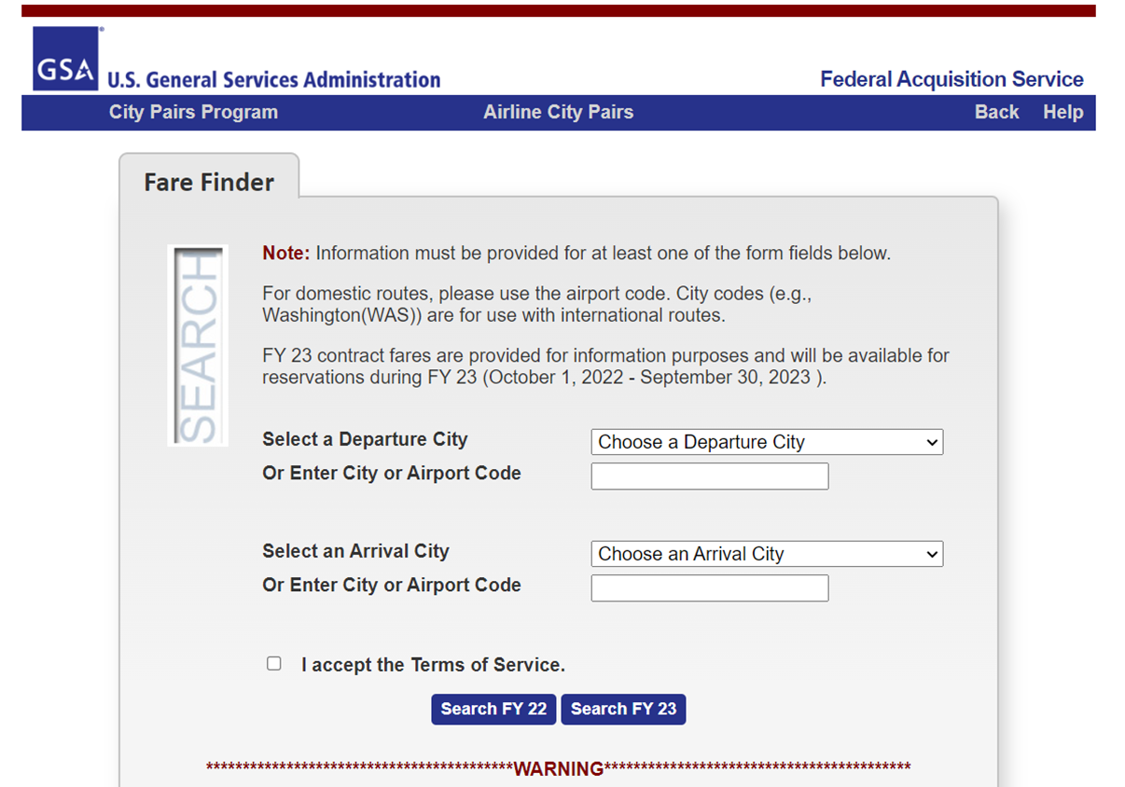
City Pair Search Tool
The GSA website has a search tool that allows users to see the contracted rates for both YCA and _CA fares.

Slide 12
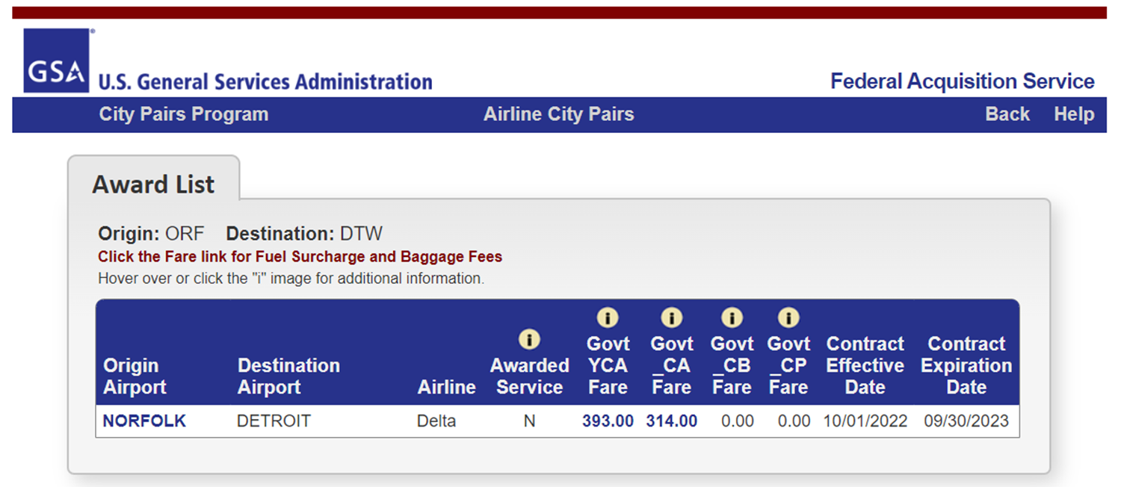
City Pair Search Tool (cont.)
Travelers can quickly see the Airline, YCA fare cost, and _CA fare cost.
Keep in mind that this price does not include taxes and fees which the traveler is entitled to if the YCA fare is being used for cost comparison purposes (Constructed Travel).

Slide 13
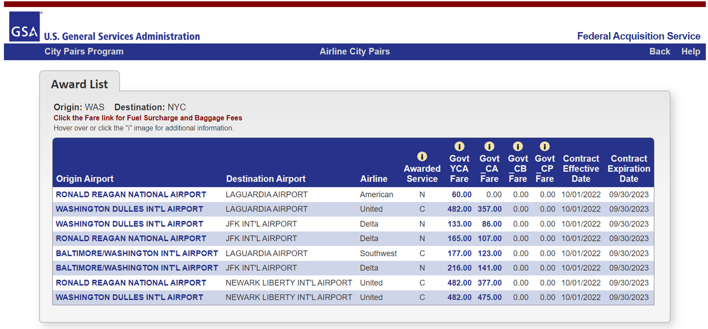
City Pair Search Tool (cont.)
For locations with multiple airports, the search tool is an excellent way to determine the most cost-effective way a traveler should book their trip.
In this example the traveler will be going from the DC to New York.
Flying from IAD to LGA costs $482, while flying out of DCA costs only $60.

Slide 14
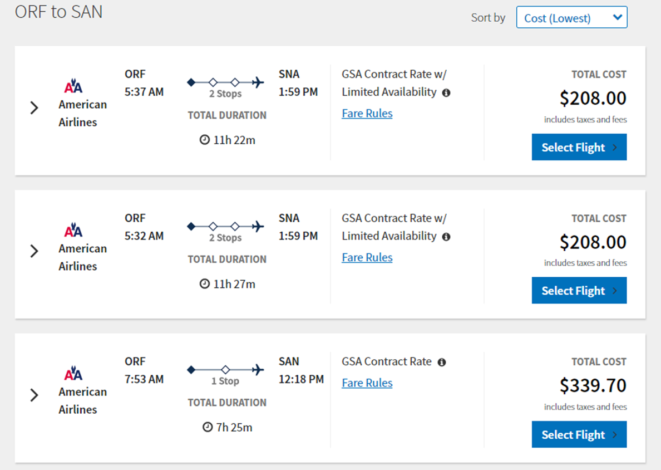
GSA City Pair Fares in DTS
When looking for flights in DTS, if available, the GSA City Pair Fares will always be listed before other options.
_CA fares appear in DTS as “GSA Contract Rate w/ Limited Availability”.
YCA fares appear as “GSA Contract Rate”.
DTS will display _CA fares first before YCA.
A _CA airfare should be used when available.

Slide 15
GSA City Pair Fares in DTS
In this example, the flight time for the _CA fare is almost doubled compared to the YCA.
While the cost of the flight is cheaper, the traveler’s mission requirements may justify them choosing the YCA instead.
If the traveler chooses either the _CA or YCA fares, they will not receive a Pre-Audit flag.

Slide 16
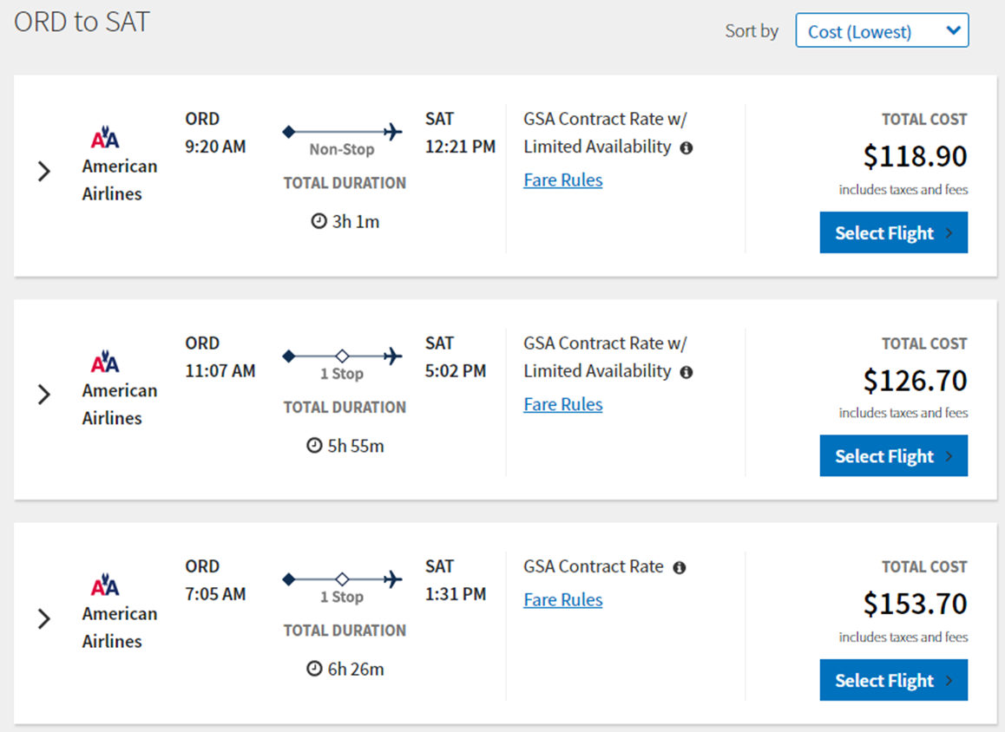
GSA City Pair Fares in DTS
In this example, the traveler is traveling from Chicago to San Antonio.
If the traveler wishes to have the non-stop flight that leaves at 9:20am, they must choose the _CA fare.
This fare will not display as a YCA fare until all the _CA seats have been selected.
This is one way that DTS will force your travelers to book _CA over YCA fares.

Slide 17
Other Government Rate Fares
Other Gov’t Rate fares are competitive fares with many (but not all) of same benefits of GSA fares at around the same cost.
Some differences with Other Gov’t Rate compared to GSA Fares:
  The fare is not guaranteed until ticketing
  The airline can cancel earlier for lack of ticketing
  Last seat availability is not applicable
These fares are offered in City Pair Markets by other airlines that do not have the City Pair Contract.

Slide 18
Other Government Rate Fares (cont.)
These flights should only be selected when GSA rates are not available or do not meet your travel needs.
  Selecting this type of fare when a GSA is available will create a Pre-Audit Flag that requires a Reason Code and Justification.
Price is not a valid justification for this rate because this fare is not offered to the general public.

Slide 19
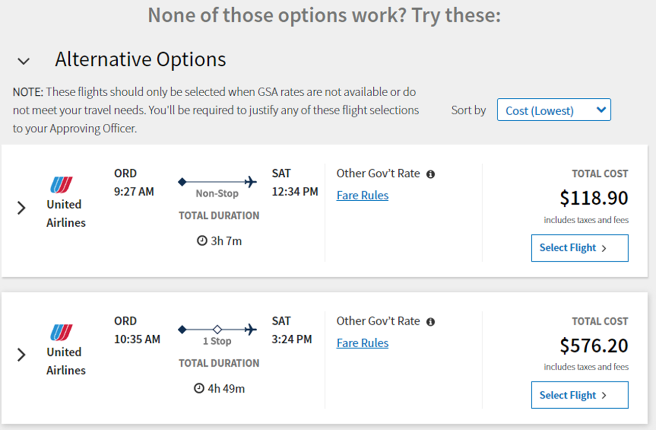
Other Government Rate Fares in DTS
These appear in DTS as “Other Gov’t Rate” below all the GSA City Pair options.
In this example, the cost of this rate is priced to compete with the GSA City Pair cost.
Unfortunately, since this price is not offered to the general public, cost cannot be a determining factor in justification to the Approving Official.
Selecting a Non-GSA Fare when a GSA Fare is available will result in a Pre-Audit flag that requires a reason code and justification.

Slide 20
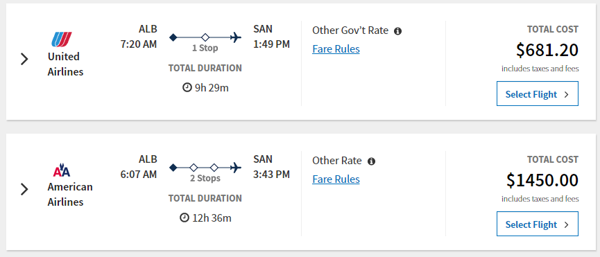
Other Airfare
Other Airfare is fully refundable, economy coach class airfare offered to the general public.
  Price can be a valid justification for this type of rate, however, it’s very unlikely that you’ll find an Other Rate fare that is cheaper than the GSA City Pair.

Slide 21
Restricted Airfare
Restricted Airfare is airfare that may not be fully refundable, may have advance purchase and ticketing requirements, or may have penalties for changes and cancellations.
The rules and requirements for ticketing, changing, and cancelling vary from airline to airline.
  Travelers should check with the Fare Rules prior to making reservations.
Restricted airfares cannot be applied in a blanket fashion but can be considered for each trip on an individual basis.

Slide 22
Restricted Airfare (cont.)
The AO may authorize or approve restricted airfares when they are offered to the general public and if trip cancellation would not impose significant costs.
Reservations MUST be made through the TMC (via DTS) and not an online booking tool.
For City Pair Program routes, if the contract carrier offers a lower fare, the traveler must use that airline’s restricted fare before selecting another airline’s restricted economy or coach airfare.
If the AO approves a restricted airfare, the funding Command, not the traveler, accepts total financial responsibility for the restricted airline ticket if the trip is changed or canceled for any official reason.

Slide 23
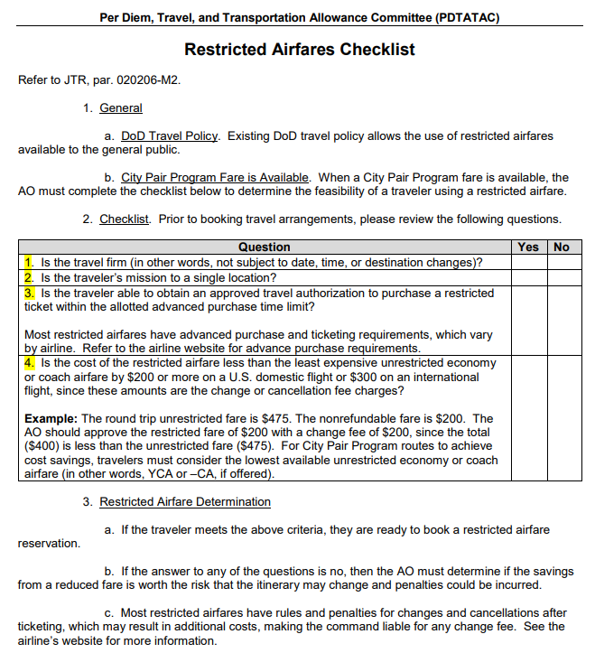
Restricted Airfare Requirements with GSA City Pair
When a GSA City Pair fare
is available, the AO must complete the Restricted Airfare Checklist to determine the feasibility of a traveler using a restricted airfare.
https://www.defensetravel.dod.mil/Docs/AP-RA-01.pdf

Slide 24
Restricted Airfare Checklist
The Restricted Airfare Checklist must be completed by the Approving Official prior to the traveler making reservations.
https://www.defensetravel.dod.mil/Docs/AP-RA-01.pdf

Slide 25
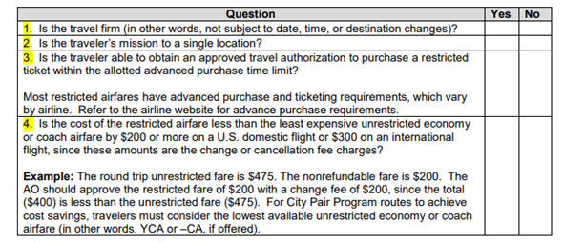
Restricted Airfare Checklist
If the answer to any of the questions is no, then the AO must determine if the savings from a reduced fare is worth the risk that the itinerary may change, and penalties could be incurred.
https://www.defensetravel.dod.mil/Docs/AP-RA-01.pdf

Slide 26
Restricted Airfare Requirements with GSA City Pair
When a City Pair Program fare is not available, the traveler and AO must consider:
  The chance that the flight will be changed or canceled.
  Applicable charges and fees that may be incurred, when determining if the savings is worth the risk that the trip will change.
Use of the Restricted Airfare Checklist is not required, but travelers still must follow their Service or Agency guidelines for using restricted tickets.
Reservations still need to be made with the Travel Management Company (TMC) via DTS.
  Travelers are not permitted to book airfare outside of the TMC or DTS.

Slide 27
Lowest Logical Airfare – Restricted Airfare in DTS
DTS allows travelers to select restricted airfares if all of the following conditions are true:
  The trip includes only a single TDY location.
  The overall trip is not a City Pair market.
  The traveler has a Government travel charge card (GTCC) or the traveler’s unit has a traditionally reconciled (i.e., outside DTS) centrally billed account (CBA).
The process DTS uses to search for and display available flights is referred to as Lowest Logical Airfare (LLA).
Once a Restricted Airfare is selected in DTS, it CANNOT be cancelled or changed.

Slide 28
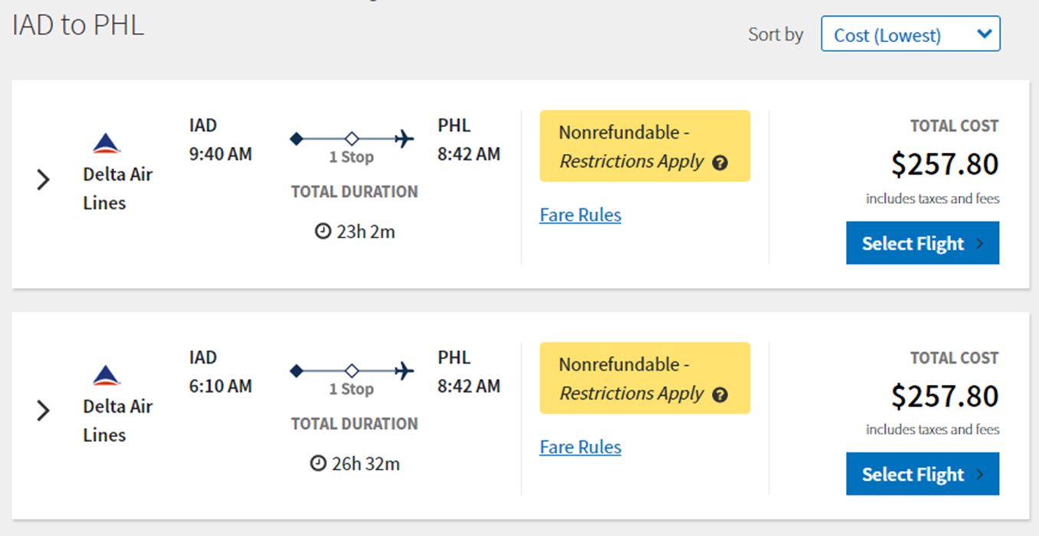
Lowest Logical Airfare
When DTS displays restricted flights, the system highlights them in several ways.

Slide 29
Lowest Logical Airfare
A large yellow box marked “Nonrefundable - Restrictions Apply” or “Refundable – Restrictions Apply” identifies the fare as restricted.

Slide 30
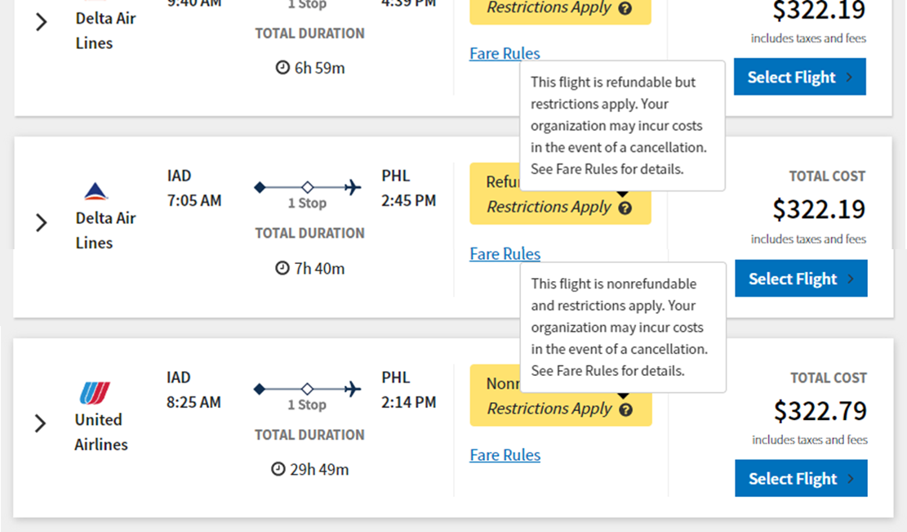
Lowest Logical Airfare
Hovering over the “?” icon will display a general warning about selecting a restricted flight.

Slide 31
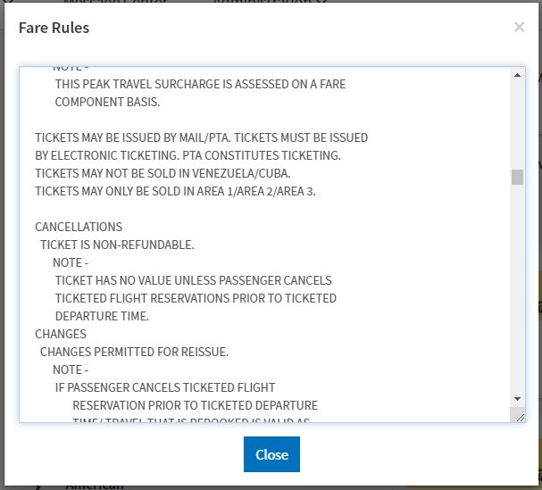
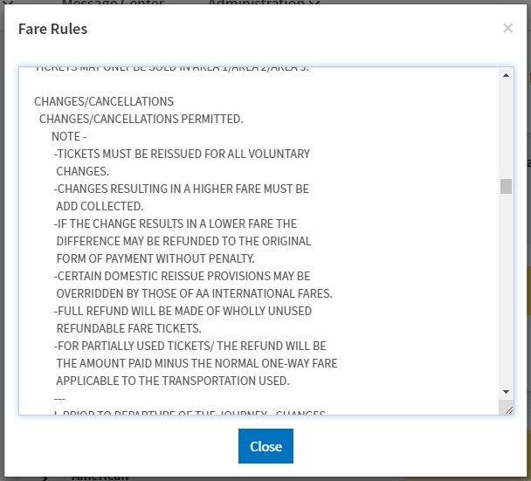
Lowest Logical Airfare
Travelers should review the fare rules prior to selection.
This will include an indication of whether the fare is refundable or changeable, and if so, under what circumstances, the penalty for changing or canceling the flight after ticketing, and much more.

Slide 32
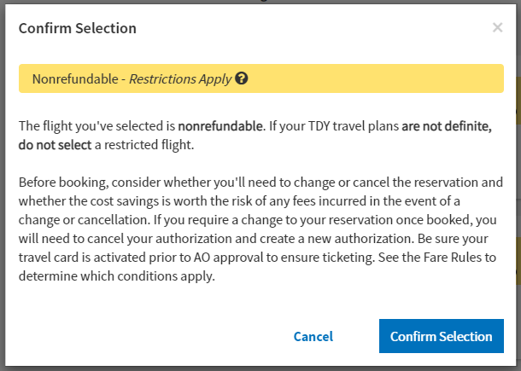
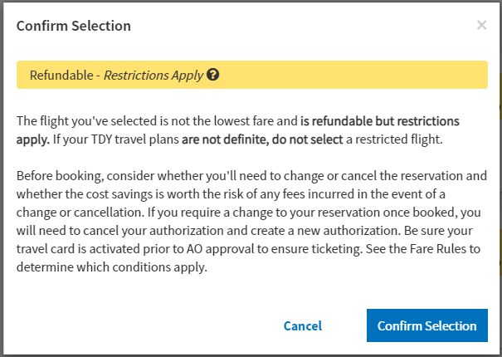
Lowest Logical Airfare
Selecting a restricted airfare generates a message that explains the specifics of choosing the selected airfare, provides a reminder to ensure their GTCC is active, and other key information.

Slide 33
Lowest Logical Airfare
It gives the traveler a chance to Confirm their airfare choice before proceeding to seat selection.
Canceling the selection gives the traveler the chance to look for cheaper Government fares on the Alternative Options results list.

Slide 34
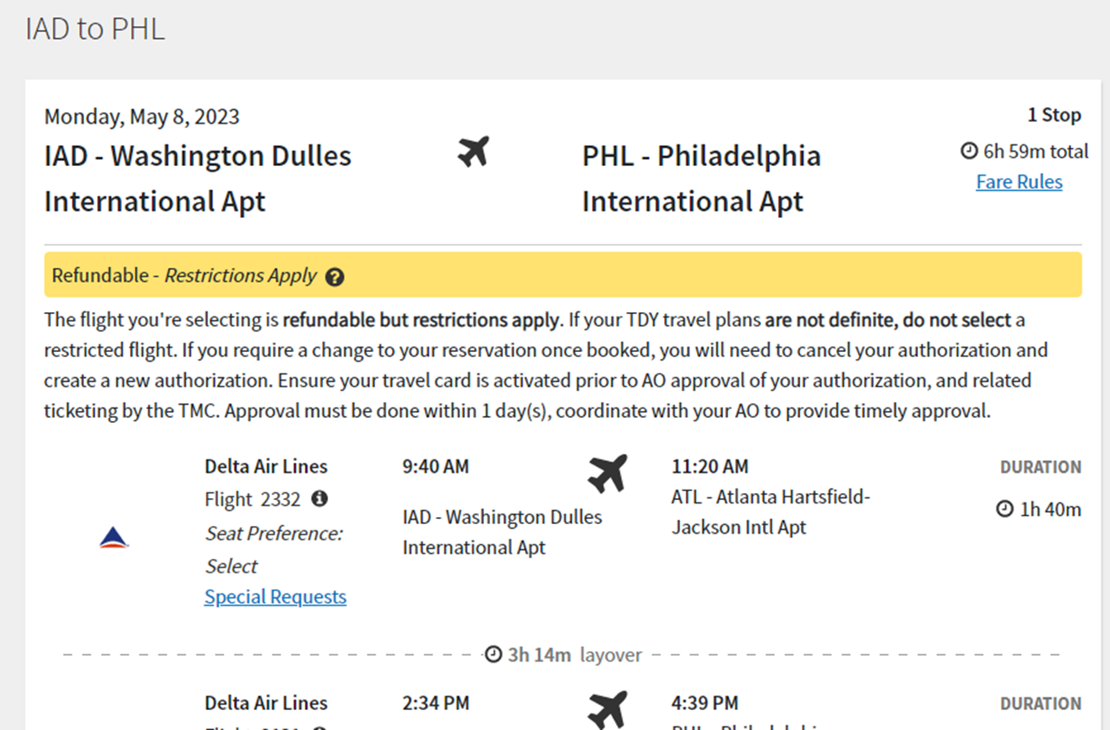
Lowest Logical Airfare
Just before booking the flight, DTS cautions the traveler once again that the flight is restricted and tells the traveler whether the fare is refundable.

Slide 35
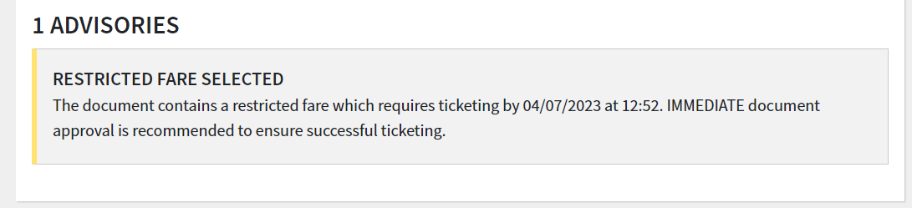
Lowest Logical Airfare
DTS will add a pre-audit flag when a Restricted Fare has been selected letting the traveler know of the urgency.

Slide 36
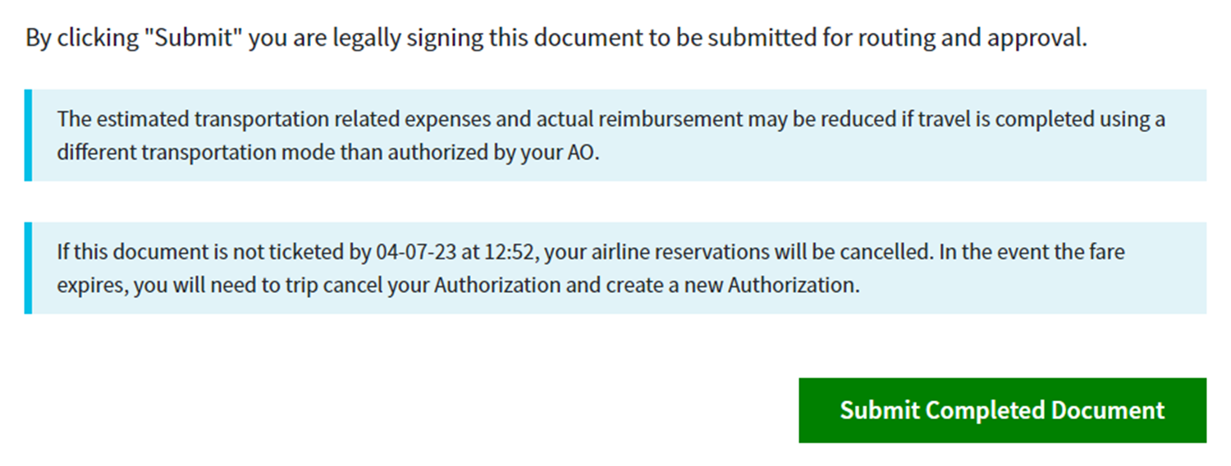
Lowest Logical Airfare
Additionally, there will also be a message on the Digital Signature page about the ticketing requirements and what to do if the fare expires.

Slide 37
Lowest Logical Airfare
Upon signing the document, the document will update to CTO SUBMIT.
  It’s very important that the document update to CTO BOOKED as soon as possible, so travelers should monitor their document after they’ve stamped it SIGNED.
After the document updates to CTO BOOKED, DTS emails all applicable AOs and ROs to urge immediate approval.
  It re-sends this email at 6, 12, and 18 hours before the ticketing deadline until APPROVED.

Slide 38
Issues with Restricted Airfare
Ticketing time limit expires
  RETURN FARE EXPIRED
Requesting TMC Assistance to Book Restricted Airfares
Paying for Restricted Fares
Changing/Cancelling Restricted Fares

Slide 39
Ticketing Time Limit Expires Prior to Approval
Upon selecting the flight, the clock begins ticking down.
  Travelers have a limited amount of time between selecting the flight and ticketing or else the flight will be cancelled.
If the ticketing time limit expires before the AO approves the authorization, DTS prevents approval and requires the AO to use the RETURN FARE EXPIRED stamp to return the document.
DTS emails the traveler, as well as all applicable NDEAs, AOs, and ROs, when the ticketing time limit expires.

Slide 40
Ticketing Time Limit Expires Prior to Approval
Upon receiving the RETURN FARE EXPIRED stamp in the DTS document, the traveler should initiate the Trip Cancel.
  Once the time limit has expired, the only stamp an Approving Official can apply is RETURN FARE EXPIRED.
The traveler should not try to re-book another flight on the same authorization.
  That document is now DEAD.
Instead, the traveler must cancel their original authorization and create a new one.

Slide 41
Ticketing Time Limit Expires Prior to Approval (cont.)
If the document has been imported from another system, you will not be able to trip cancel.
Instead, please submit a ticket to the Travel Assistance Center (TAC) for assistance on how this document will be handled.

Slide 42
Request TMC Assistance
If a City Pair flight is available, the traveler and AO are required to fill out a Restricted Airfare Checklist prior to making reservations.
Reservations still need to be made with the TMC via DTS.
  Since DTS will not present the traveler with Lowest Logical Airfare, booking a Restricted flight is done by performing a Request for TMC Assistance.
The traveler must include the need for urgency in their comments to the TMC and watch carefully for remarks from the TMC to make sure they don’t miss the purchase deadline.

Slide 43
Request TMC Assistance
Selecting Request TMC Assistance when trying to use a restricted airfare causes DTS to treat the reservation as an unrestricted fare.
  That means DTS provides no additional system messaging or emails to the traveler, the AO, etc.
  It also means that at APPROVED, DTS tags it for ticketing 3 business days prior to departure.
It’s the Organization's responsibility to develop business rules to let all concerned parties know the proper way to inform the TMC of the early ticketing requirement.
Check the DTMO website for suggested guidance when using the Request TMC Assistance option.

Slide 44
Requesting a Travel Advance for Restricted Fares
When you request a restricted airfare, you typically must pay for it within 24 hours.
  This time can be longer or shorter depending on the fare rules.
If you plan your trip well in advance of your trip start date, and if you used your GTCC to pay for the flight, you may have to repay that charge before you file your voucher.
For this reason, DTS accommodates requests for travel advances, even for travelers who are GTCC holders.

Slide 45
Requesting a Travel Advance for Restricted Fares
Create the authorization, requesting a restricted airfare, and submit it for approval.
After the AO approves the authorization, create an amendment for that authorization and navigate to the Accounting module (select Accounting in the Progress Bar).
  The Advances section appears on the Accounting screen, with the Request Advance link activated.

Slide 46
Requesting a Travel Advance for Restricted Fares
Select Request Advance.
  DTS automatically presents an advance request for the total cost of all selected restricted fares.
  The amount can be edited to request a smaller amount, but in most cases, the traveler wouldn’t want to do that.

Slide 47
Requesting a Travel Advance for Restricted Fares
After the request is made, DTS displays the request in several places.
  On the voucher’s Entitlement Summary screen.

Slide 48
Requesting a Travel Advance for Restricted Fares
After the request is made, DTS displays the request in several places.
  After approval, in the Accounting screen’s Disbursement section

Slide 49
Requesting a Travel Advance for Restricted Fares
After the request is made, DTS displays the request in several places.
  In the Review Trip Authorization screen’s Advances and Estimated Trip Cost sections
    On a voucher, those names change slightly to the Review Trip Voucher screen and the Actual Trip Cost section.

Slide 50
Requesting a Travel Advance for Restricted Fares
After the request is made, DTS displays the request in several places.
  In the Other Auths’ and Pre Audit screen’s Other Authorizations section
    Comments must be entered for this Other Authorization.

Slide 51
Requesting a Travel Advance for Restricted Fares
When the AO receives the authorization again for approval, they will be presented with a checkbox that authorizes immediate payment of the advance.
  Because the AO approved the use of the restricted airfare on the original authorization, they cannot remove the check from this box.
  After the AO approves the advance to pay for a non-refundable restricted airfare, DTS does not allow document cancellation (a comment to that effect will appear beneath the checkbox).
  The airline will charge the traveler for the airfare, so the traveler must file a voucher to claim reimbursement for that expense.

Slide 52
Changing/Cancelling Restricted Fares
If the trip is changed or canceled for any official reason, the funding Command, not the traveler, accepts total financial responsibility for the restricted airline ticket.
If the traveler needs to change a restricted fare that they reserved in DTS, the TMC must make the change.
  They should coordinate the change as early as possible.
If the trip is cancelled or the traveler exchanges a restricted ticket:
  It is the traveler’s responsibility to contact the TMC to determine how much residual ticket value, if any, remains on that ticket, and to track the use of that residual value, to minimize the monetary loss to DoD.

Slide 53
Changing/Cancelling Restricted Fares Example
The traveler was originally ticketed for a $400 Restricted Airfare ticket.
Unavoidable official circumstances caused the traveler to cancel the trip.
The airlines had a $200 cancellation fee, that money is now gone forever, the government cannot get that back.
  $400 - $200 = $200.
The remaining $200 cannot be refunded to the Government Travel Charge Card, but instead will be issued to the traveler in the form of a residual ticket voucher to go towards their next flight on that airline.

Slide 54
Changing/Cancelling Restricted Fares Example
The Organization is still responsible for reimbursement of $400 total to the Government Travel Charge Card.
For the traveler to use that residual ticket voucher:
  The traveler will need to coordinate with the TMC and advise them of the existing residual ticket value to be used towards payment of the new ticket.
  The ticket has to be booked on the same airline company as before.
  The amount can only be used for Official Travel.
  The organization and traveler must track the use of that residual value.

Slide 55
Tips for Travelers when booking Restricted Fares
If you book a restricted airfare through the Request TMC Assistance option, DTS does not notify those on the routing list of the need for urgent action.
  You must notify them to ensure your authorization reaches APPROVED and CTO Ticketed before the fare price expires.
  As a best practice, you should always pre-coordinate your intended use of a restricted airfare with the AO and everyone on your routing list, be alert to communications back from them to give yourself the best chance to meet the booking deadline.
After the AO approves your authorization, make sure you remind the TMC of the ticketing deadline, to avoid loss of flights.

Slide 56
Tips for Travelers when booking Restricted Fares
You must ensure that your GTCC is active before you book your restricted fare, to avoid a decline that would prevent timely ticketing.
If the AO returns your authorization with the RETURN FARE EXPIRED stamp applied, you must cancel your authorization and create a new one.
  You will not be able to re-book another flight on the same authorization.
Per the JTR, you must use your GTCC to purchase airfare.
  Since you must pay off your GTCC bill in full when you receive it, if you anticipate that your voucher won’t be processed before the date the payment is due, you must either pay it out of pocket, or (if your local business processes allow) request a travel advance for the amount of the air tickets and TMC fee.

Slide 57
Tips for Travelers when booking Restricted Fares
Make sure you read the fare rules before booking any restricted fares, so you are aware of the booking deadline, change or cancellation restrictions, and other important information.
If you need to change a restricted fare that you reserved in DTS and the fare is non-changeable, the TMC must make the change.
  Make sure you coordinate the change as early as possible.
You must report unused restricted tickets to the TMC and track any residual ticket value that you could apply to a future trip.

Slide 58
Tips for AOs when approving Restricted Fares
DTS sends an email (or the traveler may alert you) that use of a restricted airfare requires you to approve an authorization quickly.
  If the time limit expires before you approve the authorization, you won’t be able to approve the document.
  Instead, DTS offers you the RETURN FARE EXPIRED stamp instead of the APPROVED stamp on the Digital Signature page.
  Select it to send the authorization back to the traveler, who must cancel the authorization and create a new one.
A traveler who selected a restricted airfare may require a travel advance to pay for their flight before they file their voucher.
  If they do, make sure they only request an advance for the amount of the restricted airfare.

Slide 59
Restricted Airfare Reports for DTAs
Several reports are available in the DTS Business Intelligence and Reporting Tool (BIRT).
  None of them include information about flights reserved through the Request TMC Assistance function.
Those reports are:
  Restricted Fare Savings Report: Shows the cost of the least expensive unrestricted fare that was available when the traveler selected the RF.
  Restricted Fare Lost Opportunity Report: Shows RFs that were available when the traveler selected an unrestricted fare.
  AO Turn-around Time Expired Fares Report: Shows the value of a booked restricted fare that was ‘lost’ due to lack of timely approval.

Slide 60
Restricted Airfare Reminder…
Restricted Airfares ARE NOT REQUIRED.
If you are traveling to a destination and Restricted Airfare pops up first, it’s because your document met the following requirements:
  Single Location
  Non-GSA City Pair market
When presented with Restricted Airfare, you are not required to select it over the “Other Gov’t Airfare” or “Other Airfare” fares.
  In fact, if your trip dates/locations aren’t firm or you won’t be able to get the document approved quickly, then don’t select it!

Slide 61
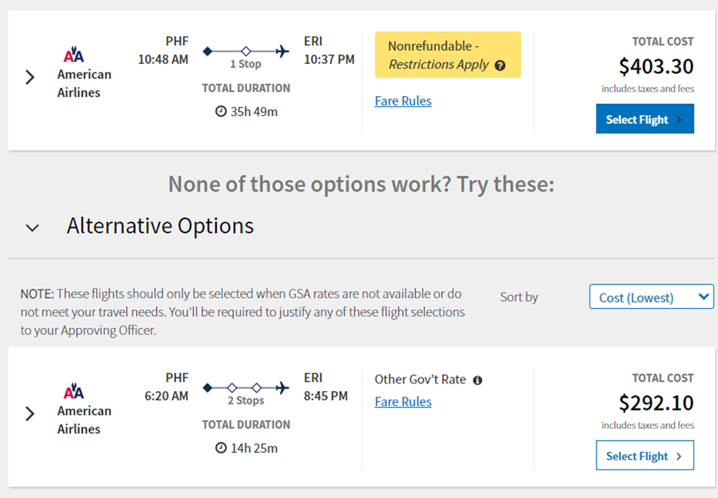
Restricted Airfare Reminder…
Instead, scroll down to the Alternative Options and choose the flight that best suits your mission’s needs.

Slide 62
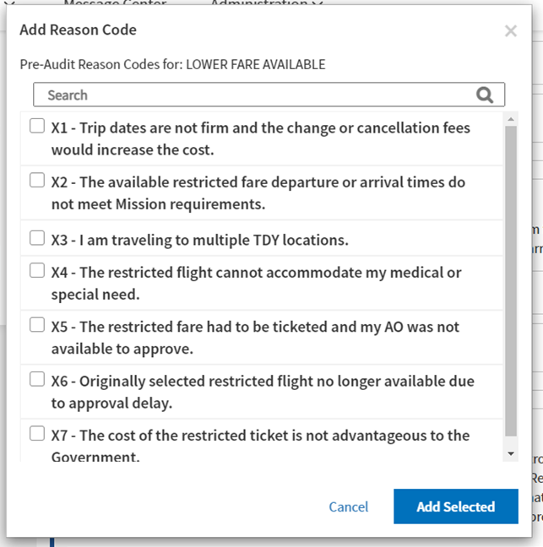
Restricted Airfare Reminder…
If DTS provides a restricted fare option, but you use an unrestricted fare, then you will need to select one or more of the following reason codes on the Pre-Audit and Other Auths page.

Slide 63
Resources
Joint Travel Regulations
  https://www.travel.dod.mil/Policy-Regulations/Joint-Travel-Regulations/
Commercial Air Program
  https://www.travel.dod.mil/Programs/Commercial-Air/
Restricted Airfares Checklist
  https://www.travel.dod.mil/Portals/119/Documents/JTR/Supplements/Restricted_Airfares_Checklist.pdf
Information Paper: Restricted Airfares Available in DTS
  https://media.defense.gov/2022/May/13/2002996901/-1/-1/0/LOOK_AHEAD_IP_2.PDF

Slide 64
Resources
Information Paper: Travel Advances for Restricted Airfares
  https://media.defense.gov/2022/May/13/2002996896/-1/-1/0/ADVANCE_FOR_TICKETED_RESTRICTED_FARE.PDF
You can contact the Travel Assistance Center (TAC) via:
  Phone 888-Help1Go (888-435-7146)
  Web (https://www.travel.dod.mil/passport)
  Chat (Available Monday – Friday between 8am and 6pm ET)

Slide 65
Questions
Questions are taken via Telephone by Site Name in alphabetical order
  A – E (Example – Dyess Air Force Base)
  F – L (Example – Fort Huachuca)
  M – S (Example – Redstone Arsenal)
  T – Z (Example – Yuma Proving Ground)
You can press #6 to unmute your phone’s line to ask a question.
Please be considerate and mute your phone if you are not talking by pressing *6.

