Slide 1
Waterways Commerce Cutter Information Session and Virtual Meeting
USCG WCC Draft PEIS
Please remain on mute until invited to speak during question and answer session following the formal presentation.
Presentation Questions and Comments:
If using Microsoft Teams, type your question into the chat box at any time.
If calling in, we will invite you to ask questions at minute 30, after the presentation.
Additional questions and comments may be submitted to: HQS-SMB-CG-WaterwaysCommerceCutter@uscg.mil
These questions will not be read during the presentation.
Alternatively comments may be submitted through the Federal Decision-Making portal at http://www.regulations.gov, using the search function for Waterways Commerce Cutter or by docket number USCG-2021-0191.
SUBMIT COMMENTS:
Federal Decision-Making Portal at https://www.regulations.gov

Slide 2
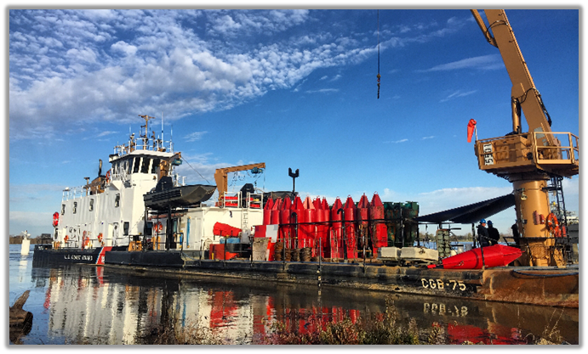
Waterways Commerce Cutter Information Session and Virtual Meeting
USCG WCC Draft PEIS
SUBMIT COMMENTS:
Federal Decision-Making Portal at https://www.regulations.gov

Slide 3
Waterways Commerce Cutter Information Session and Virtual Meeting
USCG WCC Draft PEIS
Meeting Agenda
Formal Presentation, approximately 30 minutes
Process Overview
Proposed Action – Preferred Alternative Details
Proposed Action Areas
Proposed Action Stressors
Environmental Resources & Impacts – Physical
Environmental Resources & Impacts – Biological
Socioeconomic Resources & Impacts
Prospective Timeline for PEIS Completion
Question and Answer Period, approximately 30 minutes
SUBMIT COMMENTS:
Federal Decision-Making Portal at https://www.regulations.gov

Slide 4
Regulatory Process & Timeline
USCG WCC Draft PEIS
National Environmental Policy Act (NEPA)
Enacted in 1969, NEPA requires all federal agencies to consider environmental impacts that may result from a proposed action, inform the public of potential impacts and alternatives, and facilitate public involvement in the assessment process.
Programmatic Environmental Impact Statement (PEIS)
A PEIS would include, among other matters:
Discussion of purpose and need for the proposed action (i.e., new WCCs)
A description of alternatives
As part of the process, alternatives are considered in the analysis (including the No Action Alternative of no new WCCs)
A description of the affected environment
A evaluation of the environmental impacts of the proposed action and alternatives
The No Action Alternative is analyzed as a baseline for comparing impacts of the proposed project (e.g., not approving the design and build of new WCCs)
The Coast Guard has chosen to conduct a PEIS under NEPA to determine whether the proposed WCC activities would result in significant impact or harm to the environment. The EIS will help identify ways improve the protection and conservation of marine resources while these activities are underway.
Other Applicable Environmental Laws
The Endangered Species Act (ESA) requires consultation with the National Marine Fisheries Service (NMFS) and/or the United States Fish and Wildlife Service regarding potential impacts to any endangered species in the proposed action areas.
The Marine Mammal Protection Act (MMPA) requires consideration of any potential impacts of the Proposed Action on marine mammals, their habitats, or their behavior.
The Magnuson Stevens Fishery Act requires that any potential impacts to Essential Fish Habitat (EFH) would also trigger a consultation with NMFS.

Slide 5
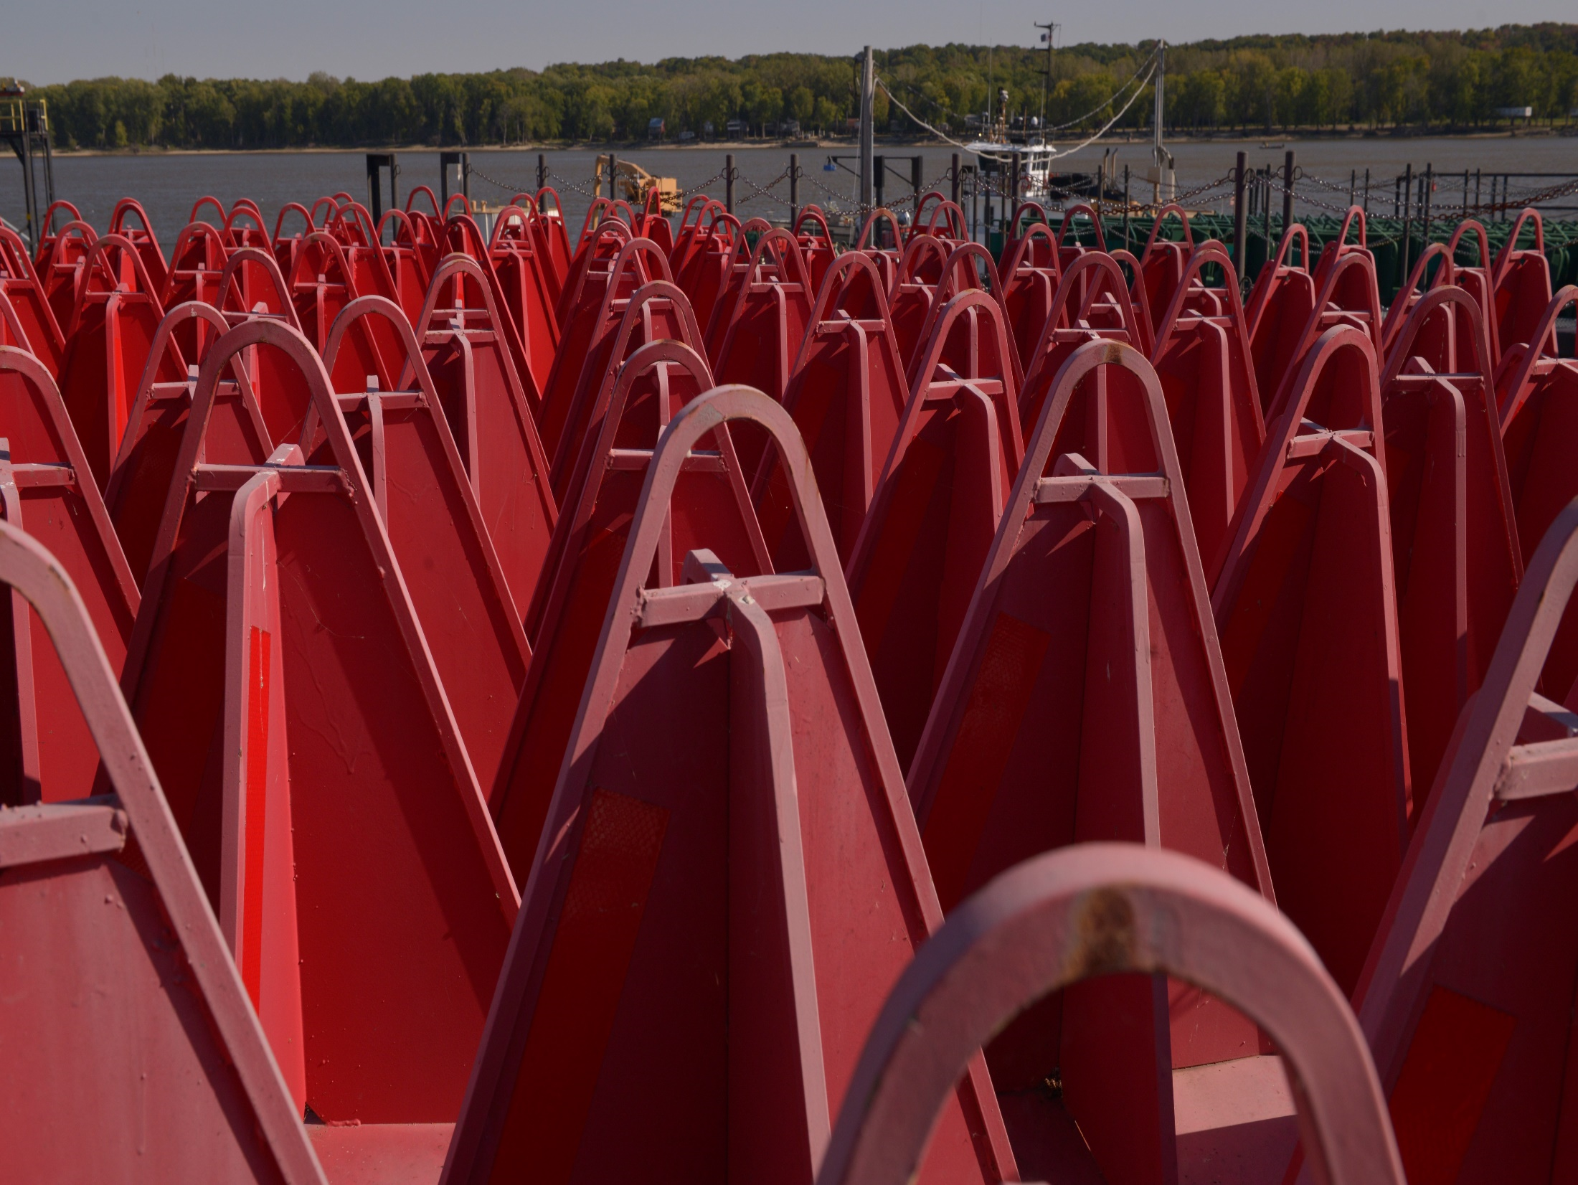
Regulatory Process & Timeline
USCG WCC Draft PEIS
Notice of Intent
We are here
Initiates the public involvement phase
Scoping Period
Learn about and comment on proposed action; Identify and prioritize potential issues; Identify resources to analyze
Draft EIS
Presents analysis of potential environmental impacts
Public Review & Comment
Final EIS
Allows public to read, review, and comment on Draft PEIS
Includes updates to the Draft PEIS and responses to public comments
30 Day Decision Period
Record of Decision
Period during which Coast Guard makes final decisions
Explains the agency's decision, describes the alternatives considered, and discusses plans for mitigation and monitoring
Floating ATON. Photo provided by USCG.

Slide 6
Proposed Action Alternatives
USCG WCC Draft PEIS
Preliminary Proposed Action (Alternative 1)
The Coast Guard would acquire and operate up to 30 WCCs with planned design lives of 30 years each to fulfill mission requirements in the proposed action areas.
Reduced Acquisition of Coast Guard Owned and Operated Systems (Alternative 2)
The Coast Guard would explore the acquisition of fewer Coast Guard Owned and Operated WCCs and perform the ATON mission with contractor personnel.
Mixed Fleet (Alternative 3)
The mixed fleet solution would be a combination of cutters and shore-based assets (including Aids to Navigation team units), electronic ATON, and contracted ATON services.
No Action Alternative
The evaluation of a No Action Alternative is required by the regulations implementing NEPA. Under the No Action Alternative, the Coast Guard would fulfill its missions using the aging cutter and barge fleet with one for one replacements as assets become unserviceable.
This Virtual Meeting will focus on the Preliminary Proposed Action (Alternative 1)
There will be more opportunities to comment on the alternatives during the public review and comment period for the Draft PEIS.

Slide 7
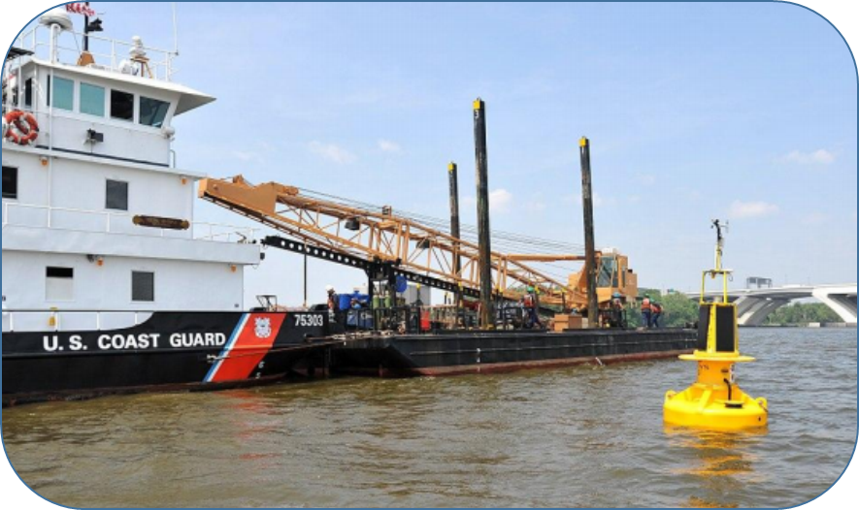
Proposed Action: Overview
USCG WCC Draft PEIS
Primary Mission: Aids to Navigation (ATON)
Establish, operate, and maintain lighted and unlighted buoys and beacons to maintain the U.S. Visual ATON Systems.
Table 1: Current USCG Inland Waterways and Western Rivers Tenders Fleet
Mission Type | Hull Classification | Years Built | Service Life
Construction Operations | WLIC (13 total) | 1944, 1962, 1976 | EXCEEDED
River Buoy Operations | WLR (18 total) | 1960, 1964, 1990 | EXCEEDED
Inland Buoy Operations | WLI (4 total) | 1945, 1954, 1963 | EXCEEDED
Why should the Coast Guard build Waterways Commerce Cutters?
Enable safe navigation of waters that support the nation’s economy.
An updated and improved fleet would allow the Coast Guard to provide timely service to ATON and offer a reliable and consistent presence throughout their operating areas.
New ships would offer a safer and more environmentally friendly platform.
No other Coast Guard assets can access the Inland Waterways and Western Rivers (IW&WR).
Replace existing fleet of
35 Inland Waterways Cutters and 27 barges with
30 Waterways Commerce Cutters (WCC)
Current Inland Buoy tender and associated barge.
Photo provided by USCG.
Photo: USCG

Slide 8
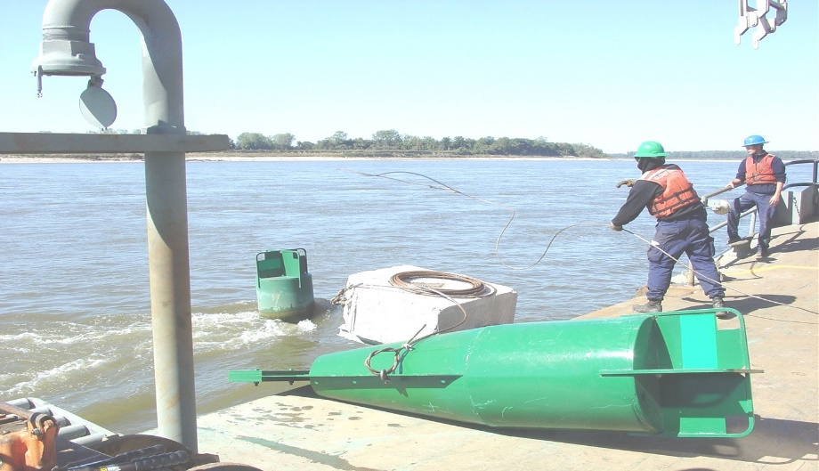
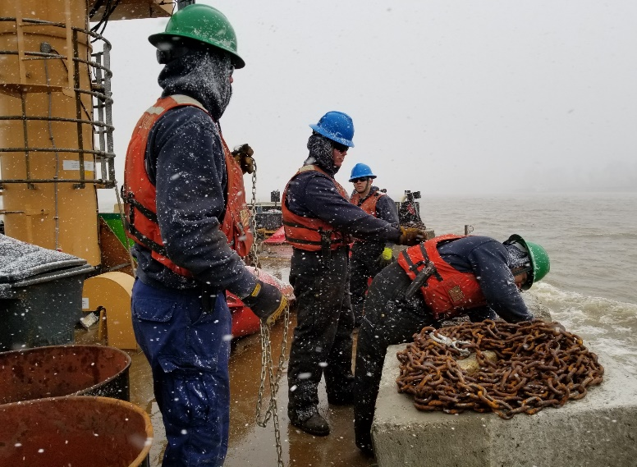
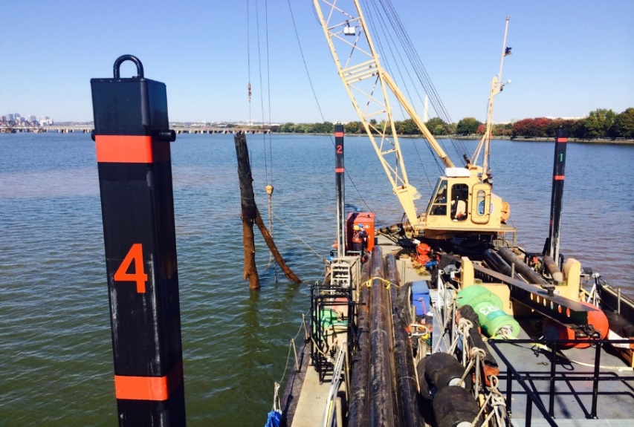
Proposed Action: Overview
USCG WCC Draft PEIS
Acquire and operate up to 30 WCCs with design service lives of 30 years each.
Provide continuous and improved fulfillment of the IW&WR ATON mission.
Maintain 28,200 ATON across approximately 12,000 miles of navigable channels.
Crew members retrieving a floating ATON and preparing to deploy a new sinker and ATON. Photo provided by USCG.
Crew members prepare a sinker for deployment.
Photo provided by USCG.
The crane of a WCC Construction Tender being used to remove a damaged fixed ATON.
Photo provided by USCG.

Slide 9
Proposed Action: Overview
USCG WCC Draft PEIS
Table 2: Proposed USCG Waterways Commerce Cutters
Class | Fleet Size | Description of Operations
Construction (WCC WLIC) | Up to 11 | Specifically designed to support pile driving operations, such as establishing and servicing fixed ATON structures.
River Buoy Tending (WCC WLR) | Up to 16 | Establish, maintain, and discontinue floating ATON and fixed ATON structures.
Inland Buoy Tending (WCC WLI) | Up to 3 | Service ATON in inland waters and waters close to shore.
Inland Construction Tenders
River Buoy Tenders
Additional Mission Support
Ports, Waterways, and Coastal Security
Search and Rescue
Marine Environmental Protection
Marine Safety
Inland Buoy Tenders
Vessel design models provided by USCG.

Slide 10
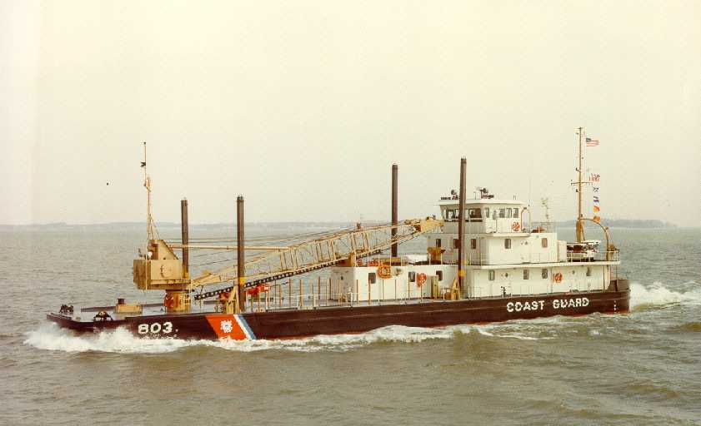
Proposed Action: WCC Inland Construction Tenders
USCG WCC Draft PEIS
Current WLIC SAGINAW
WCC Inland Construction Tenders
Would serve U.S. East Coast (USEC) Mid-Atlantic, USEC-South, and Gulf of Mexico and Mississippi River proposed action areas.
Would service inland and nearshore ATON.
Specifically designed for establishing and replacing fixed ATON.
Designed to support impact and vibratory pile driving capabilities.
WCC Inland Construction Tender
Photos provided by USCG.
Notes:
-The Construction tenders would be located in the U.S. East Coast-Mid-Atlantic, U.S. East Coast-South, Including Florida and the Bahamas, and the Gulf of Mexico and U.S. Inland States, Including the Mississippi River and Its Tributaries proposed action areas, which support the Coast Guard’s Fifth, Seventh, and Eighth Districts.
-More than 60 percent of the Coast Guard’s 21,670 beacons are located in these proposed action areas. These proposed action areas contain over 14,000 beacons and over 200 floating ATON.
-Construction tenders service inland and nearshore ATON and would be specifically designed for establishing and replacing fixed ATON.
-WCC Construction tenders would also be equipped with impact and vibratory pile driving/extraction equipment (e.g., diesel-powered or hydraulic impact pile driving hammer and vibrating pile extractor / driver hammer).

Slide 11
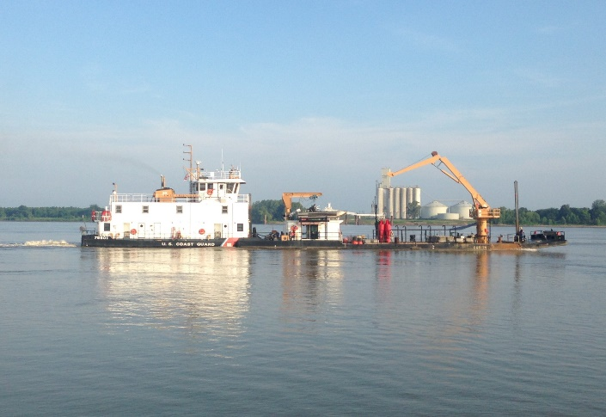
Proposed Action: WCC River Buoy Tenders
USCG WCC Draft PEIS
Current WLR GREENBRIER and Barge
WCC River Buoy Tenders
Would serve the Gulf of Mexico and Mississippi River proposed action area.
Would service 12,000 – 15,000 ATON in pooled waters and open flowing rivers.
Capable of deploying, retrieving, and relocating floating ATON and their associated equipment.
WCC River Buoy Tender
Photos provided by USCG.

Slide 12
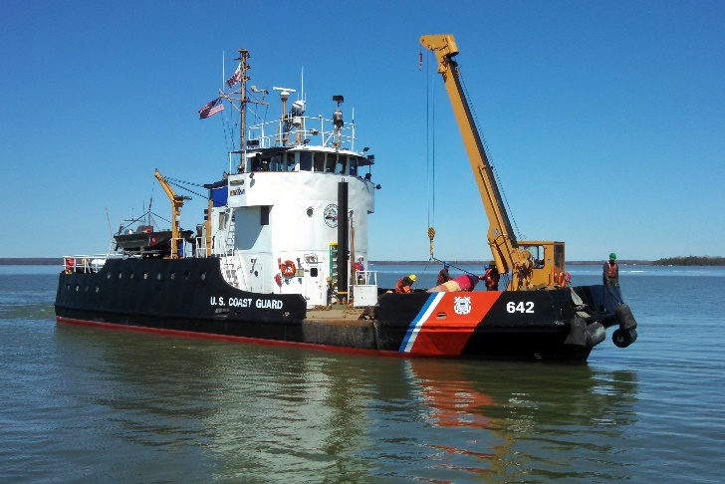
Proposed Action: WCC Inland Buoy Tenders
USCG WCC Draft PEIS
Current WLI BLUEBELL
WCC Inland Buoy Tenders
Would serve the Pacific Northwest, Great Lakes, and Southeast Alaska proposed action areas.
Specifically designed to service inland waters and waters close to shore.
Capable of deploying, retrieving, and relocating floating ATON and their associated equipment.
WCC Inland Buoy Tenders
Photos provided by USCG.

Slide 13
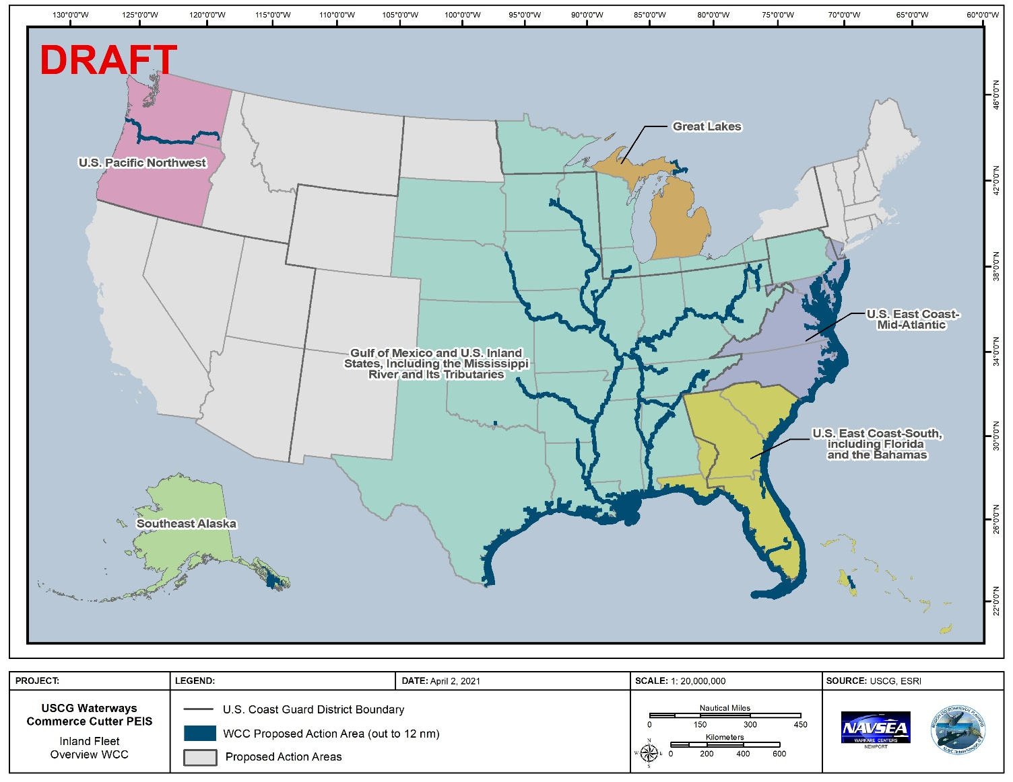
Proposed Action Areas
USCG WCC Draft PEIS
Transit would occur one time between the location of ship construction and its homeport.
Transit would occur within the IW&WR, with each WCC assigned to its own operational area.
No anticipated significant changes between the current inland tender fleet’s and future WCC’s operational areas.

Slide 14
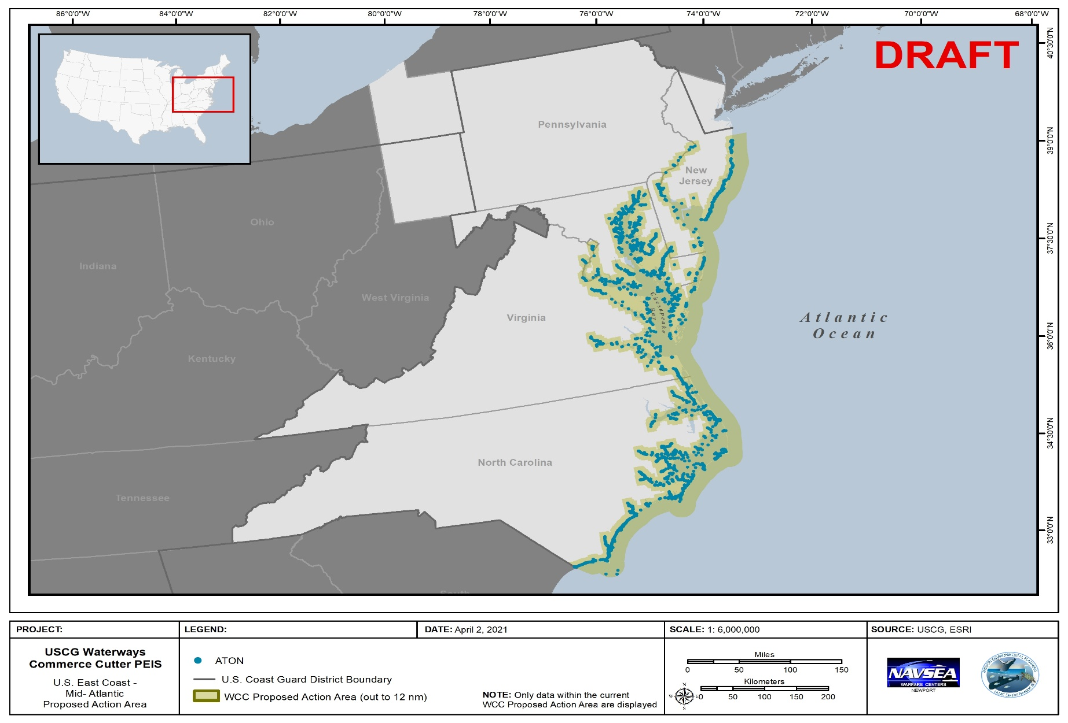
Proposed Action Areas
USCG WCC Draft PEIS
U.S. East Coast, Mid-Atlantic (District 5)
Delaware, Maryland, Virginia, North Carolina

Slide 15
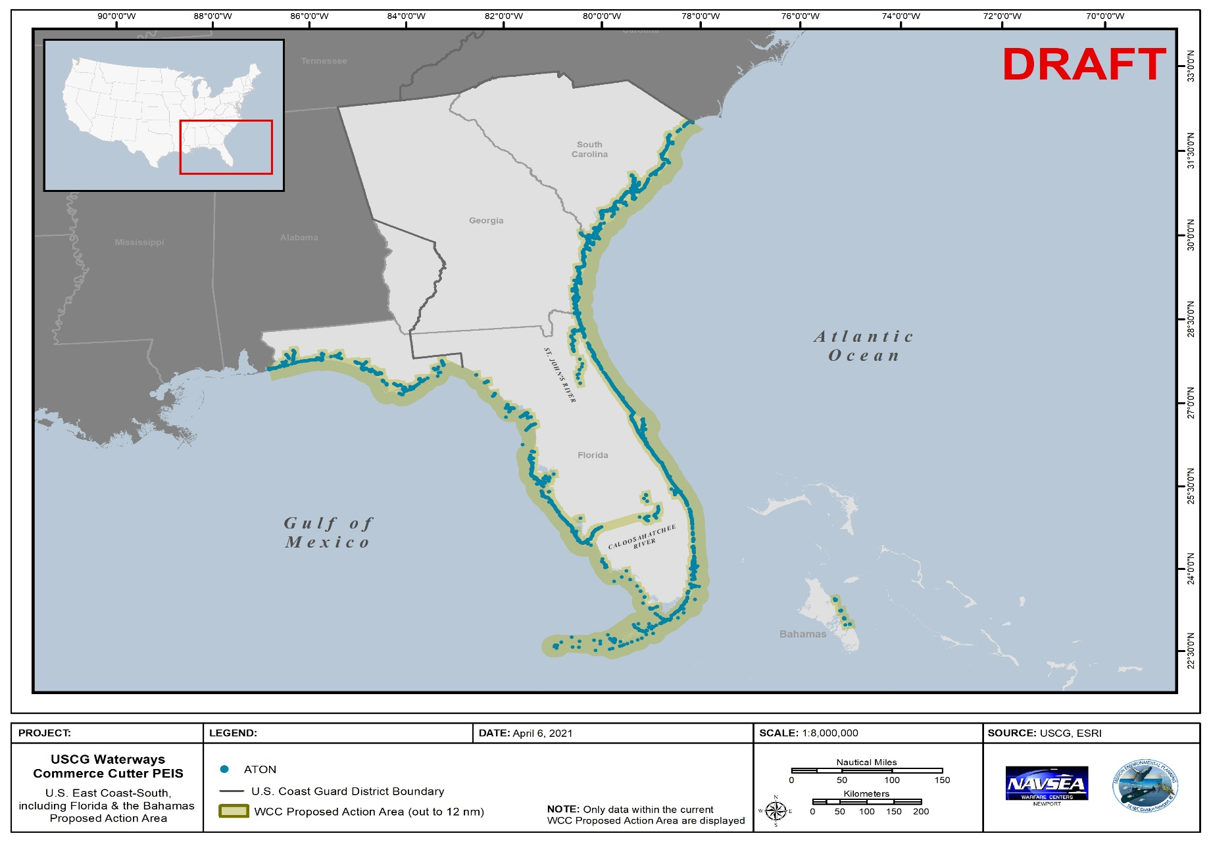
Proposed Action Areas
USCG WCC Draft PEIS
U.S. East Coast, South (District 7)
South Carolina, Georgia, Florida, and the Bahamas

Slide 16
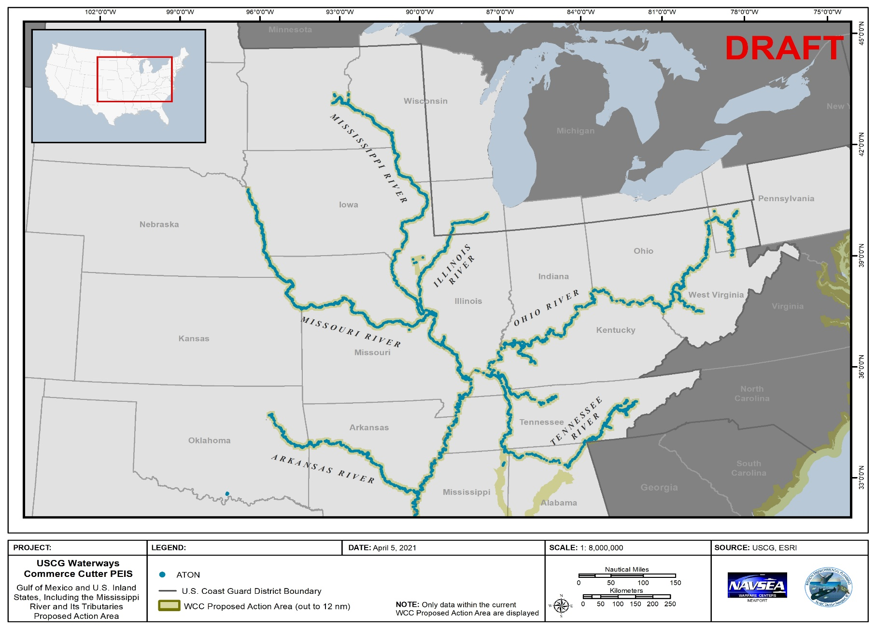
Proposed Action Areas
USCG WCC Draft PEIS
Gulf of Mexico and U.S. Inland States
(District 8)
Northern Region

Slide 17
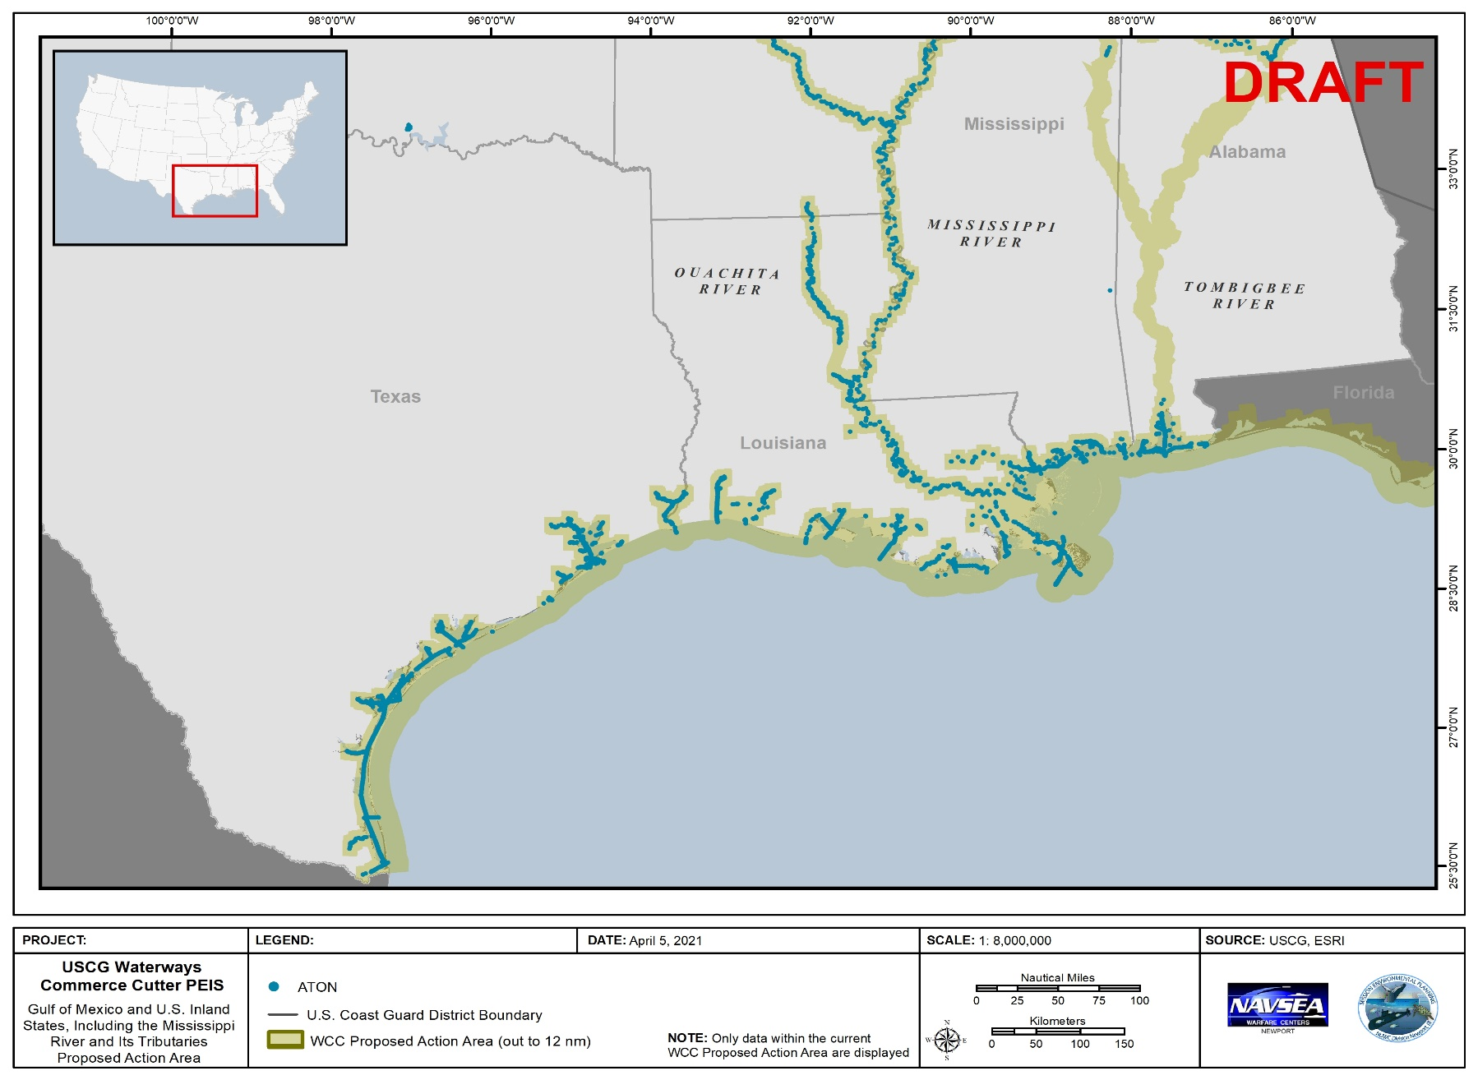
Proposed Action Areas
USCG WCC Draft PEIS
Gulf of Mexico and U.S. Inland States (District 8)
Southern Region

Slide 18
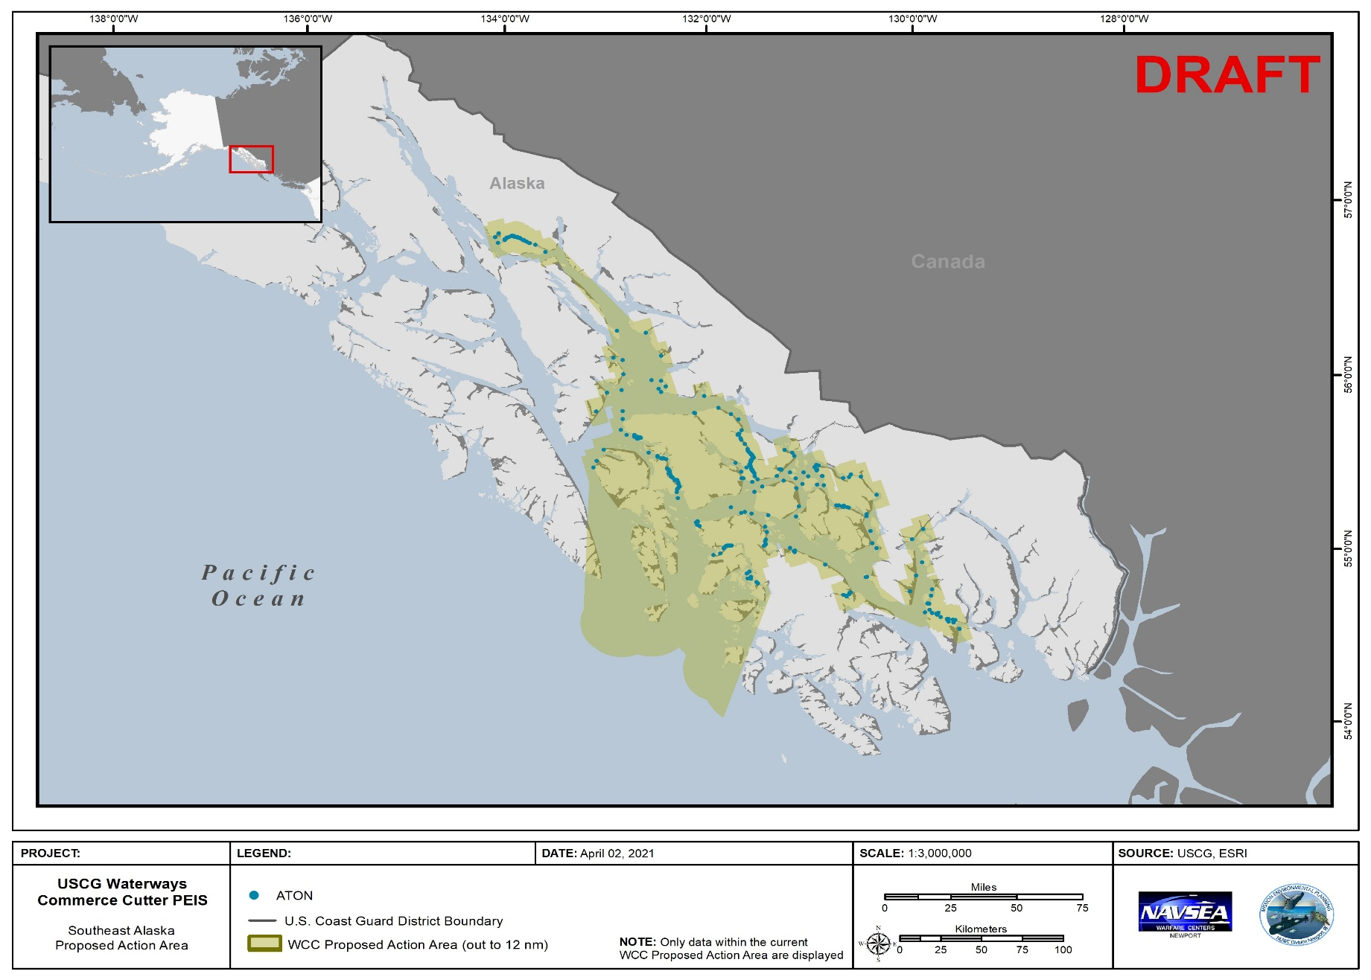
Proposed Action Areas
USCG WCC Draft PEIS
Southeast Alaska
(District 17)

Slide 19
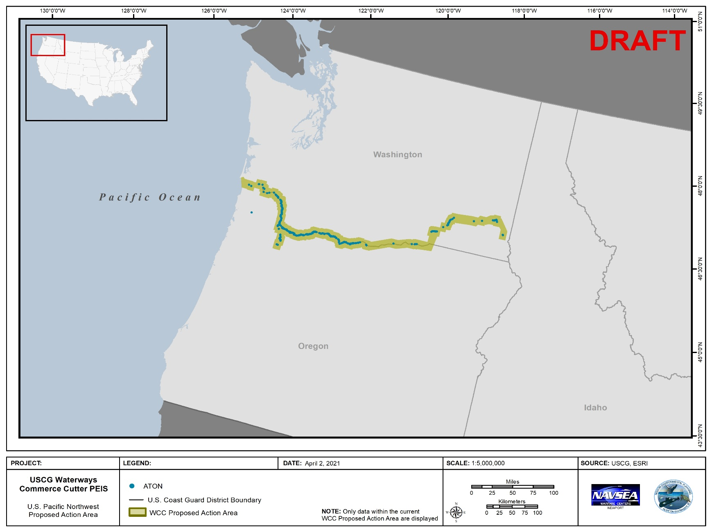
Proposed Action Areas
USCG WCC Draft PEIS
U.S. Pacific Northwest (District 13)
Washington & Oregon

Slide 20
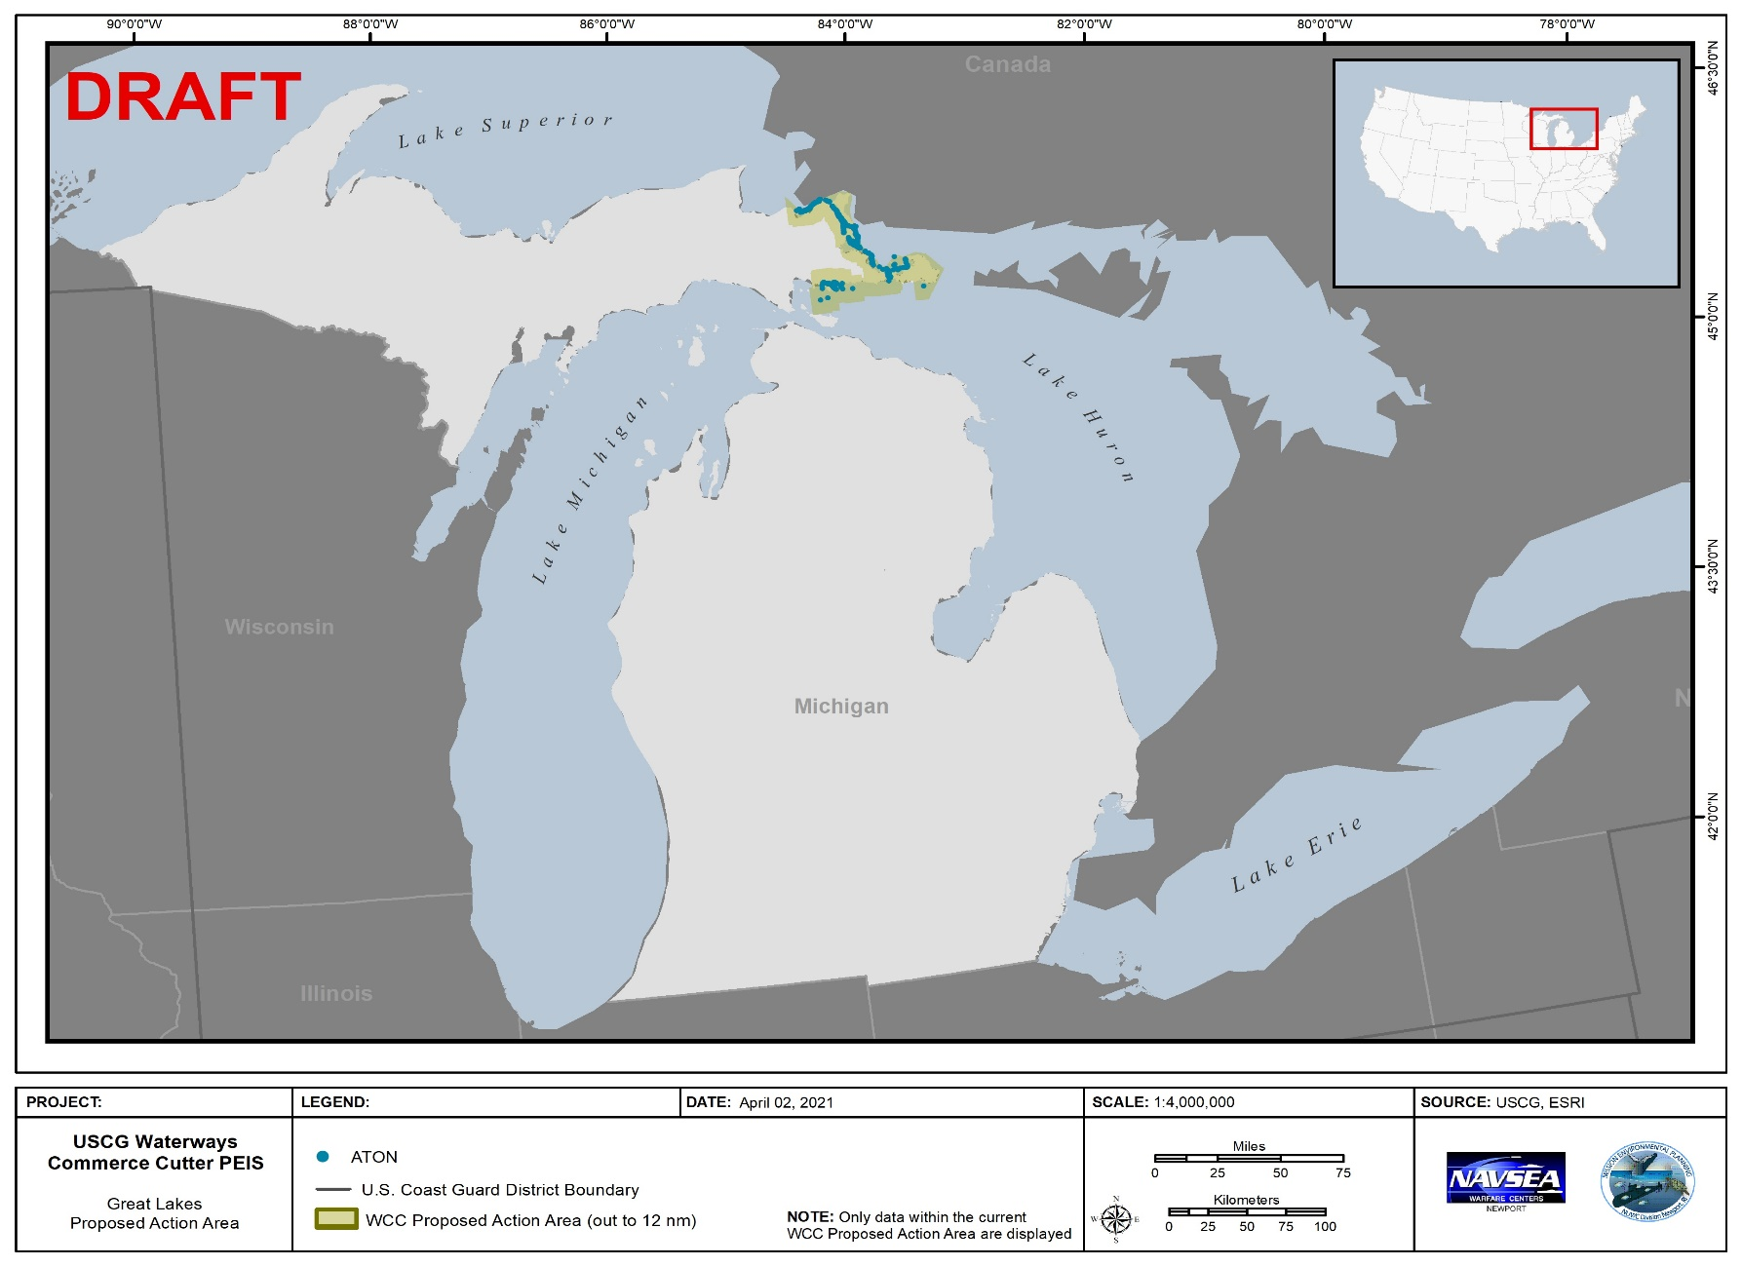
Proposed Action Areas
USCG WCC Draft PEIS
Great Lakes
(District 9)
Northern Michigan

Slide 21
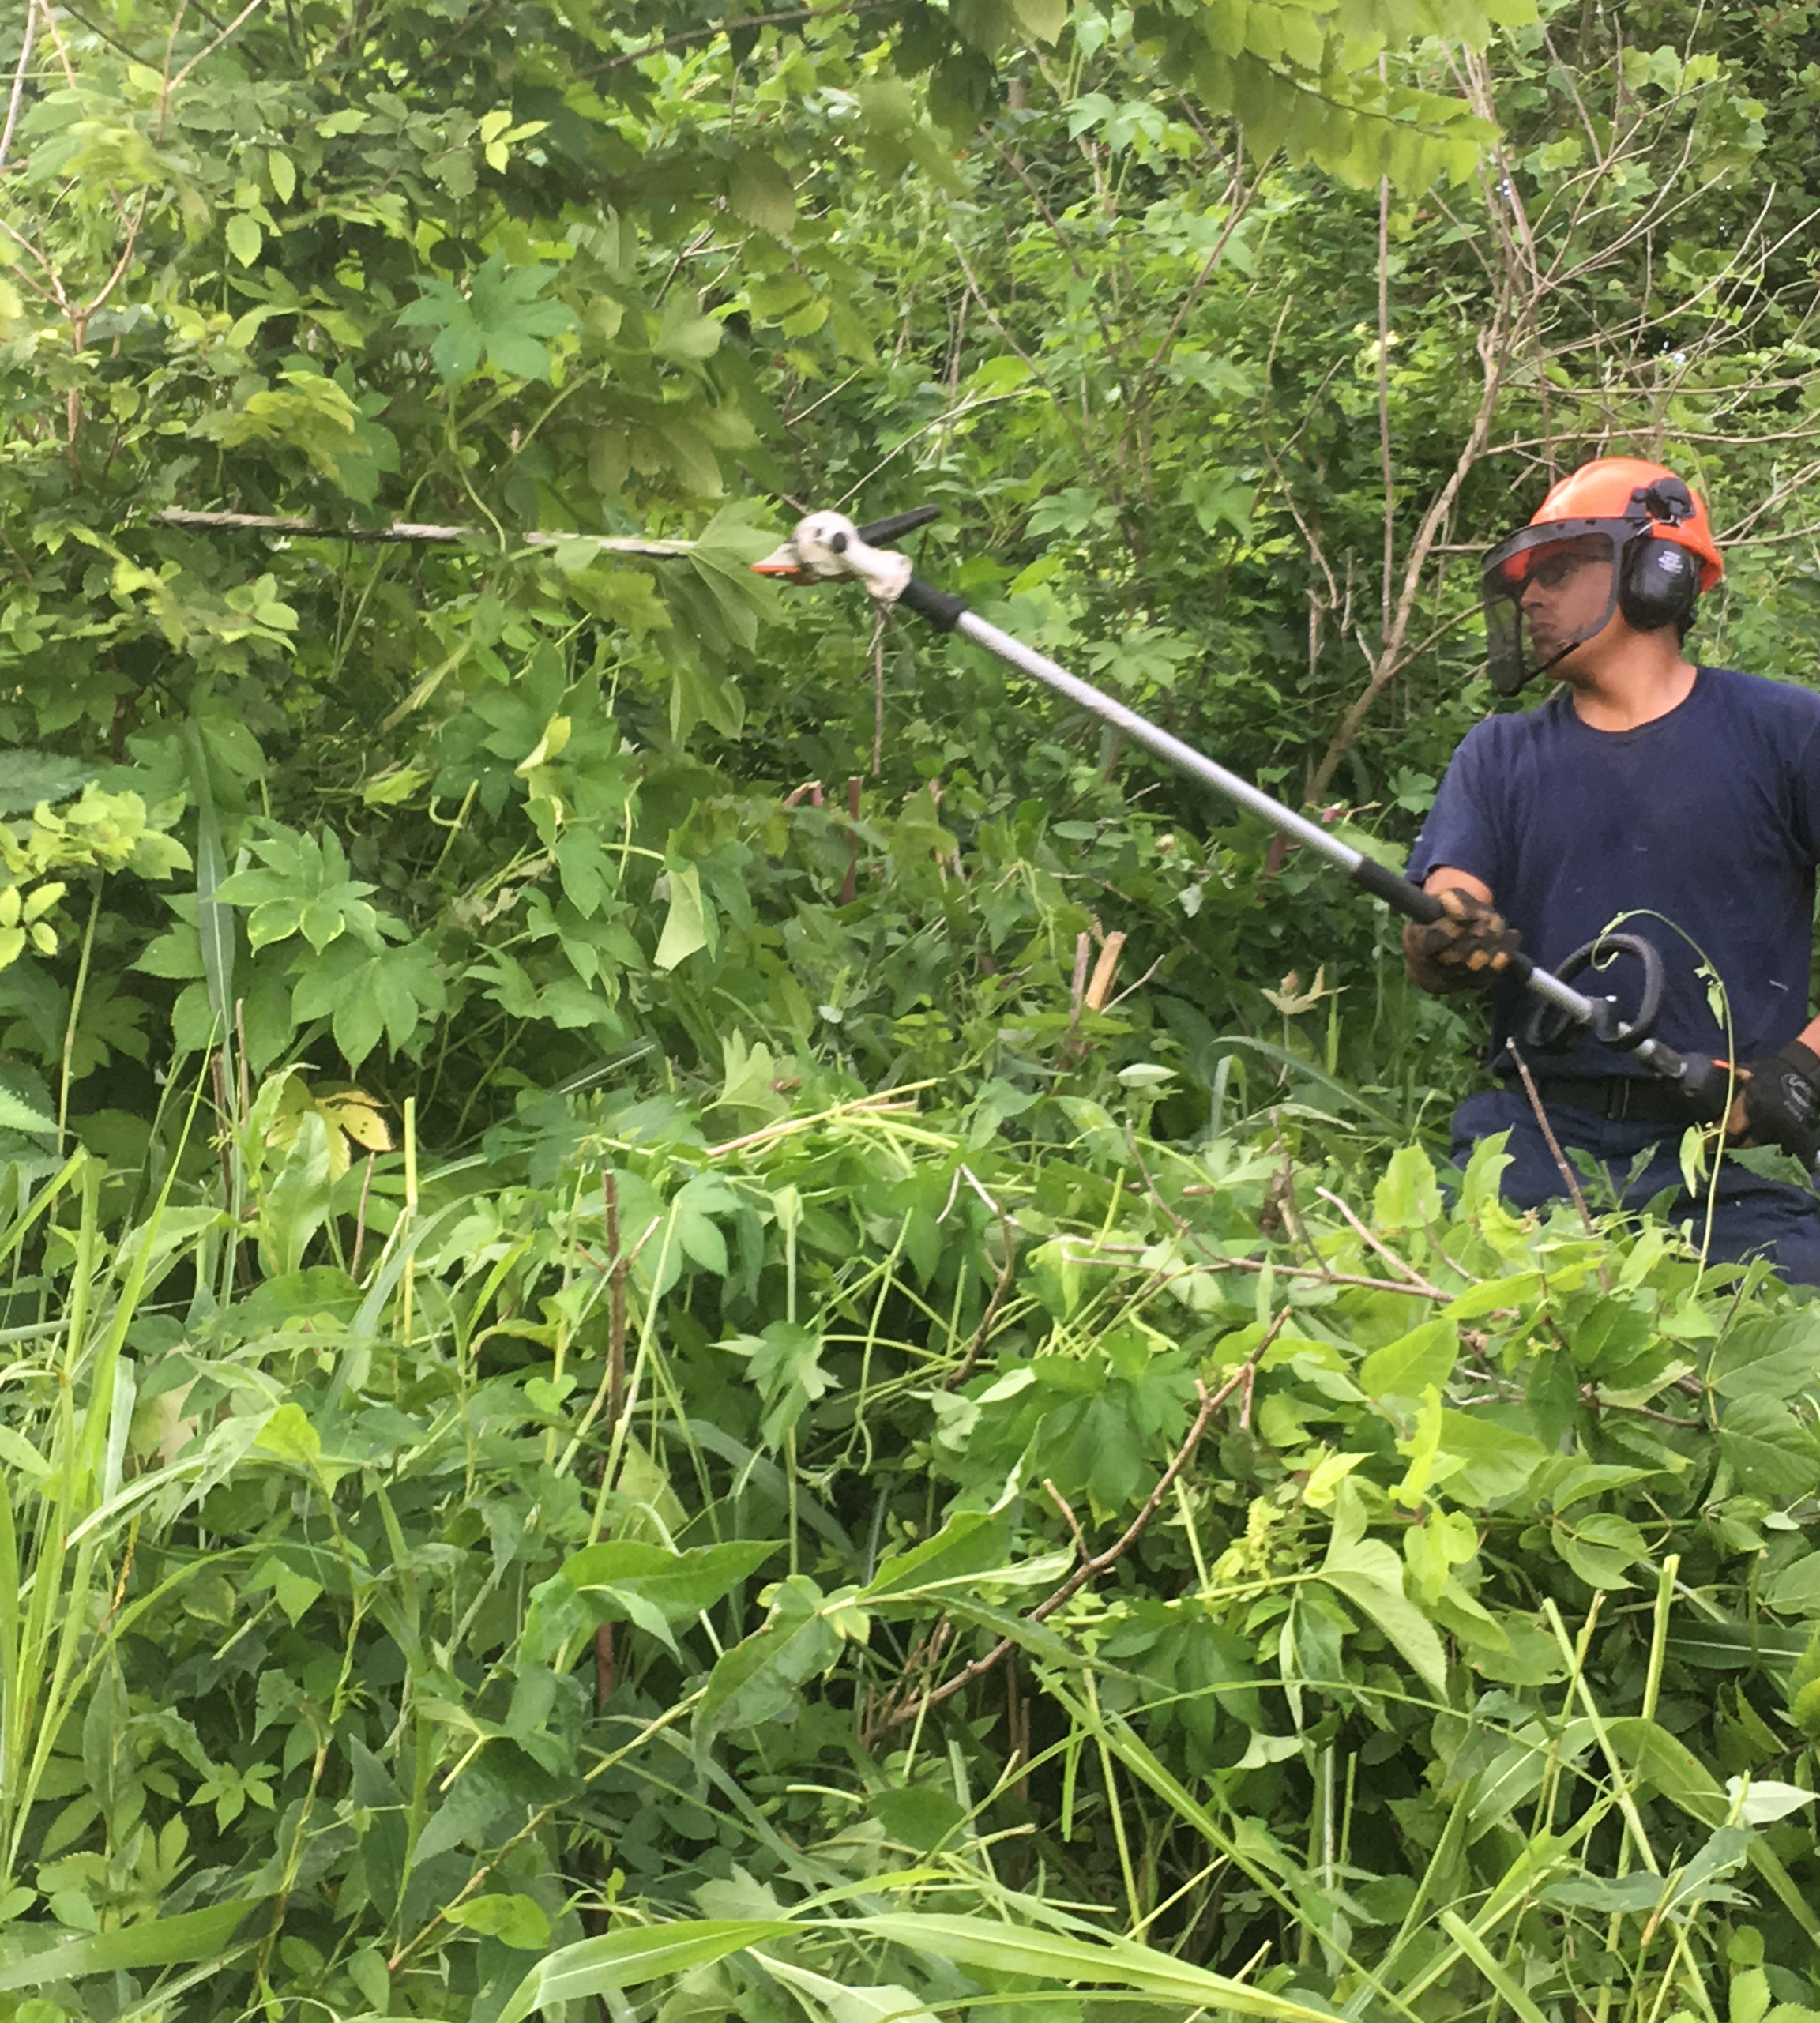
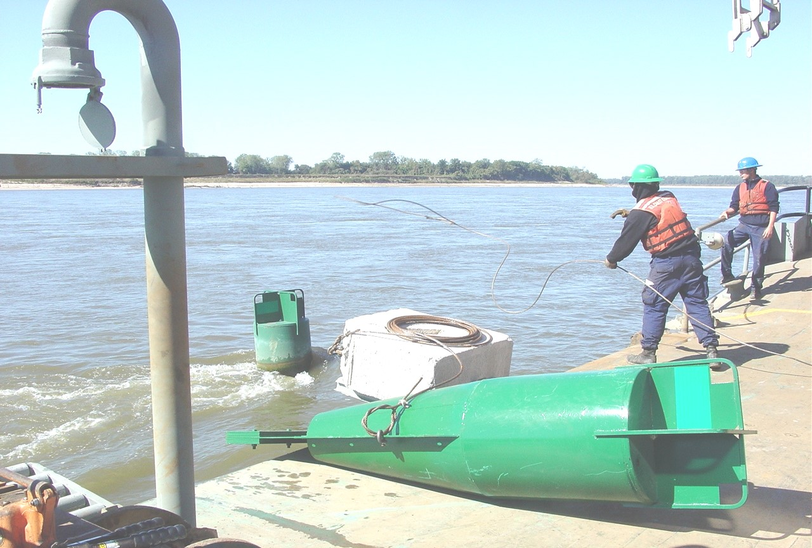
Proposed Action: Stressors
USCG WCC Draft PEIS
Acoustic Stressors
Depth-sounder/navigational system
Vessel noise
ATON signal noise
Tool noise
Pile driving noise
Physical Stressors
Vessel movement
Bottom disturbance
Ground disturbance (removal of brush/construction)
Pile driving
Debris
ATON retrieval devices and tow lines
Crew member using a pole saw to cut down vegetation to clear an ATON.
Photo provided by USCG.
Crew members retrieving a floating ATON and preparing to deploy a new sinker and ATON.
Photo provided by USCG.

Slide 22
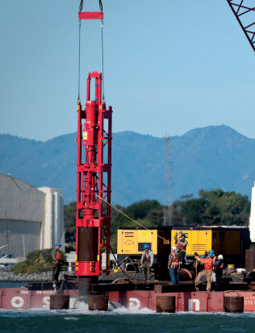
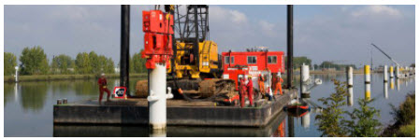
Proposed Action: Stressors - Pile Driving
USCG WCC Draft PEIS
WCC Inland Construction Tenders may be equipped with pile driving equipment to include an impact hammer, vibratory hammer, or both.
Impact hammer pile driving is best suited for hard bottomed waterways.
Vibratory pile driving methods are less disruptive to the environment but cannot service all bottom types.
Example of an impact pile driver. Photo provided by BAUER-Pileco Inc.
Example of a vibratory pile driver.
Photo provided by PVE Piling & Vibro Equipment.
Pile driving activities would only occur in water depths less than 20 ft (6m) and in the following proposed action areas: USEC-MidATL, USEC-South, and GoMEX and Mississippi River.
Notes:
.

Slide 23
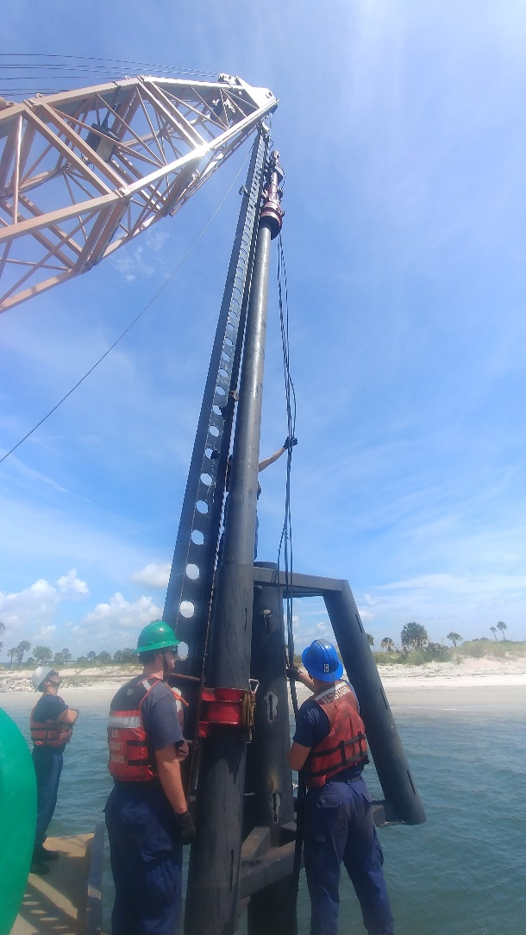
Environmental Resources for Evaluation - Physical
USCG WCC Draft PEIS
The Coast Guard is evaluating potential impacts to a wide range of environmental resources from new WCCs and associated operations and training activities.
Resource | Description
Air Quality | The Clean Air Act regulates all new and in‐use vessels flagged in the United States that contain marine diesel engines, as well as the emissions from these engines. WCCs are considered non-road mobile sources of emissions, which include carbon monoxide (CO), nitrogen oxide (NO_{X}), particulate matter, sulfur dioxide (SO₂), and volatile organic compounds (VOCs).
Ambient Sound | Biotic, abiotic, and anthropogenic (manmade) sounds make up the existing ambient sound environment. Each of the proposed action areas includes different combinations of sources that create the in-air and in-water ambient sound environments.
Bottom Habitat and Sediment | Sediments consist of solid fragments of organic and inorganic matter forming the bottom of bodies of water, often referred to as substrate. The substrate can provide suitable habitat for a wide range of species.
Water Quality | The Clean Water Act requires the EPA to develop criteria for surface water quality that reflects the best information on the impacts of pollutants on human health and the environment. Criteria exist for aquatic life, human health, and recreation.
Crew members assist the attachment of the impact pile driver to a pile.
Photo provided by USCG.

Slide 24
Potential Environmental Impacts - Physical
USCG WCC Draft PEIS
Based on preliminary analyses using the best available science the Coast Guard has evaluated the following resources:
Resource | Preliminary Analysis | Anticipated Significance of Impact
Air Quality | Emissions: WCC operations could add to existing pollutant concentrations. WCC emissions would be unlikely to measurably add to existing pollutant concentrations because of the small number of vessels and large operation areas. There would be no increase in emissions over the use of the current fleet. | No Significant Impact
Ambient Sound | Operational Noise: WCCs could impact ambient sound levels through the operation of WCC vessels, including engines, onboard equipment, and navigational technologies. WCC operational noise would be similar to the noise from other vessels in the proposed action areas. Pile driving noise would increase the sound level in air and underwater. Any resulting increase to ambient sound would be short and only for the duration of active pile driving. There would be no increase in ambient noise over the use of the current fleet. | No Significant Impact

Slide 25
Potential Environmental Impacts - Physical
USCG WCC Draft PEIS
Based on preliminary analyses using the best available science the Coast Guard has evaluated the following resources:
Resource | Preliminary Analysis | Anticipated Significance of Impact
Bottom Habitat and Sediment | ATON operations may impact exposed substrate and temporarily suspend sediments. Sediments would be expected to shift back as they normally would following a natural disturbance. There would be no increase in disturbance to bottom habitat and sediment over the use of the current fleet. | No Significant Impact
Water Quality | ATON operations may cause a temporary increase in turbidity in the footprint of and around ATON. Sediments would be expected to shift back and settle out of the water column. There would be no decrease in water quality (due to increased turbidity) over the operations of the current fleet. | No Significant Impact

Slide 26
Environmental Resources for Evaluation - Biological
USCG WCC Draft PEIS
The Coast Guard is evaluating potential impacts to a wide range of environmental resources from new WCCs and associated operations and training activities.
Resource | Description
Riverine and Marine Vegetation | Includes algae, phytoplankton, seagrass, cordgrass, and riparian vegetation. May float in the water column, attach to the seafloor, or grow along the banks of rivers, streams, and estuaries.
Invertebrates | Includes single-celled organisms, benthic worms, sponges, cnidarians (including hydroids and jellyfish), moss animals (bryozoans), cephalopods, bivalves, sea snails, chitons, amphipods, copepods, crustaceans, and echinoderms (urchins and sea cucumbers).
Fish and Essential Fish Habitat (EFH) | Includes a diverse range of species living everywhere from intertidal beaches to the bottom of the sea. EFH for federally-managed species includes all locations where fish spawn, breed, feed, or grow to maturity.
Birds | Includes species that are distributed mainly on land, but forage in aquatic habitats and those that are distributed in aquatic habitats where they also forage.
Reptiles | Includes species of turtles (including ESA-listed sea turtles), alligators, crocodiles, lizards, snakes, and worm lizards.
Marine Mammals | Includes whales, dolphins, porpoises, seals, sea lions, walruses, sea otters, and polar bears.
Terrestrial Mammals | Includes species of opossum, armadillo, rodents, rabbits, moles and shrews, bats, carnivores, and hoofed animals.
Amphibians | Includes frogs, toads, newts, and salamanders.
Insects | Includes species of beetles, flies and mosquitos, mayflies, true bugs, butterflies and moths, dobsonflies and alderflies, dragonflies, stoneflies, and caddisflies.

Slide 27
Potential Environmental Impacts - Biological
USCG WCC Draft PEIS
Based on preliminary analyses using the best available science the Coast Guard has evaluated the following resources:
Resource | Preliminary Analysis | Anticipated Significance of Impact
Riverine and Marine Vegetation | Disturbance/Removal: Vegetation may be disturbed, crushed, removed, cut down, or sprayed with herbicides during WCC operations. Vegetation has the potential to regrow. Would only impact a small percentage of the overall vegetative population. | No Significant Impact
Invertebrates | Noise from WCC activities might mask communication and cues for larval orientation and settlement for crustaceans. Masking as a result of vessel noise would be expected to be temporary and any invertebrates that were disturbed are expected to return to the area as the WCC moves from the area. No permanent impacts to hearing capabilities are expected. Collision: Some invertebrates in upper water layers might be struck by the vessel or entangled in in-water devices. Vessel presence would be temporary in a given area and time and would affect an extremely small number of organisms. Entanglement risk is low as there would be little to no slack in the lines and would affect an extremely small number of organisms. | No Significant Impact

Slide 28
Potential Environmental Impacts - Biological
USCG WCC Draft PEIS
Based on preliminary analyses using the best available science the Coast Guard has evaluated the following resources:
Resource | Preliminary Analysis | Anticipated Significance of Impact
Fish and Essential Fish Habitat (EFH) | Noise from WCC activities may cause some “hearing specialists” (e.g., cod and shad) and other fish species to be startled and to leave the immediate activity area, or avoid the area. EFH may be impacted due to the increase in ambient sound level. Any reaction to noise is expected to be temporary; animals would be expected to resume normal behaviors immediately after WCC activities end. The quality of the water column environment as EFH would be restored to normal levels immediately following the conclusion of WCC activities. Collision: Fish could be struck by the vessel or in-water devices. Vessel presence would be temporary in a given area and time. Most fish would avoid the vessel or in-water devices. | No Significant Impact

Slide 29
Potential Environmental Impacts - Biological
USCG WCC Draft PEIS
Based on preliminary analyses using the best available science the Coast Guard has evaluated the following resources:
Resource | Description | Anticipated Significance of Impact
Birds | Vessel noise is low frequency and located at the edge of most birds’ hearing range. Vessel presence would be temporary in a given area, so any effects of vessel noise would be limited to temporary behavioral responses (no impacts to hearing capabilities). Disturbance: The most likely response to any disturbance is to flush from the area. Birds would be expected to immediately return to their normal behavior once WCC activities end. | No Significant Impact
Reptiles | Collision: A WCC or in-water device may collide with a sea turtle. The widespread, scattered distribution of turtles at sea means collisions with WCCs during open ocean transits are unlikely. Sea turtles are also rare in river environments; therefore, collisions between WCCs and sea turtles in rivers are also unlikely. Noise: A sea turtle may experience a temporary hearing impact and behavioral responses from WCC activities, specifically if exposed to pile driving noise. A 1,000-meter safety zone would be established around each pile with an Environmental Observer present. If any sea turtles are observed within the safety zones, Coast Guard would follow pile driving safety and best management practices to minimize impacts. | No Significant Impact

Slide 30
Potential Environmental Impacts - Biological
USCG WCC Draft PEIS
Based on preliminary analyses using the best available science the Coast Guard has evaluated the following resources:
Resource | Description | Anticipated Significance of Impact
Marine Mammals | Noise: The low-frequency noise produced by the ship’s engine is outside the typical hearing range of seals and toothed whales (e.g., dolphins, sperm whales); however, some other marine mammals (e.g., killer whales) may be able to hear it. If a marine mammal were to hear noise associated with the Proposed Action, the marine mammal’s reaction is expected to be temporary. Pile driving noise: A marine mammal may experience a temporary hearing impact and behavioral responses from WCC activities, specifically if exposed to pile driving noise. The limited duration of Coast Guard pile driving events reduces the potential for marine mammals to be exposed. Coast Guard pile driving would not result in prolonged periods of elevated underwater sound since each pile driving only lasts, at most, a few hours. A 1,000-meter safety zone would be established around each pile with an Environmental Observer present. If any marine mammals are observed within the safety zones, Coast Guard would follow pile driving safety and best management practices to minimize impacts. | No Significant Impact
Notes:
.

Slide 31
Potential Environmental Impacts - Biological
USCG WCC Draft PEIS
Based on preliminary analyses using the best available science the Coast Guard has evaluated the following resources:
Resource | Description | Anticipated Significance of Impact
Marine Mammals | Collision: Marine mammals could be struck by the WCC or in-water devices. The probability of a vessel encountering a marine mammal is expected to be low. Mitigation measures would be initiated upon the sighting of a marine mammal. | No Significant Impact
Terrestrial Mammals | Vessel noise: The low-frequency noise produced by the ship’s engine may be within the hearing range of some terrestrial mammals. Any behavioral responses to vessel noise are expected to be temporary and any terrestrial mammals that are disturbed are expected to return to the area as the WCC moves from the area. No permanent impacts to hearing capabilities are expected. Pile driving noise may disturb terrestrial mammals during operations, potentially interrupting the daytime sleep of nocturnal species or interfering with foraging in favored locations for diurnal species. It is expected that terrestrial mammals would return to their normal behavior shortly after exposure. | No Significant Impact

Slide 32
Potential Environmental Impacts - Biological
USCG WCC Draft PEIS
Based on preliminary analyses using the best available science the Coast Guard has evaluated the following resources:
Resource | Description | Anticipated Significance of Impact
Terrestrial Mammals | Disturbance: The most likely response to any disturbance is to flush from the area. WCC activities would be temporary and terrestrial mammals would be expected to immediately return to their normal behavior once WCC activities end. | No Significant Impact
Amphibians | Vessel noise: Potential impacts to amphibians from vessel noise would most likely result in masking or cause a behavioral response. Any behavioral responses to vessel noise are expected to be temporary and any amphibians that are disturbed are expected to return to the area as the WCC moves from the area. No permanent impacts to hearing capabilities are expected. Collision: The potential for minor injury, permanent injury, or death from bleeding/trauma, paralysis and subsequent drowning, infection, or inability to feed exists if an amphibian is struck by a WCC. In the event of a strike, individuals may be impacted, but population-level effects would not be expected. | No Significant Impact

Slide 33
Potential Environmental Impacts - Biological
USCG WCC Draft PEIS
Based on preliminary analyses using the best available science the Coast Guard has evaluated the following resources:
Resource | Description | Anticipated Significance of Impact
Amphibians | Disturbance: The most likely response to any disturbance is to flush from the area. WCC activities would be temporary and amphibians would be expected to immediately return to their normal behavior once WCC activities end. | No Significant Impact
Insects | Habitat Loss: In clearing vegetation and sediment away, a small percentage of habitat may be lost. Removal of Vegetation: Insects may also experience injury or mortality due to the use of chainsaws, pole saws, hand tools, and pesticides and herbicides to clear away vegetation. Short term behavioral reactions are not expected to result in long-term impacts to individuals (such as chronic stress) or populations given the diffuse land-based ATON spread throughout the proposed action areas. | No Significant Impact

Slide 34
Socioeconomic Resources for Evaluation
USCG WCC Draft PEIS
To determine potential impacts from the addition of new WCCs and associated operations, the Coast Guard is evaluating a wide range of socioeconomic resources.
Resource | Description
Commercial Fisheries | Commercial fishing takes place throughout much of the proposed action areas, including coastal waters within 12 nm of the shore. Commercial fishing in inland freshwater is rare, but not completely absent.
Marine Construction | May include nearshore projects, such as the construction of marinas, port improvements, and beach renourishment. Offshore marine construction projects may include the construction of oil and gas platforms, pipelines, and wind turbines, amongst others.
Mineral Extraction | Sand or gravel mining may be conducted coastally or at inland locations.
Oil and Gas Extraction | States control oil and gas development within their state waters, from the coast to 3 nm for most states. Bureau of Ocean Energy Management (BOEM) manages leases for oil and gas production on the outer continental shelf (OCS). Nearly all offshore oil and gas production in the U.S. EEZ occurs within the Gulf of Mexico.
Recreation and Tourism | Includes the full range of tourism, leisure, recreationally-oriented activities, and associated development (e.g., hotels, resorts, restaurants, food industry, vacation homes, second homes, retail businesses, marinas, fishing tackle stores, dive shops, fishing piers, and recreational fishing facilities).

Slide 35
Socioeconomic Resources for Evaluation
USCG WCC Draft PEIS
To determine potential impacts from the addition of new WCCs and associated operations, the Coast Guard is evaluating a wide range of socioeconomic resources.
Resource | Description
Renewable Energy | Renewable energy resources that would be located in the proposed action areas could be categorized as riverine (hydroelectric, pump storage) and marine (emerging in-water technologies, offshore wind).
Transportation and Shipping | Container ships bringing components and finished products to markets; tankers and dry bulk vessels bringing ore, oil, gas, and more to and from their points of production; fishing vessels; passenger and tourism vessels; and research vessels.
Subsistence Fishing and Hunting and Cultural Use | Includes customary and traditional uses of wild resources for food, clothing, fuel, transportation, construction, arts, and crafts.

Slide 36
Potential Socioeconomic Impacts
USCG WCC Draft PEIS
Based on preliminary analyses using the best available science the Coast Guard has evaluated the following socioeconomic resources:
Resource | Potential Positive Impacts | Potential Negative Impacts | Proposed Mitigation or Coordination
Commercial Fisheries | USCG presence would ensure that mariners, including commercial fishermen, would have support should an emergency arise due to ATON, marine safety, and SAR missions. In addition, USCG missions protect fisheries. | Indirect impacts to fish from stressors associated with WCC operations. | No mitigation needs anticipated. Continued coordination expected.
Marine Construction | USCG presence would ensure that mariners, including construction workers, would have support should an emergency arise due to ATON, marine safety, and SAR missions. | No negative impacts anticipated. USCG would not cease or disrupt marine construction to conduct operations. | No mitigation needs anticipated. Continued coordination expected.
Mineral Extraction | USCG presence would ensure that mariners, including workers on vessels, would have support should an emergency arise due to ATON, marine safety, and SAR missions. | No negative impacts anticipated. USCG would not cease or disrupt mineral extraction to conduct operations. | No mitigation needs anticipated. Continued coordination expected.
Oil and Gas Extraction | USCG presence would ensure that mariners, including workers on vessels or oil and gas platforms, would have support should an emergency arise due to ATON, marine safety, and SAR missions. | No negative impacts anticipated. USCG would not cease or disrupt oil and gas extraction to conduct operations. | No mitigation needs anticipated. Continued coordination expected.
Recreation and Tourism | USCG presence would ensure that boaters, including fishermen and workers on vessels, would have support should an emergency arise due to ATON, marine safety, and SAR missions. | Indirect impacts to fish and marine mammals that may impact recreational fishing and whale watching. | No mitigation needs anticipated. Continued coordination expected.

Slide 37
Potential Socioeconomic Impacts
USCG WCC Draft PEIS
Resource | Potential Positive Impacts | Potential Negative Impacts | Proposed Mitigation or Coordination
Renewable Energy | USCG presence would ensure that mariners, including workers on vessels or at structures, would have support should an emergency arise due to ATON, marine safety, and SAR missions. | No negative impacts anticipated. USCG would not cease or disrupt renewable energy activities to conduct operations. | No mitigation needs anticipated. Continued coordination expected.
Transportation and Shipping | USCG presence would ensure that mariners, including those on shipping or passenger vessels, would have support should an emergency arise due to ATON, marine safety, and SAR missions. | No negative impacts anticipated. USCG would not cease or disrupt transportation or shipping to conduct operations. | No mitigation needs anticipated. Continued coordination expected.
Subsistence Fishing and Hunting and Cultural Use | USCG presence would ensure that subsistence fishermen and hunters on vessels would have support should an emergency arise due to ATON, marine safety, and SAR missions. In addition, USCG missions protect marine mammals and fish. | Indirect impacts to fish and marine mammals from stressors associated with WCC operations. | No mitigation needs anticipated. Coordination: USCG would continue open communication open with tribes, especially during subsistence hunting periods to avoid areas of potential overlap. USCG would share any useful information regarding biological resources encountered during these times.

Slide 38
Regulatory Process, Timeline, & Schedule
USCG WCC Draft PEIS
MILESTONE
DESCRIPTION
SCHEDULE
Notice of Intent to Prepare a PEIS
Initiates the public involvement phase of the NEPA process
May 2021
Scoping Meetings and Comment Period
Provides an early and open public process for identifying, defining, and prioritizing issues to be evaluated in the EIS
Includes public meetings and other opportunities to learn more about the project and submit comments
Scoping Period: April 27 - June 11, 2021
Public Meetings: May 11 & 12, 2021
Draft PEIS
Presents the analysis of potential environmental impacts for each identified alternative
Early Summer 2021
Draft PEIS, Public Review and Comment Period
Provides 60 days for the public to comment on the analysis present in the Draft PEIS
Includes public meetings and other opportunities to learn more about the project and submit comments
Comment period ends: 60 days after Draft PEIS public posting
Final PEIS
Includes updates to the Draft PEIS and responses to public comments received during the Draft PEIS comment period
Early Fall 2021
30-Day Waiting Period
Provides 30 days after the Final PEIS is published before the U.S. Coast Guard may take final action
Fall 2021
Record of Decision
Follows the 30-day wait period and consideration of public comments
Includes selection of an alternative by the U.S. Coast Guard
Late Fall 2021
Opportunities for Public Review and Comment
Complete
In Progress
Upcoming

Slide 39
How to Submit Comments
USCG WCC Draft PEIS
Public involvement is a fundamental part of the development of the PEIS. The Coast Guard welcomes and appreciates your comments.
Your comments submitted on the NOI will become part of the public record, and may be addressed in the Draft PEIS. Similarly, your comments submitted on the Draft PEIS will become part of the public record, and addressed in the Final PEIS.
Public input is essential to ensure the most informed decision is made.
Review and comment on the Draft PEIS
Sign up for the mailing list
Check the project website for updates on the PEIS and Record of Decision
Comments can be submitted:
Through the Federal Decision Making Portal at https://www.regulations.gov.
Through e-mail at HQS-SMB-CG-WaterwaysCommerceCutter@uscg.mil.
THANK YOU
COMMENTS MUST BE RECEIVED ONLINE BY
June 11, 2021
FOR CONSIDERATION IN THE DRAFT PEIS

Slide 40
Questions & Answer Session
USCG WCC Draft PEIS
Please remain on mute until invited to speak.
Those that called in will be invited to ask questions by phone number.
When called upon, please state whether or not you have a question or comment, followed by your name and the question or comment.
If using Microsoft Teams, NAVSEA has and is continuing to collect your questions and comments and will be reading them aloud shortly.
Additional questions and comments may be submitted to: HQS-SMB-CG-WaterwaysCommerceCutter@uscg.mil
These questions will not be read aloud.
Alternatively comments may be submitted through the Federal Decision-Making portal at http://www.regulations.gov, using the search function for Waterways Commerce Cutter or by docket number USCG-2021-0191.
SUBMIT COMMENTS:
Federal Decision-Making Portal at https://www.regulations.gov

