Slide 1
OPSEC & Social Media DD MMM YY

Slide 2
Overview
References
OPSEC Overview
Critical information and personal information
Vulnerabilities of Social Media
Pros and Cons of Social Media
Official Navy and Command policies and procedures
The Do’s and Don’ts of Social Media
Geotagging vulnerabilities
In the Headlines
Summary

Slide 3
References
Department of Defense Instruction (DoDI) 8170.01, 2 January 2019, Online Information Management and Electronic Messaging
SECNAVINST 3070.2A, 9 May 2019, Operations Security
NTTP 3-13.3M / MCTP 3-32B, September 2017, Operations Security
SECNAVINST 5720.44C, 21 February 2012, DON Public Affairs Policy and Regulations
Navy Social Media Handbook (2019)

Slide 4
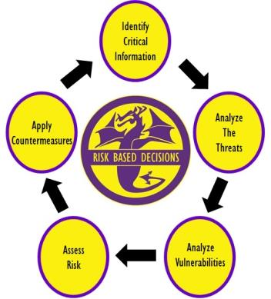
Operations Security
OPSEC is a process that identifies critical information, analyzes potential threats and vulnerabilities, assesses risk, and develops countermeasures to safeguard critical information
Notes:
Operations Security: 1. A systematic, proven process by which a government, organization, or individual can identify, control, and protect generally unclassified information about an operation/activity and, thus, deny or mitigate an adversary's/competitor's ability to compromise or interrupt said operation/activity (NSC 1988). 2. OPSEC is a process of identifying critical information and subsequently analyzing friendly actions attendant to military operations and other activities to (a) identify those actions that can be observed by adversary intelligence systems, (b) determine indicators adversary intelligence systems might obtain that could be interpreted or pieced together to derive critical information in time to be useful to adversaries, and select and execute measures that eliminate or reduce to an acceptable level the vulnerabilities of friendly actions to adversary exploitation (DOD JP 1994; JCS 1997).
Operations Security process: An analytical process that involves five components: identification of critical information, analysis of threats, analysis of vulnerabilities, assessment of risks, and application of appropriate countermeasures (NSDD 298)
Completing this process will allow commanders to make informed risk based decisions on what information they need to protect and how to protect it.

Slide 5
Critical Information
The unclassified Information we must protect to ensure success and is the same information the adversary needs to prevent our success.
Critical information will derive from our operational aspects (Presence, Capability, Strength, Intent, Readiness, Timing, Location, Method).
Not all of the operational aspects of military operations will apply to each and every organization.
Per SECNAVINST 3070.2A, the command’s critical information list (CIL) must be discussed during the onboarding process.
Discuss what is on the CIL
Provide or show a copy to newly arrived personnel, or
Let new member know where to locate or find the CIL
Every command member must be familiar with the organizations Critical Information List (CIL) per SECNAVINST
Notes:
Critical information: Specific facts about friendly (U.S.) intentions, capabilities, or activities vitally needed by adversaries for them to plan and act effectively so as to guarantee failure or unacceptable consequences for accomplishment of friendly objectives.
Critical Information will be derived from the eight operational aspects of operations, shown on this slide. However, the operational aspects are as follows:
- Presence – where your organization or unit is currently located
- Capability – The unique abilities your unit lends to operations
- Strength – The number of units or personnel coupled with the ability to withstand great force
Intent – What your unit plans to do
Readiness – Level of preparedness to execute
Timing – Specific timelines of events
Location – Where your unit will specifically deploy
Method – The way the mission will be executed
Every command must have a CIL. This CIL should be view by the new arrival and also identified where it is located so it can be referred to in the future.
In order to meet SECNAVINST annual training requirements, command members must be familiar with the command’s CIL and information contained.

Slide 6
Personal Information
By comparison, personal information, although doctrinally not considered “Critical Information”, may lead to your association with the military or military operations, and possibly related to operational aspects
Some examples of unclassified information associated with you and your family, that you may consider protecting include:
Names, photos and details of you and your children
Usernames and passwords to all accounts
Social Security Numbers (always)
Credit card/banking information (NFCU)
Significant dates (birthdays, anniversaries)
Addresses and phone numbers
Everyday schedules (your routine or predictability)
Travel itineraries, when you’re away from home
Personal information, when divulged and aggregated on the world wide web, could INDICATE your military affiliation and make you VULNERABLE
Notes:
Have you ever heard someone say “that’s an OPSEC violation” or “that’s an OPSEC issue”?
Often times, it may not be an OPSEC related issue or fall within the OPSEC “swim lane”.
OPSEC is an operations function, and unless the disclosure or critical information is derived from the operational aspects, it may fall with one of the security disciplines like information security, personal security, anti-terrorism/force-protection, industrial security etc.
However, disclosing personal information on social media platforms for example, could eventually lead to your association with a command and/or event, and then further lead to the disclosure of critical information when in the aggregate.
Depending on your mission and organization, some personal and personnel information may require a level of protection

Slide 7
Vulnerability
Weakness an adversary can exploit to gain your information
Vulnerabilities make you susceptible to intelligence / data collection
Poor security and sharing too much information are common, easily exploited vulnerabilities
Social media posts, tweets, snapchats, you tube comments can expose important information to potential adversaries and remains a very common vulnerability
Notes:
Vulnerability:
A weakness the adversary can exploit to get critical information. A vulnerability is anything that makes your critical information susceptible to intelligence collection.
Your Essential Elements of Friendly Information (EEFI)/Critical Information, threat analysis, and considering the adversaries perspective will point to the vulnerabilities in the planning process or when completing an assessment.
A vulnerability is any instance in which you expose your critical information to consumption by the general, unfiltered public. You must assume that your adversaries are apart of the public.

Slide 8
Your Social Media Profile
What do you display in your social media profiles?
Your command
Job title
Designation/rating
Past, present or future location
Current or past activities
Associations
Likes and dislikes
Birthday
Favorite pet
Relationships
Loved ones
People you trust
Are any of the above associated with your account security questions or passwords? Does it pose a risk?
Notes:
Does your profile say you’re in the Navy? Is that sensitive information? Does your profile state you’re in a job field that requires a security clearance? Does that pose a risk? Is your birthday PII? Does that pose a security risk? IS your password based off anything in your profile?
More information, means the possibility of data aggregation, means adversaries might be able to trace your personal information to the command you’re stationed. Is this a risk?

Slide 9
Social Media in the Navy
Social Media allows people to network, interact and collaborate to share information, data and ideas without geographic boundaries.
The Navy has an obligation to provide timely and accurate information to the public; keep our Sailors, Department of the Navy civilians and their families informed; and build relationships with our communities.
We all play a crucial part in these communication efforts, both on and off duty.
Is an accepted risk and vulnerability, but only a low vulnerability when:
users are informed and understand social media and OPSEC policies
Use common common sense
understand the difference between what to share and what NOT to share
Is aware of the information aggregation capabilities
The ignorant or apathetic user is the Vulnerability!
Notes:
- The Navy’s Social Media Handbook is the official publication used by the Navy regarding social media. It lists policies, instructions, guidance, and much more regarding social media. It can be found by a an easy google search “Navy Social Media Handbook”
-Department of Defense Instruction (DoDI) 8170.1 discusses the use of Internet-based capabilities (IbCs) and Applications, such as social media, and provides guidelines for their use. The instruction acknowledges IbCs, including social media, are integral to operations across the DoD. It also requires the NIPRNet be configured to provide access to IbCs across all DoD components while balancing benefits and vulnerabilities
-Official social media sites allowed for DoD commands listed in https://dodcio.defense.gov/Social-Media/.
-Apps such as Tik Tok, What’s APP may not be used to discuss any official DoD information
-Most Internet-based Capability (IbC) providers require acceptance of Terms of Service (ToS) agreements before activating accounts, however, standard ToS are often inappropriate for acceptance for official use by Department of Defense (DoD) employees and other authorized users. Therefore, the DoD only agrees to ToS that have been reviewed, modified if necessary, and approved for DoD-wide application by the DoD Chief Information Office (CIO).

Slide 10
Pro’s & Con’s of Social Media
Pro’s
For the Individual
Entertaining
Maintain Relationships
Network
Centralized Information
Collaborate
For the military
Recruitment
Public Relations
Connect service member, family members & the public
Solicit ideas and feedback
Official news and notes
Build relationship with communities
Con’s
Unsecure, unencrypted communications
Unrestricted access
No user/identity authentication
Easy source of PII & CI
Malicious code/virus
Prime target for data aggregation
Cybercriminals
Potential to compromise certificates
Notes:
Individual social networking is a great tool to network and collaborate. Social networking sites are entertaining and engaging for users.
-Social media, when used effectively, presents unequaled opportunities for you to share the Navy story in an authentic, transparent and rapid manner while building richer, more substantive relationships with people you may not have reached through traditional communication channels
- However, there are several Pros and Cons when using social media sites. Remember, just because it’s printed on social media, it doesn’t meat it’s the truth or real. There is an overwhelming amount of misinformation or “fake” news scouring the internet, and much resides on social media sites.

Slide 11
Social Media for Your Command
Official Social media presence is NOT required
Before launching a social media presence, consider your goals and what you want to accomplish:
What are your communication objectives and how do they assist your command in achieving your mission?
Is the level of transparency required in social media appropriate for your command and its mission?
Who is your primary audience and what is the right platform to reach them?
Do you want to communicate with family members, the local community, a broader DoD audience, the American public or another group altogether?
Do you have the content and personnel, both now and long term, to routinely engage your audiences?
Notes:
-Social media is not a silver bullet for all your command’s communication needs. Not every command needs a social media presence.
It’s far better not to start a social media site than to use it ineffectively and abandon the site
The first step is to determine the goals and objectives of having an official social media presence. Having one “because everyone else does” isn’t a good reason to establish a presence.

Slide 12
Social Media for Your Command
Official Navy social media presence shall:
Have Administrators designated in writing (recommend more than one)
Include written review procedures for the approval and release of information posted on official command public facing sites
Have monitoring procedures in place to periodically evaluate content and compliance with security requirements, fraudulent, or unacceptable posts or followers. Do not allow controversial organizations to associate with your site, or distasteful comments to remain posted.
Be linked to the commands primary web presence (official website). Social media sites cannot act as the command’s only public facing platform.
Be properly registered with the Chief of Navy Information (CHINFO) at www.navy.mil.
Notes:
-SECNAVINST 5720.44C Change 1 provides policy for the official and unofficial (personal) use of social media and for the content of “Navy communicators
-The administrator is responsible for ensuring postings comply with content policy.
Commands permitting postings by others must ensure the site contains an approved user agreement delineating the types of information unacceptable for posting to the site and must remove such unacceptable content. At a minimum, the DoN’s current social media user agreement is required.
Every official social media site must be registered with the Chief of Navy Information.

Slide 13
Alternatives to Social Media
Navy’s private portals that require a Common Access Card.
For families, consider using care lines (dial-in phone), Ombudsman links, emails or family readiness group meetings.
Local installation public affairs office and/or the Navy region PAO.
If you have information or content that does not regularly change, consider the command’s public facing website.
Best practice is not to create social media sites for individual missions, exercises and events. Instead, coordinate with relevant commands and provide them content that is optimized — both written and visually.
Notes:
-If your command wants to share information or content privately, social media is not your solution.
-If you have sensitive information you want to limit to a specific group, consider one of the Navy’s private portals that require a Common Access Card.

Slide 14
Your Security Clearance
The following is a security awareness statement signed by the Chief of Security, Pentagon Chief Information Officer, OSD Network Directorate:
Social sites risk security clearance. If you hold a security clearance or if you ever want to apply for one, be mindful of your postings and contacts online, particularly on social networking sites such as Facebook and Twitter.
These sites pose risks to gaining and keeping a security clearance. Question 14 of the National Agency Questionnaire (SF-86) asks for names of your relatives and associates.
The term associate is defined as any foreign national that you or your spouse are bound by affection, obligation, or close and continuing contact.
Be mindful of all contacts, associates, “friends” and followers on your personal social media platforms. Be prepared to discuss the above during security clearance interviews.
Notes:
SF-86– required to be granted a security clearance. Associate is anyone that you or your spouse have close or continuing contact with. This includes “friends” on social media platforms. Who are your friends and associates?
Do you know who ALL of your social media friends are? Before you click “accept” ensure you know the risk you are taking.

Slide 15
Consider the ToS
We use the data we have - for example, about the connections you make, the choices and settings you select, and what you share and do on and off our products - to personalize your experience.
We collect the content, communications and other information you provide when you use our products, including when you sign up for an account, create or share content, and message or communicate with others. This can include information in or about the content you provide (like metadata), such as the location of a photo or the date a file was created.
We collect information about the people, pages, accounts, hashtags and groups you are connected to and how you interact with them across our products, such as people you communicate with the most or groups you are part of. We also collect contact information if you choose to upload, sync or import it from a device (such as an address book or call log or SMS log history).
Notes:
This is only half the list of Facebook’s terms of service! You freely give up a lot of information to not just other users, but to Facebook itself. Does this create more of a vulnerability? Does this increase risk?
Many of the ToS on other platforms read very similarly. Be aware.
“If you’re not paying for it, you’re not the customer; you’re the product being sold”.

Slide 16
Privacy & Security
Keep up with the latest security and privacy settings for your social media sites and applications (Apps)
Protect your profile
Only allow trusted people to view your profile
Limit others to search your profile
Protect your posts
Only allow trusted people to view your posts
Know who can see what you post and when
Understand what friends of your friends can see
Change your password frequently and make it complex
Always log out of your account when not using it
Notes:
Privacy settings are available on most sites and vary depending on the specific sites privacy policy.
Facebook’s current privacy settings are now included in the rights that you grant Facebook in regards to what they are able to do with your information, as well as what applications linked to the site are able to obtain.
There are over 100 different security/privacy settings on Facebook.

Slide 17
Social Engineering
Manipulating individuals into divulging confidential or personal information for fraudulent purposes.
Do not provide critical or personal, sensitive information to anyone on social media sites
Trust by exception
Be suspicious of ALL online contacts
Verify the authenticity of a friend request
If unsure, do not trust
If it appears too good to be true, it probably is
Be aware of the different ways in which adversaries will use social engineering techniques, for example, “phishing” or using appealing photos.
Notes:
Do not trust who you cannot see and verify. It is not hard to establish fake accounts and to fake information to target people. There are adversaries out there who are targeting you with social engineering. It is easy, it’s cheap, and it is an effective tool for gathering information and exploiting vulnerabilities in both the cyber, and real world.

Slide 18
DO’S & DON’TS of
SOCIAL NETWORKING
Notes:
Do’s and Don’ts of Social Networking and using social media platforms
An outline of some basic points that a user should follow to make their use of the internet safer.

Slide 19
Do – Use Common Sense
When posting, post in PAST tense
Be mindful of timelines
Timelines can quickly reveal patterns and routines when aggregated
Understand your audience on the world wide web (www). You are potentially posting to millions, regardless of your privacy settings!
Always remember to protect other’s information as if it were your own.
Never post someone else’s picture, itinerary, location and so on (unless given permission). If they wanted that information posted on the internet, they will do it themselves.
Notes:
Always make it a habit to post PAST tense. For example:
“Leaving for our week vacation in OBX” versus “Had a wonder week in the OBX”. A thief can use the first post to their advantage, knowing you won’t be home for the week where as a Past tense post provides a the same thief nothing!
Be mindful of timelines
Timelines can quickly reveal patterns and routines when aggregated
Understand your audience on the world wide web (www). You are potentially posting to millions, regardless of your privacy settings!
Always remember to protect other’s information as if it were your own.
Never post someone else’s picture, itinerary, location and so on (unless given permission). If they wanted that information posted on the internet, they will do it themselves.

Slide 20
Do – Monitor Your Children
Talk to your children about the Do’s and Don’ts of social media
Monitor their accounts (multiple)
Be aware of:
Cyber-bullying
Kidnapping
Sexting
Sextortion
Stalking
Pedophiles
Who are their friends and followers
What organizations are associated with their pages or profiles
Notes:
Children are especially vulnerable on the internet and make easy targets. Monitor closely children's use the internet to insure they are not posting sensitive and personal information, to include family information.
Sextortion can start with a simple friend request.
Children, especially teens are very savvy. Some will allow you to monitor their pages……but are you sure the sites you’re monitoring are the only ones they are on?

Slide 21
Do – Practice Computer Security
Be a hard target for cyber and computer criminals
Be aware and always on alert for
Hackers
Thieves
Planted software codes
Do the easy things right
Keep anti-virus software up to date
Check Firewall status often
Use strong passwords, change often
Limit permission and access settings
Log off after use
Notes:
Computer Security is the most important point.
Antivirus software is critical. Norton, Mcafee, AVG and others are all vital programs that every computer should run to protect from virus’ and other malicious attacks. Virus scans, virus definition updates and spy ware scans should be done daily to insure a computer, both at work and at home, are as secure as possible.
Firewalls and routers should be configured correctly and with strong passwords to help guard against unauthorized access.
File permissions should be set to restrict access to unauthorized users.
A wireless router is often the single point of both access and failure in any given home. Those with weak passwords and easily accessed routers are easy targets.

Slide 22
Do – Verify
Verify All Friend Requests
Social engineering starts with a friend request
Adversaries can get the data from:
Free people search engines
Other social media sites
Your posts/profile
Your friends posts/profile
Do Not Trust Who You Cannot See
Notes:
Do not trust who you cannot see and verify. It is not hard to establish accounts and to fake information to target people.
How do you verify? It’s easy, call them.

Slide 23
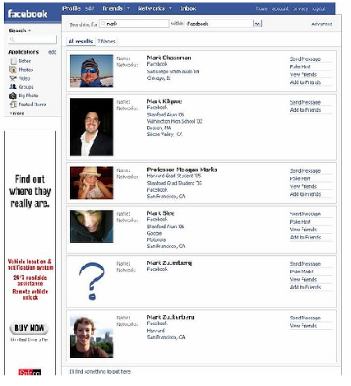
Do – Utilize Privacy Settings
Customize available settings to be as secure as possible
“Everyone” may be accessed by anyone with access to the internet
Check setting often, especially after software updates
How many security settings are available on Facebook?
Over 100
Notes:
Privacy settings are available on most sites and vary depending on the specific sites privacy policy.
Facebook’s current privacy settings are now included in the rights that you grant Facebook in regards to what they are able to do with your information, as well as what applications linked to the site are able to obtain.
There are over 100 different security settings on Facebook.

Slide 24
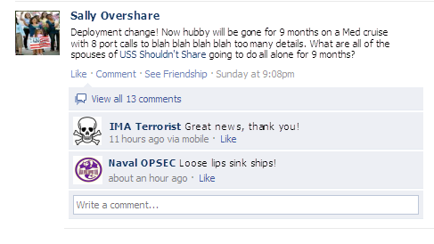
Do – Know Friend’s Settings
Your profile may be secure, but what about all your friend’s profile settings?
Your settings are only as good as our weakest friends.
Notes:
All the privacy settings in the world mean nothing if someone in your network of friends does not have any privacy settings. Be careful what you and your friends post and make available to the world.

Slide 25
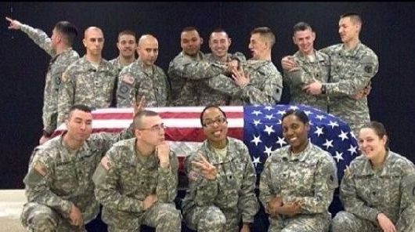
Do – Use Discretion
Consider the information you make available
Does your post, photo, or video serve a valid purpose
Consider how comments, photos and videos can be interpreted or manipulated
Understand your digital foot print and audience
Once posted, you completely lose control of the information
Notes:
Always consider how the information that you make available can be used against you.
What image does your social networking profile give of you?
What messages are your posts actually saying about you?
Also understand your post today could actually affect you years down the road

Slide 26
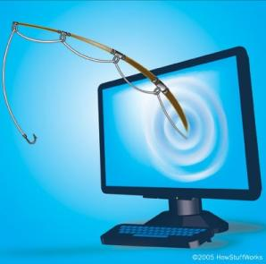
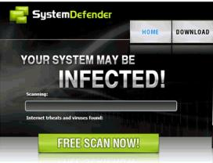
Do – Validate Executable Files
Verify Links & Files Before Executing
Be aware of:
Phishing scams
Malicious coding
Viruses
Scareware
Spam
Pop-Up Windows requesting you update your anti-virus software may not actually be your provider.
Verify before executing!
UNCLASS INFO
Notes:
The same threats that exist in your inbox, exist in social networking sites, and in any download.
Verify links and websites before accessing and executing.
Do not follow links provided in emails, go through a trusted link that you know to be good.
Call your bank and verify that the information they are requesting or sending is legitimate. Often times a bank will not contact you via email for account changes.
Tax filing season is an opportunity for scammers……so be aware. The IRS will not call or send you a text.

Slide 27
Do – Use Passwords
Password protect your smart phone, devices and accounts
Love your smart phone, but never trust your smart phone!
Use complex passwords (16+ characters is best)
Have a separate password for each device and account. You banking account passwords should not be the same as your social media passwords.
There is a difference between security passwords and privacy settings
Know what to do if you lose it, and be confident it will not get hacked with your complex password
Notes:
Password protect your smart phone, devices and accounts
Use complex passwords (16+ characters is best)
Have a separate password for each device and account. You banking account passwords should not be the same as your social media passwords.
There is a difference between security passwords and privacy settings
Know what to do if you lose it, and be confident it will not get hacked with your complex password

Slide 28
Do – Be Informed
Be an informed user of social media. You wouldn’t drive a car without a drivers license, so know how to “drive” on your social media platform
Review how much personal information you broadcast
Be very careful about what details you post
Understand data aggregation issues and capabilities
Learn all the security or privacy settings, and keep them up to date as software updates occur…. and may change your settings.
Are you willing to accept the risk?
Notes:
Be an informed user. Know the terms of use, the changes to the site, and all of the different settings that are available. Make your site as secure as possible, understand that data collection is the job of many– from marketing campaigns to adversaries.
Regardless of settings, never post details– details make you vulnerable.

Slide 29
Do – Have a Backup Plan
Have a Contingency Plan – no one can predict the future
What’s the plan if killed in action, missing in action or if you or a loved one becomes a prisoner of war?
What happens to your profiles or sites?
What details can an adversary exploit?
Plan ahead and review your platforms often
Have a Power of Attorney (POA)
Set up memorial pages
Notes:
In the event of death or capture, have a power of attorney in place to allow family members to delete or change your social media profile. Protect your personal details from the media and adversaries.

Slide 30
Don’t – Rely on Privacy Settings
Depend on social media platform security settings, unless you are 100 percent certain it is private!
Because they are social, there is a good chance they’re not private
Accept the Terms of Service without reading and understanding
Assume settings are correct
Provide details that can be used for sale or data collection
Just accept upgrades or site changes without understanding the changes
Assume only authorized persons will view your information
Make it easy for hackers
Use At Your Own Risk
Notes:
Never forget- the true purpose of social media from the creators
There are many instances where your information that you thought was private, really isn’t.
Security isn’t perfect, and in many cases, it’s not even adequate because it’s not a priority for the owners of the social media platforms.
Straight from the Facebook statement of rights & responsibilities- “USE AT YOUR OWN RISK. We do not guarantee that Facebook will be safe or secure.”
Also remember security is not privacy when it comes to settings

Slide 31
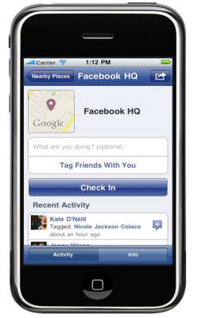
Don’t – Check-In
Geotagging: Location /GPS data embedded in photos
Default feature in most smart phones and digital cameras
Latitude/longitude/altitude
Device details and access to information depending on ToS and what you accept
Information can potentially be retrieved from posted digital photos
Several “Check-in” features on applications
Facebook Places
Google Latitude
Foursquare
Gowalla
Many others
Notes:
Geotagging: Location /GPS data embedded in photos.
Location / GPS settings are normally defaulted ON in most smart phones and digital cameras. Most users leave this feature on because it also provides mapping instructions while driving and provides a host of other benefits. Do understand that Latitude/longitude/altitude will be imbedded in digital photos…….where the photo was actually taken.
Device details and access to information may also be enabled depending on the ToS and what you accept on different applications
Information can potentially be retrieved from posted digital photos
There are several “Check-in” features on applications, too many to list, but a few include:
Facebook Places
Google Latitude
Foursquare
Gowalla
Many others

Slide 32
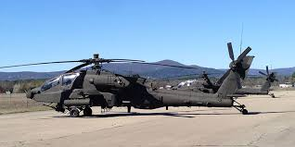
Geotagging
Smart watches and software can track movements
Depending on your mission, can pose a security risk and vulnerability
In 2007, new AH-64 Apache helicopters arrived at a base in Iraq
Soldiers took pictures on the flight line.
From the photos that were uploaded to the Internet, the enemy was able to determine the exact location of the helicopters inside the compound.
A mortar attack was conducted, destroying four of the Apaches.
Notes:
Here is a costly example of geotagged data used by an adversary
Though this technology is relatively “old” it is still a major vulnerability. Many people still do not know about geotagging and the risks they take when they post digital images online.

Slide 33
Don’t – Discuss Details
Post anything you would not tell directly to the enemy
Never post private or personal information – your “real” friends probably already know this information
Assume the information you share will be made public, and shared again
Never post command critical information
Do educate family members so they Don’t post or share command critical information
If It Has To Be Protected, Protect It
Notes:
Don’t discuss or post details regardless of security settings. There is no truly secure computer with access to the internet- keep that thought in mind at all times and keep details to yourself.

Slide 34
Don’t – Make the Headlines
Air Force Technical Sergeant Loses Rank over Racially Charged Video
Marines punished for online conduct following nude-photo scandal
How 4 U.S. Attack Helicopters Were Destroyed Because of Geotagged Pictures
Police Raid Cancelled After Facebook Leak
Social media posts invalidates home and life insurance
Social Media Controversies That Landed Students in Trouble This School Year
Posting to a Nazi Chat Group
'Let’s Shoot Up the School at Homecoming‘
Sharing an Image of a Teacher Photoshopped to Look Like Porn
'Liking' a Post Referencing a School Shooting (Instagram)
Harvard University rescinds admissions offers to 10 students after offensive memes were posted
Notes:
-These are just a few examples. I’m sure we’ve all heard stories of Sailors getting in trouble by posting inappropriate things on social media. Parties, political thoughts, etc. Selfies onboard a ship with critical information or sensitive equipment in the background.
What you post on facebook could negatively affect your career! It could also negatively affect your personal life.

Slide 35
Summary – One Navy Team
Leaders
Communicate expectations
Outline policy, making sure teams know what they can and cannot do online
Sailors, Civilians, Families
Consider what messages are being communicated, and how they may be received
Do not create or share content that is inconsistent with Navy values or standards of conduct
Only post if information demonstrates dignity and respect for self and others
Protect unclassified, critical information and indicators
Public Affairs and Operations Security (OPSEC) Officers
Project often and accurately, keeping our family members informed
Ensure everyone upholds OPSEC online just as much as you do offline
Notes:
-Large commands have full time Public Affairs Officers, smaller commands do not, but have PA reps fulfilled by collateral duty. Regardless,
Almost all commands have either an official .mil website and/or a facebook page managed by an administrator, and every command should have a public release review process in place, and that includes an OPSEC review.

Slide 36
Navy OPSEC Capability
Your Logo here
Your Command OPSEC Program Manager information here.
OPSEC@navy.mil
757-203-3656
Naval Information Forces
ATTN: Naval OPSEC Support Team
115 Lake View Parkway
Suffolk, Virginia 23435
Notes:
Insert the program manager information.
The NOST is the Navy’s OPSEC Support Capability, can be reached and located via the above.

