Slide 1
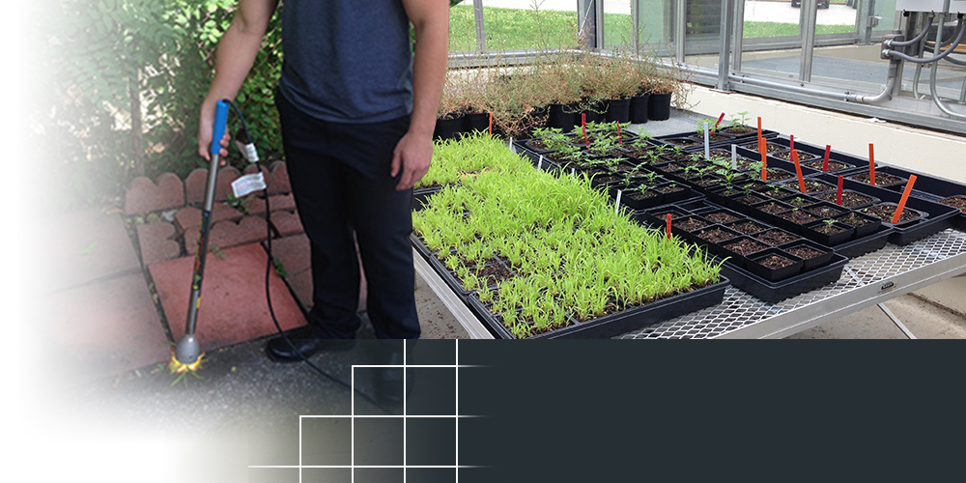
Global Neighbor Inc.
Centerville, Ohio
TOPIC NUMBER: AF121-207
TOPIC TITLE: Floral Disruptor – Directed Energy Weed Abatement and Prevention Tool
TECHNICAL PROJECT OFFICE:
Air Force Test Center
Edwards AFB, CA
The company is selling its product through Amazon and several other online dealers
Could eliminate costly herbicides that damage the environment
SMALL BUSINESS BLOSSOMS THROUGH AIR FORCE PARTNERSHIP
The Air Force’s search for a chemical-free way to kill weeds helped put an Ohio-based small business on the road to commercial success.
Global Neighbor, Inc., is now selling its NatureZap product through Amazon and several online dealers. The hand-held, spot treatment technology – which uses directed energy to control unwanted vegetation - was developed with support from an Air Force Small Business Innovation Research/Small Business Technology Transfer (SBIR/STTR) award.
Jon Jackson, Global Neighbor’s president and principal investigator, said the SBIR/STTR program was a key to bringing the product to consumer markets and he expects the company to sell 1,000 units in 2016.
Notes:
To activate hyperlink, you must be in slide show view.

