Slide 1
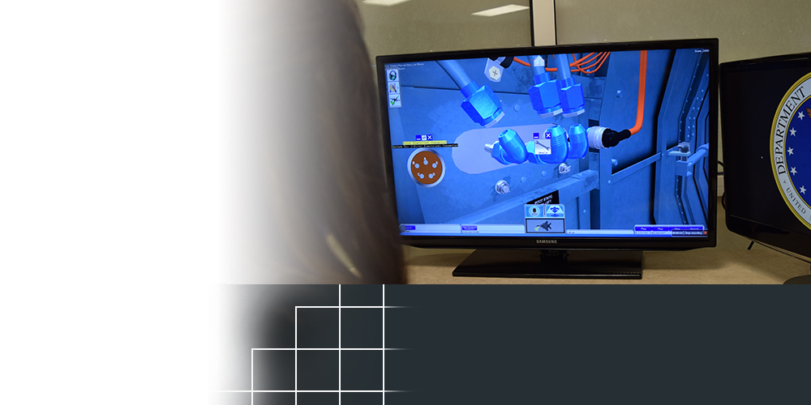
Cambridge, Massachusetts
TOPIC NUMBER: AF121-017
TOPIC TITLE: Adaptive Gaming and Training Environment for Maintenance Operations
TECHNICAL PROJECT OFFICE:
AFRL Airman Systems Directorate Wright-Patterson AFB, OH
SPONSORING ORGANIZATION:
Air Force Life Cycle Management Center
Instructors are able to manage more students
Avoids potential for costly system damage
Virtual solution could
REVOLUTIONIZE AIRCRAFT MAINTENANCE TRAINING
A Massachusetts-based company is building a virtual aircraft maintenance trainer for the Air Force that would allow for larger class sizes and troubleshooting scenarios that are difficult to present in a traditional live setting.
With support from the Air Force Small Business Innovation Research/Small Business Technology Transfer Program, Charles River Analytics developed the underlying software and is refining it to provide maintenance training for the F-15E Strike Eagle. The technology combines high-resolution graphics with automated system feedback to teach complex maintenance procedures.
The company is in the early stages of a two-year effort to transition the technology and the expectations are that it will eventually be applicable to any aircraft.
Notes:
To activate hyperlink, you must be in slide show view.

