Slide 1
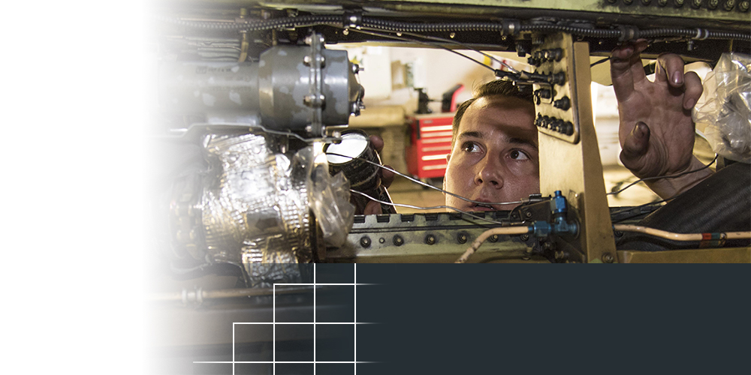

Metis Design Corp.
Boston, Massachusetts
TOPIC NUMBER: AF03-T017
TOPIC TITLE:
Intelligent Structural Health Monitoring Infrastructure
TECHNICAL PROJECT OFFICE:
Air Force Sustainment Center
Robins AFB, GA
SBIR-BACKED AIRCRAFT
HEALTH MONITORING TECHNOLOGY POISED FOR WIDESPREAD USE
One of the world’s largest aerospace companies is looking to revolutionize the industry with new technology developed by a small business in partnership with the Air Force and Navy.
UTC Aerospace Systems, a unit of United Technologies Corp., recently signed an agreement to license the MD7-Pro digital structural health monitoring system from Boston, Massachusetts-based Metis Design Corp. This newer sensing technology offers on-demand structural health data collection and analysis for aircraft components and systems. When integrated with the UTC Aerospace Systems’ Pulse Health Monitor, the MD7-Pro will provide an accurate and timely assessment of aircraft component life expectancy, significantly reducing the maintenance hours spent conducting periodic manual inspections.
Notes:
To activate hyperlink, you must be in slide show view.

