Slide 1
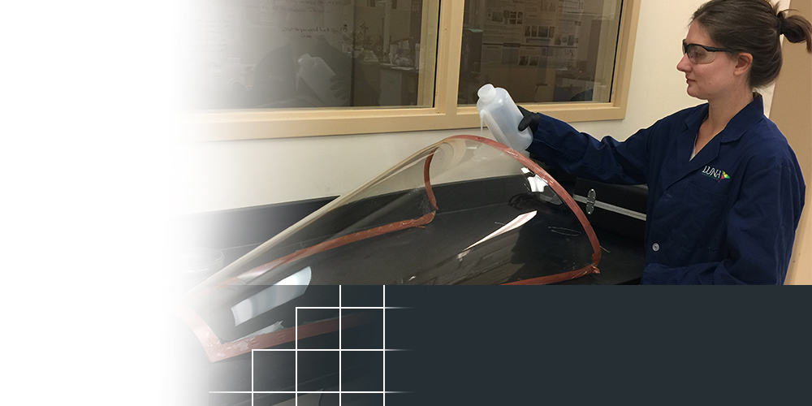
Luna Innovations
Roanoke, Virginia
TOPIC NUMBER: N102-135
TOPIC TITLE: Durable Rain-Repellent Coatings for Aircraft Transparencies
TECHNICAL PROJECT OFFICE:
Air Force Sustainment Center
Hill AFB, UT
Improves aircraft canopy water shedding capability
License agreement providing royalties
Evaluated for wider global use
COATING DEVLEOPED FOR MILITARY USE SHOWS COMMERCIAL PROMISE
A Virginia-based company is better positioned for long-term growth because of its work on a coating technology for the Department of Defense.
Luna Innovations has filed for patents for the general coating formulation and signed a licensing agreement with partner UltraTech International for production and marketing. Under the trade name Gentoo, the coating is providing royalties to Luna while being evaluated for wider global use by dozens of companies in various industries such as glass, automotive and biomedical.
Originally developed for pilots who faced a hazard with water pooling on aircraft canopies and windshields, the coating is designed to quickly shed water off transparent surfaces for improved visibility during inclement weather.
Notes:
To activate hyperlink, you must be in slide show view.

