Slide 1
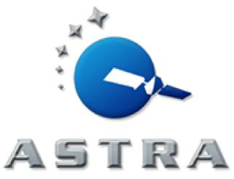
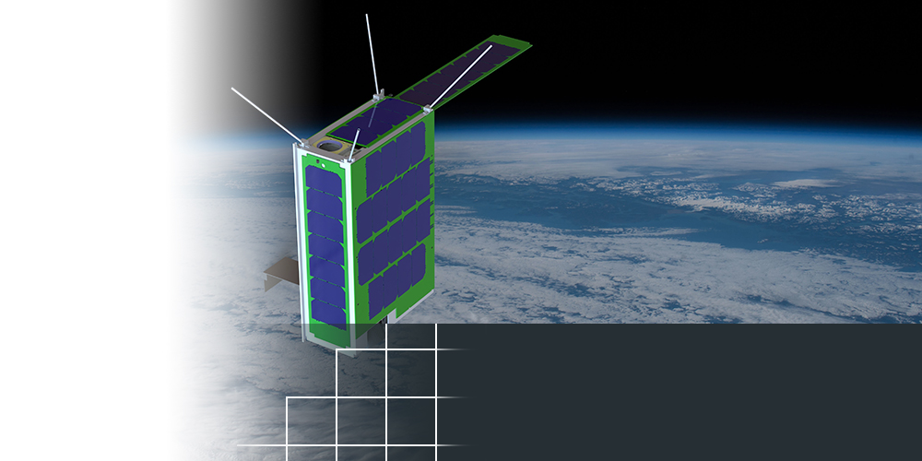
Atmospheric and Space Technology Research Associates
Boulder, Colorado
TOPIC NUMBER: AF093-088
TOPIC TITLE:
Modular Cubesat Architectures and Components
TECHNICAL PROJECT OFFICE:
AFRL, Space Vehicles Directorate
Kirtland AFB, NM
Significantly smaller, lighter and cheaper than instruments flown previously
Pinpoints problems that impact communication and navigation
NEW INSTRUMENT SHOWS
BIG POTENTIAL TO HELP MISSION PLANNERS
An innovative scanning technology developed by a Colorado-based small business may eventually save lives and boost the success rate of military missions.
Funding from the Air Force Small Business Innovation Research/Small Business Technology Transfer (SBIR/STTR) Program helped Atmospheric and Space Technology Research Associates – also known as ASTRA – to create a new instrument to pinpoint atmospheric problems that impact communication and navigation signals. This compact smart-scan mirror provides near real-time detection of “bubbles” in the Earth’s upper atmosphere, which can interfere with radio signals used by the Department of Defense.
Armed with the data, military planners could avoid performing operations in areas where the irregularities are
occurring.
Notes:
To activate hyperlink, you must be in slide show view.

