Slide 1
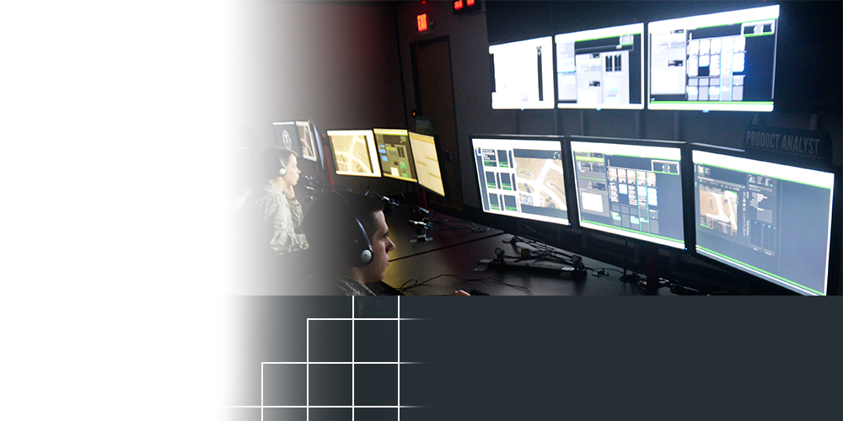
Etegent Technologies Ltd.
Cincinnati, OH
TOPIC NUMBER: AF112-026
TOPIC TITLE: Cognitive Approaches to Integrated Intelligence Production
TECHNICAL PROJECT OFFICE:
AFRL Airman Systems Directorate
Wright-Patterson AFB, OH
More effectively examine large sets of location-based data
New capability to find relationships between different types of data sets
NEW SOFTWARE TOOL EXPECTED TO BOOST INTELLIGENCE PRODUCTION CAPABILITIES
The Air Force Research Laboratory and an Ohio company are working to revolutionize the way critical information is processed by intelligence analysts who are increasingly overwhelmed by massive volumes of data while striving to ensure national security.
With support from the Air Force Small Business Innovation Research/Small Business Technology Transfer Program, Cincinnati-based Etegent Technologies Ltd. worked with AFRL’s Airman Systems Directorate to create the NTellus Relationship Visualization tool. Also known as NTellusRV, the software allows analysts to more effectively examine and visualize information contained in large sets of location-based data. It also provides a new capability to discover and visualize relationships between different types of data sets so analysts can quickly discover relevant information in a way not previously possible.
Notes:
To activate hyperlink, you must be in slide show view.

