Slide 1
Gathright Dam Stakeholders Meeting
Norfolk District
02 November 2017

Slide 2
WCM – What is it? & Why is it important?
Water Control Management is the regulation of Gathright Dam to accomplish authorized Project Purposes
Project Purpose:
  Flood Control – Protection of industrial, commercial and residential properties along the Jackson and James Rivers with immediate impact on City of Covington, VA
  Low Flow Augmentation - Minimum Flow in Jackson River at Covington of 160 cfs (Dec/Jan) to 250 cfs (Jul), Release Temperature Regulation, and Maintaining Dissolved Oxygen Levels
  Recreation – Operations and maintenance of recreational areas transferred to US Forest Service in 1981 prior to completion of reservoir filling

Slide 3

Current Storage Allocations
Total Storage at Spillway Design Flood 477,800 acre-feet
El = 1679.5
Top of Dam
El = 1684.5
Total Storage at Spillway Invert 421,500 acre-feet
Spillway El = 1667.5
Total Storage at Full Flood Control Pool =203,600 acre-feet
El = 1610
Flood Control Storage = 79,900 acre-feet
El = 1582
Conservation Storage = 60,747 acre-feet
Multi-Level
Withdrawl
Ports
El = 1570
– 1494.5
El = 1554
Inactive Storage = 62,992 acre-feet
Invert Elev at Intake 1430.5
Outlet
Works
Invert Elev at Outlet 1424.6
NTS

Slide 4
Reservoir Levels (Apr 1982 – Oct 2017)

Slide 5
WCM – Notifications & Release Information
Phone Recording Daily after 08:30
(540) 965-4117
Signage at Public Access Sites
Social Media
Project Notifications
E-Mail Distribution to Stakeholders (PAO)
Predictive Releases via Web Site
http://www.nao-wc.usace.army.mil/nao/index.html

Slide 6
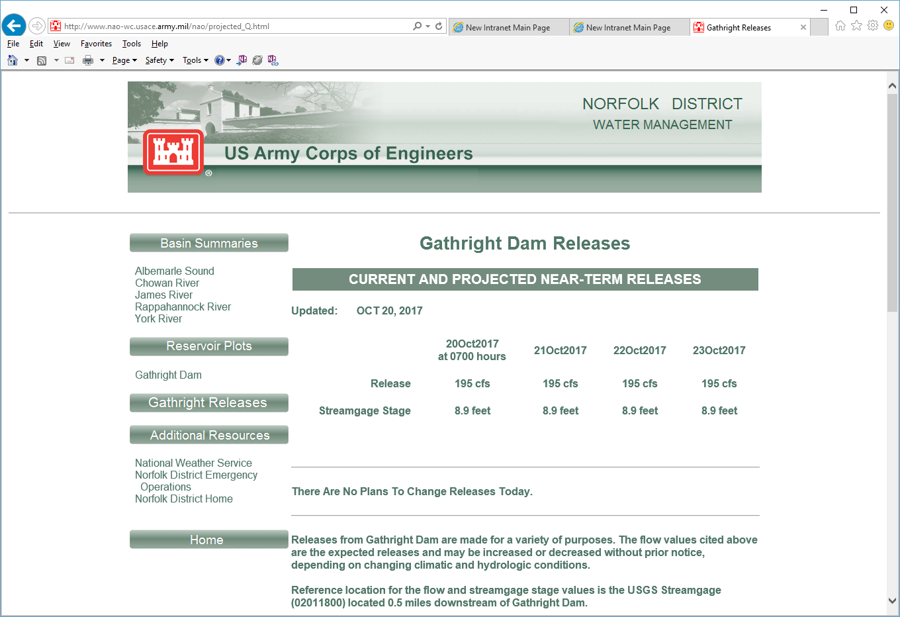
WCM – Notifications & Release Information

Slide 7
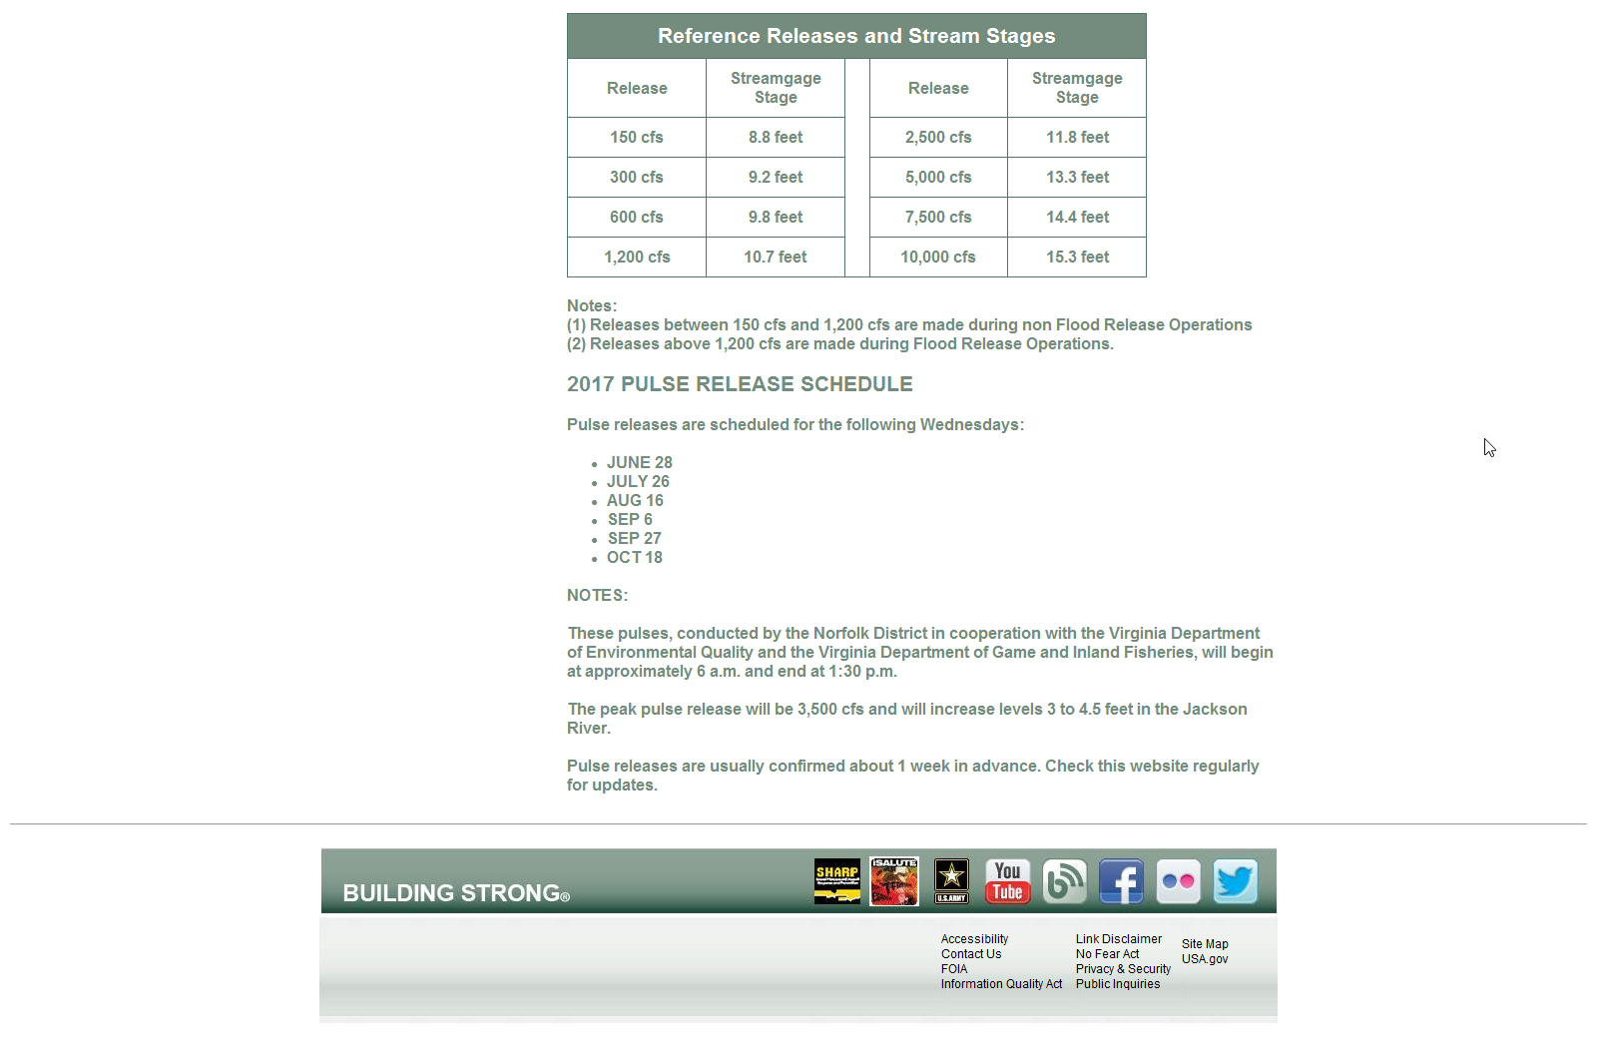
WCM – Notifications & Release Information

Slide 8
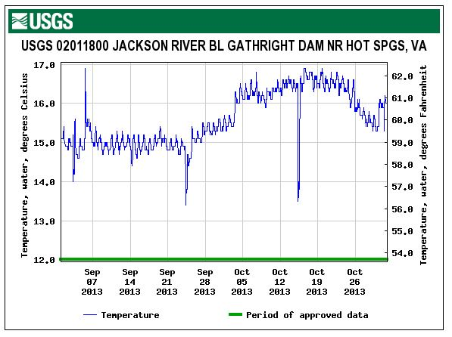
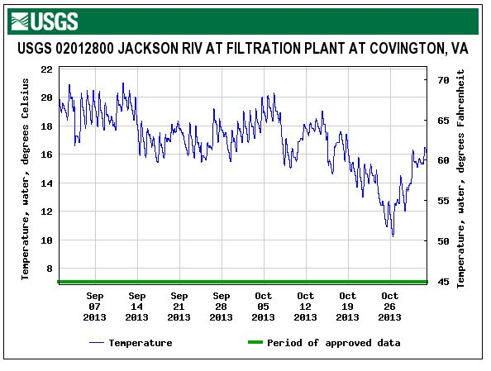
Water Quality changes for September and October (2013)

Slide 9
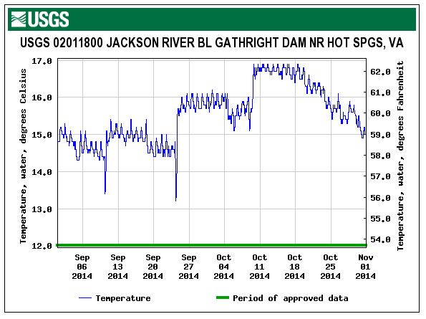
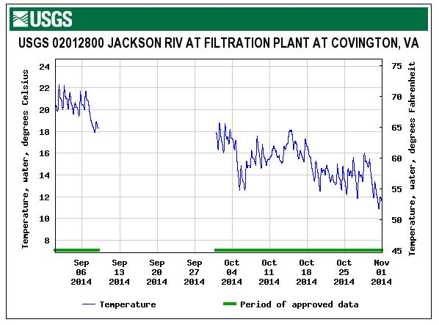
Water Quality changes for September and October (2014)

Slide 10
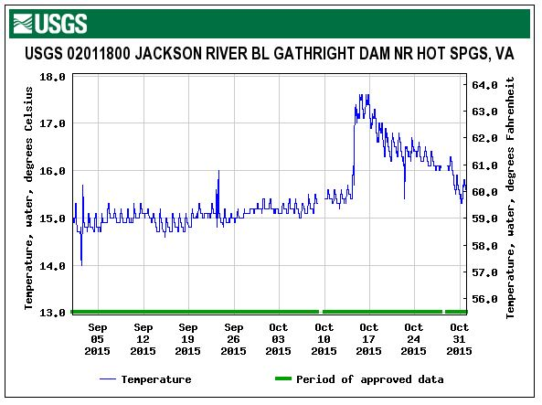
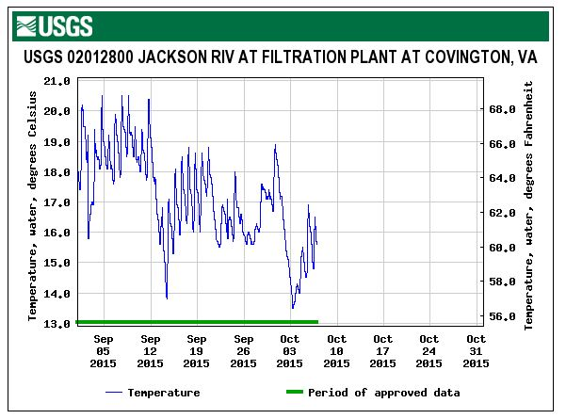
Water Quality changes for September and October (2015)

Slide 11
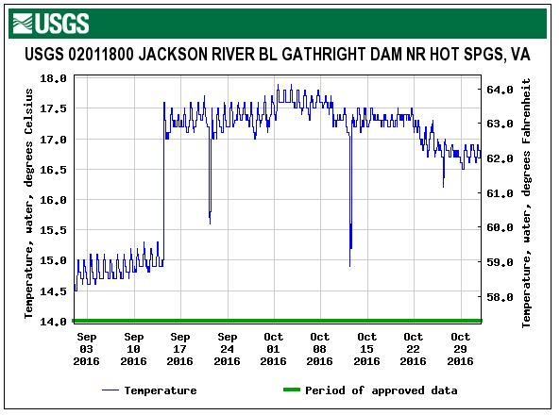
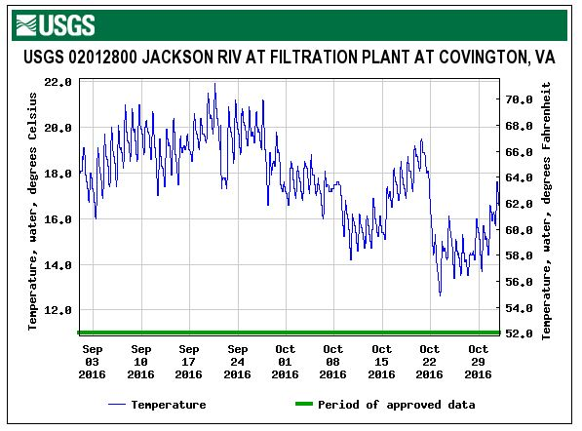
Water Quality changes for September and October (2016)

Slide 12
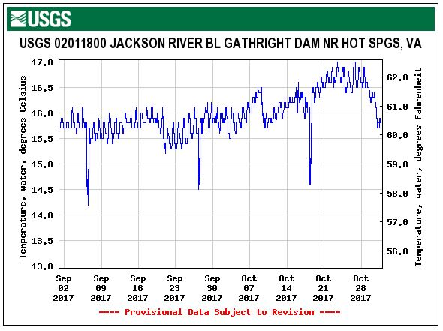
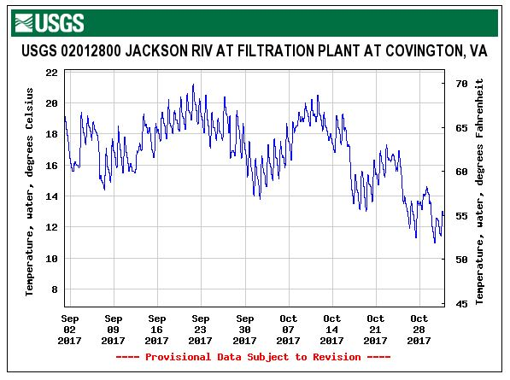
Water Quality changes for September and October (2017)

