Slide 2
Norfolk District Operations Branch
Organizational Chart:

Slide 3
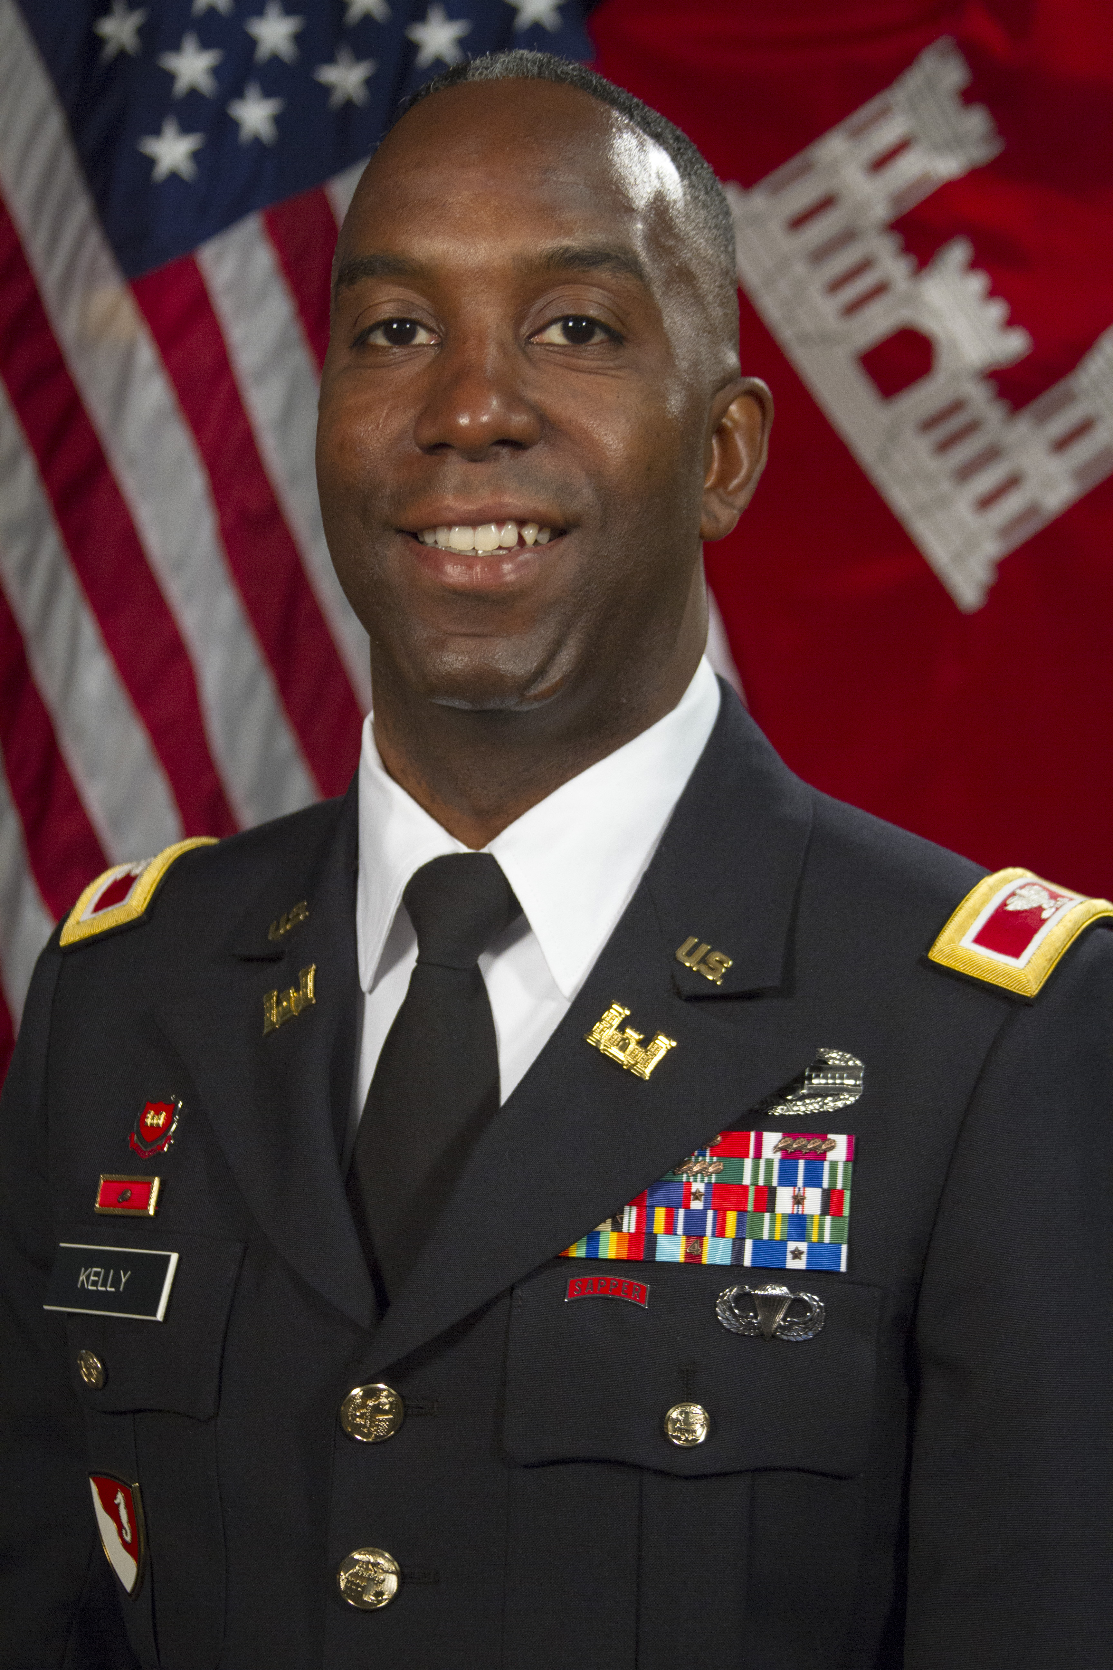
Colonel Jason E. Kelly
District Commander
Col. Jason E. Kelly assumed duty as the 58th commander of the Norfolk District, U.S. Army Corps of Engineers, on July 16, 2015. As the commander, he oversees the district’s civil works, military construction, regulatory and emergency operations missions, and is responsible for more than 350 employees in Norfolk and in resident offices throughout the Commonwealth of Virginia.
A native of Flint, Michigan, Col. Kelly attended the United States Military Academy at West Point, New York and received his commission as an engineer officer upon graduation in 1994.
During more than 21 years of service, Col. Kelly has held leadership positions from platoon to brigade, with duty in Asia, the Middle East and the United States, Other key assignments include participation in the Army's Advanced Civil Schooling Program, duty as an advanced calculus instructor in the Department of Mathematics at the United States Military Academy, Aide-de-Camp to the Superintendent, United States Military Academy, and service on the Headquarters, Department of the Army Staff at the Pentagon in the Office of the Chief of Engineers.
Col. Kelly holds a Bachelor of Science degree in mathematics from West Point, a Master of Science degree in Engineering Management from the Missouri University of Science and Technology, a Master of Science degree in Statistics from the Georgia Institute of Technology, a Master of Science degree in Joint Campaign Planning and Strategy from the National Defense University, and a Master of Science degree in Strategic Studies from the United States Army War College. He is a graduate of the Joint Advanced Warfighter School, Combined Arms Services Staff School, the Sapper Leader Course, as well as the Engineer Officer Basic and Advanced Courses. He is also a certified Project Management Professional.
Col. Kelly's awards and decorations include the Bronze Star with two oak leaf clusters, the Meritorious Service Medal with four oak leaf clusters, the Army Commendation Medal with three oak leaf clusters, the Army Achievement Medal, the Meritorious Unit Award, the National Defense Service Medal, the Kosovo Campaign Medal with Bronze Star Device, the Afghanistan Campaign Medal, the Iraqi Campaign Medal, the NATO Medal, the Combat Action Badge, the Parachutist Badge, and the Sapper Tab. He is also the recipient of the Army Engineer Association's Bronze Order of the Defleury Medal.

